Slide 1
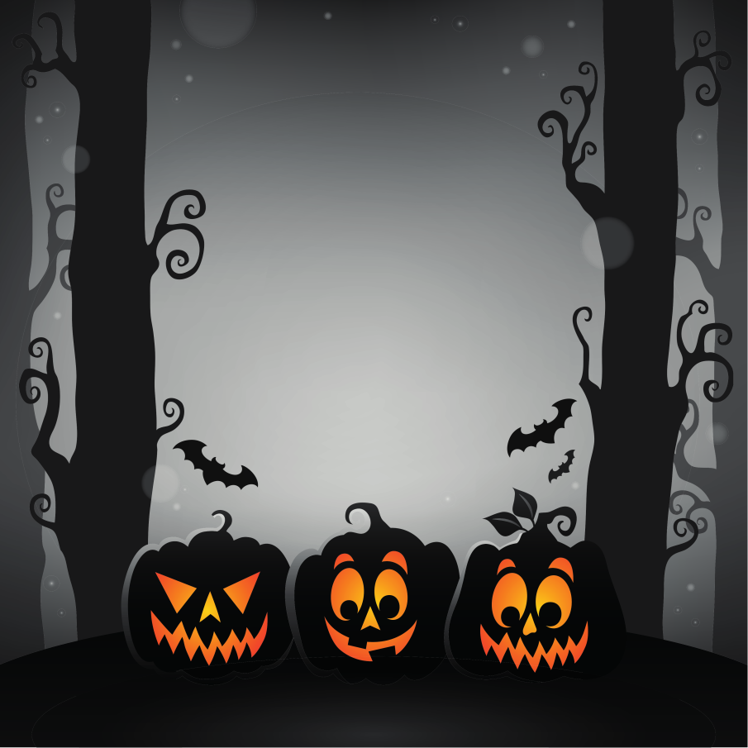
Halloween STEM

Slide 2
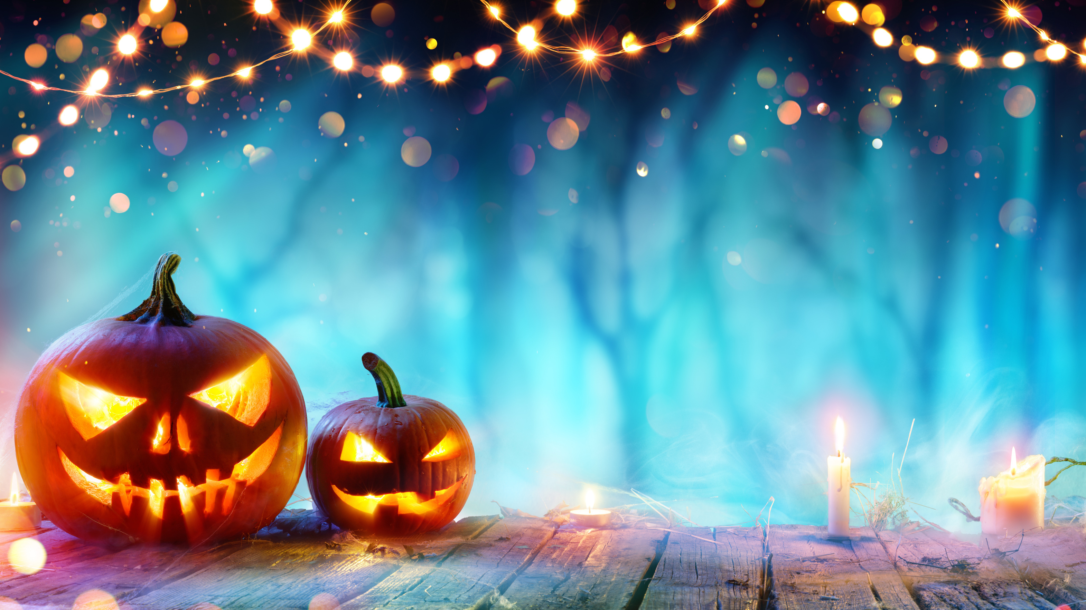
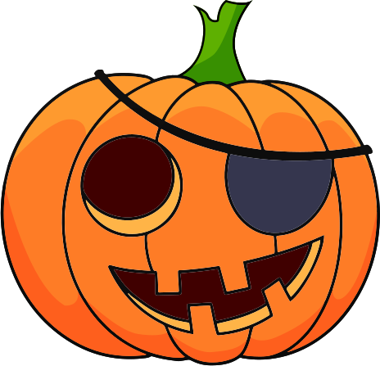
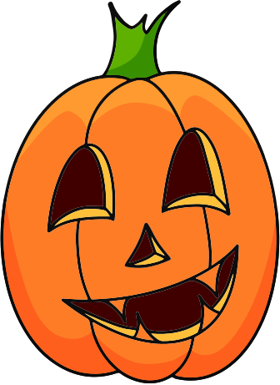
LEARNING OBJECTIVES
Develop a range of ideas to support STEM teaching in your setting.

Slide 3
HOW TO INCORPORATE HALLOWEEN STEM
Themed Day/Week
Part of IDL
Stand Alone Activity

Slide 4
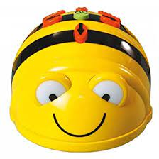
SAVE THE BEEBOT
Task Brief: To code a journey to save the Beebot from the Halloween monsters.
Suggested Level: Early
Key Learning: Directional language and the basics of putting together a code to make an object move.
Extension Task: Increase the difficulty of the path. Pupils write out their journey using directional language or symbols.
E & O: TCH 0-13a
Notes:
Create a path for the Beebots with a range of Halloween themed Monsters around it.
Pupils need to code the journey to help the Beebot get past all the scary things.

Slide 5
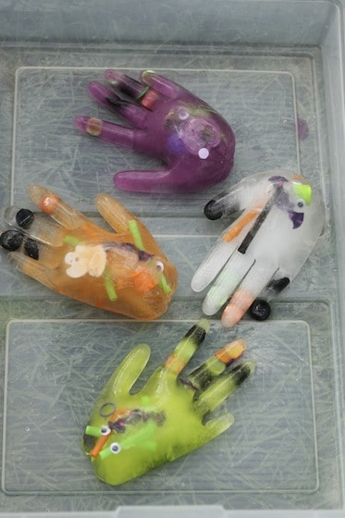
HAUNTED HAND MELTING
Task Brief: Investigate which substance helps to melt the hand the quickest.
Suggested Level: Early/ First
Key Learning: Salt melts ice quickly. Sugar and baking powder work well.
Extension Task: Make links to winter when salt is put outside on paths and roads. Trial different substances and record the times in a table.
E & O: SCN 0-05a/ 1-05a
Support Link
Notes:
This does require a bit of prep.
Give pupils a range of substances - room temp water, cold water, hot water, sugar, salt. Even try some random substances such as lemon juice or cola.
Older pupils should be encouraged to record the time.

Slide 6
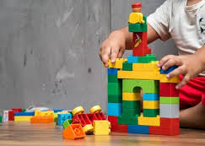
HAUNTED HOUSE
Task Brief: Design and build a haunted house.
Suggested Level: Early/First
Key Resources: Blocks, Kapla, Lego, junk materials etc
Extension Task: Make links to literacy and write a story about the haunted house.
E & O: TCH 0-09a/ 1-09a
Notes:
There are many resources you could use to do this. Use what is easy to get in school.
Make literacy links with descriptive writing.

Slide 7
CATAPULT
Task Brief: Build a catapult to project items over a barrier.
Suggested Level: First
Key Learning: Potential and elastic energy
Extension Task: Try different wighted items on the catapult to compare any differences. Make links to the history of catapults and what they were originally invented for.
E & O: SCN 1-04a
Support Link
Notes:
There is stored energy or potential elastic energy as you pull back on the popsicle stick, bending it. When you release the stick all that potential energy is released into energy in motion producing the projectile motion.
Give pupils a barrier (a target) they need to get their sweets, or weighted items, over.

Slide 8
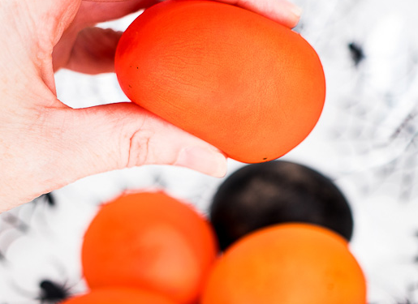
MONSTER EYES
Task Brief: Turn an egg into a bouncy ball.
Suggested Level: First/ Second
Key Learning: This is a chemical reaction. The vinegar reacts with the eggshell causing carbon dioxide.
Extension Task: Talk about Osmosis with the food colouring. Gummy bear experiment.
E & O: SCN 1-16a/2-15a
Support Link
Notes:
How does this work? The vinegar reacts with the eggshell, which is made of calcium carbonate to create carbon dioxide. This results in the eggshell dissolving.
When the eggshell has dissolved Osmosis occurs. The vinegar is able to pass through the membrane of the egg resulting in it becoming bouncy.
Top tip: Leave the egg in the vinegar for at least 48 hours to ensure enough time for all this to occur.
Perhaps somewhere outside!

Slide 9
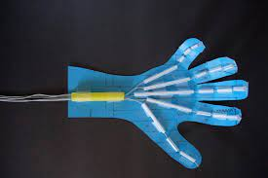
SKELETON HAND
Task Brief: Make a moving model of a hand.
Suggested Level: First/ Second
Key Learning: There are 3 bones in each finger and 2 in the thumb. They connect to 5 bones in the palm. The muscles and tendons in your forearm contract and relax to move your hand and fingers.
Extension Task: For second level find out about muscles and tendons and how they help us move.
E & O: SCN 1-12a/ 2-12a
Support Link
Notes:
Great activity to help pupils see exactly how their hand moves and the role each part plays in this.

Slide 10
HALLOWEEN BALLOONS
Task Brief: Create a chemical reaction to blow up a balloon.
Suggested Level: Second
Key Learning: This is a chemical reaction. The vinegar reacts with the baking powder to release carbon dioxide which blows up the balloon.
Extension Task: Experiment with different amounts of baking powder of vinegar and note the differences.
E & O: SCN 2-15a
Support Link
Notes:
Chemical reaction occurs between the vinegar and baking soda. This creates carbon dioxide which blows up the balloon.
A different way to use this chemical reaction is the "Puking Pumpkins" experiment. Carve the pumpkin and put the vinegar, baking soda and a drop of fairy liquid in the pumpkin.

Slide 11
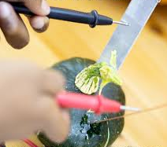
PUMPKIN BATTERY
Task Brief: Create an electrical circuit using a pumpkin as the battery.
Suggested Level: Second
Key Learning: Basic understanding of simple electric circuits. The acid in the pumpkin moves electrons.
Extension Task: Create a diagram using the correct electricity symbols. Try with different fruits and vegetables to compare.
E & O: SCN 2-09a and 2-10a
Support Link
Notes:
How does the pumpkin battery work?
The acid in the pumpkin is strong enough to get electricity moving. It dissolves ions off the zinc metal, which travel over to the copper through the wire. That movement of electrons creates electricity!

Slide 12
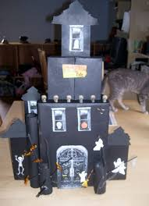
HAUNTED HOUSE
Task Brief: Design and build a haunted house using cardboard.
Suggested Level: Second
Key Resources: Cardboard, Make Do
Extension Task: Give criteria for the task, e.g. must have two towers. Make links to literacy and write a story about the haunted house. Use electric circuits to create lights or a doorbell.
E & O: TCH 2-09a

Slide 13
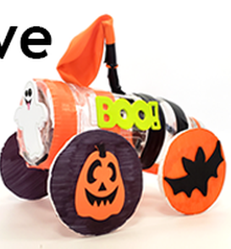
HALLOWEEN BALLOON CAR
Task Brief: Design and create a balloon-powered car.
Suggested Level: Second
Key Learning: Potential and Kinetic Energy
Extension Task: Measure the distance covered and record time it takes to travel this. Use this information to calculate the speed of the car. Learn about Newton's laws of motion. Make connections to other moving items pupils may come across.
E & O: SCN 2-04a
Support Link
Notes:
You can think of this activity in terms of energy.
When you inflate the balloon, it stores potential energy. When you release the balloon, this stored potential energy is converted to kinetic energy, the energy of motion.

Slide 14
LITERACY LINKS

Slide 15
ROOM ON THE BROOM
Create a wind-proof hat for the witch
Design a broom for the witch, that has space for all her friends. Create this broom out of Lego.
Balance Broom

Slide 16
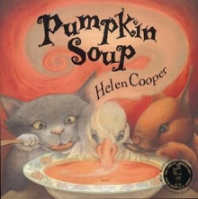
PUMPKIN SOUP
Make pumpkin soup.
Find out about the life cycle of a pumpkin.
Draw a map to show the different locations in the story.

Slide 17
FUNNYBONES
Investigate the different bones in the skeleton.
Look at skeletons of animals. Make comparisons.
Using cottong buds, create a diagram of a skeleton.
Create an animation of the story.

Slide 18
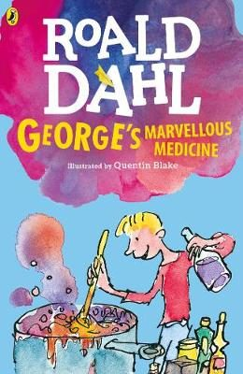
STEM THROUGH STORIES

Slide 19
LINKS
STEM Learning Magazine • Primary 13 by STEM Learning
Halloween primary resources (theiet.org)
STEM Learning: Spooktacular Resources! | All About STEMAll About STEM
22 Halloween Science Projects and Experiments! | Science Buddies Blog
31 Spooky Halloween STEM Activities - Little Bins for Little Hands
31 Days of Halloween STEM Activities and Projects (steampoweredfamily.com)

Slide 20
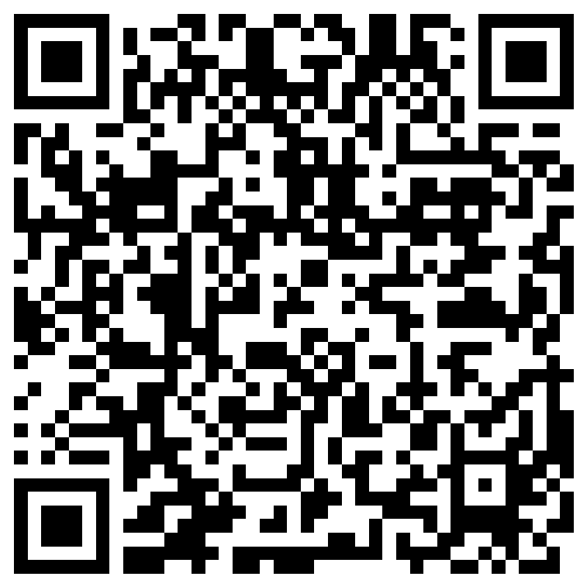
CONTACT
Victoria Paddon
PSDO Falkirk
victoria.paddon@falkirk.gov.uk
@RAiSE_Falkirk
#FalkirkSTEMpire

