Slide 1
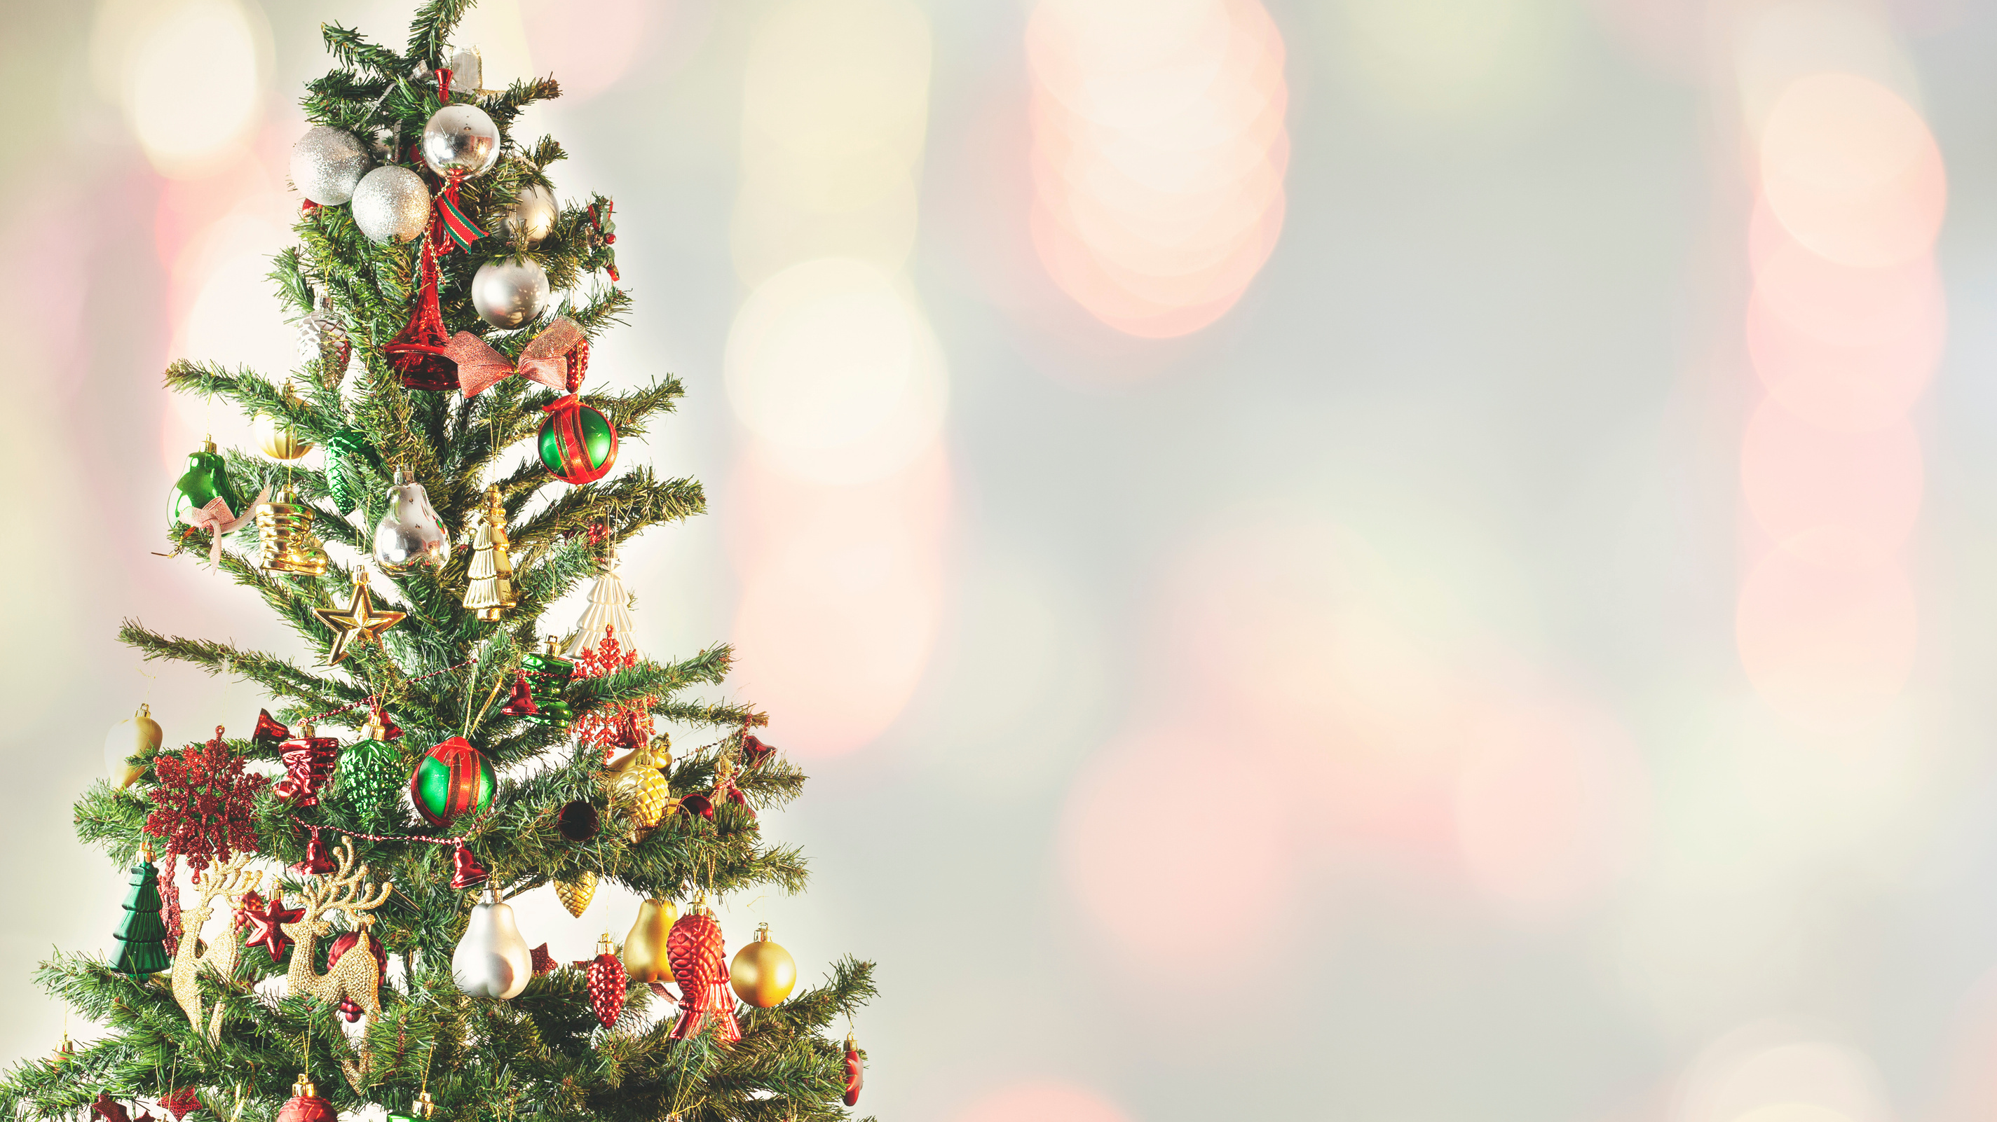
CHRISTMAS
STEM
#FalkirkSTEMpire

Slide 2
LEARNING OBJECTIVE
DEVELOP A RANGE OF IDEAS TO SUPPORT STEM IN YOUR SETTING.

Slide 3
HOW TO INCORPORATE CHRISTMAS STEM INTO YOUR SETTING
Stand Alone Activity
Themed Day/Week
STEM Advent Calendar
Part of IDL

Slide 4
STEM ADVENT CALENDAR
24 STEM activities completed throughout December
Linked to the four elements of STEM
Art incorporated into the challenges too
Linked to any school events - Active School Challenge, Concert

Slide 5
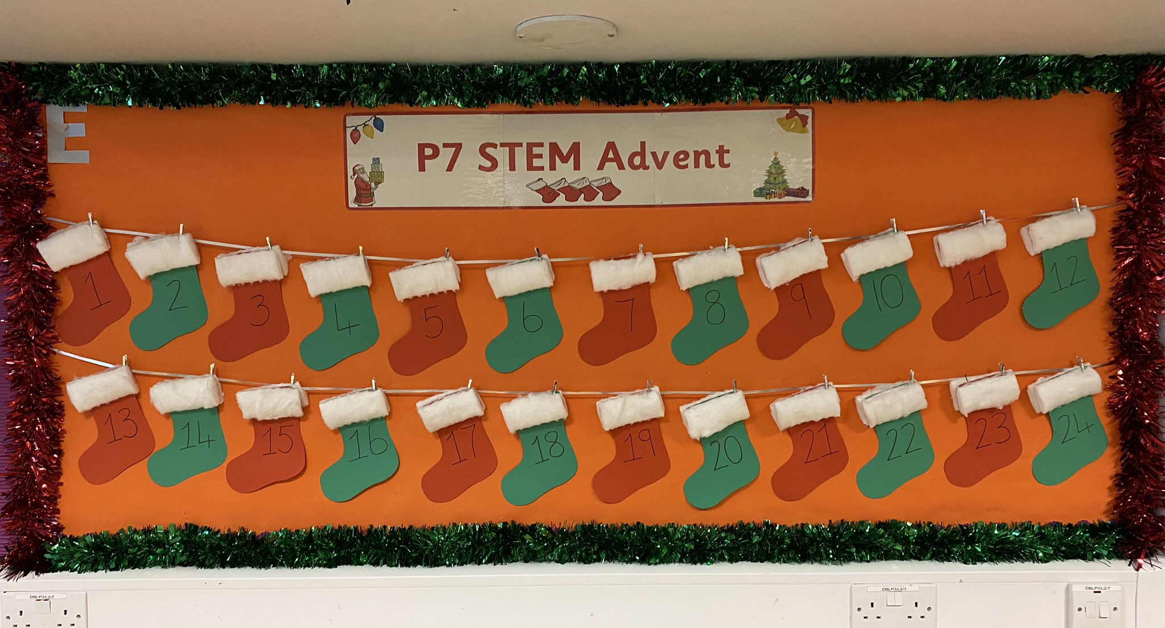

Slide 6
RAiSE STEM Elves
Daily STEM Challenge from the PSDOs
Challenges accessed on Twitter
@RAiSE_Falkirk

Slide 7
Tech Fest 24 Days of STEM
A highly interactive, online resource for practitioners and children to participate in a range of exciting activities throughout December.
Each day in December a new STEM activity is unlocked.
All activities are designed to be easy to run at home or in the classroom using readily available resources.
All teachers that sign up are sent an extensive Teachers Guide Resource Pack.
TechFest's 24 Days of STEM is coming back!
Notes:
The STEM Advent calendar is hosted on TechFest's website and there is no cost to schools or families who wish to sign up and take part.

Slide 8
ACTIVITIES WE WILL LOOK AT TODAY
Stand Alone Activities for each stage
Woodwork
Sewing
Literacy Links
Downloadable Resources

Slide 9
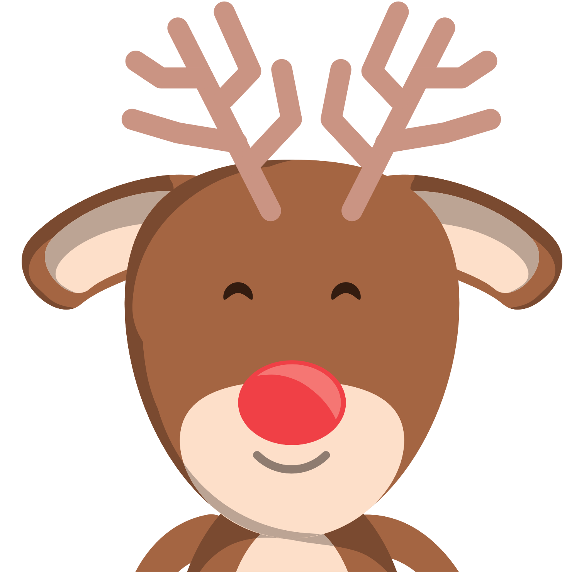
LIGHT UP RUDOLPH'S NOSE
Support Link
Task Brief: To create a simple electric circuit to make a light shine.
Suggested Level: Early/First
Key Learning: You need to have a complete circuit to allow the electrons to move.
Extension Task: Add in other elements to the circuit.
E&O: SCN 1-09a

Slide 10
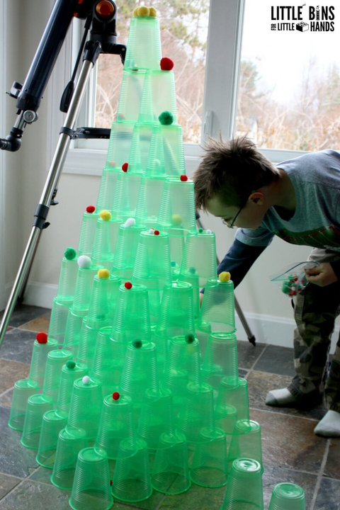
CUP CHRISTMAS TREE
Task Brief: To build a Christmas Tree using plastic or polystyrene cups.
Suggested Level: Early/First/Second
Key Learning: A strong base is important to ensure stability.
Extension Task: Measure the height of the trees. Record data in a table or graph. Use different materials to create a tree.
E&O: TCH 0-09a/ 1-09a/ 2-09a

Slide 11
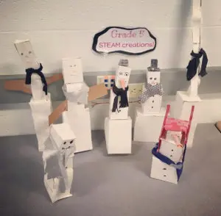
SNOWMAN STRETCH
Support Link
Task Brief: To create the tallest freestanding snowman.
Suggested Level: Early/First/Second
Key Learning: A strong base is important to ensure stability. 3D shapes.
Extension Task: Measure the height of the snowmen. Order from tallest to shortest. Write a story about the snowmen.
E&O: TCH 0-09a/ 1-09a/ 2-09a
Notes:
How to add differentiation and challenge to modify for different levels/stages.
-Have a minimum height level to reach
- Has to be a certain number of "tiers"
- Each tier has to be a percentage shorter than the one below it
- Each tier has to be a different shape
- Build an inverted snowman: smallest tier at the base, largest tier at the top
- Use tissue paper

Slide 12
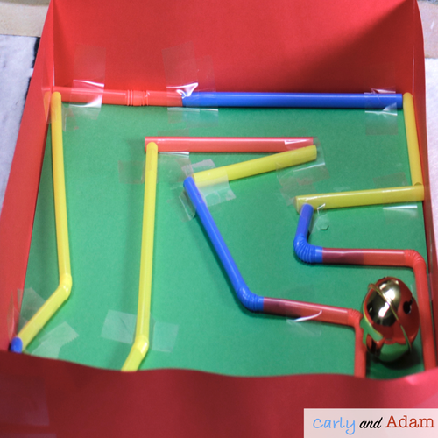
JINGLE BELL MAZE
Support Link
Task Brief: To design and create a maze.
Suggested Level: Early/ First
Key Learning: Problem solving skills developed.
Extension Task: Work in groups to make a bigger maze. Add other elements e.g. a bridge or a tunnel
E&O: SCN 0-09a/ 1-09a

Slide 13
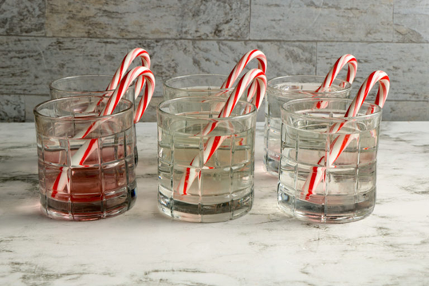
Support Link
CANDY CANE EXPERIMENT
Task Brief: To observe the affect different liquids have on a candy cane.
Suggested Level: First/Second
Key Learning: Pupils are developing observational skills. Different water temperatures and solutions will have different effects on the candy canes.
Extension Task: Record and display results in a variety of ways - table, diagram
E&O: SCN 1-15a/ 1-16a/ 2-15a
Notes:
Mini candy canes are the best to use - suggest weighing the canes before starting the experiment. This will ensure a fair test.
Suggested liquids: hot water, cold water, salt water, lemon juice or vinegar, dish soap.
You can use as many liquids as you like. Just make sure they are measured equally.

Slide 14
DESIGN A SLEIGH FOR SANTA
Task Brief: Design a sleigh for Santa with special features to keep him warm and occupied during his long journey on Christmas Eve. Draw a clearly labelled diagram.
Suggested Level: First/Second
Key Learning: Think about features in cars/ different transport, that help to keep us ocmfrotable on long journeys. Let a bit of imagination come into to this too!
Extension Task: Let pupils build their finished design.
E&O: 1-09a/ 2-09a

Slide 15
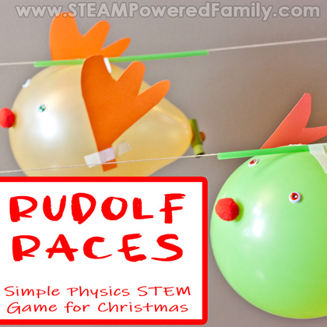
RUDOLPH RACES
Support Link
Task Brief: Create a way to get your reindeer from one side of the room to the other, using only the resources given.
Suggested Level: First/Second
Key Learning: Newton's Third Law of Motion - for every action there is an equal reaction (air released from the balloon in one direction and the force propels it in the opposite direction.
Extension Task: Look at the different results depending on the amount of air in the balloon. Record results.
E&O: 1-07a/ 2-07a
Notes:
Each group/pair should have the following resources: string, balloon, peg, plastic straw, paper to create reindeer design, Sellotape.

Slide 16
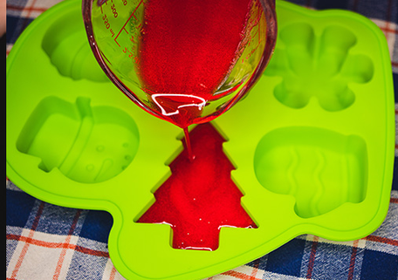
BIOPLASTIC DECORATIONS
Support Link
Task Brief: Create bioplastic to make a sustainable and more eco-friendly Christmas decoration.
Suggested Level: Second
Key Learning: Bioplastic is not created using fossil fuels so is more eco friendly. Gelatin is made up of long chains of hundreds of amino acids. When we heat it up the bonds (spaces) between the acids stretch and join with the water molecules. This is called a hydrogen bond.
Extension Task: Link to climate change and use of plastics. Discuss other uses for Bioplastic.
E&O: 2-15a
Notes:
As the mixtures sets it might start to curl at the edges. Important to keep it in the hard mould for a few days to minimise curling.

Slide 17
SNOWSTORM IN A JAR
Support Link
Task Brief: Create a chemical reaction to make a snowstorm.
Suggested Level: Second (Could be used with Early and First but no Es and Os for these levels)
Key Learning: Oil and water don't mix. Oil is less dense that water. The Alka-Seltzer tablet reacts with the oil and water, creating carbon dioxide gas bubbles. The bubbles push the water and paint mixture upward, but the oil exerts pressure downward and pushes the mixture back down to create the snow effect.
E&O: SCN 2-19a

Slide 18
WOODWORK
#FalkirkSTEMpire

Slide 19
Christmas plans for Woodwork are currently being made. These will be shared on the Teams page and our blog, once completed.

Slide 20
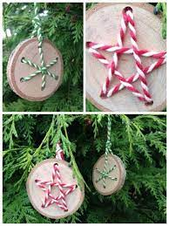
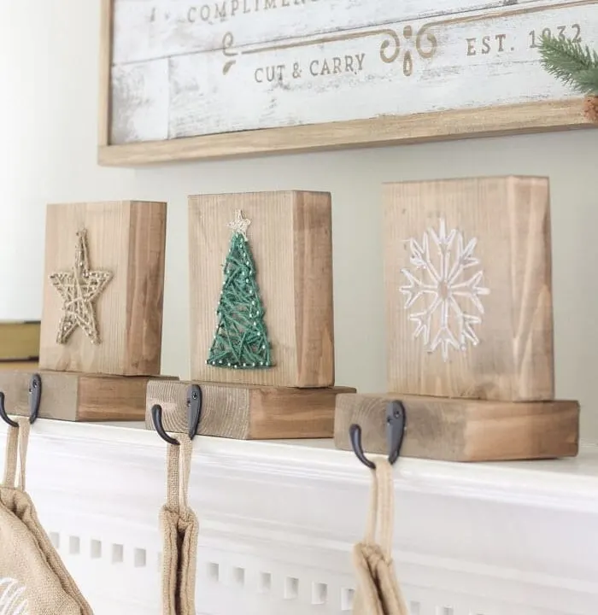

Slide 21
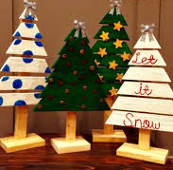
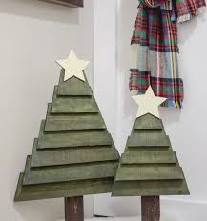

Slide 22
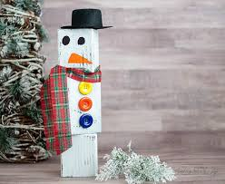
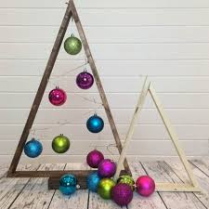

Slide 23
SEWING
#FalkirkSTEMpire

Slide 24
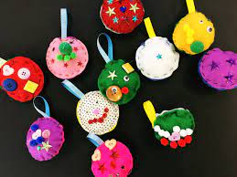
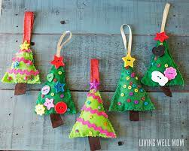

Slide 25
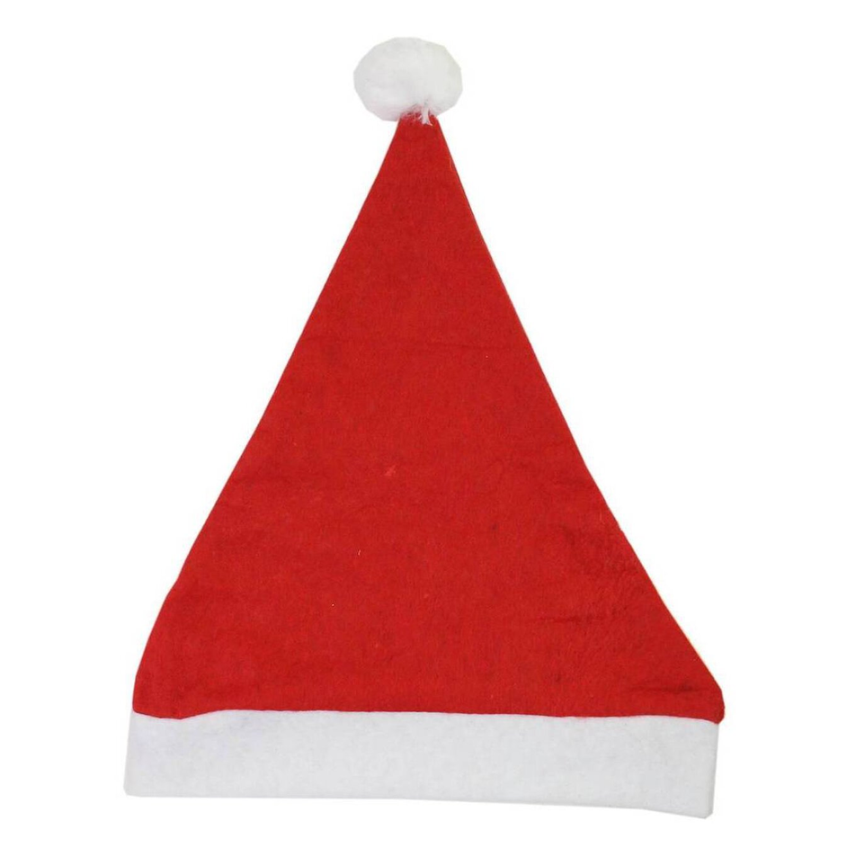
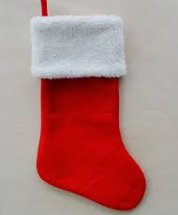

Slide 26
DOWNLOADABLE RESOURCES
#FalkirkSTEMpire

Slide 27
Notes:
12 STEM Activities across the levels to complete. Comes with a lesson overview and resource list.

Slide 29
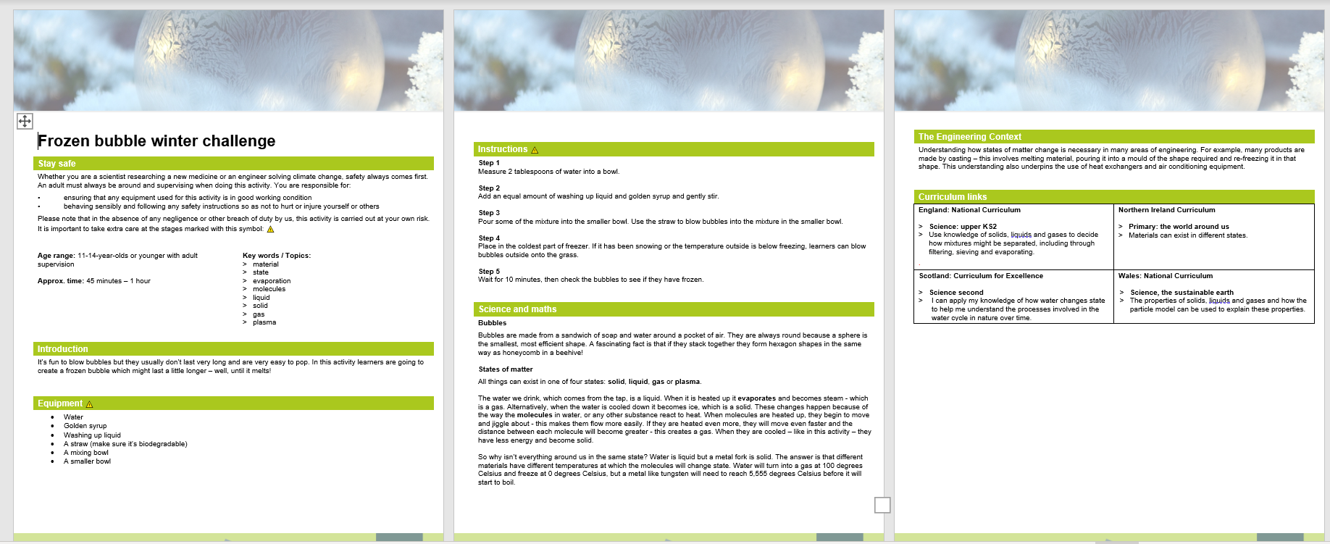
IET Website - Christmas Planners

Slide 30
LITERACY LINKS
#FalkirkSTEMpire

Slide 31
STEM Through Stories

Slide 32
How to Catch An Elf
Create an elf trap
Design and build a house for the elf to stay.

Slide 33
The Biggest Christmas Tree Ever
Use different resources and materials to build trees - decide which material is the best and why
Measuring skills
Life cycle of a tree
Why are trees important to our environment?

Slide 34
Arthur Christmas
In this film, you’ll be amazed to see just how much STEM goes into the magic of Christmas!
From the present sorting conveyor belts, parachuting delivery teams, North Pole Mission Control and the enormous number counter counting the children as they get their presents!
Get pupils to record all things STEM as they watch the movie. Then design their own invention to help Arthur and his family.

Slide 35
LINKS
Little Bins for Little Hands
STEM Learning
STEAM Powered Learning
Science Sparks Christmas STEM Challenges
IET Christmas STEM
STEM Through Stories

Slide 36
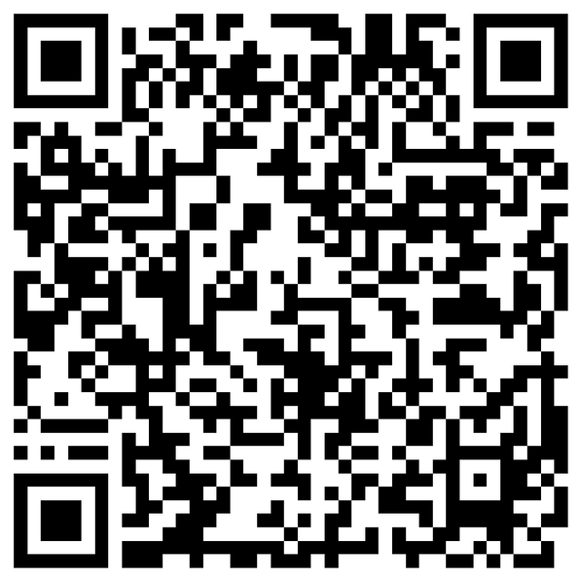
CONTACT
victoria.paddon@falkirk.gov.uk
@RAiSE_Falkirk
@MrsPaddonSTEM
#FalkirkSTEMpire
Upcoming CLPL
STEM Nation Award Info Session – 28th November 3.45pm
Code and Go Mouse
Sphero Indi and Bolt
Micro:bit Progression

