Slide 1
Starter What is happening here!?
MODULAT ION!
Below: An example from the Classical Period

Slide 2
Chords!
We have started to look at chords
Looking specifically at how they are built from individual notes

Slide 3
More Chords!
If we take an F major scale… F G A Bb C D E F
1 2 3 4 5 6 7 8
If we count 5 up from F we get to C. C is chord V here – the Dominant

Slide 4
Dominant 7th
The chord built on this note is called the Dominant chord.
If we add in the 7th note above C…and add a flat sign in front of it. We get a Dominant 7th chord

Slide 5
Dominant 7th
This chord was popular in the Classical Period. Nearly always heard at Perfect Cadences in this period!
Dominant 7th chord

Slide 6
Other Concepts
We are going to look at some other concepts in the profiles.

Slide 7
Coloratura
Term for high, florid, vocal singing involving scales,
runs and ornaments.
REMEMBER: We looked at this type of singing for the Da Capo Aria (Baroque Period)

Slide 8
Harmonic Minor
The harmonic minor scale is a minor scale where the 7th note is
always sharpened.
A B C D E F G# A

Slide 9
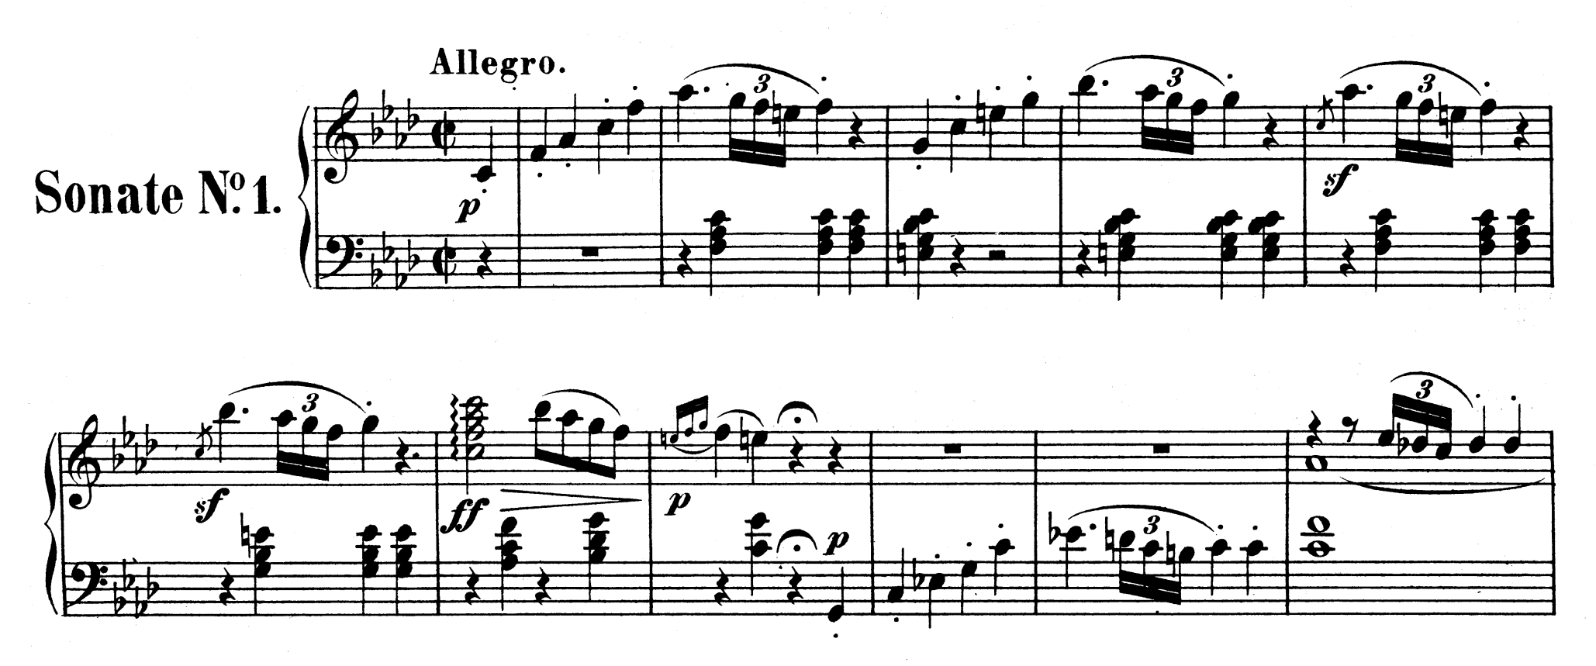
Harmonic Minor

Slide 10
Melodic Minor
The melodic minor scale is JUST LIKE THE MAJOR SCALE but with a flat 3rd. Then it is like the relative major on the way down…
A B C D E F# G# A
Ascending
A G F E D C B A
Descending

Slide 11
Melodic Minor

