Slide 1
Binary Form
Just like in computing studies where the two digit pattern (0 or 1) is called Binary. Music that is in TWO parts is said to be in Binary Form. These two sections will be different and we label them A and B

Slide 2
Ternary Form
Three part form. A section is repeated again after B. A and B and A
Twinkle, twinkle, little star, How we wonder what you are.
Up above the world so high, Like a diamond in the sky.
Twinkle, twinkle, little star, How we wonder what you are.

Slide 3
Rondo Form
The a section keeps returning after different sections in between. A section is repeated after every different section. A and B and A and C and A
The sections that are not ‘A sections’ are called Episodes
The sections that are not ‘A sections’ are called Episodes

Slide 4
Theme and Variations
We are going to create our own
Theme Var.1 Var.2 Var.3

Slide 5
Sonata Form Explained…
1. Exposition – The statement of the subjects (themes).
2. Development – A modulating section developing the themes.
3. Recapitulation – A return to the first themes from the exposition. Think of the word RECAP

Slide 6
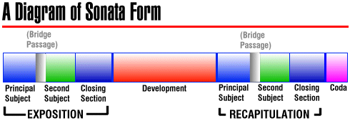
Sonata Form
Sonata Form Explained in a fun way… https://www.youtube.com/watch?v=L7PfGTtUC84

