Slide 1
Dynamics
The Dynamics of a piece of music give it character and mood. So far you should know four dynamic terms… Piano - Quiet Forte - Loud Pianissimo – Really Quiet Sforzando – Suddenly Loud Fortissimo – Really Loud Crescendo – Gradually getting louder Diminuendo – Gradually getting quieter

Slide 2
A New Invention!
The Classical Era also brought the birth of the Piano - full name Pianoforte.
This replaced the Harpsichord which had been so popular in the Baroque period.
Why do you think it is called Pianoforte?
Because it can play QUIET + LOUD

Slide 3
The Piano
The Piano was the first keyboard instrument that allowed people to play both loudly and quietly.
This is an example of a Piano Sonata

Slide 4
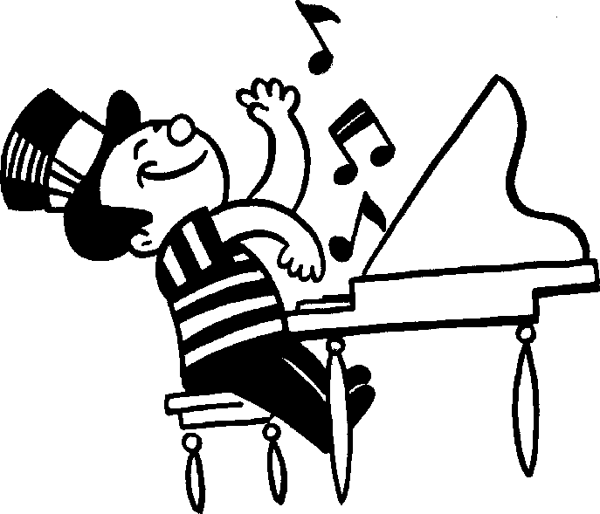
Sonata
The Piano brought with it the invention of the Sonata. This is a type of composition for...
A composition for solo Piano
or
2. A composition for a solo instrument accompanied by Piano.

Slide 5
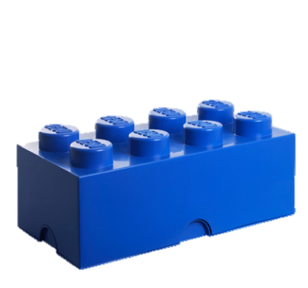
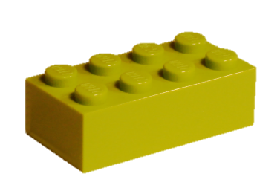
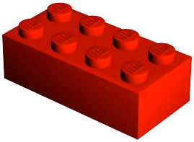
Musical Building Blocks!
Chords are musical Lego! They are the building blocks of all music.

Slide 6
Chords!
If we take a chord and break it from this this to
we call it a BROKEN chord

Slide 7
Alberti Bass
If the notes of the Broken Chord follow a certain pattern: 1 5 3 5 We call it ALBERTI BASS – this was hugely popular in the Classical period.
HINT: if you are listening to a piece of Piano music with Alberti Bass – its probably from the classical period.

Slide 8
Alberti Bass
Turn these chords into Alberti Bass. The first one has been done as an example!
Fill in these bars - use the example above to help!

