Slide 1
The Classical Era
The Classical Era came just after the Baroque Era and lasted from 1750 to 1810.
Some key composers during this time were Mozart, Haydn and Beethoven

Slide 2
Symphony
The Orchestra grew much larger and composers started to write music for these large orchestras. The type of composition born from this was the Symphony. A large work with 3 or 4 different movements. Mozart wrote 41, Haydn wrote of 106!! Listen to this famous Symphony:

Slide 3
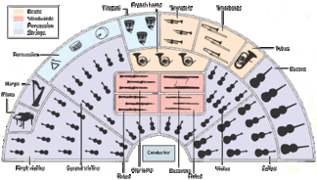
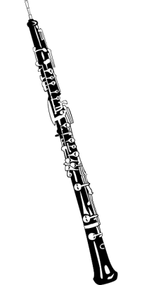
Concerto
The Concerto evolved out of the Concerto Grosso. Instead of having a small group of soloists we now have one soloist against the whole orchestra! vs

Slide 4
Concerto
Spot the soloist!
A few concepts… Concerto, Clarinet, Major, Perfect Cadence, Trill, Imitation, Allegro, 4 beats in the bar, Arco (strings played using the bow), Crescendo

Slide 5
Cadenza
Why is this impressive? What is a cadenza?
A flashy “show-off” moment for the solo instrument in a concerto. Happens towards the end of a Concerto.

Slide 6
Chamber Music
As Orchestras grew larger and larger, Chamber Music grew popular.
This would be for a small group of instruments (e.g. String Quartet).

