Slide 1
Cadences
The most common cadences are:
Perfect (V – I) and Imperfect (I – V)

Slide 2
Plagal Cadence
The plagal cadence is also known as the "Amen Cadence" because of its frequent
setting to the text "Amen" in hymns.
The plagal cadence is a weaker cadence moving from chord IV to chord I.
Similar to the perfect cadence the music can sound finished.
It is found in many types of styles including religious works and popular music.

Slide 3
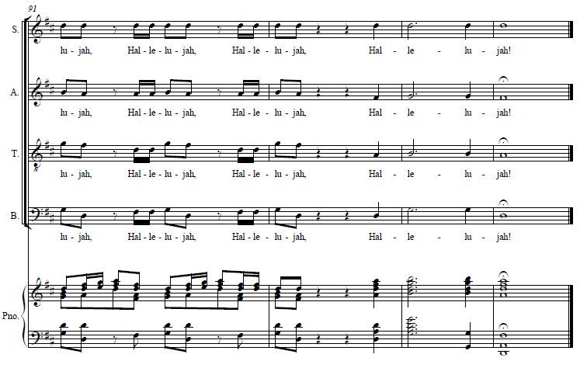
Plagal Cadence
G (IV) to D (I)

Slide 4
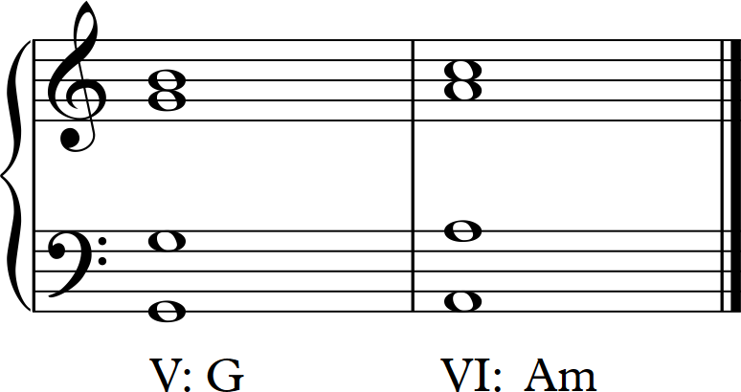
Interrupted Cadence
The interrupted cadence is almost like a musical question mark.
One common interrupted cadence is the progression of chord V to chord VI.
Generally the interrupted cadence is a cadence which finishes on any chord other
than chord V or chord I.
Similar to the imperfect cadence the music does not sound finished.
The interrupted cadence is often found before a cadenza in the classical concerto.

Slide 5
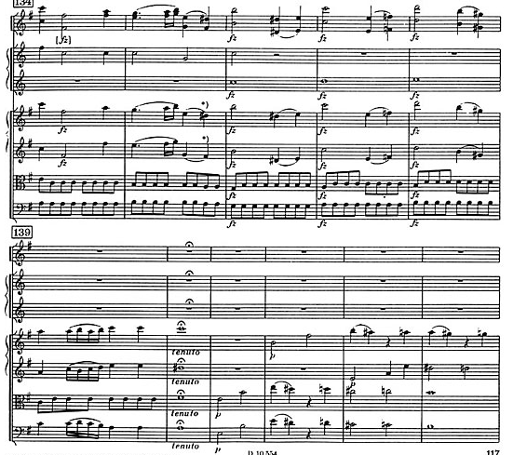
Interrupted Cadence

