Slide 1
S4 (Higher) BAROQUE MUSIC

Slide 2
Ornaments
Ornaments – fast, decorative extra notes added to a melodic line by a singer or instrumentalist.
Trill – Two alternate notes repeated rapidly.
Mordent – the note, the note below then the first note again OR the note, the note above then the first note again
Acciaccatura – a short fast note played before a longer note.

Slide 3
Cadences
Cadences are ways in which musical sentences finish. They can be Perfect, Imperfect, Interrupted or Plagal.
Perfect - the music moves from chord V to I.
Imperfect - the music move from chord I to V
Interrupted - the music moves to chord VI (minor)
Plagal - the music moves from chord IV to I
Tierce de Picardie – music which is minor but the last chord is major.

Slide 4
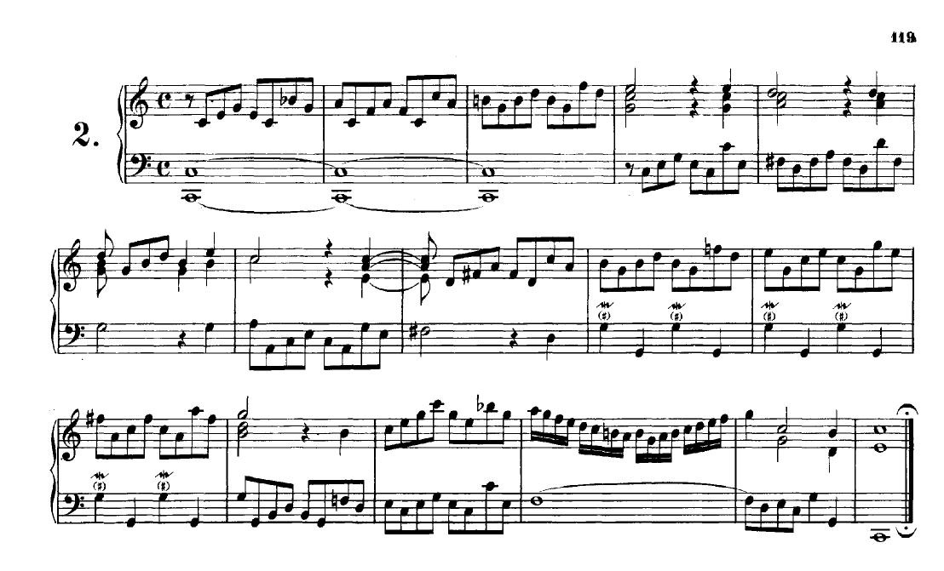
Baroque Literacy Task
Dominant 7th
Imitation
Pedal
Modulating to Dominant (G major)
Mordent
Pedal
Perfect Cadence

