Slide 1
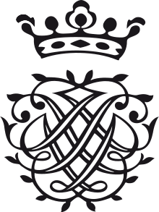
S4 (Higher) BAROQUE MUSIC

Slide 2
Ritornello Form
Ritornello literally means little return.
In a Concerto grosso, the ritornello is the main theme played by the Ripieno group (the orchestra).
The Ritornello may return frequently throughout the movement, similar to a Rondo.

Slide 3
Revision from N5
Canon
Strict imitation. After one part starts to play or sing a melody, another part enters shortly afterwards with exactly the same melody.
Ground Bass
A theme in the bass which is repeated many times while the upper parts are varied. Watch this demonstration: https://www.youtube.com/watch?v=Rk5DWqls0gg

Slide 4
Passacaglia
A Passacaglia (like a ground bass) is a repeating bassline. On top of this we have a series of variations. Watch this example: https://www.youtube.com/watch?v=7S2pm1g70DI

Slide 5
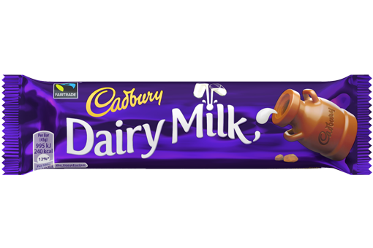
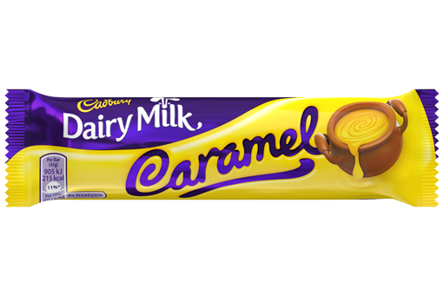
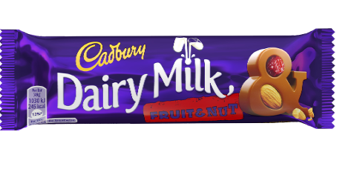
Group Passacaglia Task
We are going to create our own Passacaglia diagram!
Theme Var.1 Var.2
Bassline that repeats over and over

Slide 6
Oratorio
An Oratorio – a biblical story set as a large work for Orchestra, Soloists and Chorus.
Can you think of another large work for Orchestra, soloists and chorus?
Example: Handel’s “Messiah” deals with the Birth of Jesus, his crucifixion and death and finally the redemption of all man through belief in Christ

Slide 7
Fill in the concepts!
Opera
What different parts make this up?
Where would it be performed?
Oratorio

Slide 8
Fill in the concepts!
Opera
Aria
Chorus
Non-ReligiousText
Recitative
Acted on a Stage in a Theatre
Oratorio
Aria
Chorus
ReligiousText
Recitative
Not Acted – performed in a concert hall or religious setting.

