Slide 1
S4 (Higher) BAROQUE MUSIC

Slide 2
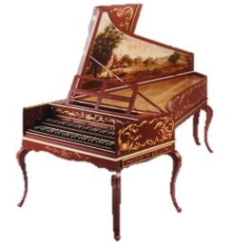
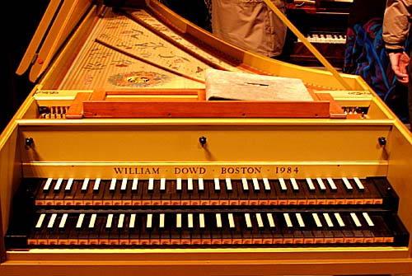
The Harpsichord
The harpsichord was invented during the Baroque era but became obsolete by the Classical era as the piano was invented. As a result the harpsichord is a keyboard instrument strongly associated with Baroque music.
HINT: If you hear a Harpsichord, you are most likely listening to Baroque music!

Slide 3
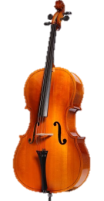
Basso Continuo
A continuous bass line which could be played by cello, viola da gamba or bassoon depending on which instruments were available. Along with this would be harpsichord or organ to fill in harmonies built on that bass line. HINT: In Baroque Orchestral music, you will nearly always hear a Basso Continuo.

Slide 4
The Concerto Grosso
The concerto grosso was the main form of Orchestral composition in the Baroque period.
Describe what you can hear/see in this excerpt.
Are there different groups of instruments playing? Is there a solo instrument? What other concepts can you hear? (Think TEMPO, TONALITY…)

Slide 5
…more Concerto Grosso
A Concerto Grosso consists of two groups of instruments.
Concertino – a small group of solo instruments
Ripieno – the rest of the Orchestra (or the whole Orchestra playing together – soloists included).
Aswell as this we also have the Basso Continuo – present in all Baroque orchestral music!

Slide 6
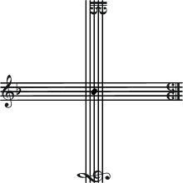
Watch the Concerto Grosso

