Slide 1
Mr Knight’s Mental Maths Darts Challenge

Slide 2
Instructions
x2
x3
25
50

Slide 3
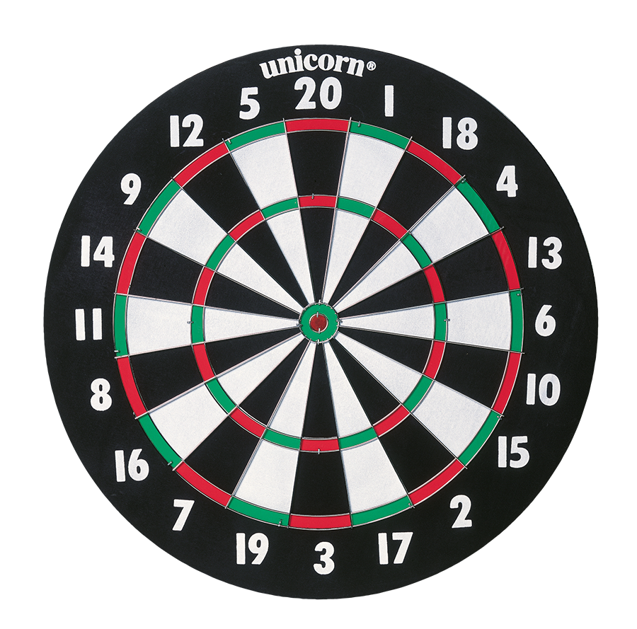
Dart 1 | 6
Dart 2 | 9
Dart 3 | 18
Final Score | 33

Slide 4
Dart 1 | 5
Dart 2 | 10
Dart 3 | 16
Final Score | 31

Slide 5
Dart 1 | 6
Dart 2 | 6
Dart 3 | 2
Final Score | 14

Slide 6
Dart 1 | 20
Dart 2 | 17
Dart 3 | 8
Final Score | 45

Slide 7
Dart 1 | 9
Dart 2 | 4
Dart 3 | 15
Final Score | 28

Slide 8
Dart 1 | 1
Dart 2 | 9
Dart 3 | 17
Final Score | 27

Slide 9
Dart 1 | 19
Dart 2 | 1
Dart 3 | 14
Final Score | 34

Slide 10
Dart 1 | 17
Dart 2 | 4
Dart 3 | 11
Final Score | 32

Slide 11
Dart 1 | 3
Dart 2 | 17
Dart 3 | 20
Final Score | 40

Slide 12
Dart 1 | 18
Dart 2 | 14
Dart 3 | 9
Final Score | 41

Slide 13
Dart 1 | 20
Dart 2 | 10
Dart 3 | 25
Final Score | 55

Slide 14
Dart 1 | 19
Dart 2 | 19
Dart 3 | 19
Final Score | 57

Slide 15
Dart 1 | 17
Dart 2 | 15
Dart 3 | 7
Final Score | 39

Slide 16
Dart 1 | 18
Dart 2 | 19
Dart 3 | 20
Final Score | 57

Slide 17
Dart 1 | 14
Dart 2 | 19
Dart 3 | 25
Final Score | 58

Slide 18
Dart 1 | 17
Dart 2 | 22
Dart 3 | 20
Final Score | 59

Slide 19
Dart 1 | 17
Dart 2 | 22
Dart 3 | 20
Final Score | 59

Slide 20
Dart 1 | 18
Dart 2 | 30
Dart 3 | 16
Final Score | 64

Slide 21
Dart 1 | 40
Dart 2 | 25
Dart 3 | 26
Final Score | 91

Slide 22
Dart 1 | 20
Dart 2 | 20
Dart 3 | 38
Final Score | 78

Slide 23
Dart 1 | 24
Dart 2 | 36
Dart 3 | 16
Final Score | 78

Slide 24
Dart 1 | 20
Dart 2 | 20
Dart 3 | 38
Final Score | 78

Slide 25
Dart 1 | 14
Dart 2 | 34
Dart 3 | 40
Final Score | 88

Slide 26
Dart 1 | 50
Dart 2 | 22
Dart 3 | 12
Final Score | 84

Slide 27
Dart 1 | 12
Dart 2 | 16
Dart 3 | 15
Final Score | 43

Slide 28
Dart 1 | 2
Dart 2 | 27
Dart 3 | 25
Final Score | 54

Slide 29
Dart 1 | 50
Dart 2 | 22
Dart 3 | 12
Final Score | 84

Slide 30
Dart 1 | 21
Dart 2 | 6
Dart 3 | 20
Final Score | 47

Slide 31
Dart 1 | 5
Dart 2 | 39
Dart 3 | 14
Final Score | 58

Slide 32
Dart 1 | 60
Dart 2 | 20
Dart 3 | 17
Final Score | 97

Slide 33
Dart 1 | 60
Dart 2 | 20
Dart 3 | 20
Final Score | 100

Slide 34
Dart 1 | 57
Dart 2 | 19
Dart 3 | 50
Final Score | 126

Slide 35
Dart 1 | 57
Dart 2 | 16
Dart 3 | 36
Final Score | 109

Slide 36
Dart 1 | 51
Dart 2 | 42
Dart 3 | 18
Final Score | 111

Slide 37
Dart 1 | 60
Dart 2 | 45
Dart 3 | 4
Final Score | 109

Slide 38
Dart 1 | 21
Dart 2 | 54
Dart 3 | 48
Final Score | 123

Slide 39
Dart 1 | 60
Dart 2 | 51
Dart 3 | 24
Final Score | 135

Slide 40
Dart 1 | 54
Dart 2 | 27
Dart 3 | 40
Final Score | 121

Slide 41
Dart 1 | 25
Dart 2 | 60
Dart 3 | 50
Final Score | 135

Slide 42
Dart 1 | 60
Dart 2 | 57
Dart 3 | 24
Final Score | 141

Slide 43
Dart 1 | 54
Dart 2 | 40
Dart 3 | 34
Final Score | 128

Slide 44
Dart 1 | 50
Dart 2 | 48
Dart 3 | 45
Final Score | 143

Slide 45
Dart 1 | 57
Dart 2 | 57
Dart 3 | 57
Final Score | 171

Slide 46
Dart 1 | 60
Dart 2 | 60
Dart 3 | 50
Final Score | 170

Slide 47
Dart 1 | 60
Dart 2 | 60
Dart 3 | 60
Final Score | 180

