Slide 1

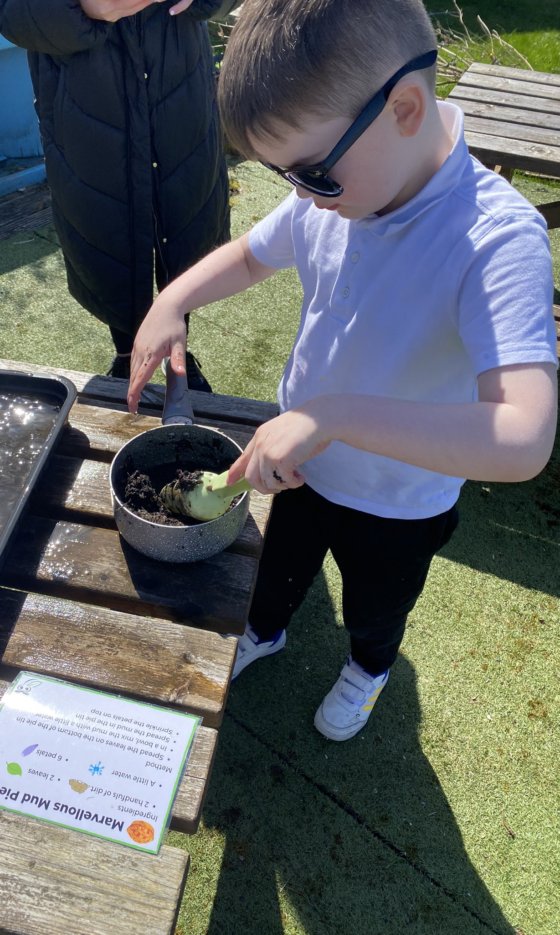
Service Overview
The Inclusion and Wellbeing Service is a Stage 4 provision with 34 young people with social, emotional and behavioural needs. We support individual pupils from across the authority with class sizes of six. At the end of session 2024/25 there were 7 school leavers.
Our curriculum spans from early level to National 5. In addition, we offer a variety of wider achievement experiences which are supported by National Qualifications and external providers. These include Dynamic Youth and High Five awards. We also work with a variety of partners within our local community to support our learners through college and work experience opportunities.

Slide 2


Progress and Attainment
Achieved Silver Rights Respecting Schools Award
71% of the leavers have a positive destination
Across secondary, 52% of pupils accredited in a variety of wider achievement qualifications
Across senior phase, 90% of pupils achieved Nat 3 in Maths and 60% achieved Nat 4
Across senior phase, 80% achieved Nat 3 in English and 20% achieved Nat 4
Across senior phase, 90% of pupils achieved Nat 3 in Art and Design
75% of primary pupils achieved Hi5 Awards in Survival Skills

Slide 3
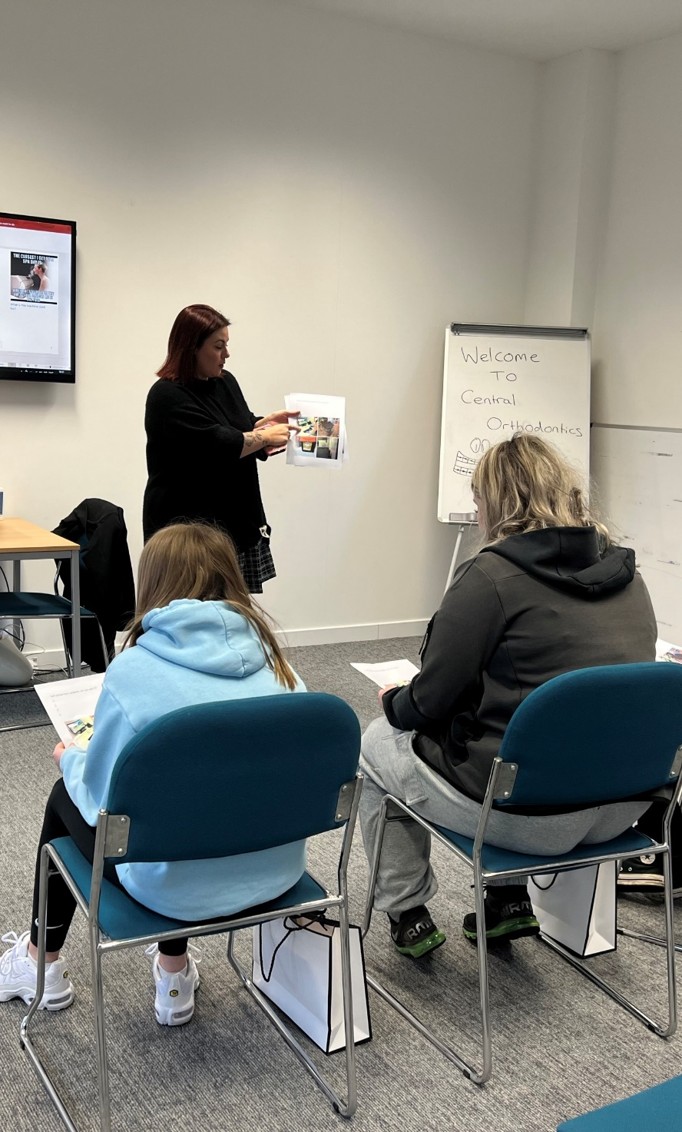
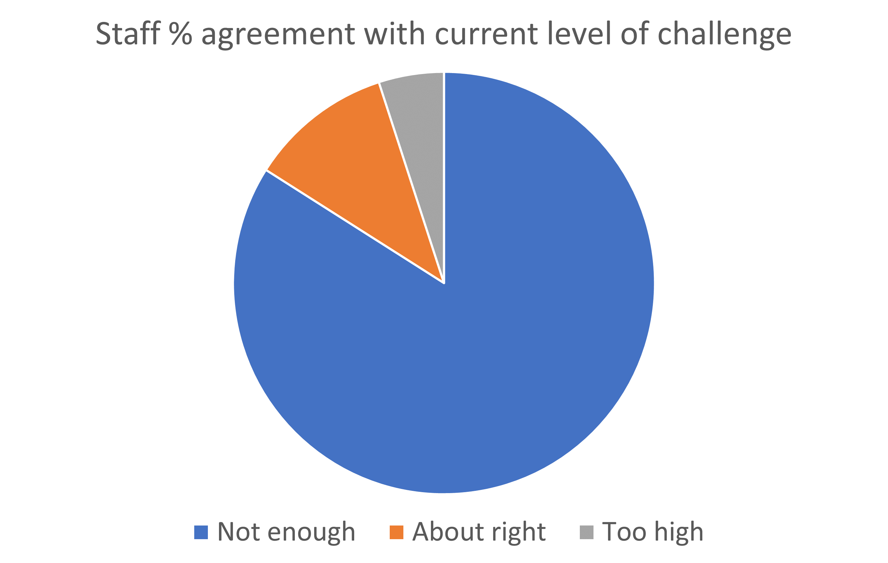
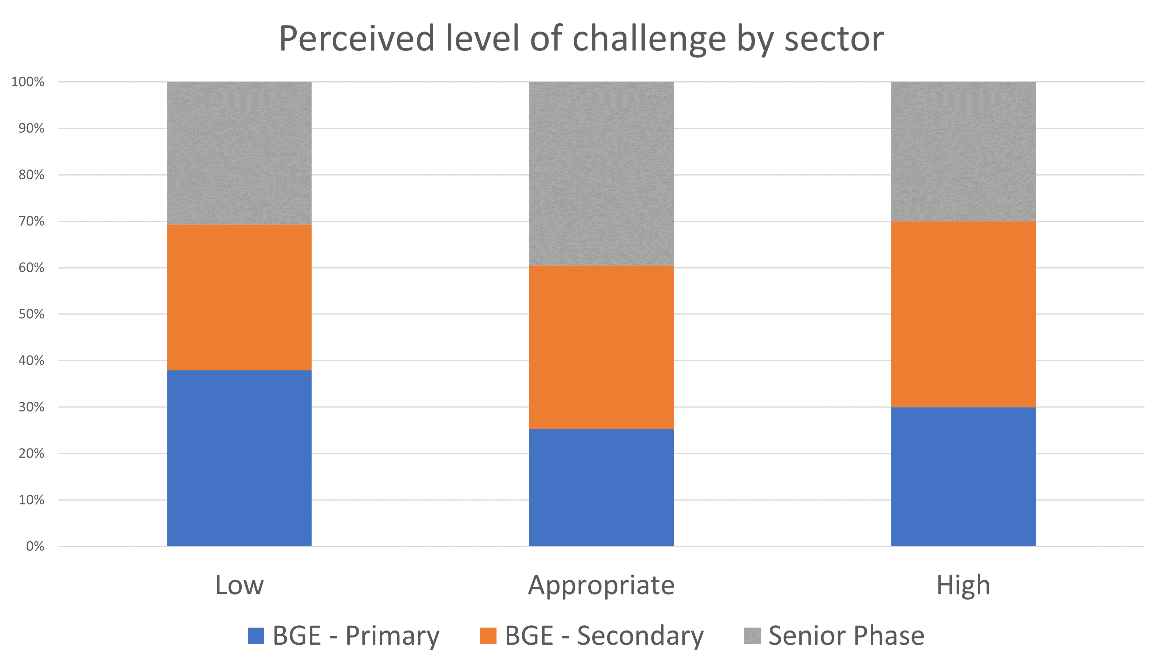
Priority 1
Learning and Teaching to Support an Increase in Challenge
Staff questionnaire completed which focussed on increasing challenge when delivering the pupil offer.
Almost all staff identified that learning and teaching experiences should be enhanced. Allowing learners to develop critically in an environment where they are encouraged to strive for excellence and grow.

Slide 4

Priority 2
Rights Respecting Schools and Improved Gathering of Pupil Voice
School received a Silver Rights Respecting Schools Award.
The Children’s Officer and the ESO UNCRC visited the school and identified that pupils are aware of the rights that they are entitled to. ‘… to have your rights, you just need to be alive’.
RRSA Accreditation Report identifies that almost all pupils feel safe and protected in school and know who to speak with if something goes wrong or they have questions.
Creation of ‘You Said, We Did’ wall displays and subsequent discussions have allowed pupils to be more willing to voice views and ask for change.
Almost all pupils are now more able to speak about the rights of others and the role they can play in promoting these rights in their community.

Slide 5

Priority 3
Campus Move and Development
Plans shared with pupils and Parent Group. The parents felt that little consultation had taken place before the public announcement and that the needs of our young people have not been fully recognised when the Dawson Centre has been allocated as the new school. Parents do not feel that the indoor space will be able to accommodate the curricular flexibility required to support learners but they were enthusiastic about the outside space.
Staff visit to new site in June 2025. All staff provided positive feedback particularly in relation to the outdoors space.
In preparation for school move, staff have been cleansing resources to minimise costs of removals. This will continue over the coming school year.

Slide 6
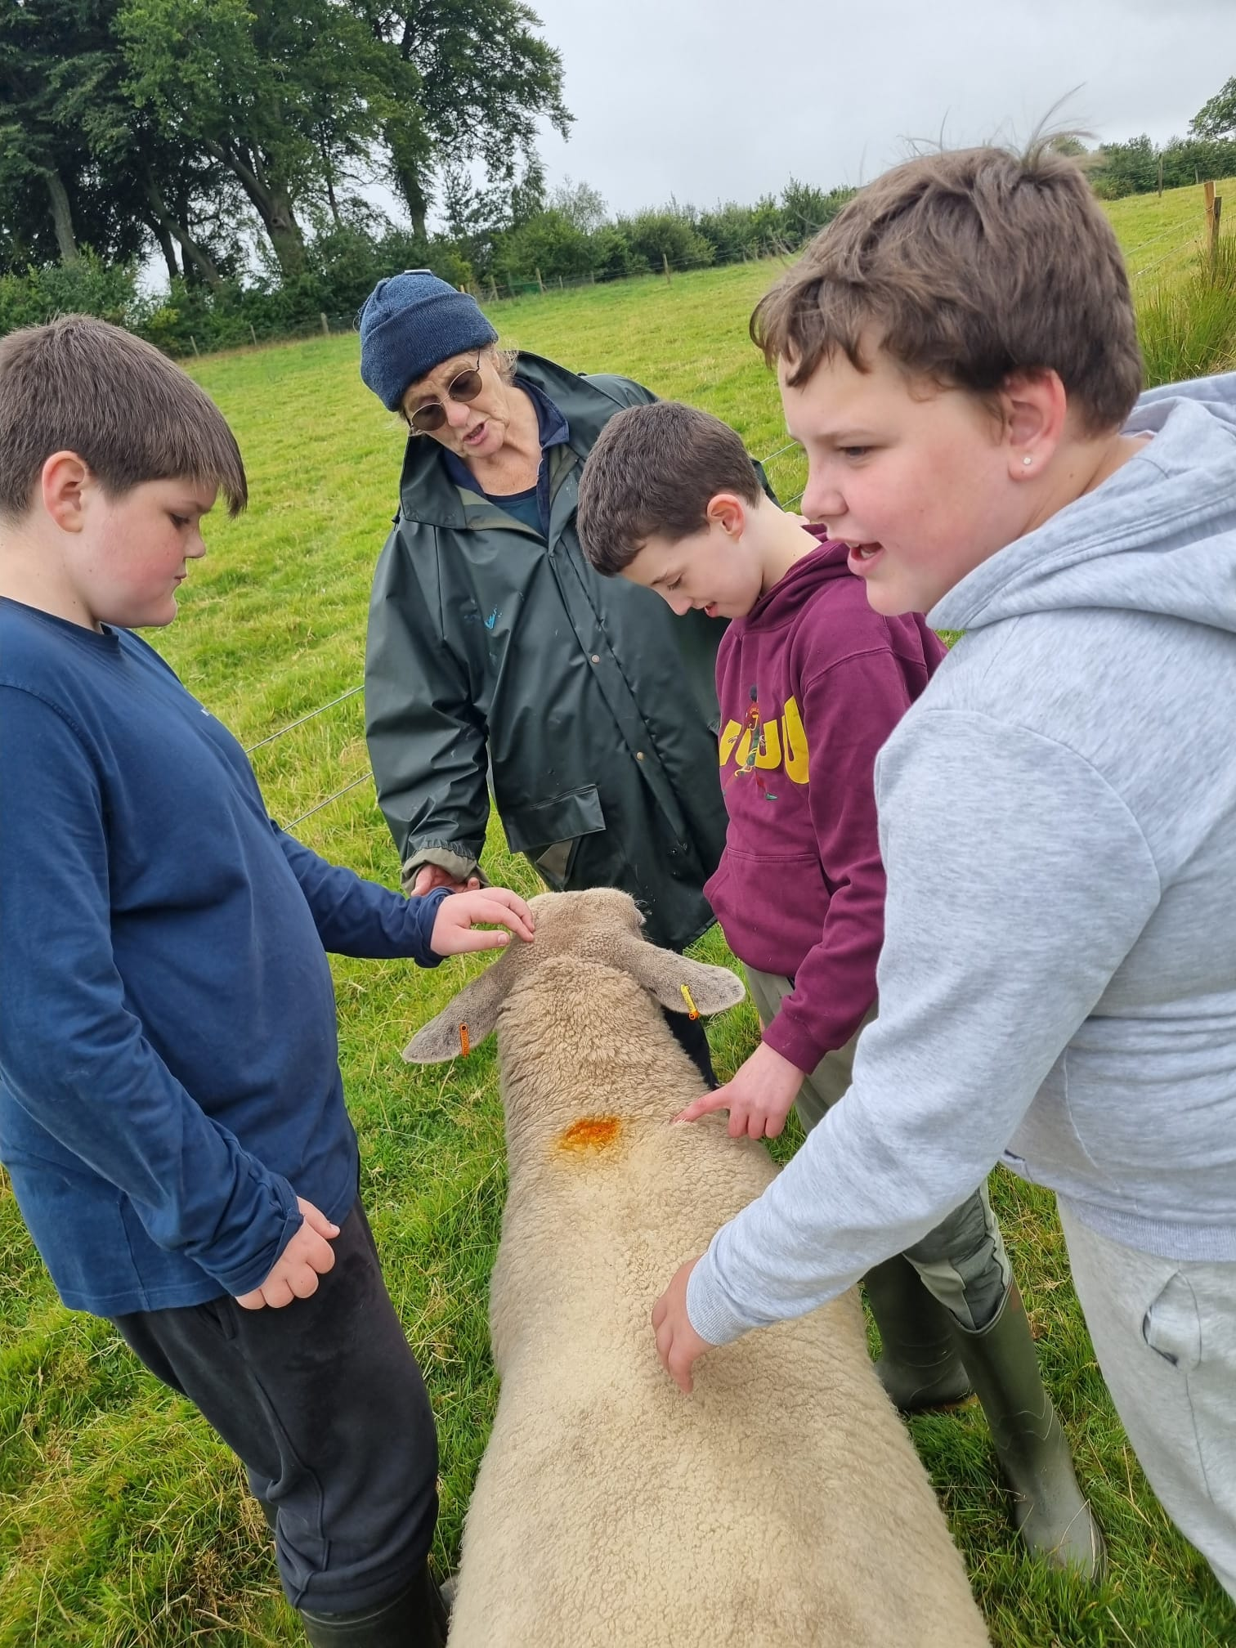
Priority 4
Health and Wellbeing Strategies and Implementation through pupil voice and the creation of an updated Wellbeing Web
A staff working group undertook research to explore alternative wellbeing assessment models utilised within comparable school contexts.
All school staff identified the limitations of current approach.
In response to this, we are introducing a new focused metal health curriculum this year which includes:
How trauma affects the brain
Kids frustration tolerance
My anger kit
My anxiety kit
Sleep well course
Calming strategies
The polyvagal theory
Emotional intelligence
The truth about self harm
Nervous system regulation

Slide 7

Next Steps
Collegiate quality assurance visits commencing Term 2 with a focus around pupil challenge, attainment and resilience.
Participation in SEBN thematic review with Forth Valley RIC colleagues.
Re-instate Pupil Council to gather pupil voice to inform improvement planning.
School community to continue to engage and consult on the Campus relocation.
Partnership working with link Educational Psychologist to support the planning and recording of Health and Wellbeing Assessment.

Slide 8

Key School Priorities 2025/26
Curriculum, Learning, Teaching and Assessment
Raising attainment in writing using digital technologies
Raising attainment in numeracy
Targeted support for pupils with less that 80% attendance
Culture, Ethos, Relationships, Equality and Inclusion
Development of mental health curriculum for boys
Introduction and implementation of MAYBO training for staff
Planning and development of BGE faculty
Improving Outcomes
Evaluation and re-design of outreach model
Increase in sustainable positive destinations for school leavers.
Development of self-evaluation processes
Provide high quality and consistent learning opportunities

