Slide 1
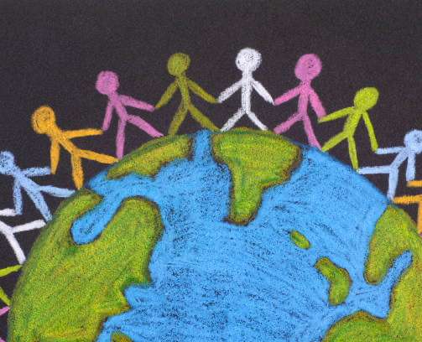
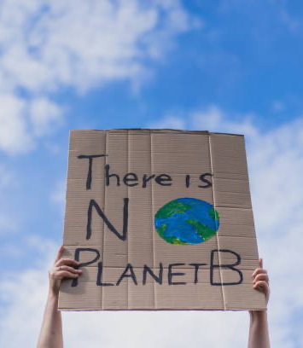
Stop Plastic Pollution!
Exploring Activism by P5/6/7

Slide 2
Our Project begins.
At Whitecross Primary, we were asked to take part in a partnership programme with French schools, to find out about the impact of Plastic Pollution.
We were able to work collaboratively with Mrs McEwan from Graeme High, to develop our knowledge of French vocabulary associated with Plastic pollution.
We decided to look at activism and raising awareness of plastic pollution in the local community.

Slide 3
We began by creating a Menti meter about how we could raise awareness about Plastic Pollution. These were our class suggestions.

Slide 4
Using the Menti Meter results, we planned out our Project.
We used the poll results to help us decide what activism measures we wanted to use to raise awareness and prevent plastic pollution.
As a class, we are very interested in making sure our local waterway isn’t polluted and recently released fish into the burn too. Thus, making it of great importance to keep the burn plastic free!

Slide 5
Phase one
Impact of plastic pollution on local wildlife.

Slide 6
Walking to gather evidence
We went a walk to the local burn to gather evidence of plastic pollution and the wildlife it effects.

Slide 7
Using this information we created posters to raise awareness in the school.
We worked with Mrs McEwan to translate our information and findings into French. This will allow us to share our findings with the French partnership School.
The posters were created to raise awareness and to try stop plastic pollution in the local waterway.
They were aimed at educating people on how bad plastic pollution is and the animals it impacts. They also were used to tell people that the plastic doesn’t just disappear or is magically removed.

Slide 8
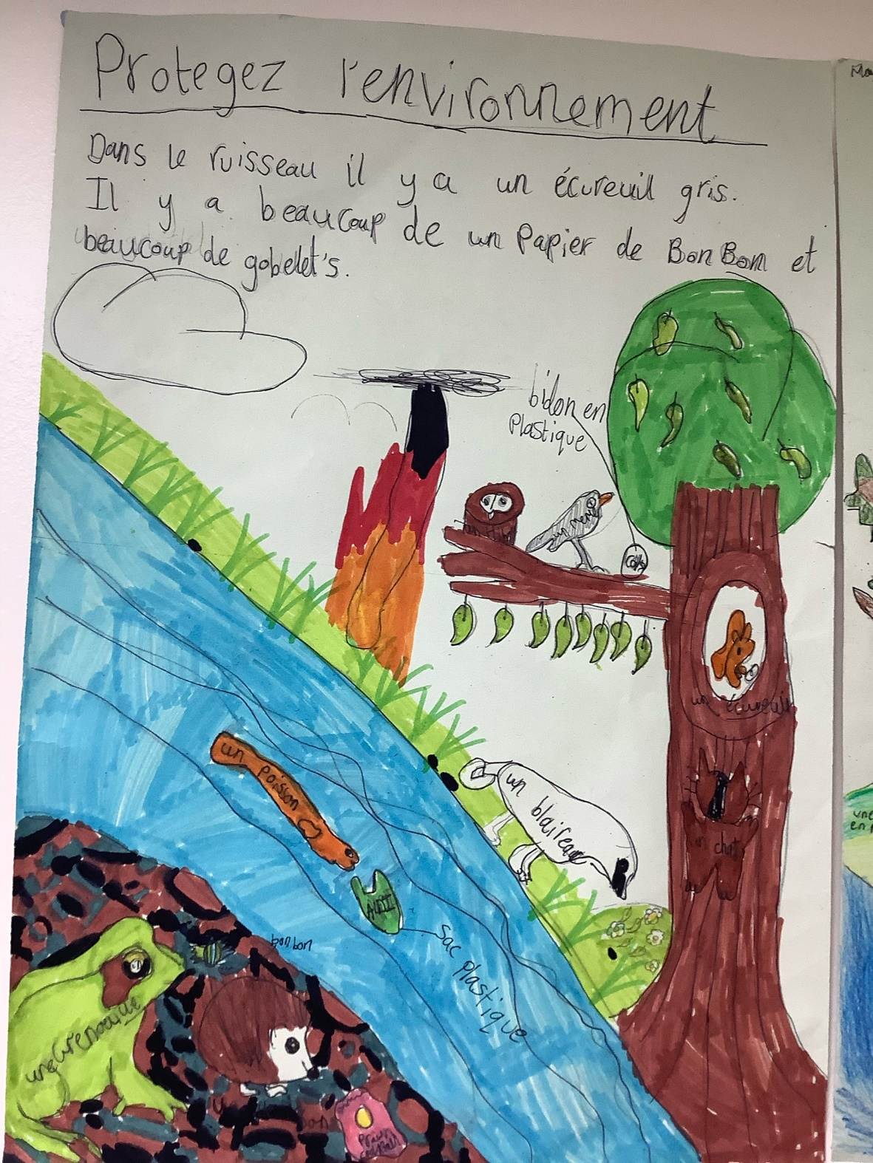
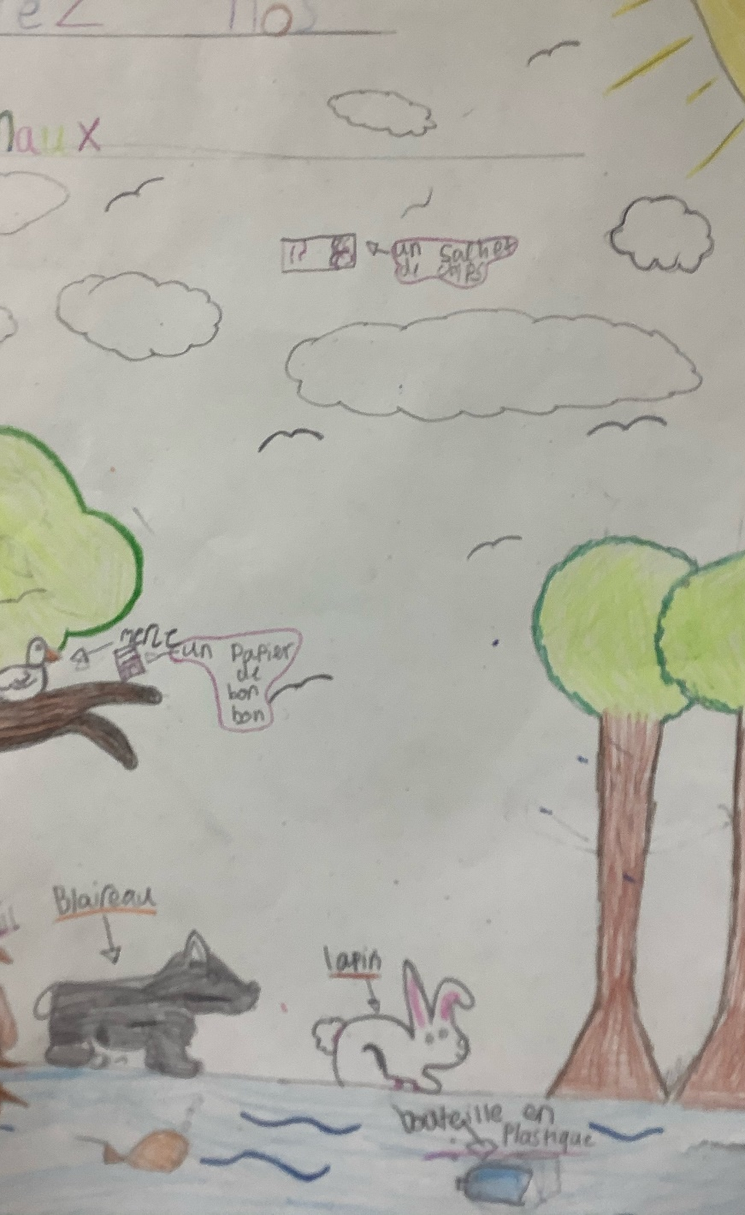
Look at our fabulous posters

Slide 9
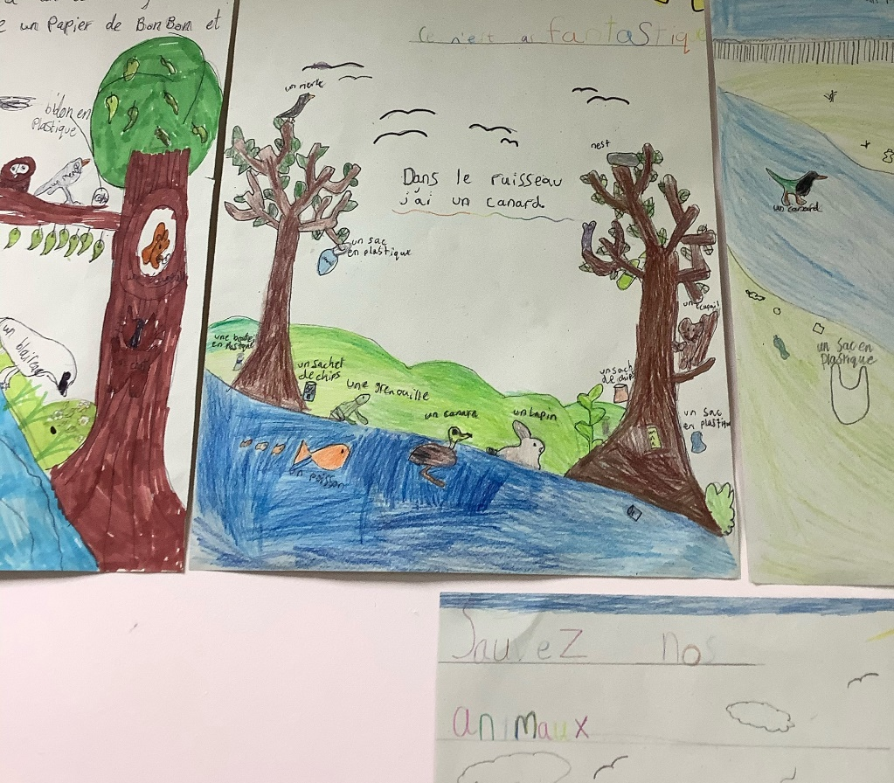
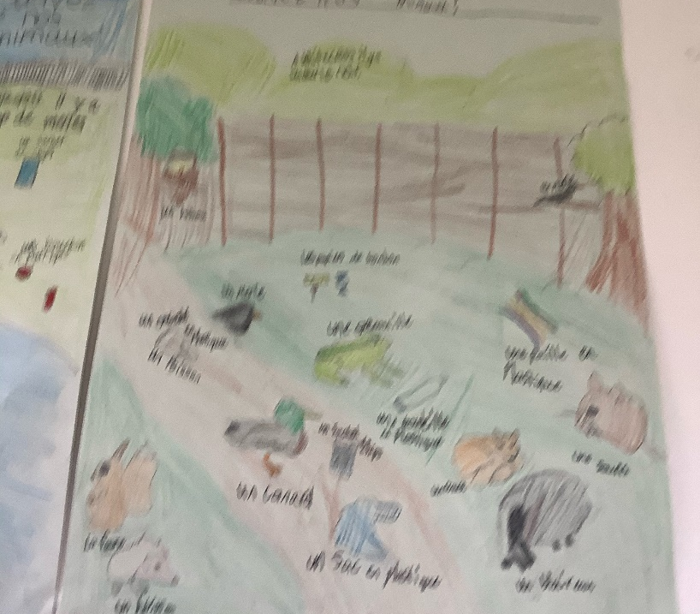
Look at our fabulous posters

Slide 10
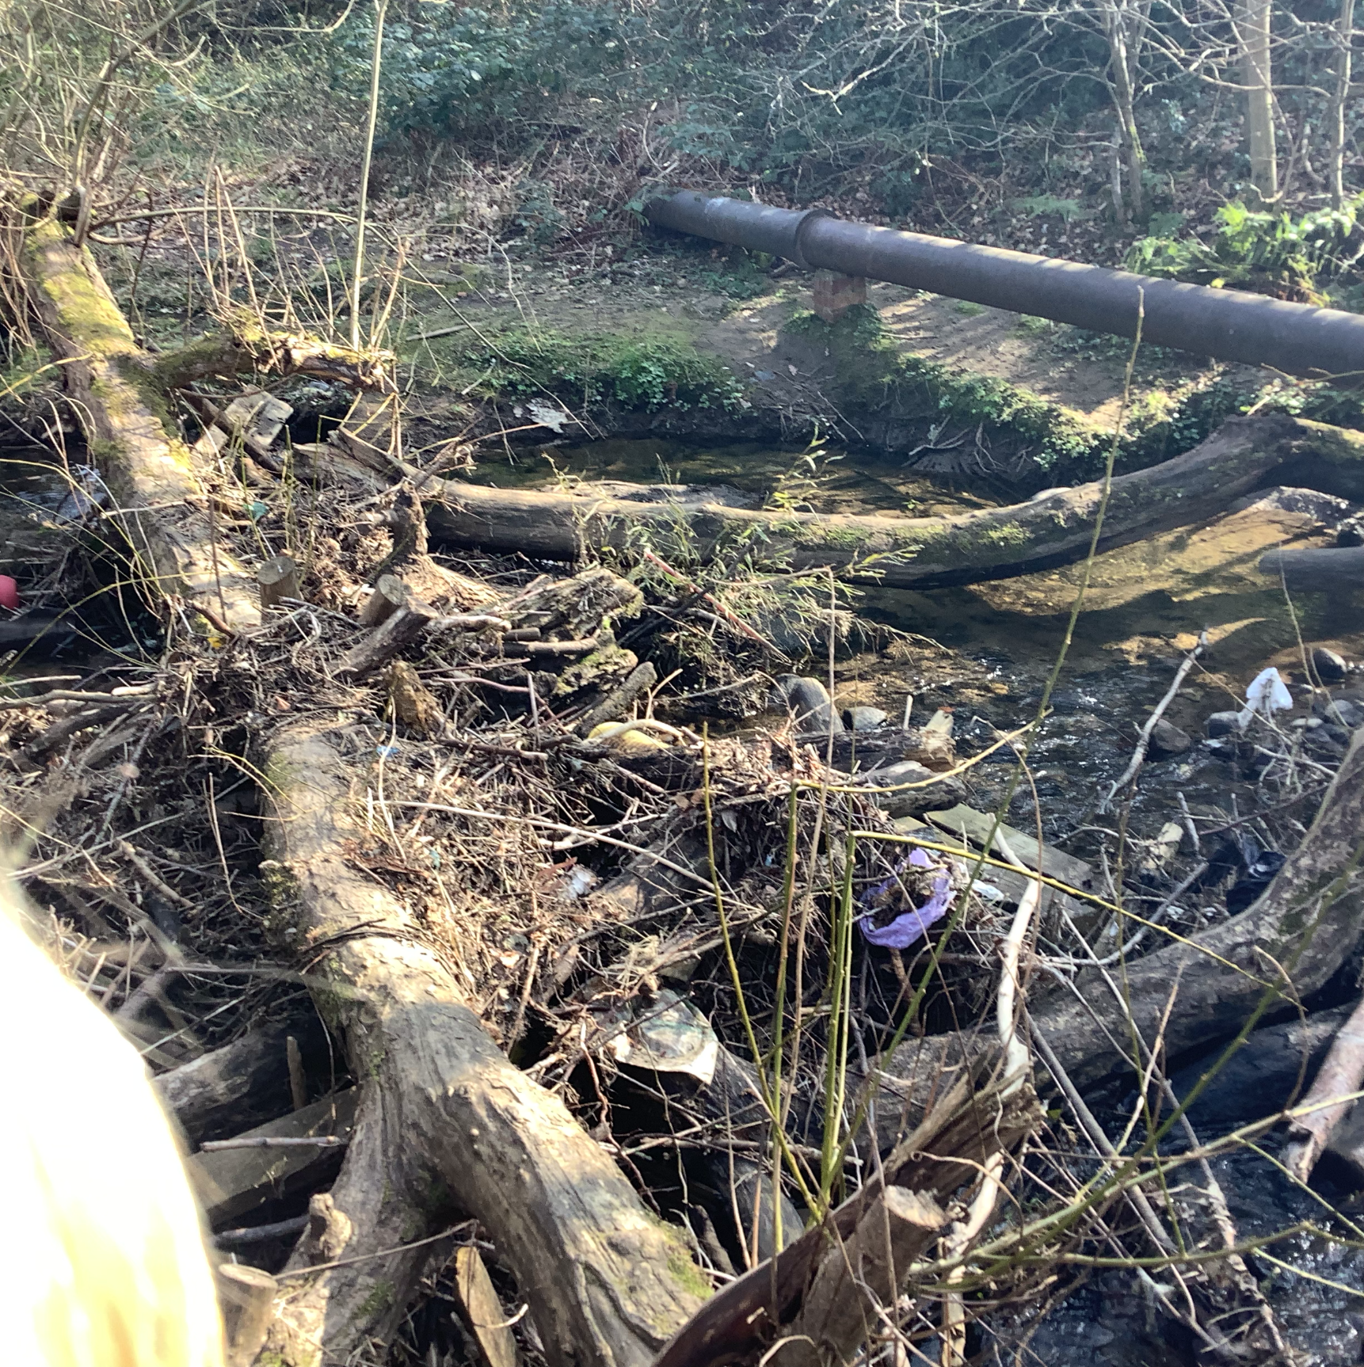
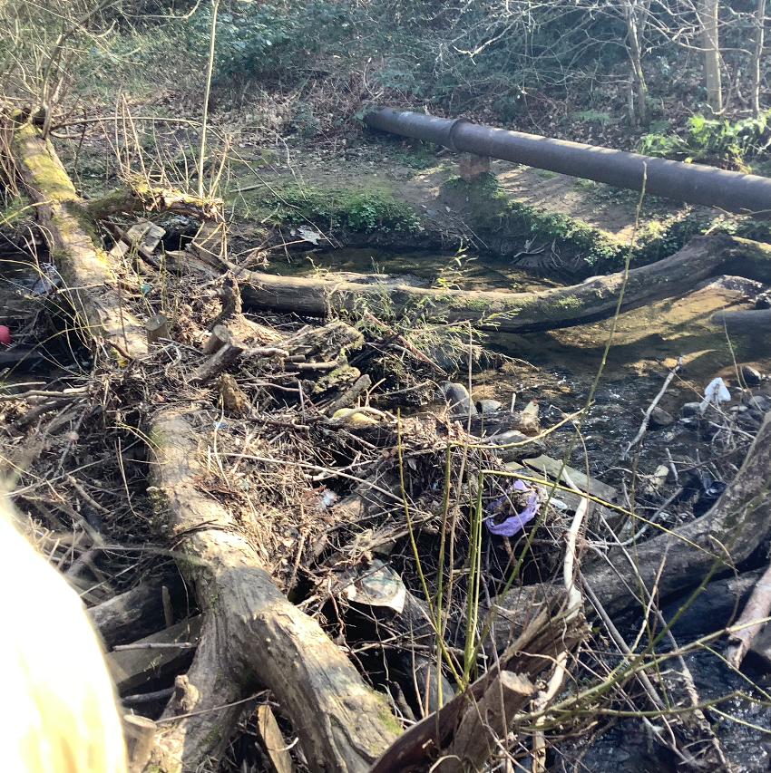
This is what our stream looked like a week ago.

