Slide 1
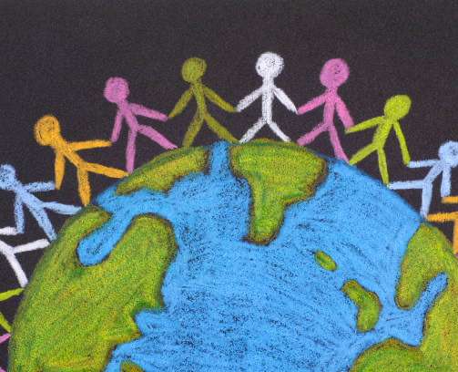
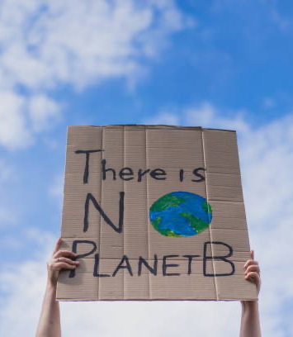
Stop Plastic Pollution! Part Two
Exploring Activism by P5/6/7

Slide 2
Phase two
Sharing our knowledge

Slide 3
Where does the plastic come from? Where does it end up?
After gathering our evidence and creating our posters, we composed and sent off emails to the local authority to notify them about our findings and attached our photos.
We then used Google maps to help trace where our local water source ends up. Did you know our plastic could end up in the North Sea and eventually the Ocean!
We even translated one email into French!

Slide 4
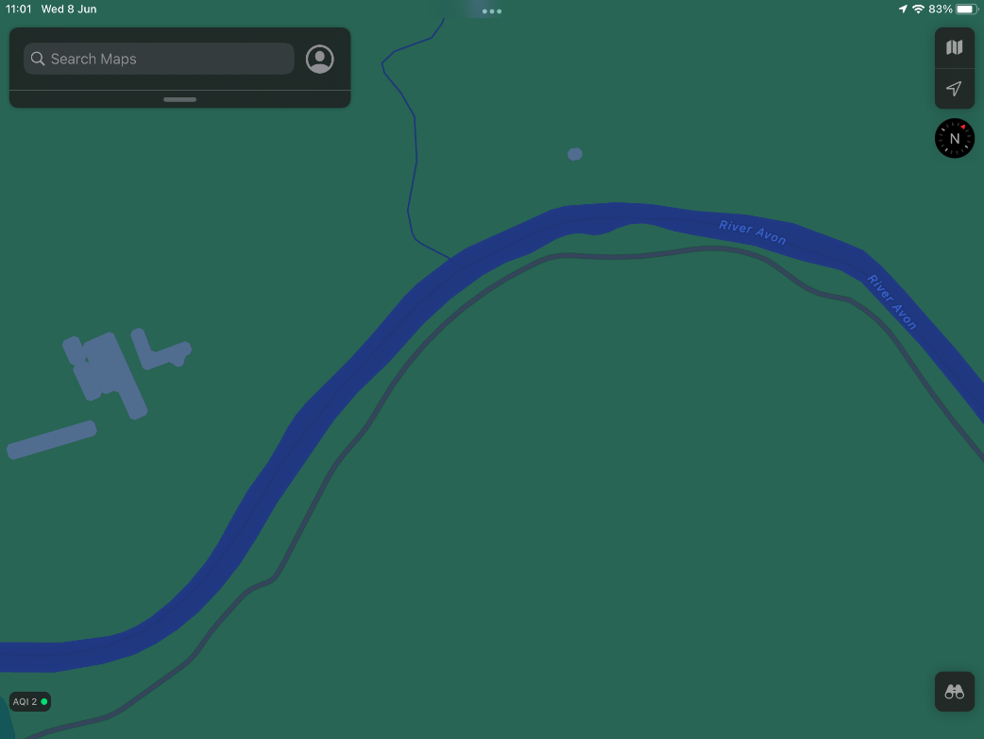
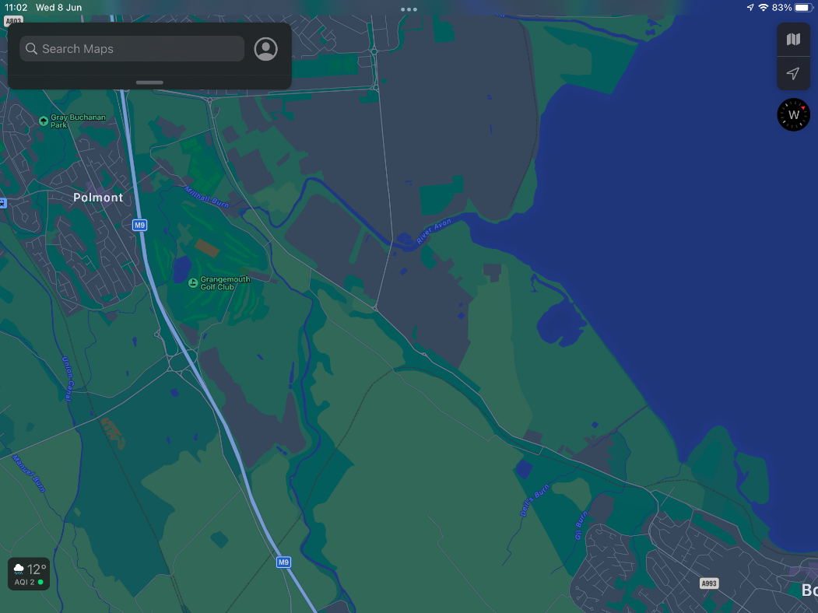
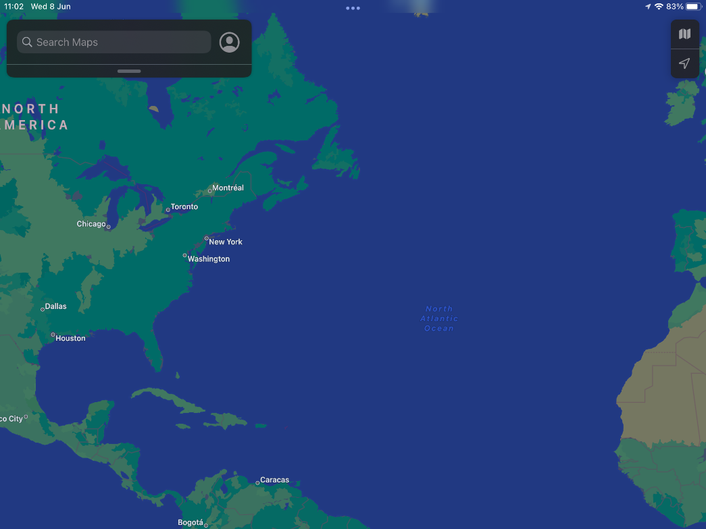
This is how the plastic gets to the ocean.

Slide 5
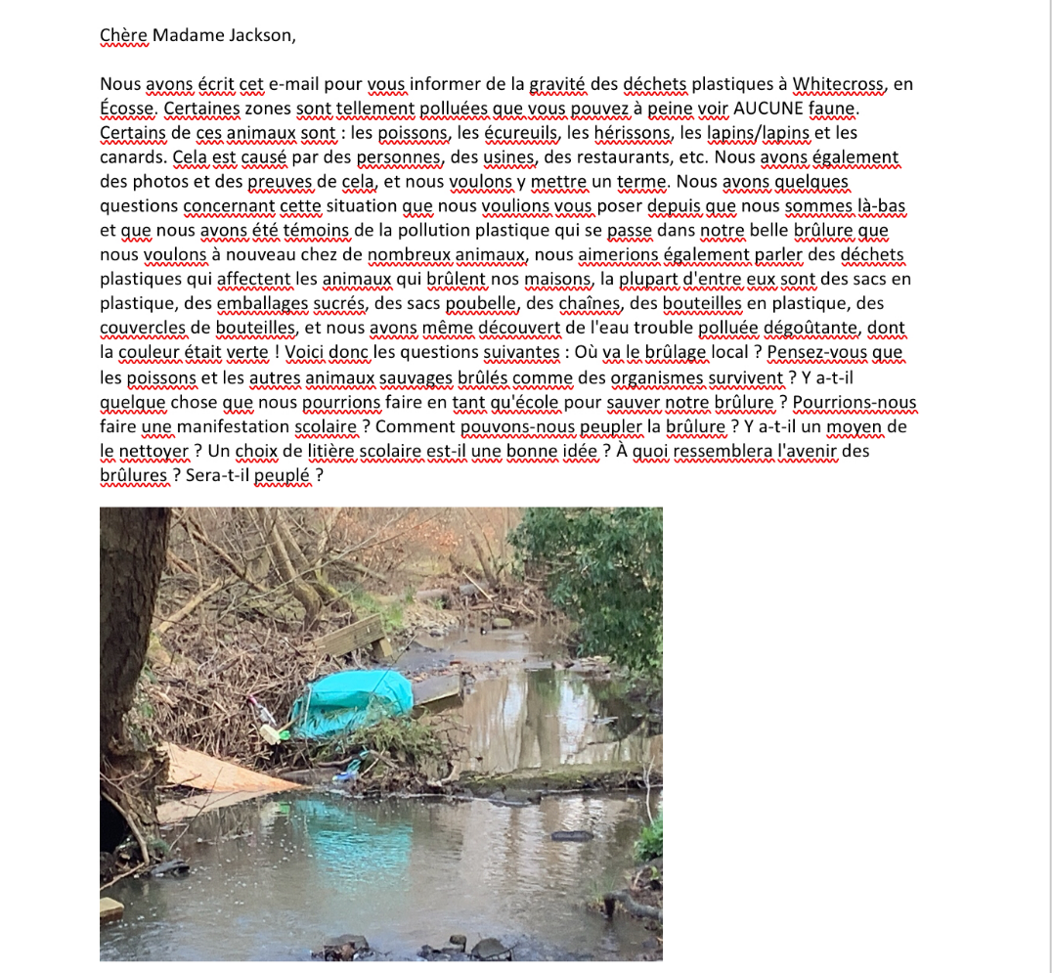
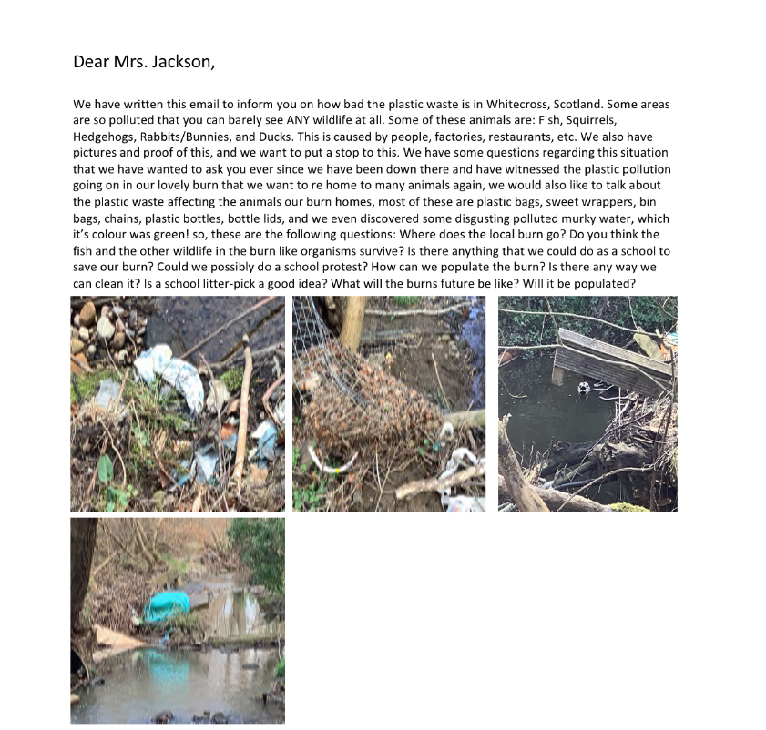
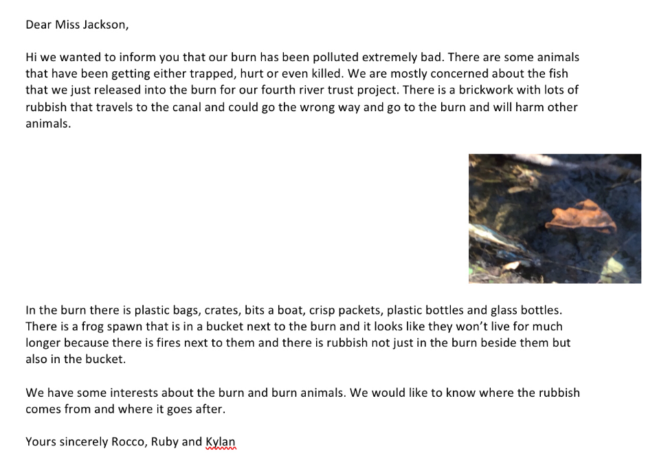
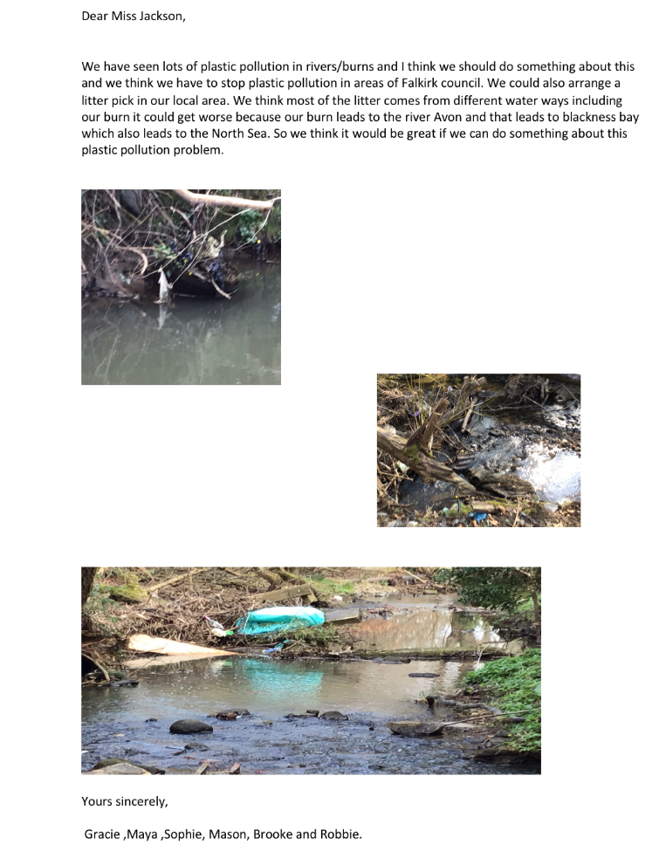
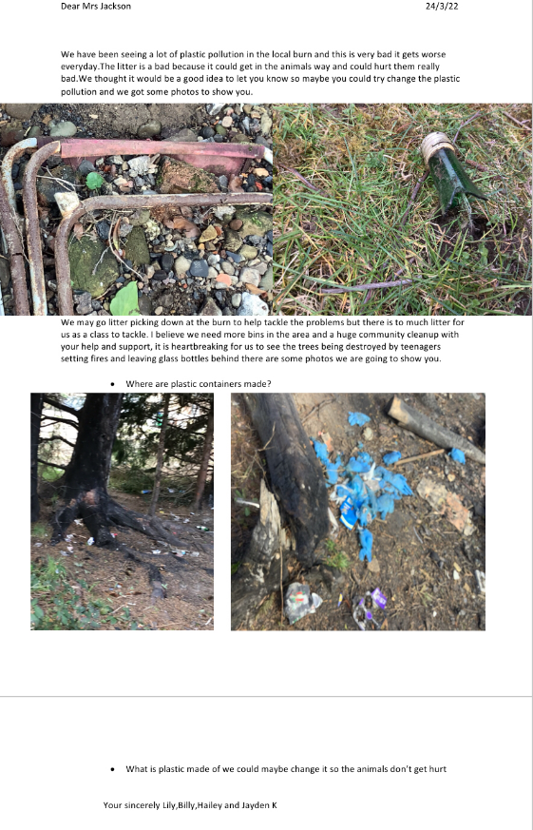
Emails
We have written some emails to send to Jane, about the impact of plastic pollution in our rivers.

Slide 6
Phase Three
Using activism to raise awareness

Slide 7
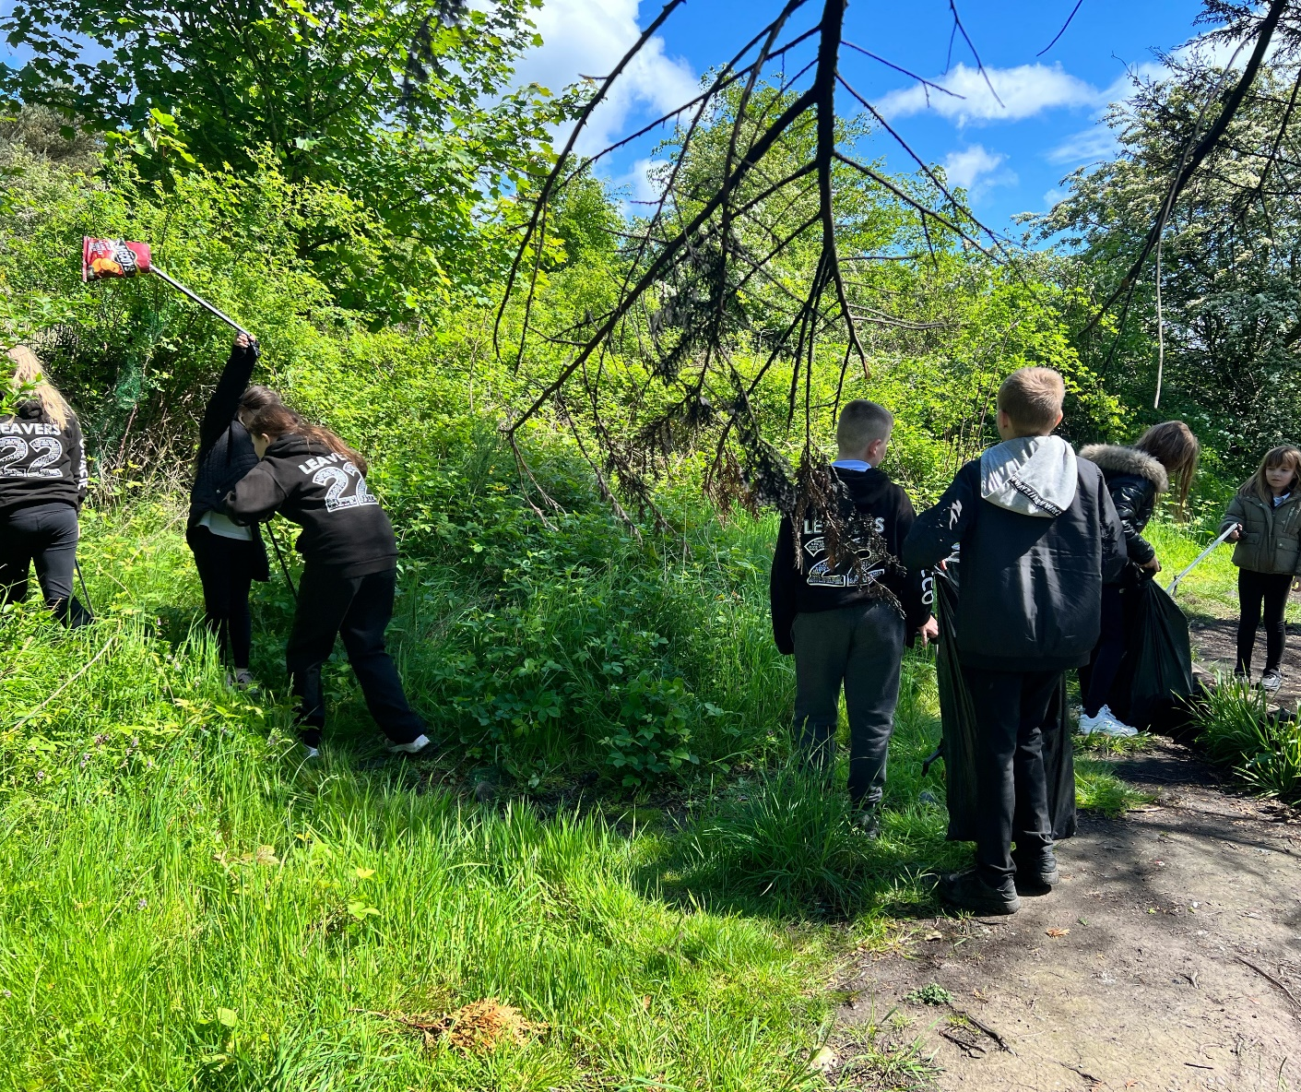
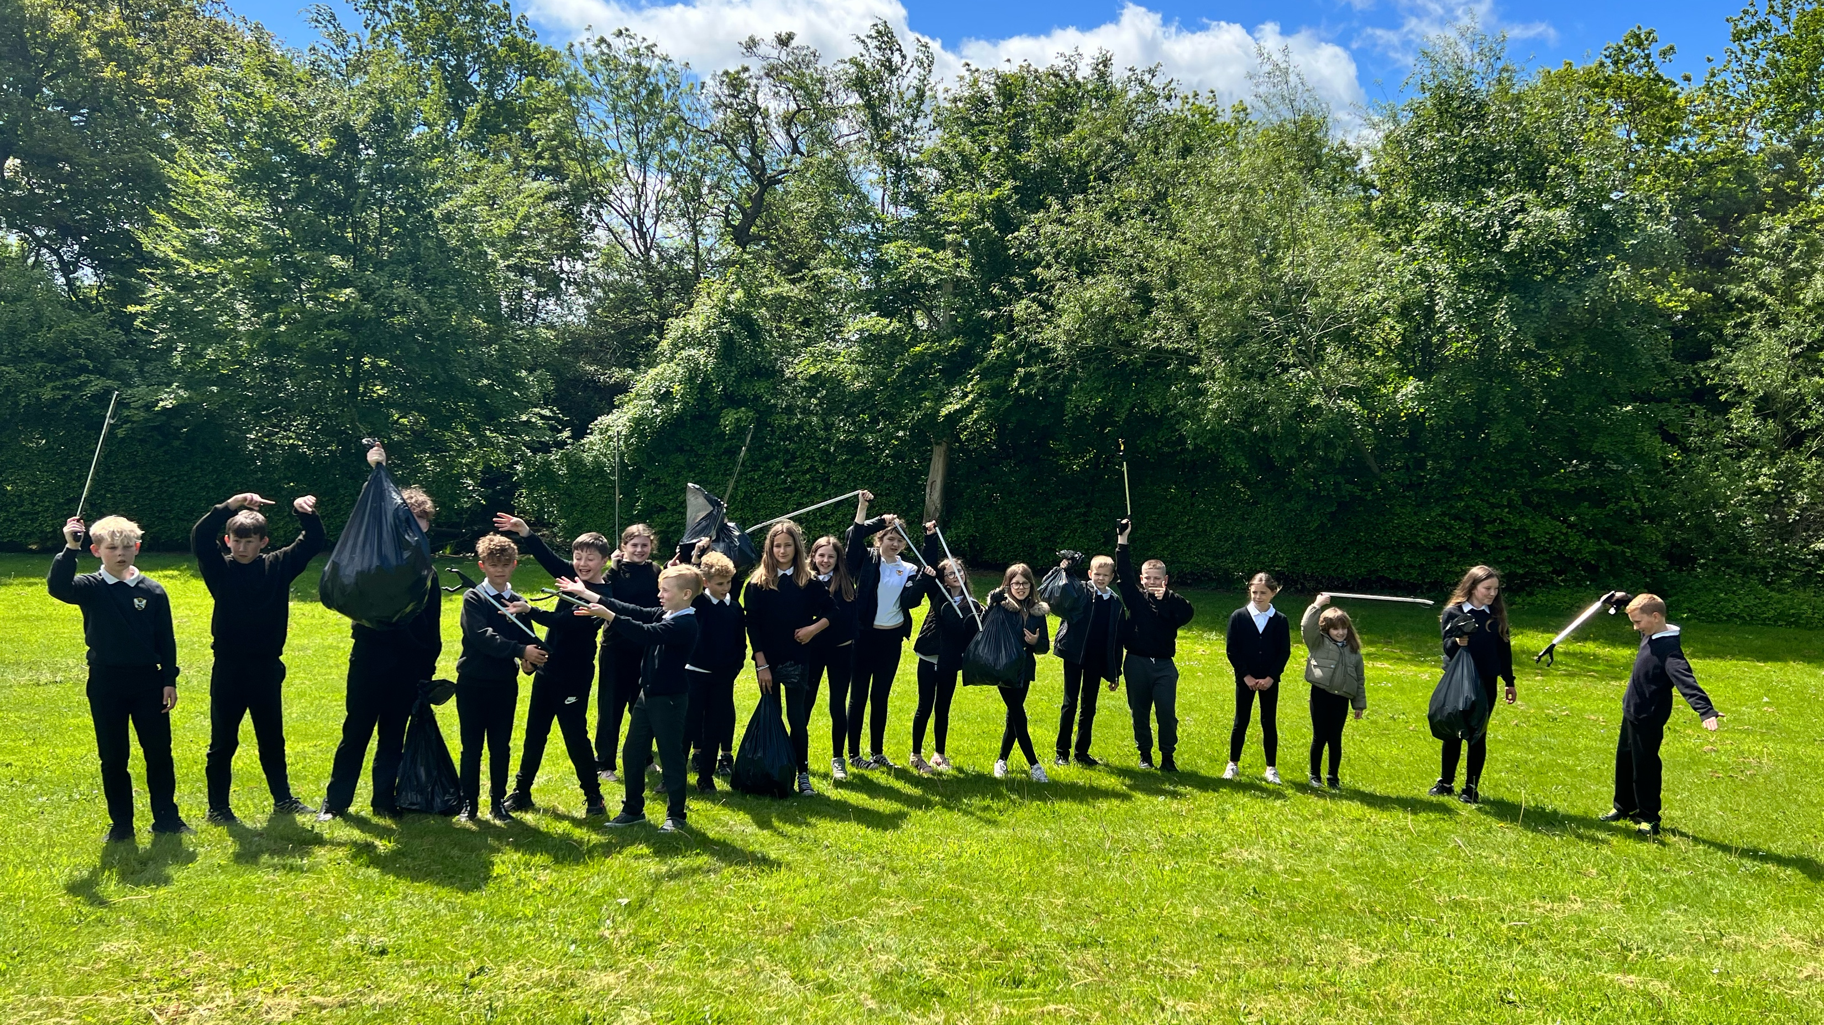
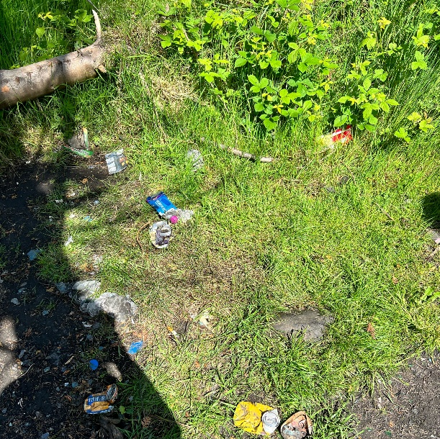
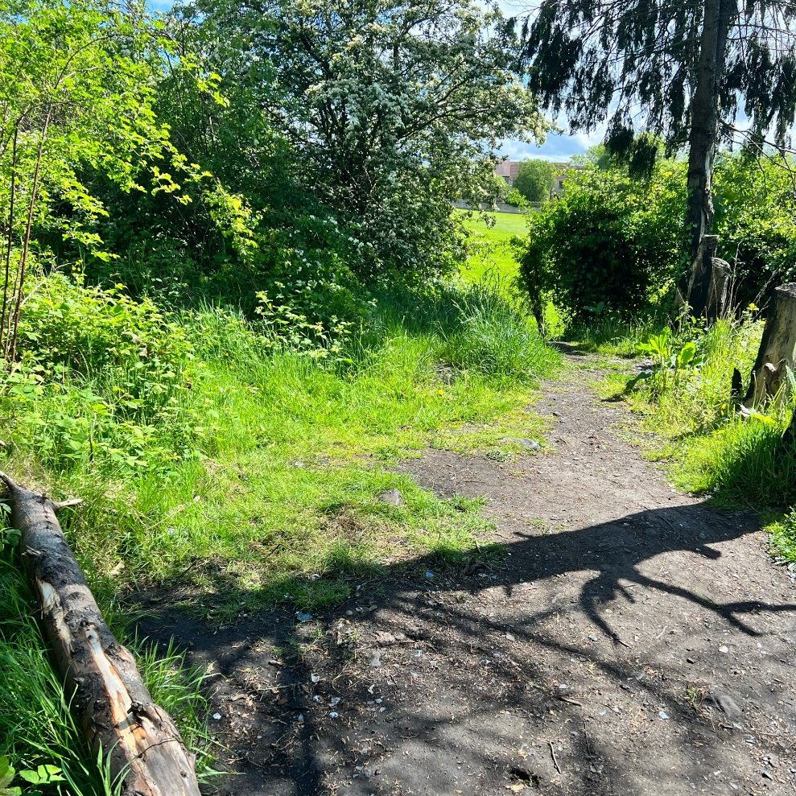
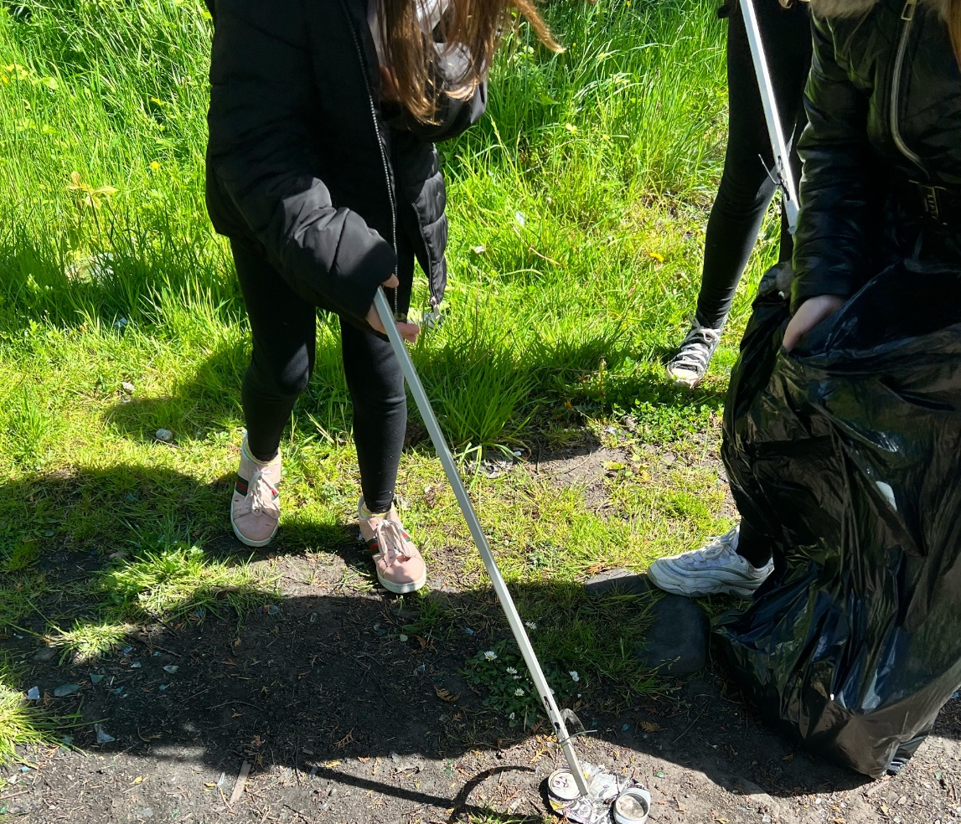
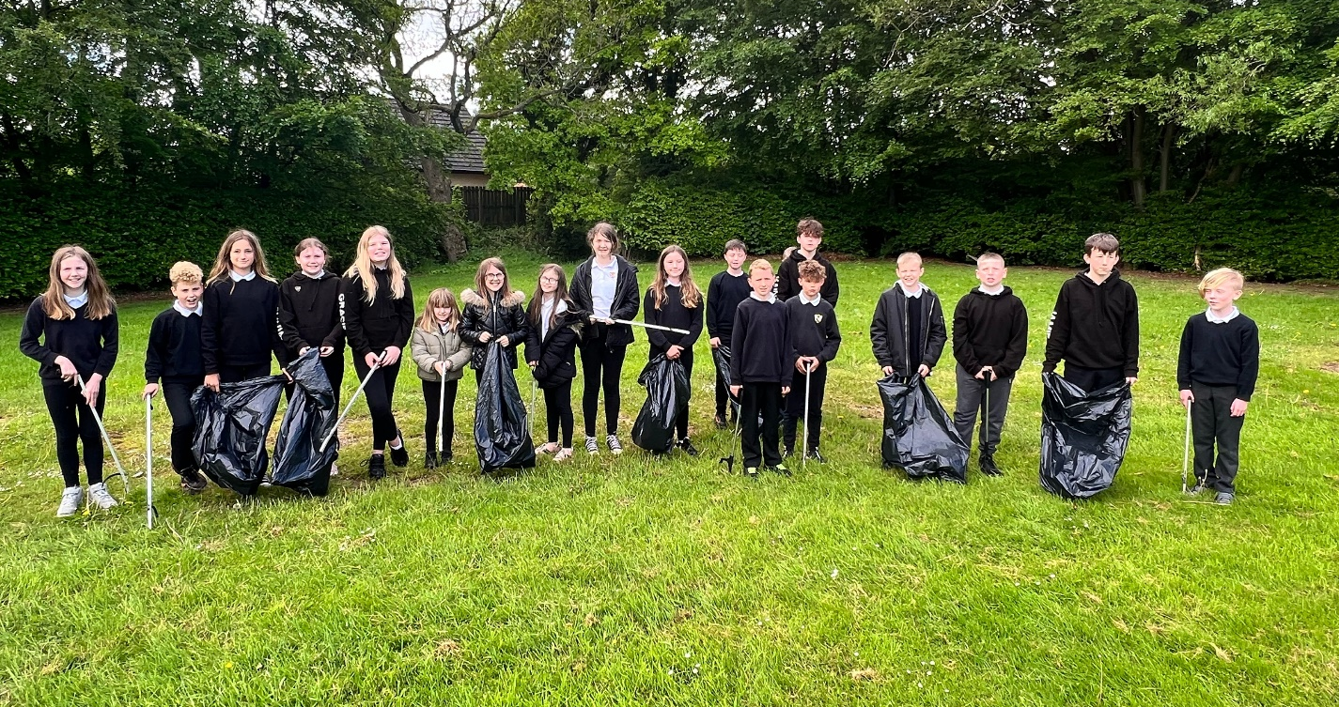
Litter picking
The whole class went outside to pick litter around the burn and field. When we got down there, we started to litter pick, here is some pictures of before and after. It is crazy how much we can change the world by stopping plastic pollution.

Slide 8
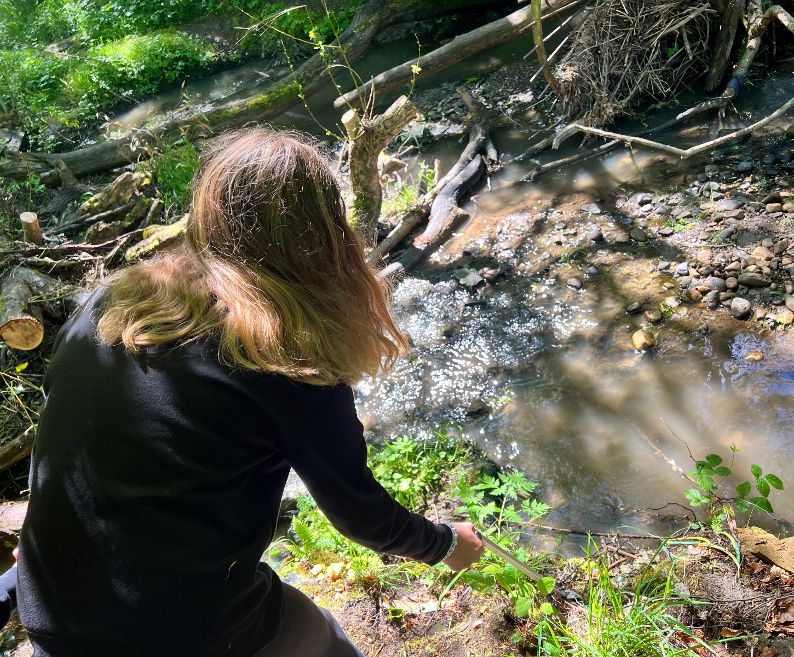
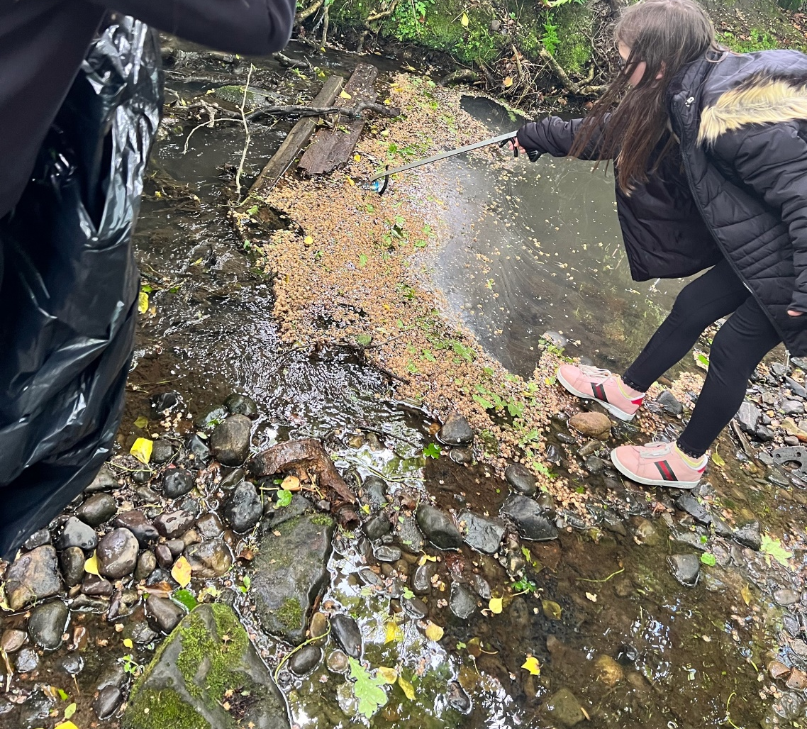
Litter Pick Results
We were surprised by the amount of single use plastic we found and thought to ourselves we need to do something about it!
It was time to be proactive instead of reactive!

Slide 9
Litter pick

Slide 10
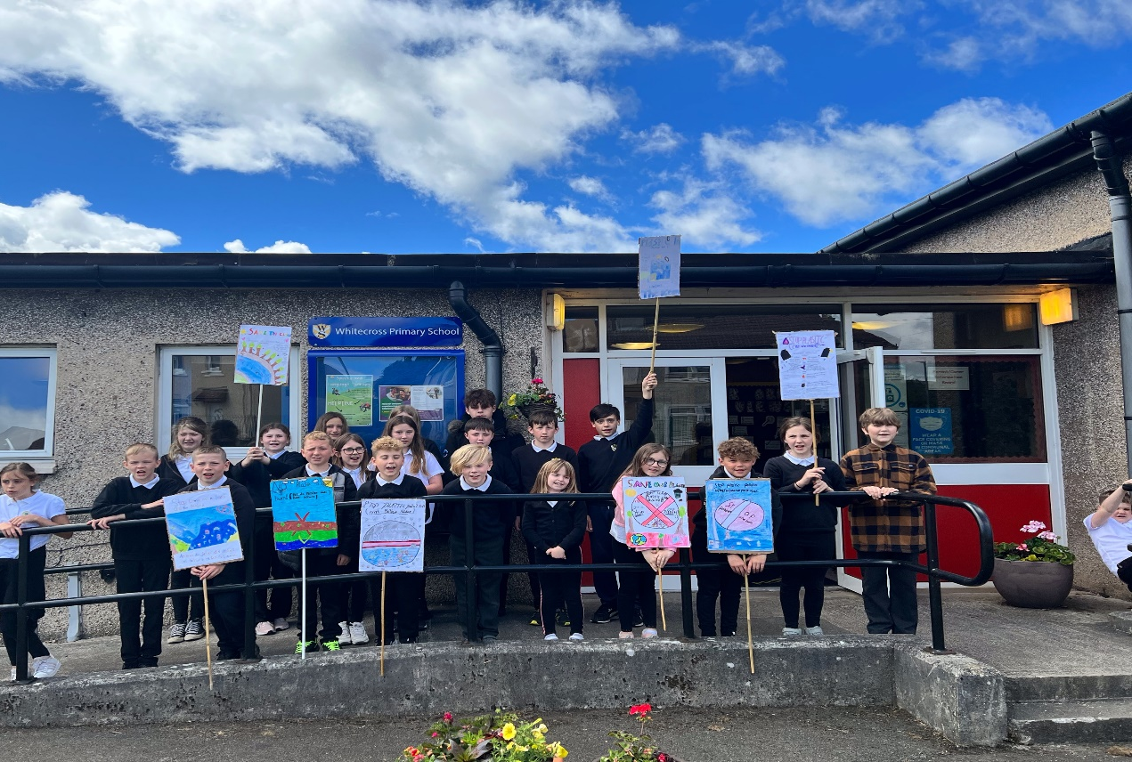
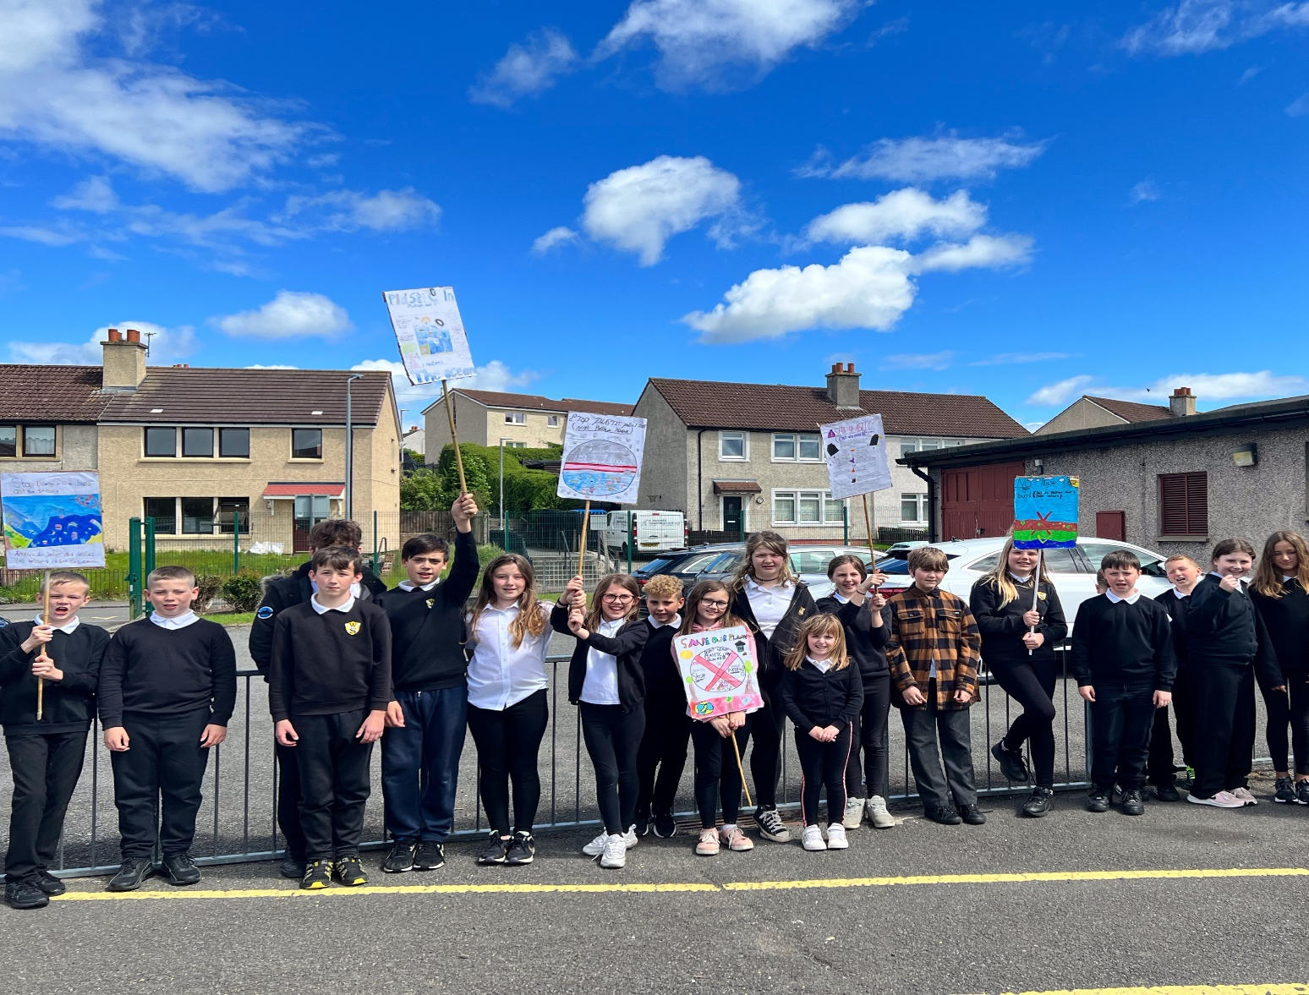
Our Class Protest
We used our rights to voice our opinions, to help create our protest and act upon the impact of pollution.
We even conducted our protest in French too!

Slide 11
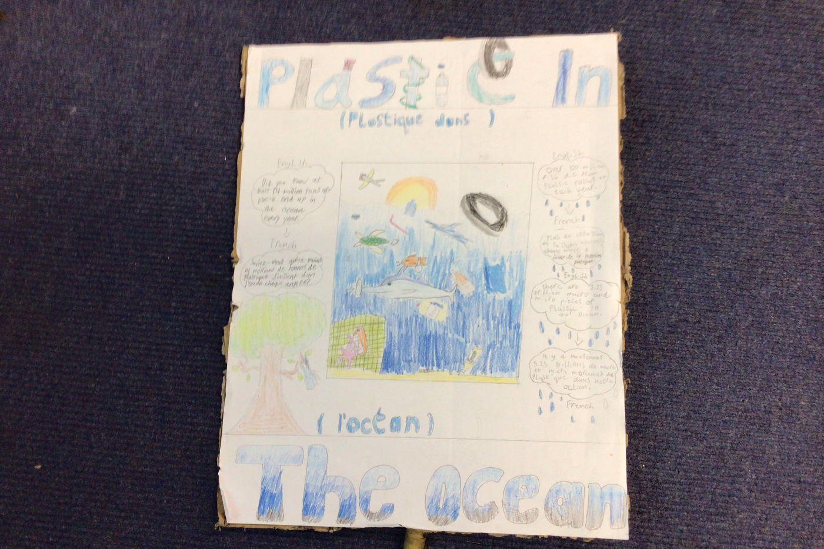
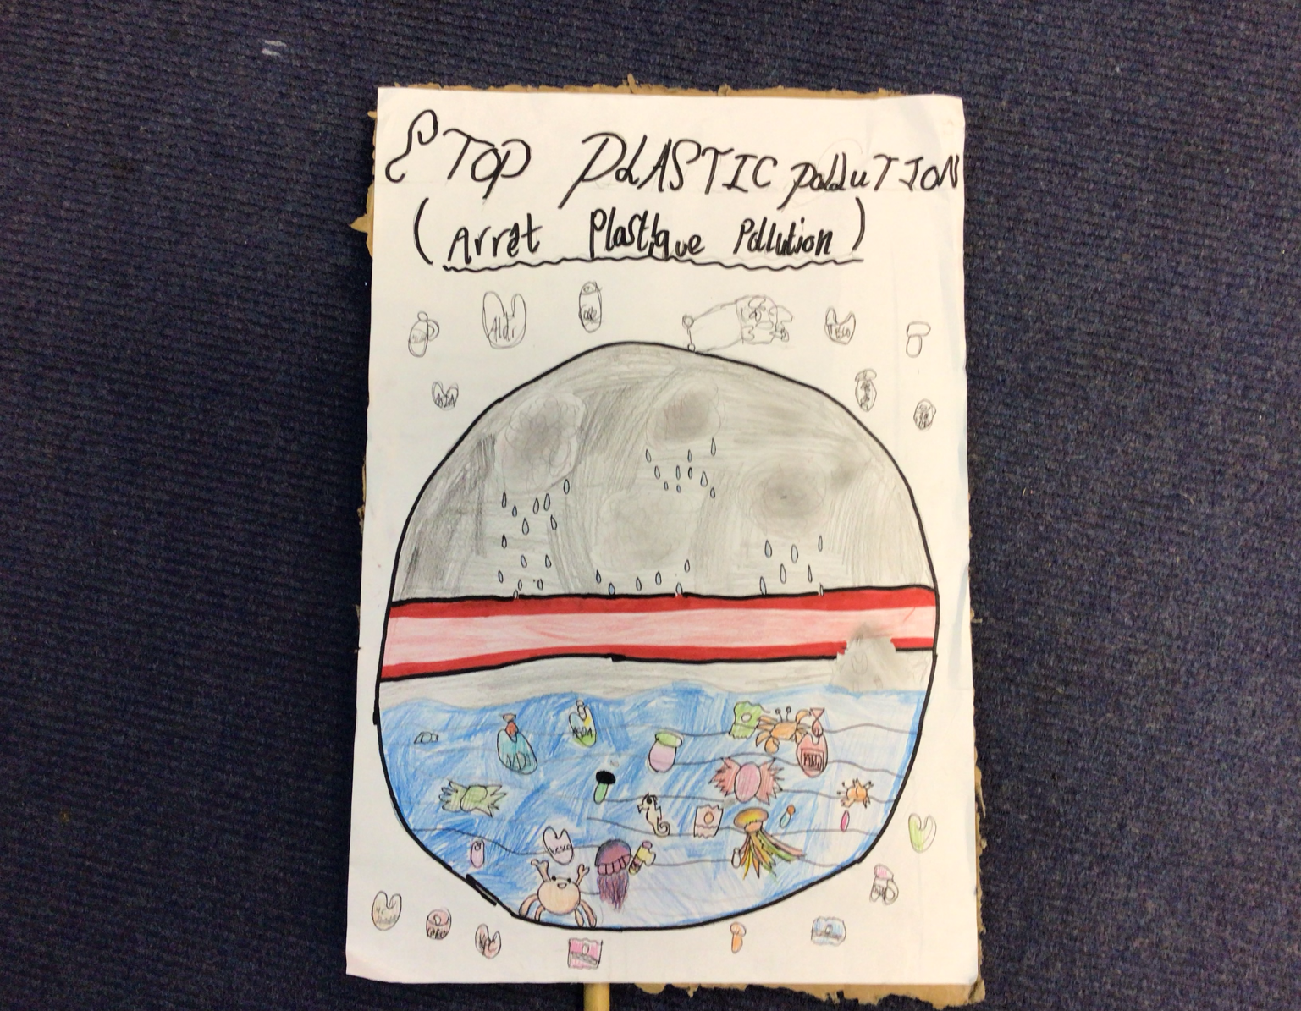
Our Class Protest

Slide 12
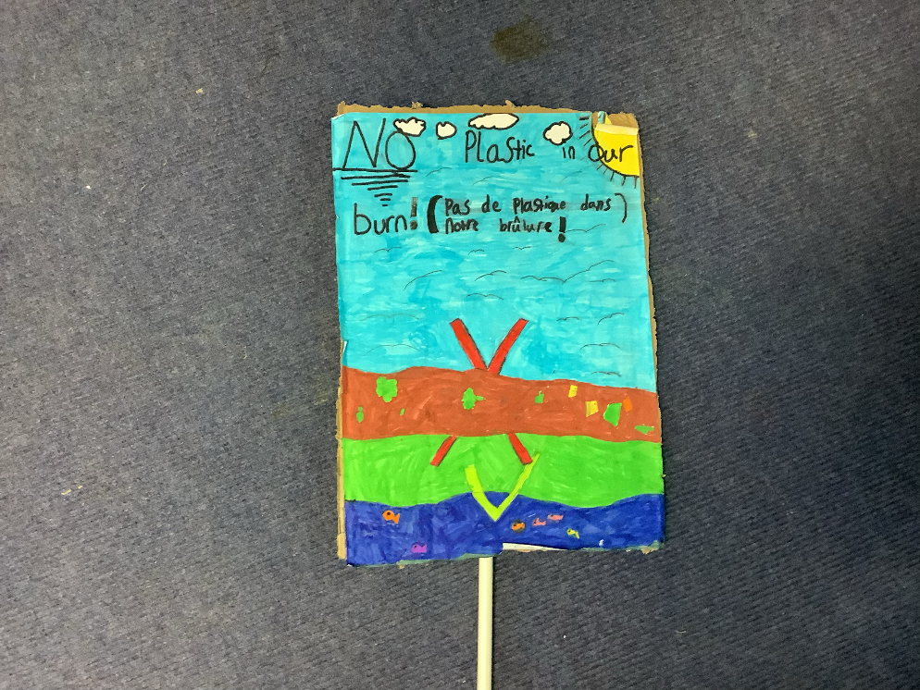
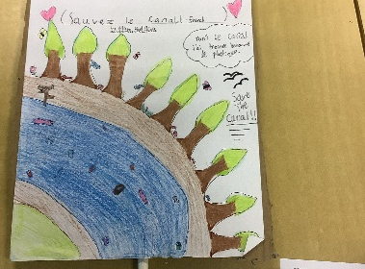
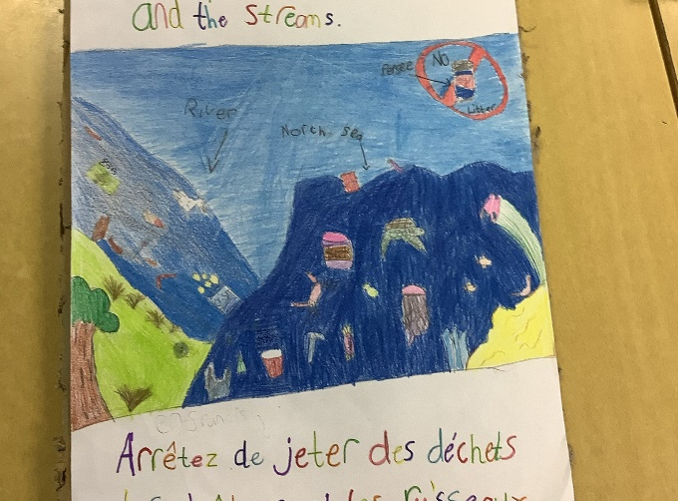
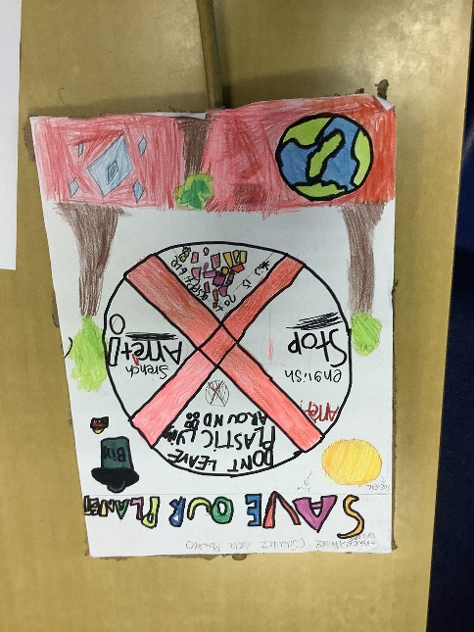
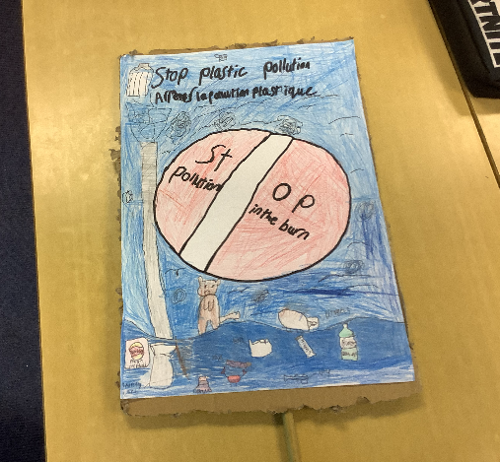
Some of our picket signs.

Slide 13
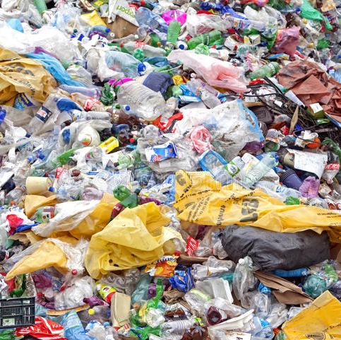
Class protest
We done a protest so people can notice the real impact of plastic pollution. Plastic pollution can kill animals, the animals can choke on plastic and get their head stuck too which can stop them from breathing.
Did you know that over 100 million marine animals die from plastic waste every year.

