Slide 1
Comic Strip Conversations

Slide 2
Uses of Comic Strip Conversations
Problem solving and conflict resolution
Communicating feeling and perceptions about event
Reflect in non-threatening manner
Help CYP understand when things were difficult
Help planning for the future

Slide 3
Elements of Comic Strip Conversations
Begin with drawing the event that caused the problem.
Draw key people, relevant items and actions
Use speech bubbles and thought bubbles
Explore interpretation and discuss and include alterative representations of what happened
Draw a solution or idea for the future

Slide 4
Example of a Comic Strip Conversation
During a P.E lesson, playing rounder's, Francesca, who finds taking turns difficult, pushed in front of Poppy whilst waiting to bat. Poppy challenged Francesca which culminated in lots of shouting and Francesca pushing Poppy.
A key was agreed with Francesca and she added good thoughts and words to her initial drawings (these are in green) Francesca was able to see the situation from Poppy’s perspective and she apologised to Poppy.
Notes:
During a P.E lesson, playing rounder's, Francesca, who finds taking turns difficult, pushed in front of Poppy whilst waiting to bat. Poppy challenged Francesca which culminated in lots of shouting and Francesca pushing Poppy. A key was agreed with Francesca and she added good thoughts and words to her initial drawings (these are in blue) Francesca was able to see the situation from Poppy’s perspective and she apologised to Poppy.

Slide 5
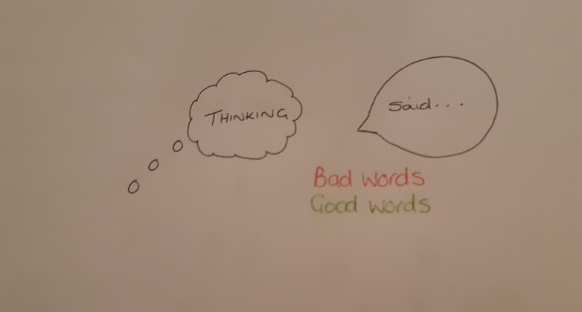

Slide 6
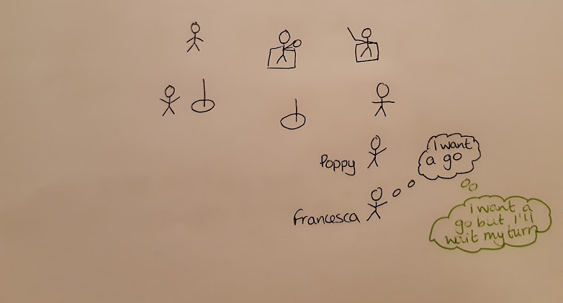
Where were you?

Slide 7
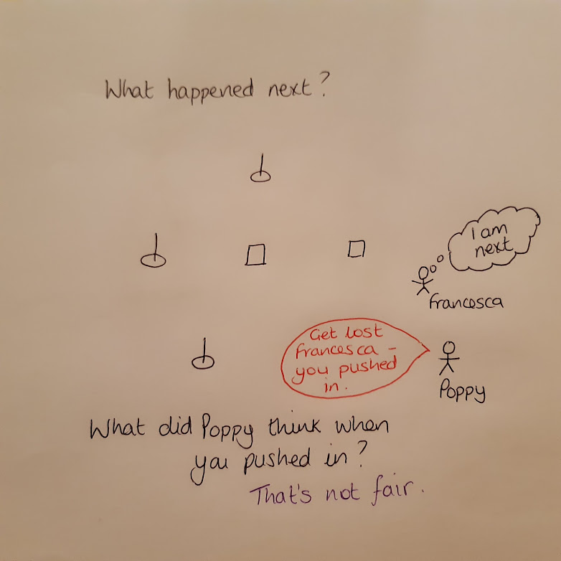

Slide 8
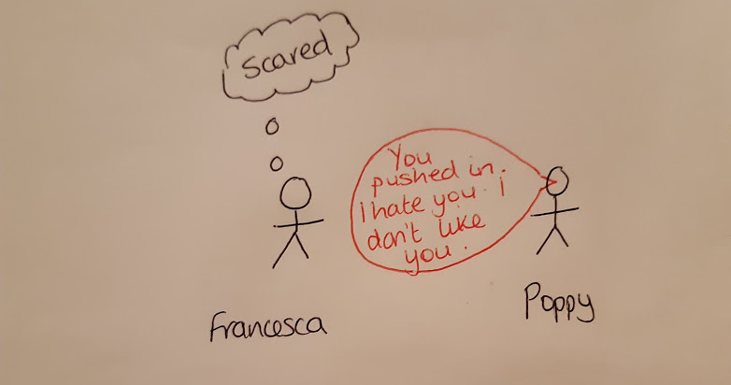

Slide 9
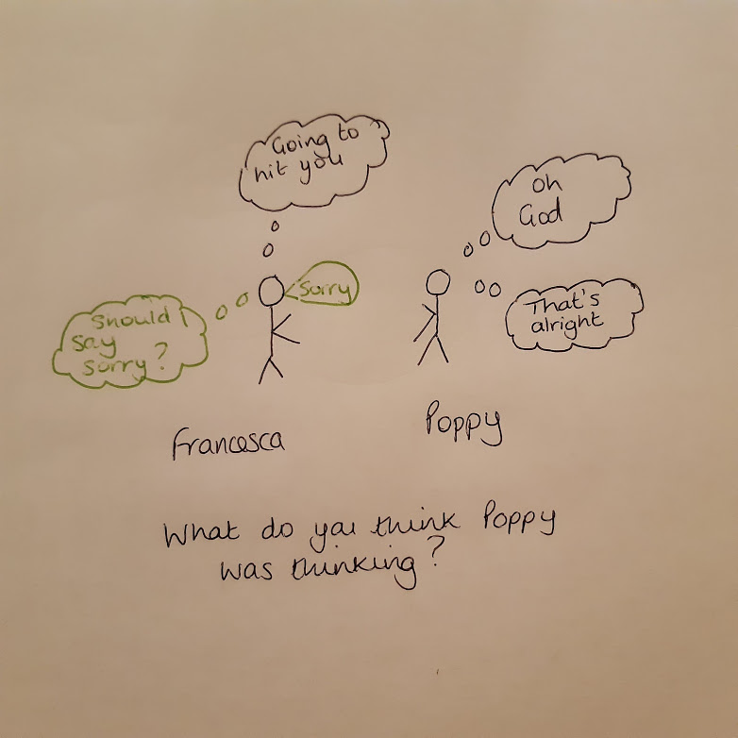

Slide 10
Useful websites and resources
https://carolgraysocialstories.com/about-2/carol-gray/​
https://www.autism.org.uk/about/strategies/social-stories-comic-strips.aspx​
Comic Strip Conversations: Illustrated interactions that teach conversation skills to students with autism and related disorders (Paperback) by Carol Gray
Successful Social Stories for Young Children with Autism by Dr Siobhan Timmins, foreword by Carol Gray​
The New Social Story Book (1 January 2010) by Carol Gray

