Slide 1
Implementing the 5-point scale
Identify the target behaviour / context or situation
Decide on the descriptors / content for each rating on the scale
Notes:
Once the target behaviour has been identified – it is broken down into 5 parts.
It can be beneficial to include the CYP at this stage and work together to identify each level and its corresponding level or what the emotions may feel like for the child or even to identify strategies that might help them. Using meaningful visuals can increase the child’s engagement with the scale.
The first step is to label the two extremes of the scale as comparisons – so starting with no 1 and no 5.
From that you then determine no 3 before expanding and discriminating the ratings at nos 2 and 4.
When designing the scale always use non-judgemental language – for example use big and small rather than good and bad.

Slide 2
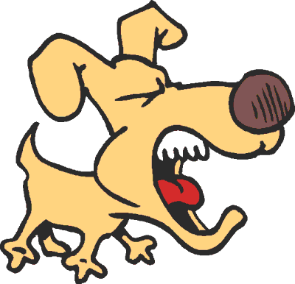
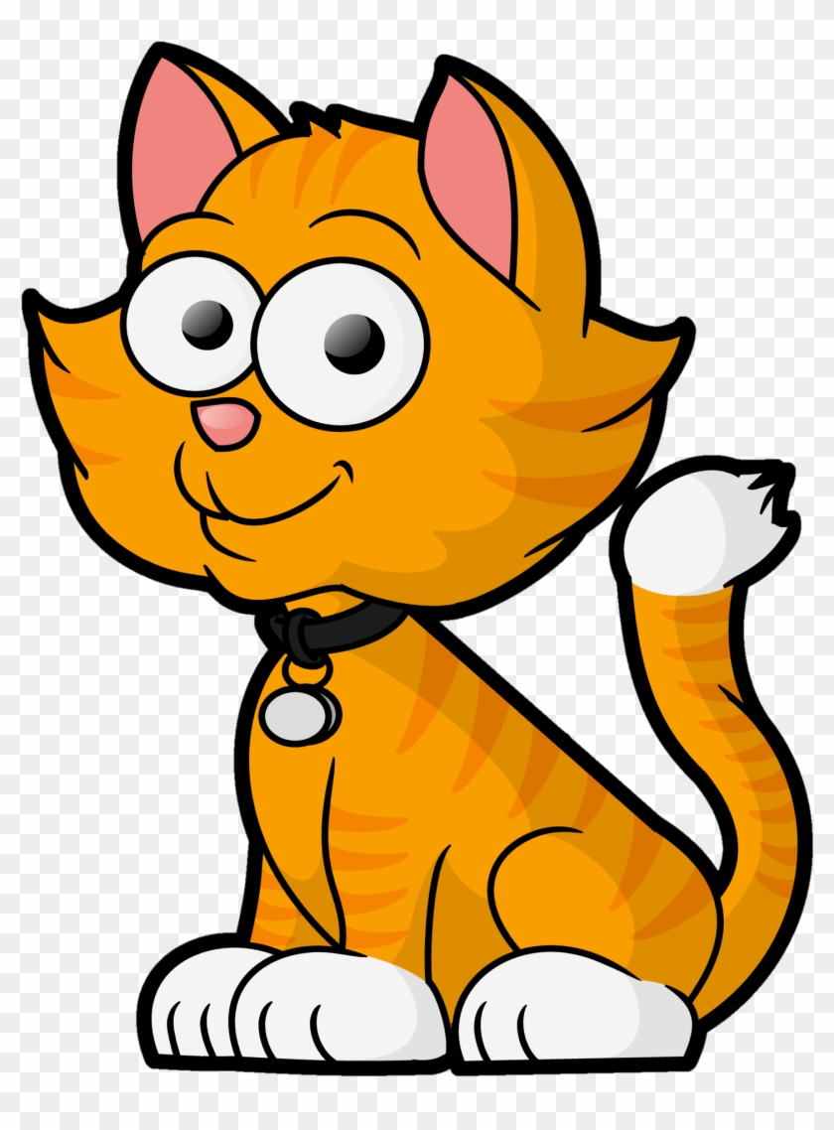
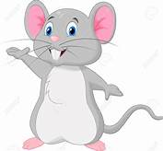
Case study example
5 | Screaming | When I am hurt and help When there is an emergency
4 | Outside voice | When I am in the playground or watching my brother’s football game
3 | Inside voice | When I am in class, or when talking to my friends or answering my teacher. When in the lunch hall
2 | Whisper | When I am in the library When I am working with my partner or group in class
1 | No sound | When walking in the corridors in school When in assembly
Notes:
In our case study Alex worked with the class teacher to talk about different voice volumes that people have and when and where they might be appropriate or not appropriate. These were used in the scale with terminology of inside voice and outside used. Also Alex’s love of animals was used to provide a visual representation of each level on the scale with the two extremes of voice volume represented by a mouse and a lion.

Slide 3
Implementing the 5-point scale
Identify the target behaviour / context or situation
Decide on the descriptors / content for each rating on the scale
Develop a story or visual cue for the scale
Notes:
The scale should have a meaningful title. A story or visual cue should be developed carefully based on the child or young persons age and stage and incorporate their interests. It should also explain how the scale is to be used.
For example – this is an example of a social story used for our case study called “when my voice gets too big”
When no words come out of my mouth my voice is at a 1
When I go to the cinema I should try to keep my voice at 1.
Sometimes my voice is little.
Some people call this a soft voice.
This is when my voice is at a 2. A 2 is like a whisper.
I use a 2 voice when I am in the library.
A 3 voice is not really loud but it is loud enough for people to hear me when I am talking.
My teacher would like me to try really hard to keep my voice to a 3 in the classroom.
When I get excited or upset my voice might go to a 4. This is when my teacher will remind me about using a 3 or 2 voice in school.
If I am in the playground I might use a 4 when playing with my friends. A 4 is quite loud. A 4 is sometimes called an outside voice.
A 5 means I am screaming I should only use a 5 if it is an emergency and I am calling for help.
It is important to know about how loud my voice is.
Some places have rules about how loud a voice can be and sometimes my friends might get scared when I use a loud voice or scream.
My teacher can help me remember about my voice by pointing to the number on the scale I should be at.
They don’t even have to talk about it – they can just point to the number and then I will know that I accidentally got too loud and will try to lower my voice.
For older children a social story may not be appropriate so Buron and Curtis, in their book “the Incredible 5-point scale: the significantly improved and expanded second edition” have examples of written memos to remind them to use their scale on a regular basis.

Slide 4
Implementing the 5-point scale
Identify the target behaviour / context or situation
Decide on the descriptors / content for each rating on the scale
Develop a story or visual cue for the story
Introduce the scale to the child / young person
Notes:
To use the scale successfully the child or young person must learn how to discriminate and identify each stage.
The scale should be used regularly and consistently with the child or young person, either before, during or after a terget situation so they can begin to develop awareness for identifying and discriminating each stage.
Buron and Curtis have suggestions of hands on activities that can be used with children – for example matching picture card emojis to the ratings on the scale.

Slide 5
Implementing the 5-point scale
Identify the target behaviour / context or situation
Decide on the descriptors / content for each rating on the scale
Develop a story or visual cue for the story
Introduce the scale to the child / young person
Practise the scale with the child / young person, making any necessary revisions.
Notes:
The scale should be made available for the child to use on a regular basis – and ideally will become a tool which is embedded in their day-to-day use.
In the case study all the adults who came into contact with Alex at school used the scale. When Alex began to become loud the class teacher would

Slide 6
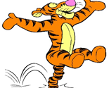
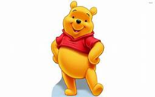
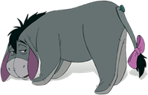
Modifying the scale
Rating | Feels like: | Looks like:
5 | Feeling wild. I can't stop moving.
4
3 | Ok – I can do my work
2
1 | Too tired... I feel like taking a nap
Notes:
It may be appropriate for modifications to the scale depending upon the age and stage of the YP, and the scales flexibility easily allows this adaptation.
For example, when working with children in the nursery it may be more appropriate to break a concept or idea into three parts, rather than 5 because it is an easier and more concrete way to initially introduce the idea of using a scale..
However, when deciding whether or not to use a 3-point sclae or a 5-point scale it is important to remember that you a teaching a system for social and emotional learning. The idea of a system is the most important part so a 3-point scale is acceptable. However, for some children on the autism spectrum, it may provide an extra challenge for them progressing and expanding from using a 3 point to a 5-point scale. For example, if the number 3 was previously the biggest or most energetic level how can it then become an average or more acceptable level at a later stage?
An alternative is to use a number scale of 5 (with 5 being the biggest) but only actually using the numbers 1, 3 and 5, as exampled in this scale which looks at energy level. In this way you are introducing a system which allows for future growth. After the child has learned to identify the 3 basic levels then the scale can be expanded to teach more subtle levels of energy without changing the original three ratings.
And as was mentioned earlier incorporate favourite characters of objects into the scale to help build motivation for children to look at and attend to the scale during the teaching phase.
Other ways the scale has been used by Buron and Curtis is through use of balloons to visually illustrate parts of the scale. Using different colours and sizes, rather than numbers, are ordered in a line to provide a visual representation of the stages of the target concept.
And when working with older children you may agree to reduce the size of the 5-point scale to that of a small credit card or on a keyring so that it is a tool which can be carried around and used discretely – without drawing attention of peers to its use.
Or the scale can be used with a group of children – why not get them to work collaboratively to identify

Slide 7
Ways to increase success of the 5-point scale
Factors which can improve successful use of the 5-point scale include:
Consistent use
Including CYP in the process
Making it meaningful
Monitoring and evaluating outcomes
Notes:
There are a number of way to improve the successful use of the Incredible 5-point scale for children and young people in your educational settings.
The key to success is to inform all staff working with the child or young person so they all have a copy of the scale and know how to use it and use shared language to support the child. This helps them to begin to generalize understanding of behaviours across different contexts which is key to the social and emotional learning intentions of the scale. Remembering that it is a learning tool and so should be embedded in daily use for child, rather than a tool which is used only when behaviours begin to escalate.
Including the CYP when devising the scale can make it more meaningful. For example, including their language to describe feelings and emotions or including visuals and symbols which are of interest to them help to make the scale more engaging, meaningful and motivating. It can also be important to consider ways of using the scale whereby the child or young person does not feel ‘singled’ out to use it – so using of ways whereby its use is possibly discrete or using it a part of a larger group, if this is appropriate.
And it’s important to monitor and evaluate the use of the scale – is it being used consistently? And what are the outcomes on the targeted behaviour? Are there any improvements needed? And if it is proving to be an effective strategy are there other target behaviours or situations for which a 5-point scale could also support the child or young person?
Inconsistent use • If student “feels” like singled out to use it • Becomes what “they” (the students) use, rather than part of the class • Lacks meaningfulness for the student
The more consistent, meaningful, and organic, the Incredible 5-Point Scale is for the student, the more successful he/she will be in its use.

Slide 8
Reflections for practice
Think of one pupil you know who may need support with understanding or dealing with a challenging social or emotional concept or situation.
What different ways can the Incredible 5-point scale be designed to meet the needs of pupils at different ages and stages of development?
How might the Incredible 5-point scale be used for a group of individuals or a class?
How might you increase a pupil's motivation to use the scale?
How will you monitor and evaluate outcome(s) of the 5-point scale?
Notes:
Some reflective questions for teams to consider when thinking about implementing the 5-point scale

Slide 9
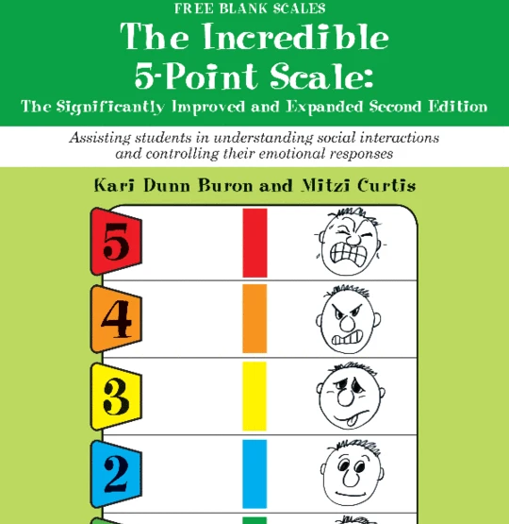
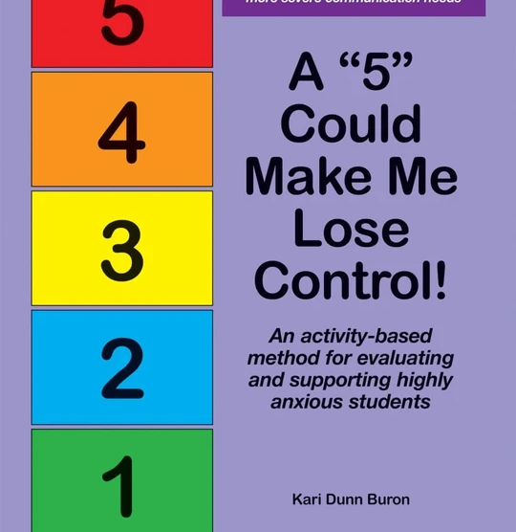
Resources
Website with downloadable resources - blank scales and examples of completed scales

