Slide 1
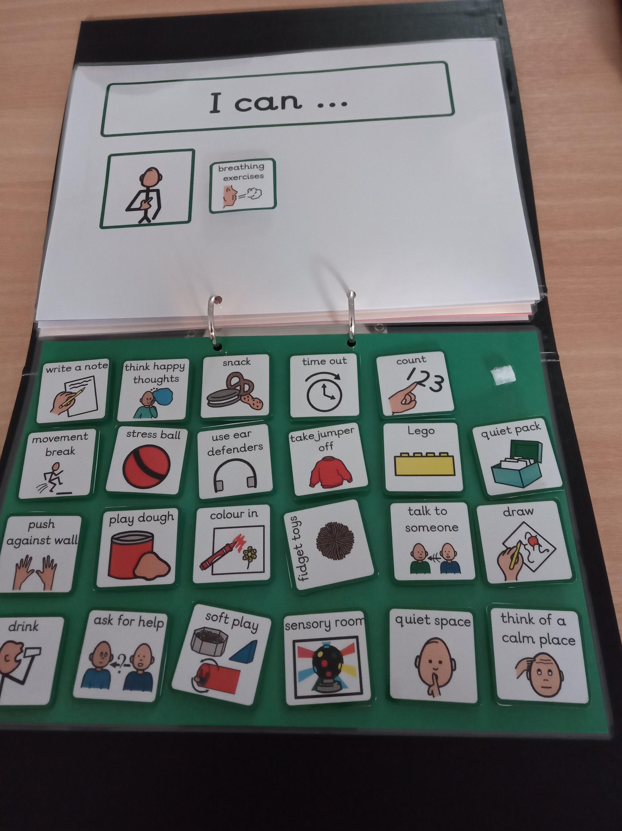
https://blogs.glowscotland.org.uk/fa/epspractitioners/materials/
http://www.ableschools.org.uk/able_resources
Notes:
“I can…”
This section looks at alternative strategies which can be used by the young person when they next experience the feeling under review. So this section is looking at making appropriate and positive adaptations to behaviours.
It is important to stress that this does not mean decreasing negative feelings and increasing positive ones, because suppressing negative feelings and forcing ourself not to express them is not a good self-regulation process.
Rather it is about offering the child or young person alternative strategies or tools to use which more appropriate.
You will see from the slide that there are many different suggestions offered. Again, having too much choice may be overwhelming or difficult for a young person so when first using this tool you may decide to limit the number of suggested strategies.
When selecting strategies include things that you know the young person likes or which are engaging to them. And it is also advisable to include some less familiar suggestions to increase the number of options which may prove useful. This may provide an opportunity for discussion on alternative strategies and for the adult to model to the young person less familiar strategies – for example mindfulness breathing exercises.
And it is important for the adult to check in with the child or young person on a regular basis to see what alternative strategies they have tried and what they thought of them. This allows for some reflection by the young person on the experience of working through the Calm kit folder. So being curious and asking questions such as - Did they try any alternative strategies? If so did they help? If not, what can be done differently next time?
After going through this with a child or young person you could create a personalized “self-regulation visual”. For this particular example you could have a vertical or horizontal script with:
The symbol for ‘worried’
Then the symbol for the ‘sore head’
Then the symbol for the positive behaviour or strategy for the child which in this case was “breathing exercises”.
This would give us a personalised 3 symbol strip (worried/sore head/breathing exercise) for this particular example.
This strip could then be stored on the child’s desk or jotter or in a safe, personal place. The adult can then remind the child to look at their personal calm kit “visuals” when things are
going well for the child. This could act as a reminder or prompt for the child. There could be several visual strips completed for the child to keep if appropriate.
If you have any feedback or questions regarding this resource please contact Falkirk EPS via our blog

