Slide 1
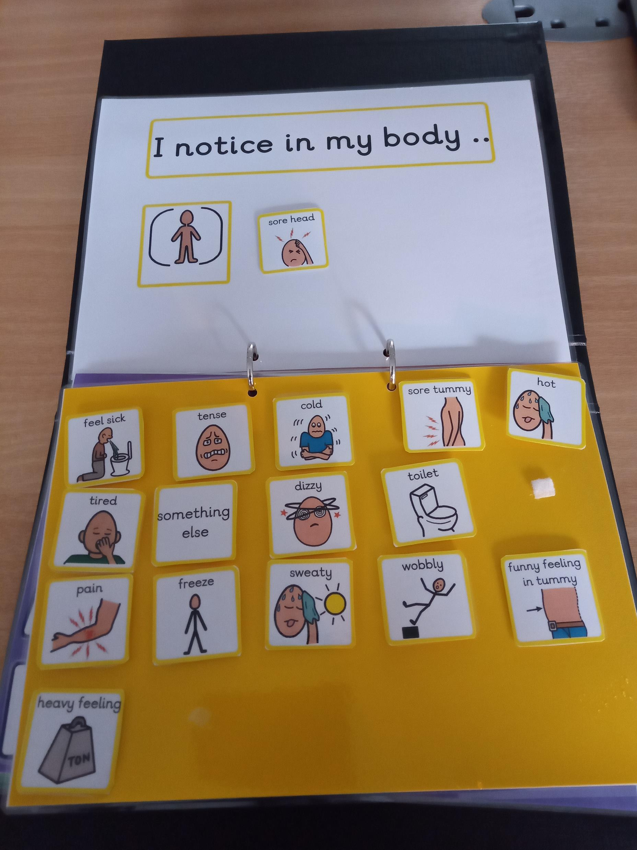
Notes:
“I notice in my body…”
The next section of the resource explores the physical sensations of what happens in the young person’s body when they experience the selected emotion or feeling. In this example the young person has selected the ‘sore head’ symbol.
It is quite difficult to have a symbol for every possible sensation or to fully encapsulate what the young person feels. For that reason, there is a symbol called “something else”, which can be used to explore any sensations which the young person feels is not covered by the other options.
Again, there is an option for the adult to share experience of what they notice when they experience the same feeling.

Slide 2
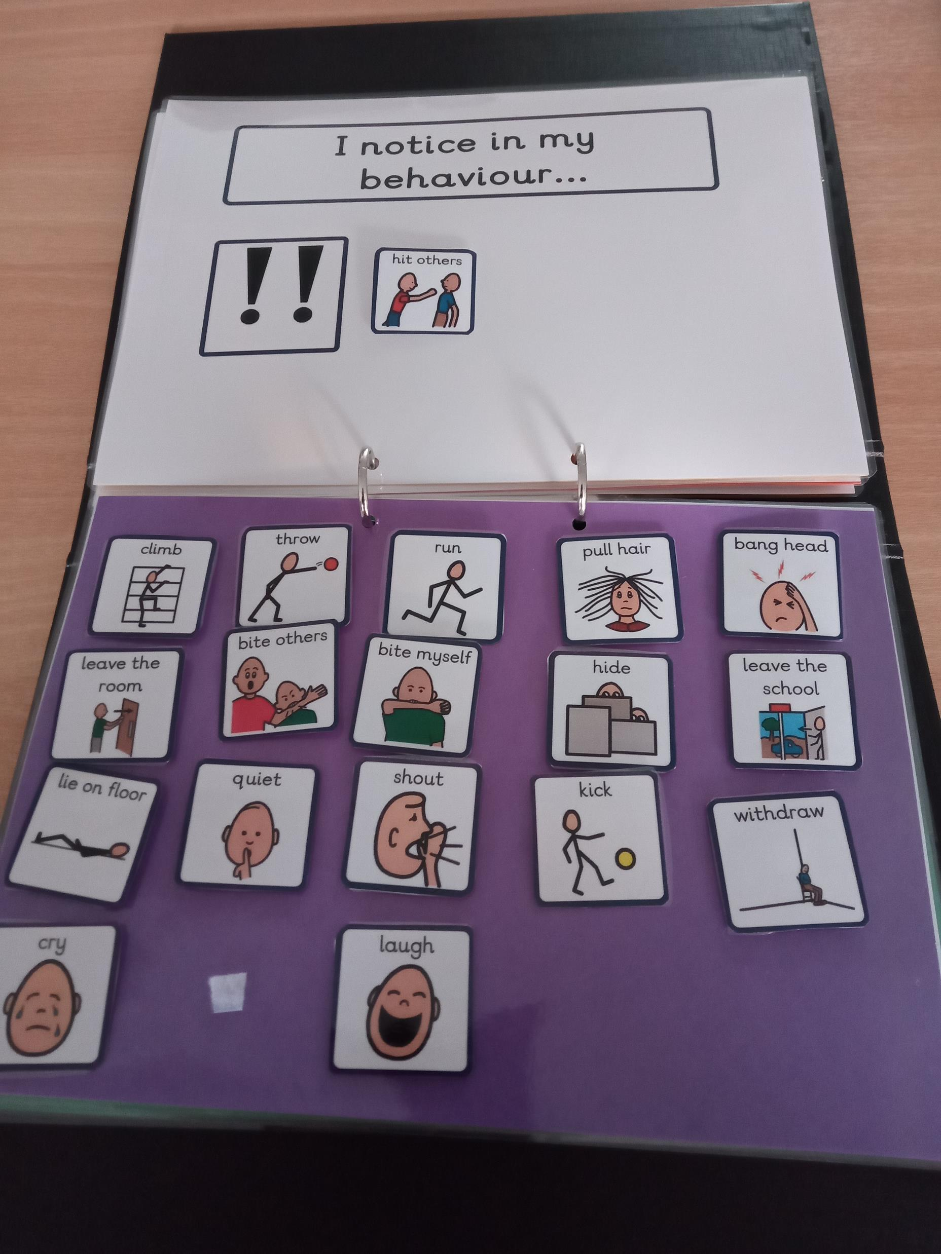
Notes:
“I notice in my behaviour…”
This section explores the child or young person’s perception on what they notice about their behaviour when they experience the selected feeling. In this case the young person has selected ‘hitting others.
This is a useful time to check out any differences in perception and observation between the adult and young person. Depending on the young person there is the opportunity for additional discussion and questions.

