Slide 1
Understanding and managing challenging behaviour – the low arousal approach
Training for Support for Learning Assistants May In-service 2019
Susi Wakely Educational Psychologist Falkirk Educational Psychology Service in consultation with Dr Lucie Risk Clinical Psychologist CAMHS, Forthvalley

Slide 2
Course Content
Understanding that all behaviour is communication
Changing perspectives on behaviour
Tool kit -
Managing the behaviour without escalating the situation
Low Arousal Approach
Evaluating what went wrong
STAR Analysis
Changing what needs to be changed so that we lessen the risk of it happening again
7 universal rules for preventing problem behaviours

Slide 3
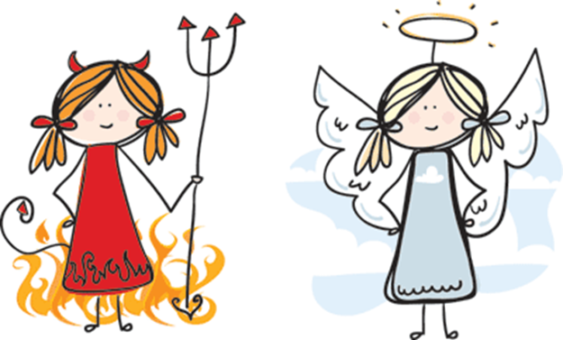
Good vs Bad
Behaviour is functional – there is a reason the child is displaying the behaviour.
Behaviour is communication. It can signal a need. It often signals DISTRESS
What are they trying to tell us?
Why?
Falkirk Children's Services Educational Psychology Service

Slide 4
Common triggers (WHAT/WHEN)
Frustration
Anxiety/worry
Sensory issues
Strong feelings
Hyperactivity
Discomfort
Inability to understand
Boredom
Change in routine
Falkirk Children's Services Educational Psychology Service

Slide 5
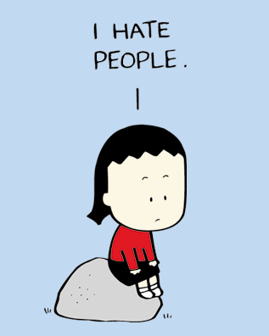
Distressed Behaviours
Self injury
Physical aggression
Verbal aggression
Non-compliance
Repetitive and stereotyped patterns of behaviour
Disruptive/destructive behaviour
Withdrawal
Falkirk Children's Services Educational Psychology Service

Slide 6
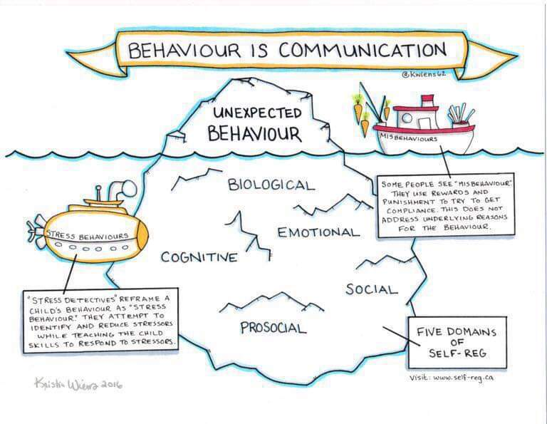
Falkirk Children's Services Educational Psychology Service

Slide 7
Kids do well if they can
Learner’s ability and skills
Situational Demand
Mismatch results in distressed behaviours which act to redress the balance
Falkirk Children's Services Educational Psychology Service
Notes:
Kids do well if they can. Low arousal with Bo Hejlskov Elvén Episode 2. 1m 31
https://youtu.be/pq84Ni5X-hc

Slide 8
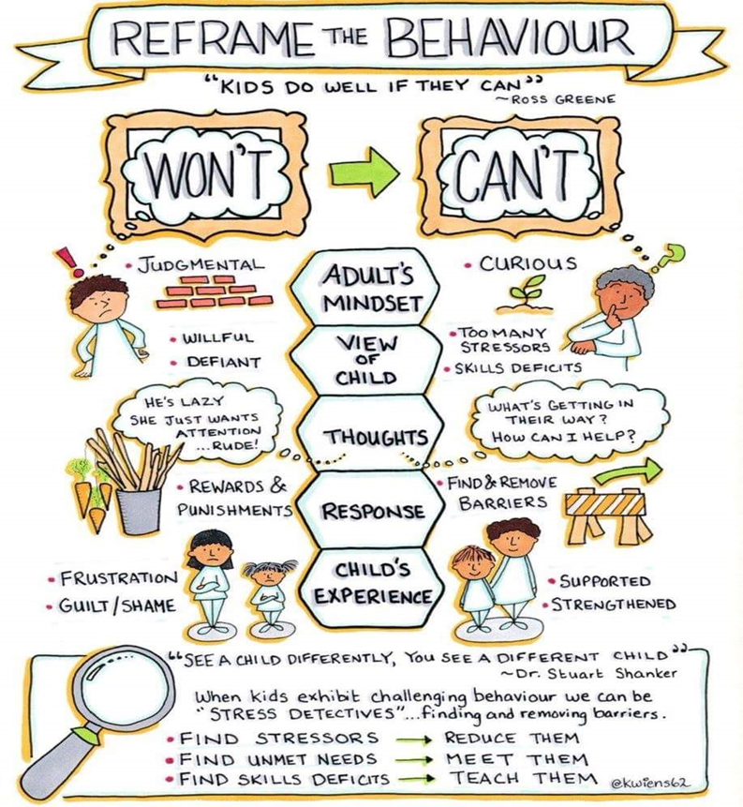
Falkirk Children's Services Educational Psychology Service

Slide 9
Change of perspective
If we believe that the child is doing something on purpose and should know how to behave better…..
We attribute controllability to the child
We expect the child to be responsible
We take it personally
Our curiosity about why the behaviour occurred decreases
Our use of empathy decreases
We like the child less
We become less accepting and flexible
We adapt the environment and our demands less
It becomes a vicious circle….
Falkirk Children's Services Educational Psychology Service

Slide 10
Change of perspective
If we believe that the child is doing their best…..
We do not attribute controllability to the child
We accept responsibility
We do not take it personally
Our curiosity about why the behaviour occurred increases
Our use of empathy increases
We like the child more
We become accepting and flexible
We adapt the environment and our demands
It becomes a positive circle….
Falkirk Children's Services Educational Psychology Service

Slide 11
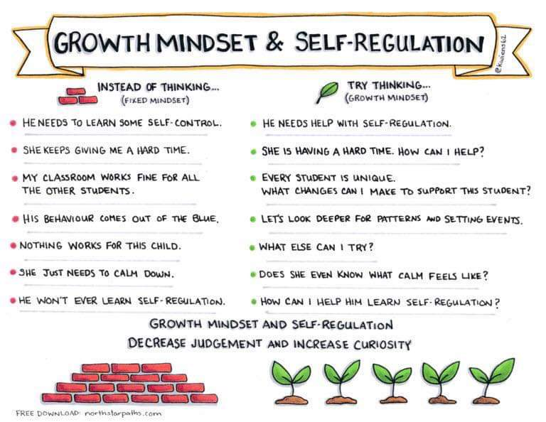

Slide 12
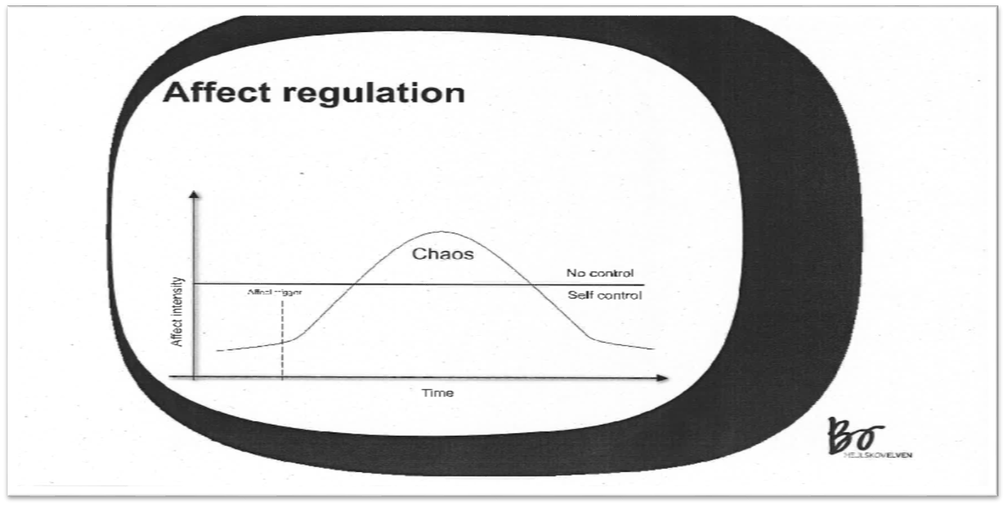
You need self control in order to cooperate
Falkirk Children's Services Educational Psychology Service
Notes:
You need self control in order to cooperate. Low arousal with Bo Hejlskov Elvén Episode 6. 1m 19
https://youtu.be/RGS7k13ZuAQ

Slide 13
Self Control- Exercise
What strategies do you use everyday to keep your sense of self control?
What strategies have you observed young people you know using to maintain their self control?
Think about social and anti-social strategies!

Slide 14
We do everything we can to maintain self control
Strategies we can use to maintain self control
Refusing
Lying
Running away
Spitting or hitting
Threats
Biting one’s hand
Swearing
Falkirk Children's Services Educational Psychology Service
Notes:
We do everything we can to maintain self control. Low arousal with Bo Hejlskov Elvén Episode 7 2m 57
https://youtu.be/wI0aqnrhKr4

Slide 15
Conflicts are Solutions- Win/Win
Challenging behaviour and conflicts can end up going back and forth and escalating-
I have a problem- I solve it- my solution becomes a problem for the other person- they solve their problem with a solution that becomes a problem for me- I have a new problem to solve- my solution becomes a new problem for them……and so on…..
We solve the problem when we can find a solution that is not a problem for the other person- think creatively!
Falkirk Children's Services Educational Psychology Service
Notes:
Conflicts are solutions. Low arousal with Bo Hejlskov Elvén Episode 9 2m 36
https://youtu.be/riaHN5gYlN0

Slide 16
The Principle of Control
You need another person to have self control in order to cooperate
That’s why we must strive to …
Make sure the child keeps their self control
Help the child regain their self control if they have lost it
Make demands in ways that work
We want the child to want to follow our lead
Falkirk Children's Services Educational Psychology Service
Notes:
We make demands in a way that works. Low arousal with Bo Hejlskov Elvén Episode 10. 2m 37
https://youtu.be/vB65OyUG18g

Slide 17
Making demands- Exercise
What works for you when someone is placing a demand on you?
What works for the young people you know when you are placing a demand on them?
Let’s share what works!

Slide 18
Affect Contagion
How do these faces make you feel?
Falkirk Children's Services Educational Psychology Service

Slide 19
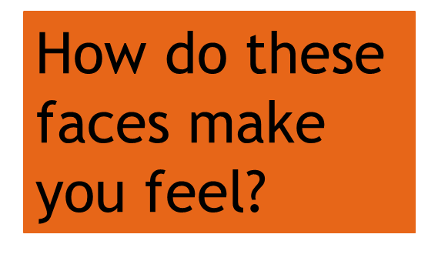
Falkirk Children's Services Educational Psychology Service

Slide 20
Falkirk Children's Services Educational Psychology Service

Slide 21
Falkirk Children's Services Educational Psychology Service

Slide 22
Affect is contagious
We feel each other’s emotions
For children with complex needs relationships are central to their behaviour and emotional well-being
They need adults who are SENSITIVE
ATTENTIVE
RESPONSIVE
STIMULATING
AFFECTIONATE
Adults see the world from the child’s point of view and seek to meet their needs.
Falkirk Children's Services Educational Psychology Service
Notes:
Affect is contagious. Low arousal with Bo Hejlskov Elvén Episode 8 2m 29
https://youtu.be/jTSsT8ixdrw

Slide 23
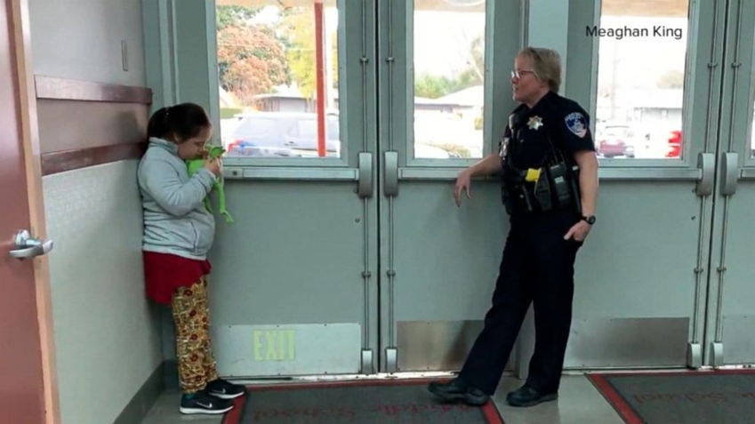
School resource officer makes a heart warming connection
Falkirk Children's Services Educational Psychology Service
Notes:
https://www.youtube.com/watch?v=uEEZ-a0rVFU

Slide 24
Passing on our CALM – Exercise
What does the Officer’s CALM look like?
What does your CALM look like?
Falkirk Children's Services Educational Psychology Service

Slide 25
Betari Box
Falkirk Children's Services Educational Psychology Service
Notes:
Betari box
The big picture
It is uncertain who or what Betari was, but the Betari box (also known as Betari’s box) has become a classic model in conflict management. The box helps you to understand the impact of your behaviour and attitudes on the behaviour and attitudes of others and shows how quickly we can descend into spirals of negative communication (see Figure 43.1).
If I feel negative about you, I will display negative behaviour towards you; this in turn will change the way you feel, resulting in negative behaviour towards me. Equally, a positive attitude from you or me can create a virtuous circle.

Slide 26
Tools we need
Managing the behaviour without escalating the situation
Evaluating what went wrong
Changing what needs to be changed so that we lessen the risk of it happening again
Falkirk Children's Services Educational Psychology Service

Slide 27
Trigger Stage
Falkirk Children's Services Educational Psychology Service

Slide 28
Trigger Stage
Role of Adult: pass on their CALM/divert/de-escalate Aim: Learner maintains self-control | Keep CALM Avoid prolonged eye contact Use a calming, soothing tone of voice, speak slowly, reduce language Diversion-try to divert attention away from trigger Keep your distance- take a step back every time you place a demand Stand alongside, maintain calm, relaxed body language Avoid standing opposite or over- remove yourself to the side, lean against the wall, think about walking home on a Saturday night how do we keep ourselves safe
Falkirk Children's Services Educational Psychology Service

Slide 29
Chaos Stage
Falkirk Children's Services Educational Psychology Service

Slide 30
Chaos Stage
Role of Adult: To assess whether or not this is a dangerous situation. We are not teaching at this time- we are managing. Aim: letting Learner calm themselves | Create safe area for leaner to try to calm themselves Remove bystanders Wait and wait at a safe distance Avoid restraining- if restrain for safety let go quickly (up to 5 sec)- let leaner go so that they become calm
Falkirk Children's Services Educational Psychology Service

Slide 31
Returning to self control
Falkirk Children's Services Educational Psychology Service

Slide 32
Returning to self control stage
Role of Adult: restore and divert onwards Aim: support Learner to return to self-control We are not teaching at this time- we are managing. | Adults remain CALM Adults tidy up and restore environment to avoid re-escalation Divert onwards- eg. hot chocolate
Falkirk Children's Services Educational Psychology Service

Slide 33
Evaluate in order to plan change…
Falkirk Children's Services Educational Psychology Service
Notes:
Manage, evaluate, then change. Low arousal with Bo Hejlskov Elvén Episode 14 1m 51
https://youtu.be/cxaBn7qn9ng

Slide 34
Your thoughts?
Trigger stage
Chaos stage
Returning to self control stage
What aspects of the advice are you comfortable with?
What aspects of the advice are you less comfortable with?
Why?
Falkirk Children's Services Educational Psychology Service

Slide 35
Tools we need
Managing the behaviour without escalating the situation
Evaluating what went wrong
Changing what needs to be changed so that we lessen the risk of it happening again
Falkirk Children's Services Educational Psychology Service

Slide 36
Making sense of behaviour
Falkirk Children's Services Educational Psychology Service
Notes:
Click the picture to start the video

Slide 37
Making sense of behaviour
Falkirk Children's Services Educational Psychology Service
Notes:
Click the picture to start the video

Slide 38
STAR Analysis A Framework for the Functional Analysis of Behaviour
Setting
Trigger
Action
Results
Functional analysis helps us understand the function of a certain behaviour.
Falkirk Children's Services Educational Psychology Service

Slide 39
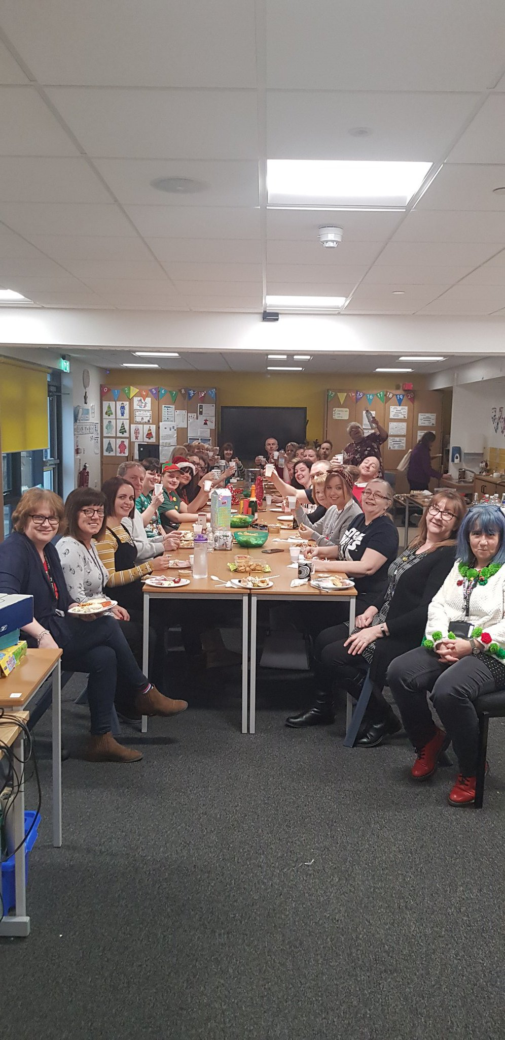
Setting – where does the behaviour take place
Classroom
Dining hall
Corridor
Toilets
Outside area
Reception area
Swimming pool
….
Falkirk Children's Services Educational Psychology Service

Slide 40
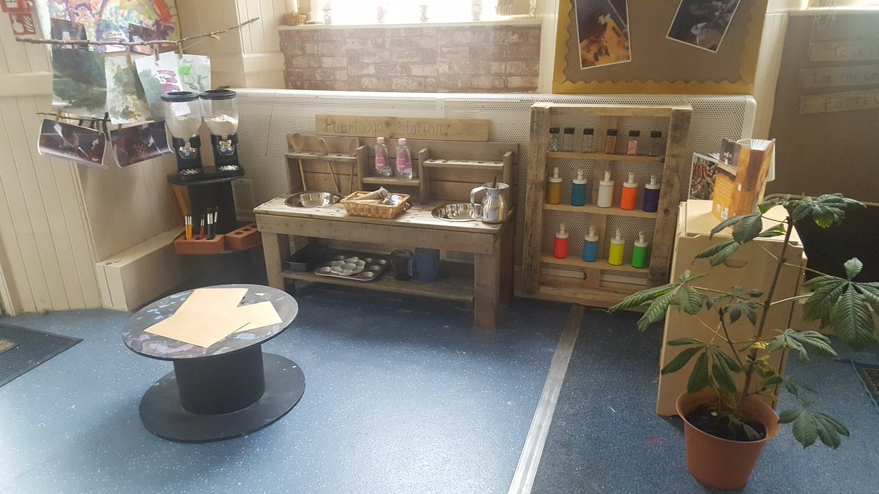
Setting – where does the behaviour take place
Playdough Station
Tipi
Sandpit
Outside
….
Falkirk Children's Services Educational Psychology Service
Notes:
Wings

Slide 41
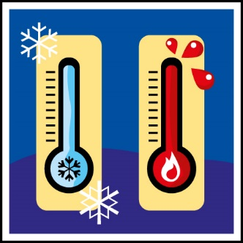
Trigger – what happens immediately before the behaviour?
Sensory
loud noises; too hot; too cold; need to move
Asked to do something
Item/activity restricted
Attention restricted
Transition
Unexpected change in routine
Unfamiliar adult
….
Falkirk Children's Services Educational Psychology Service

Slide 42
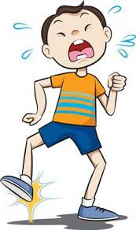
Action – what is the behaviour?
Verbal protest
Physical aggression
Damage to property
Self injurious behaviour
Non compliance
Withdrawal
Socially inappropriate behaviour
…
Falkirk Children's Services Educational Psychology Service

Slide 43
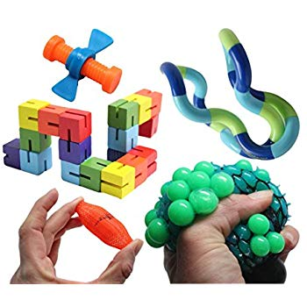
Results – what happens immediately after the behaviour?
Given an object
Removed from setting
Lots of staff come round child to help them
Verbal reassurance
Other children come round the child
…
Falkirk Children's Services Educational Psychology Service

Slide 44
Why?
Wanted some attention?
Wanted an object/activity?
Hungry?
Helps them get sensory stimulation?
Allows them to escape attention - maybe they’re feeling overwhelmed?
Avoid doing what’s asked of them?
Staff unexpectedly changed – I don’t know this person?
Confusion – we’re going out of the classroom but I don’t know where or why?
What are they trying to tell us?
Falkirk Children's Services Educational Psychology Service

Slide 45
Now what?
Carry round the small sheets in your pocket/have them easy to hand somewhere in the classroom
Every time the behaviour happens (as often as practically possible!) quickly scribble down:
Put completed sheets in an easily accessible box/ back in your pocket to put in the box later
Don’t over think it – just note down what you see!
Falkirk Children's Services Educational Psychology Service

Slide 46
Something to have at the back of your mind for the future…
How will we analyse the behaviour to understand what the learner is communicating to us?
How will we meet that need?
What proactive strategies will we put in place to prevent the behaviour happening in the first place?
What reactive strategies will we use if the behaviour occurs?
How will we know if these strategies are working?
… but that’s for the next time!
Falkirk Children's Services Educational Psychology Service

Slide 47
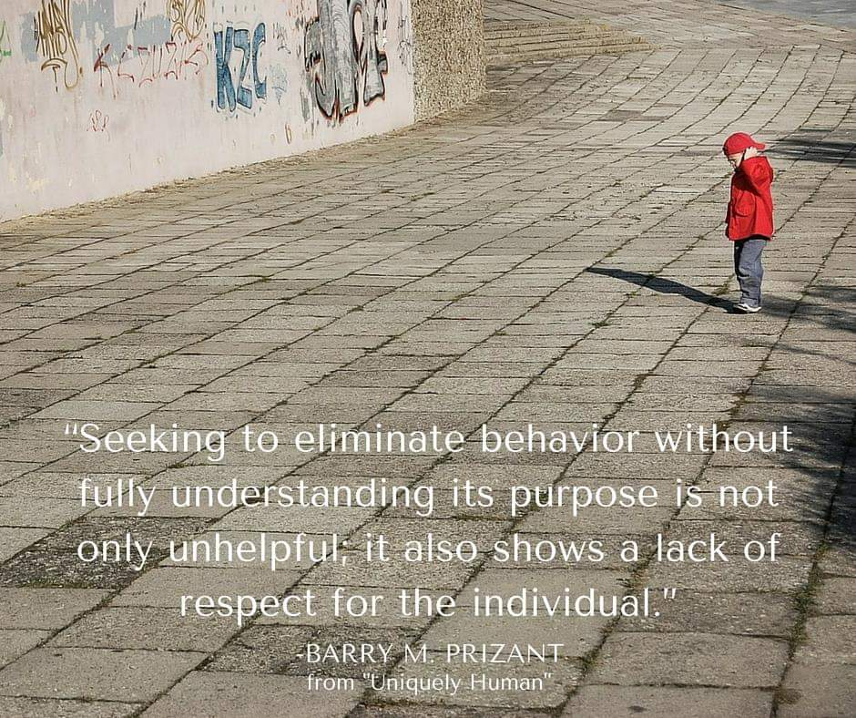
Falkirk Children's Services Educational Psychology Service

Slide 48
Top tips from a colleague…..
Timetable is law
Behaviour is communication
Positive Behaviour Support
Be consistent
Think about the future when using strategies
Keep in mind the child’s developmental level and focus on developing the skills (life skills) appropriate to that level
Patience and Persistence are key
It’s ok to do an activity in the corridor
Be consistent in implementing a total communication environment
Be aware of sensory needs
Falkirk Children's Services Educational Psychology Service
Notes:
What were the key skills and approaches that you learnt that made the difference to you and the young people?
Timetable is law
Child has to be able to trust you and feel safe. If you say something/put it on the timetable that you’re going to do an activity then you have to follow through – even if the activity only lasts 2mins or even 2 seconds.
Behaviour is communication
ABC charts/proactive strategies
Positive Behaviour Support
Even the smallest kind of accidental reinforcement can have an effect and the behaviour can stick.
Redirection
Distraction
Positively ignore behaviour but not child
Be consistent (yourself and across staff)
If one member of staff allows a child to have the ipad after you’ve said ‘finished’ because they bite/kick then this will reinforce it, even if all other staff following through with the ‘finished’.
Think about the future when using strategies
Will this child still be able to do this activity when they are 5 years older, taller and stronger than they are now? i.e. don’t lift them as a means of transition because they will learn to expect that and physically that will not always be possible.
Playing tickling games – parents may have done this all the child’s life but now child is going through puberty and parents don’t feel as comfortable doing it. Developmentally the child’s not changed – might find it hard to understand why parent all of a sudden stops playing that game.
Keep in mind the child’s developmental level and focus on developing the skills (life skills) appropriate to that level.
e.g. I got very excited when a non-verbal child started saying the alphabet in his first language and English. I’d teach him different words/numbers and he’d ‘learn’ them. But never in context. Yet this child couldn’t dress himself – a more important life skill than being able to recite rote the numbers from 1-20 without knowing what numbers actually are. Balance between optimism and realism.
Patience and Persistence are key
Skill development can be slow – it took 4months for us to get every child sitting at the lunch table at once, for the whole 20min lunch.
It’s ok to do an activity in the corridor
Transitions between classes can be difficult. The child does not have to be in class. There’s no reason they can’t carry out their whole timetable of activities with you in the corridor. (staffing permitting)
Be consistent in implementing a total communication environment
Signalong, Object Signifiers, Song Signifiers, PECS, VOCAs, Big Macs, Visuals
Be aware of sensory needs
Room lighting, noise, use of deep pressure, carrying sensory toys with you

Slide 49
7 Universal Rules for Preventing Problem Behaviour (Dr Barry Prizant)
Have developmentally appropriate tasks and attentional expectations given the child’s ability and chronological age (duration of the activity, motor skills)
Reduce stimulation, slow down input, simplify the environment
Use appropriate supports- interpersonal and learning supports, especially in “high risk” situations e.g. transitions
Prioritise social communication skills (presymbolic and symbolic) and peer relationships
Build self-determination; choice making
honour refusals/protests when appropriate
Build executive function (planning, organisation) and self-regulatory skills
Utilise breaks systemically – think about movement breaks
Falkirk Children's Services Educational Psychology Service

Slide 50
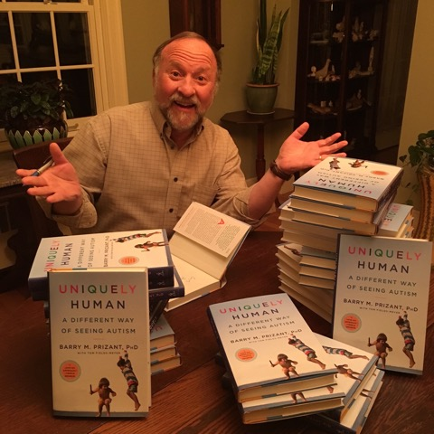
References
Training materials for teachers of learners with severe, profound and complex learning difficulties
www.complexneeds.org.uk
Falkirk Children's Services Educational Psychology Service
Notes:
https://eng.hejlskov.se/
http://www.complexneeds.org.uk/
https://barryprizant.com/

