Slide 1
PRESS F5 TO START
This presentation contains National 5 past paper questions complete with solutions.
The questions are sorted into topics based on the National 5 course.
To access a particular question from the main grid just simply click on the question number.
To access the formula sheet press the button.
To begin click on Main Grid.
F
Main Grid

Slide 2
Topic | 2014 (Lifeskills) |  | 2015 (Lifeskills) |  | 2016 (Lifeskills) |  | 2017 (Lifeskills) |  | Specimen (Applications)
 | Paper 1 | Paper 2 | Paper 1 | Paper 2 | Paper 1 | Paper 2 | Paper 1 | Paper 2 | Paper 1 | Paper 2
Fractions/Deciamls |  |  | 1 |  |  |  |  |  | 8
Tolerance | 2 |  | 4 |  |  | 4b | 1 |  | 3
DST | 5 | 6 | 2 |  | 3 | 2, 6c |  | 5b, 7c | 1
Volume | 9 |  |  | 6c |  | 8c |  | 1 |  | 10c
Percentage Calculations |  | 2, 4 | 6 | 1b |  | 1, 7 |  | 2 |  | 1
Probability | 1 |  |  |  | 2 |  |  | 5d | 2
Money Calculations | 4, 8 | 7 | 9 | 3 | 1, 4, 7 | 5 | 2, 5b | 3, 5c, 6b | 4, 6, 7, 11 | 6, 8
Statistics | 7 | 1 |  | 2a, 5, 6ab |  | 3, 6ab | 3, 5a, 8 | 4, 7ab | 5, 10 | 3, 4
Scale Drawing |  | 3 |  | 4 |  | 4a |  | 5a |  | 2, 7
Length including Pythagoras | 3a | 5a | 7 | 2b | 6 |  | 9a | 8a | 13a | 9a
Area | 3b | 5b | 10 |  | 8 |  | 7, 9b | 8bc |  | 9bc
Precedence Tables | 6 |  |  |  | 5 |  |  |  | 13b
Packaging |  |  | 3 |  |  |  |  | 6a |  | 5
Ratio & Proportion |  |  | 5 | 1a | 9 | 8ab | 6 |  | 9 | 10ab
Gradient |  |  | 8 |  | 10 |  | 4 |  | 12

Slide 3
Topic | 2018 (Applications) |  | 2019 (Applications)
 | Paper 1 | Paper 2 | Paper 1 | Paper 2 | Paper 1 | Paper 2 | Paper 1 | Paper 2 | Paper 1 | Paper 2
Fractions/Deciamls | 5, 6 | 7
Tolerance | 1
DST | 9 | 4b, 9d
Volume |  | 5b, 11c
Percentage Calculations | 8, 10 | 1
Probability | 14
Money Calculations | 2, 7 | 3, 8ab, 10
Statistics | 3 | 2, 4a, 8cd
Scale Drawing | 4, 12
Length including Pythagoras | 11
Area | 13 | 11ab
Precedence Tables |  | 9ab
Packaging |  | 9c
Ratio & Proportion |  | 5a, 6
Gradient | 15

Slide 5
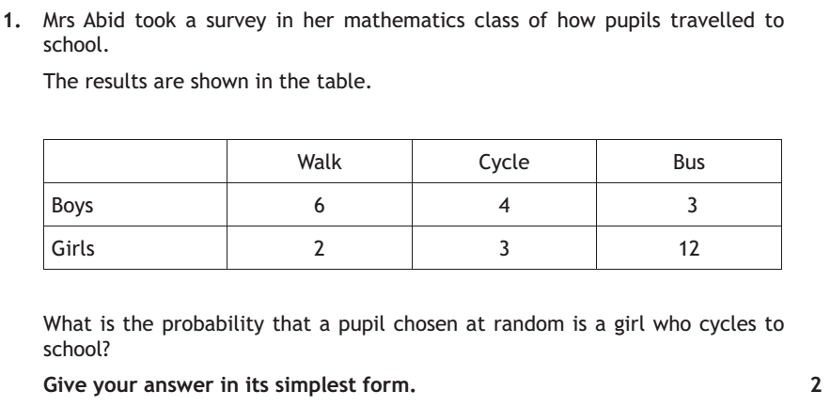
F
Solution
Main Grid

Slide 6
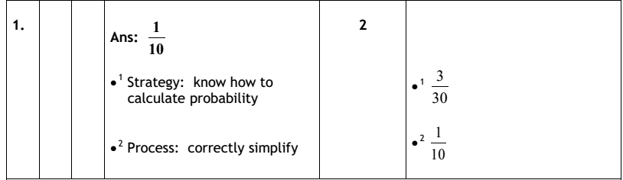
Main Grid

Slide 7
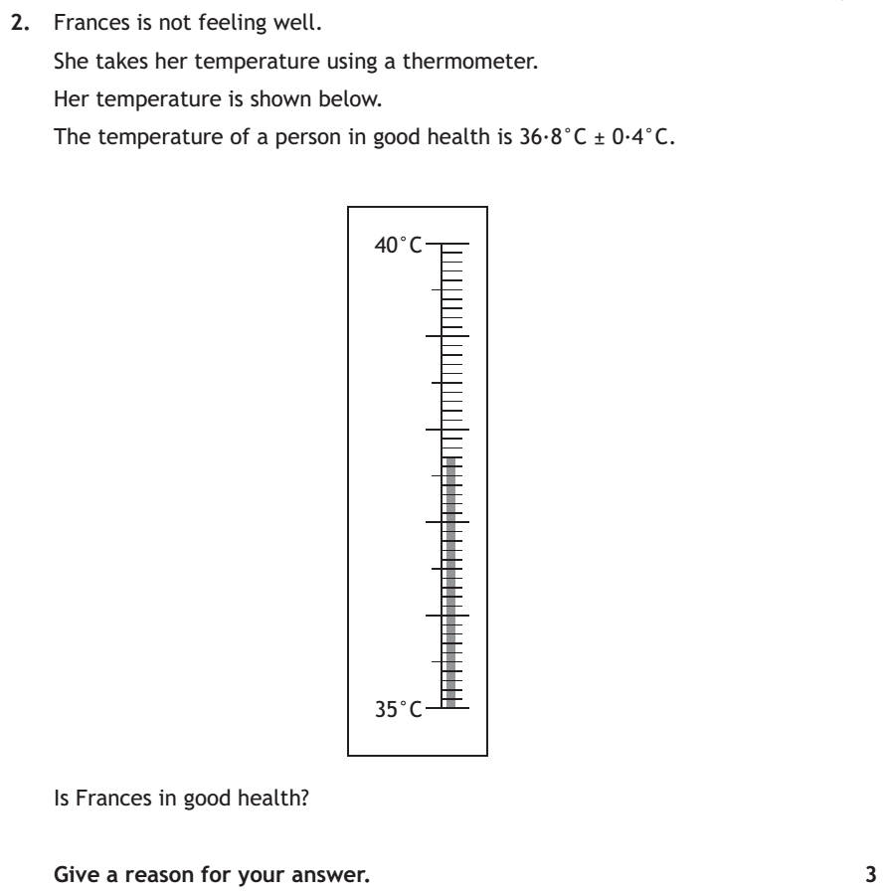
F
Solution
Main Grid

Slide 8
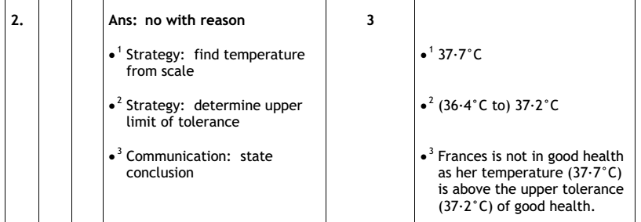
Main Grid

Slide 9
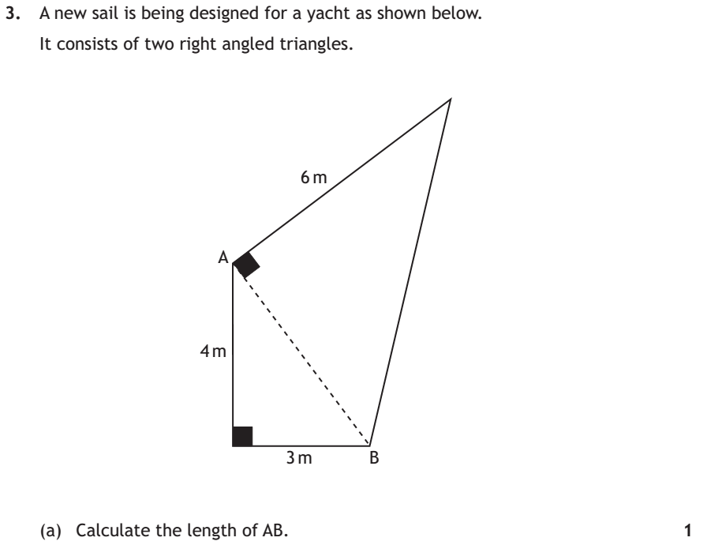
F
Solution
Main Grid

Slide 10
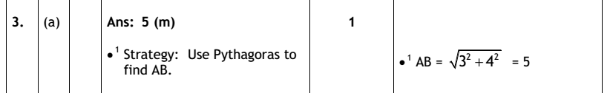
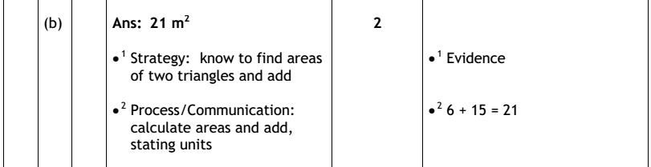
Main Grid

Slide 11
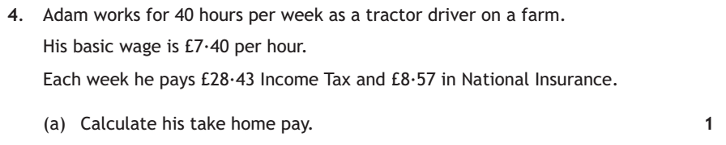
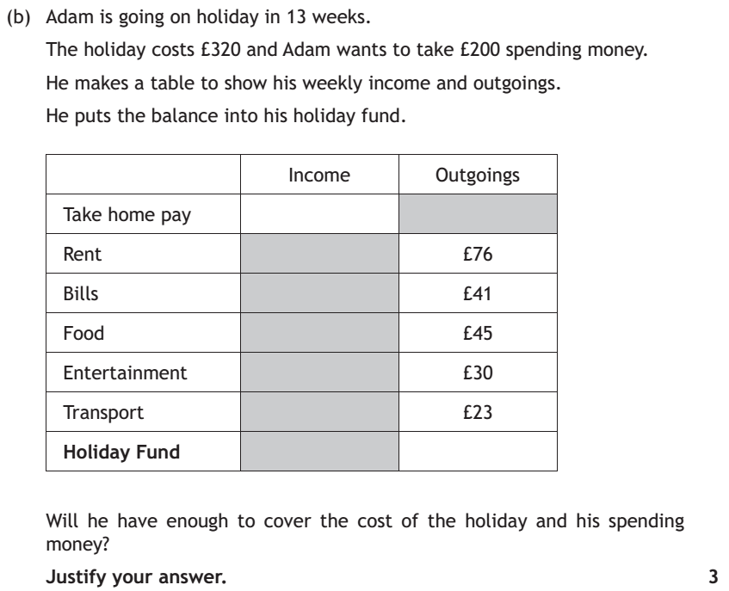
F
Solution
Main Grid

Slide 12
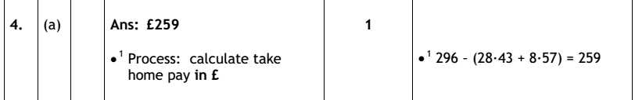
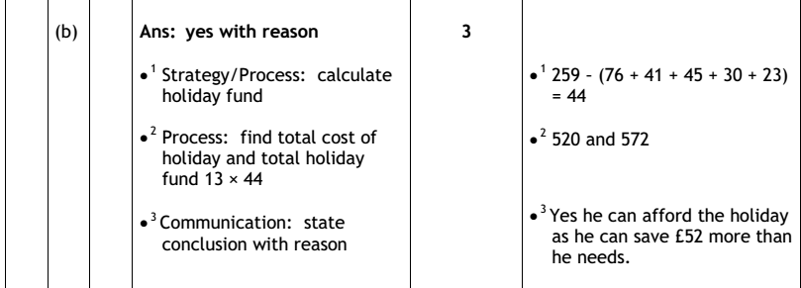
Main Grid

Slide 13
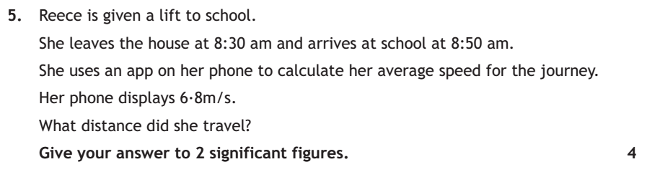
F
Solution
Main Grid

Slide 14
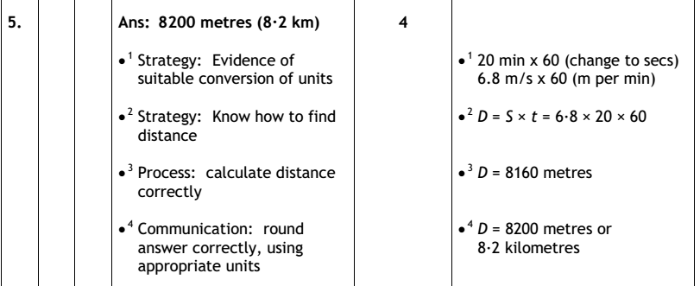
Main Grid

Slide 15
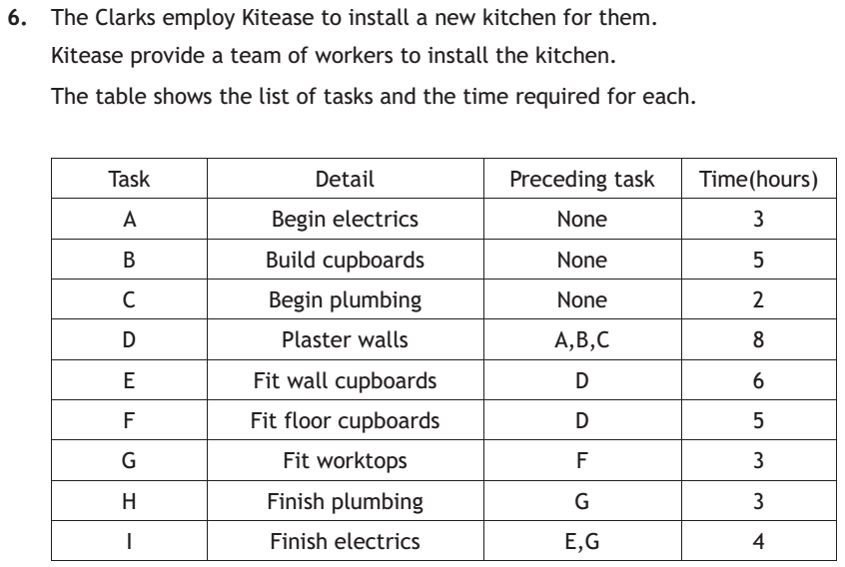
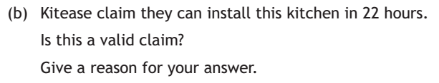
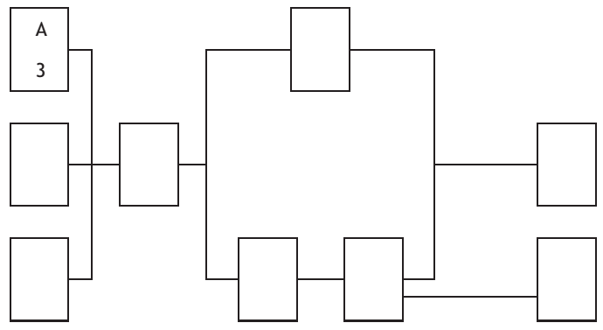
(a) Complete the table below
F
Solution
Main Grid

Slide 16
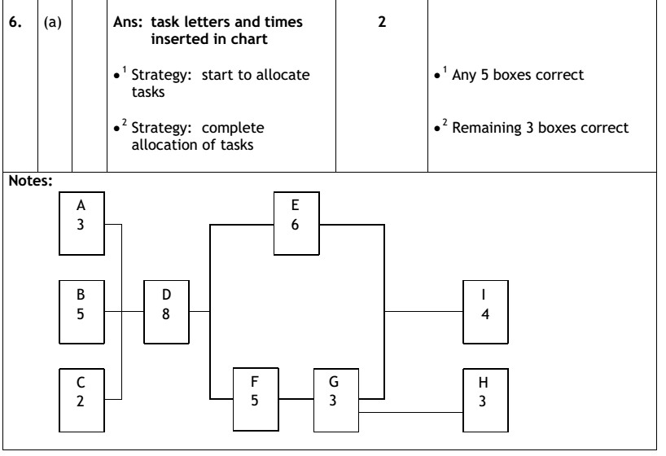
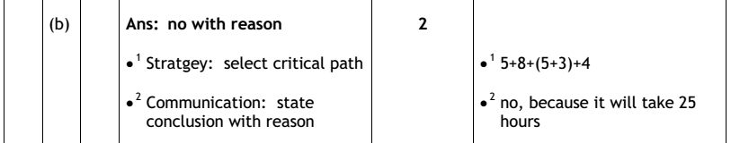
Main Grid

Slide 17
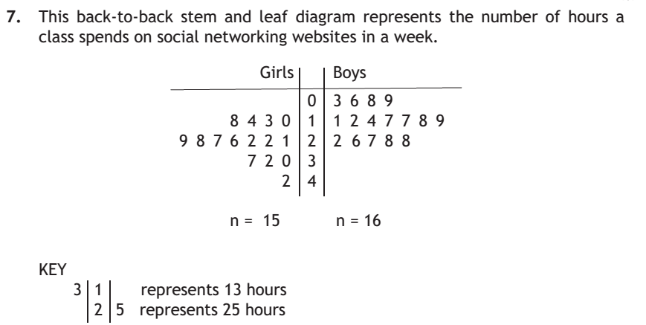
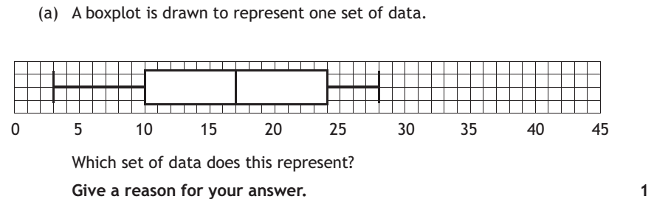
F
Main Grid
Question 7 b & c

Slide 18
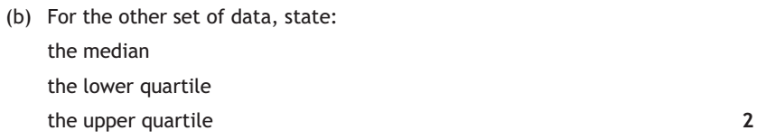
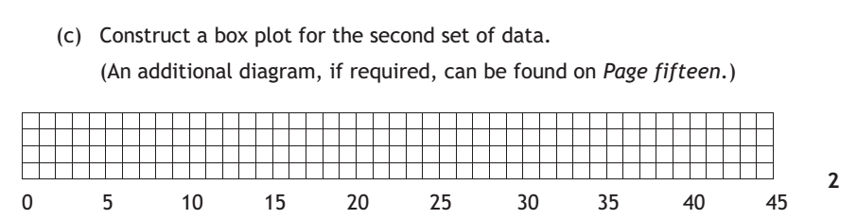
F
Main Grid
Solution

Slide 19

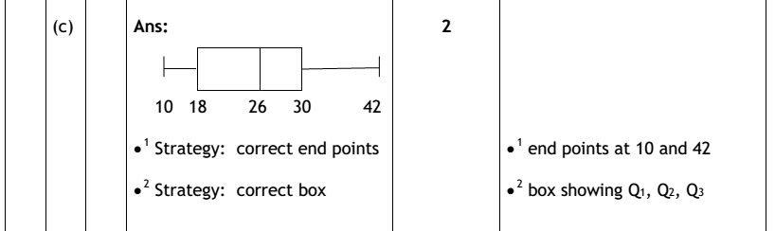
Main Grid

Slide 20
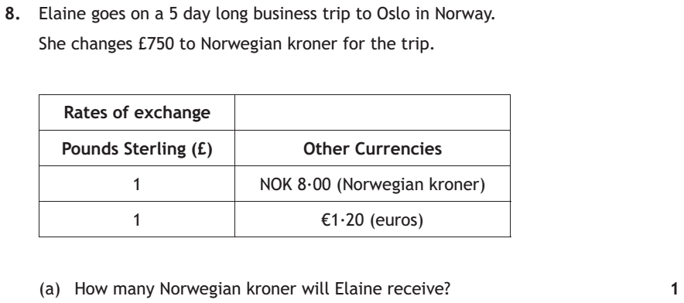
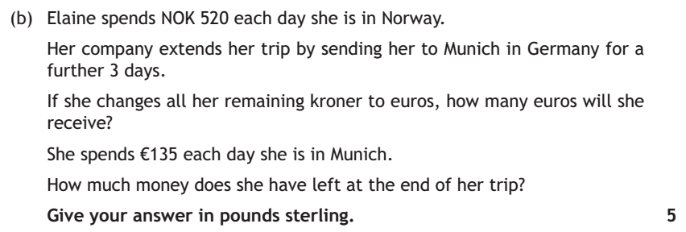
F
Solution
Main Grid

Slide 21
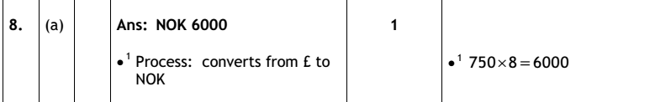
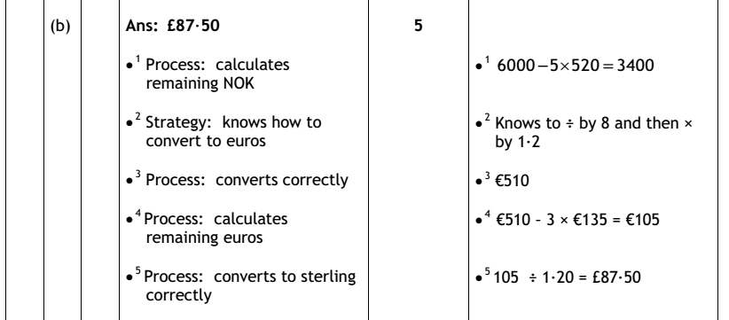
Main Grid

Slide 22
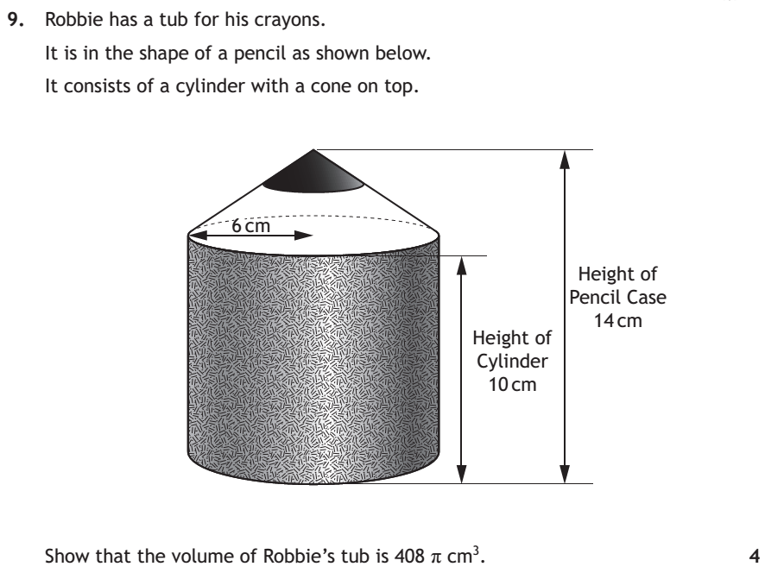
F
Solution
Main Grid

Slide 23
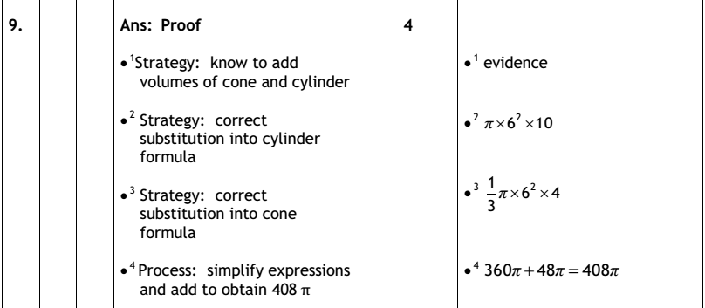
Main Grid

Slide 24
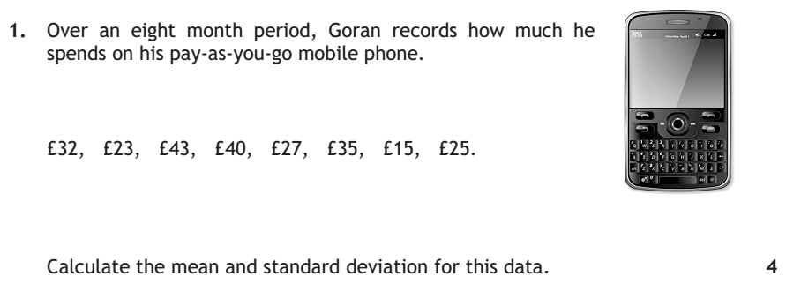
F
Solution
Main Grid

Slide 25
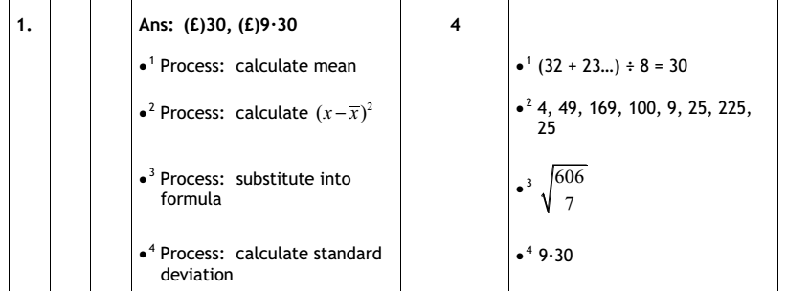
Main Grid

Slide 26
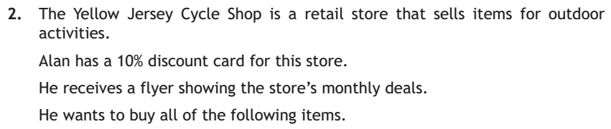
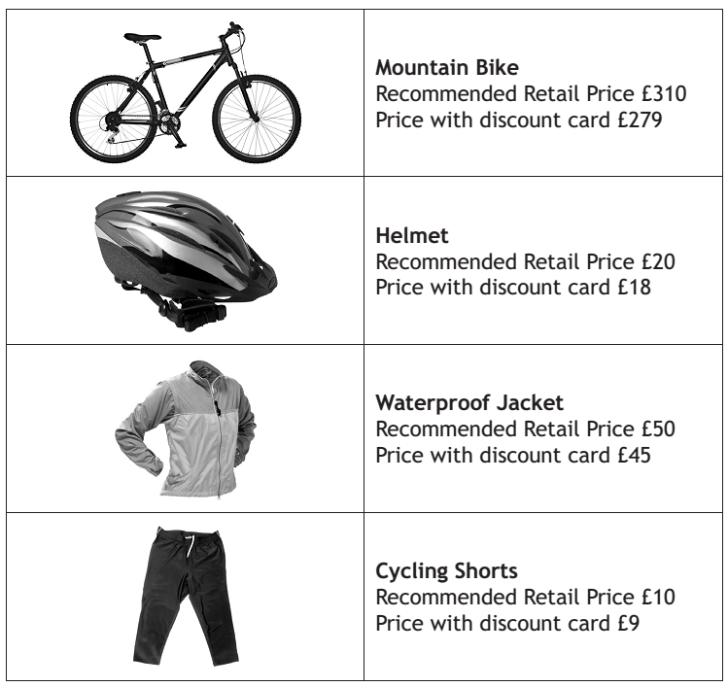
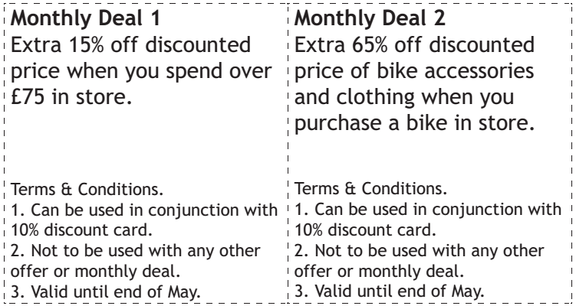
F
Solution
Main Grid

Slide 27
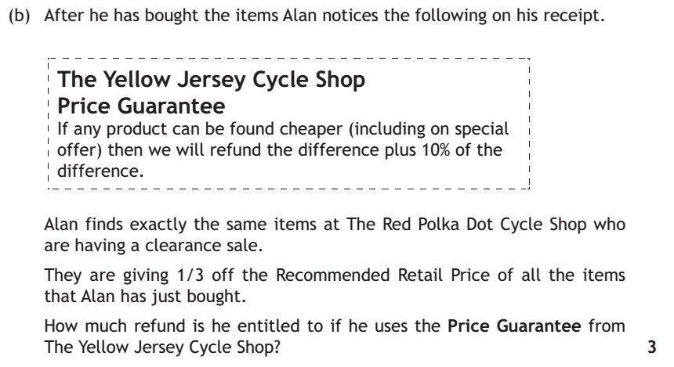
F
Solution
Main Grid

Slide 28
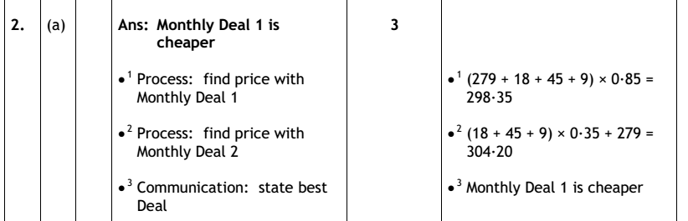
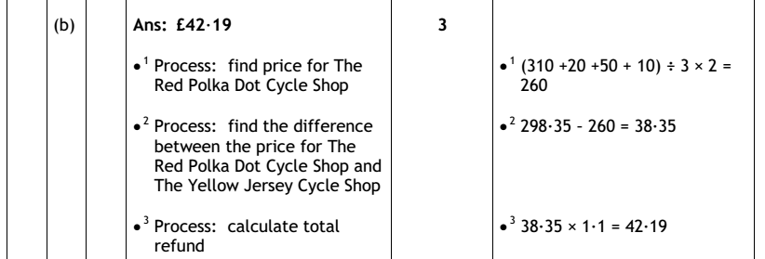
Main Grid

Slide 29
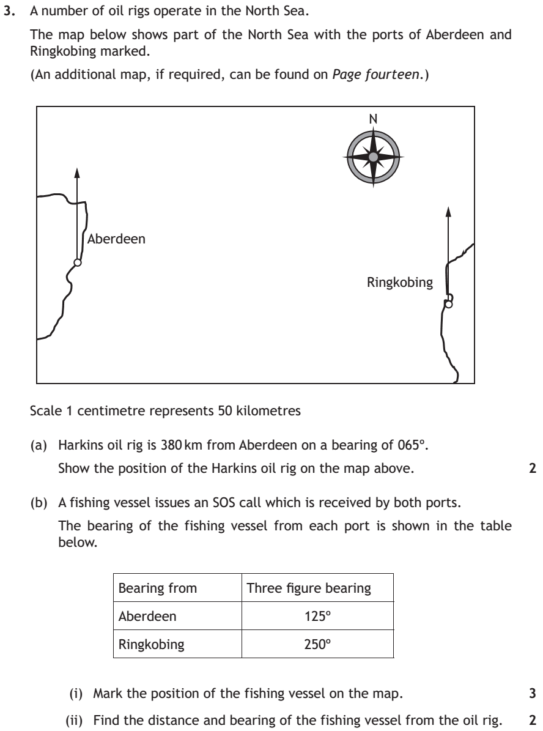
F
Solution
Main Grid

Slide 30
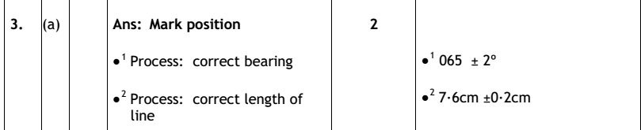
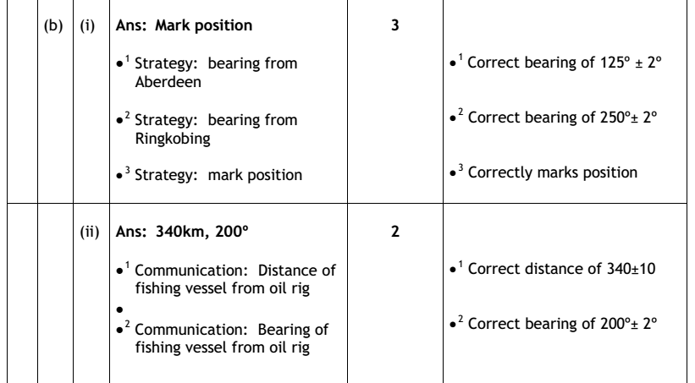
Main Grid

Slide 31
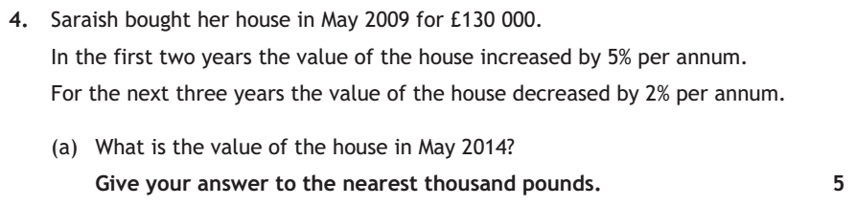
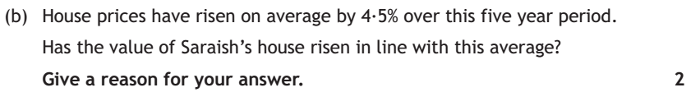
F
Solution
Main Grid

Slide 32
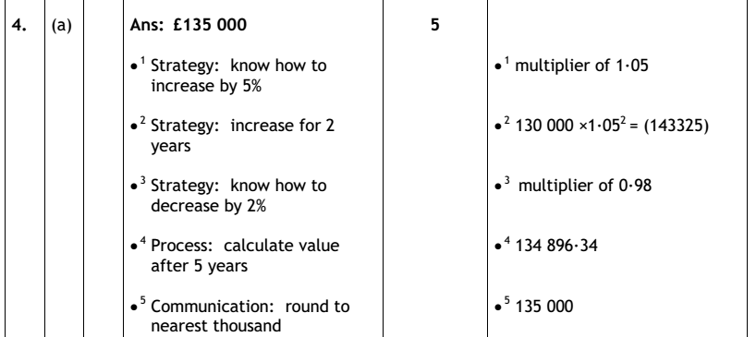
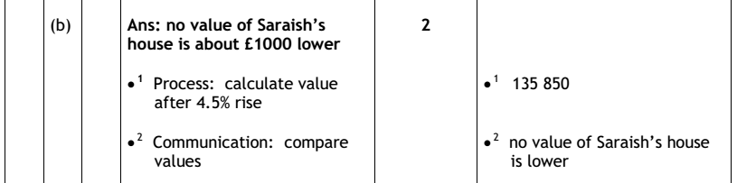
Main Grid

Slide 33
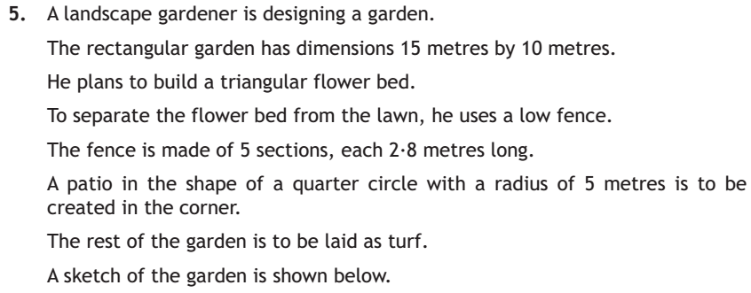
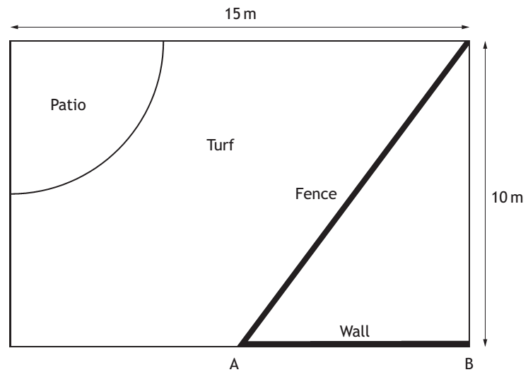
F
Solution
Main Grid

Slide 34
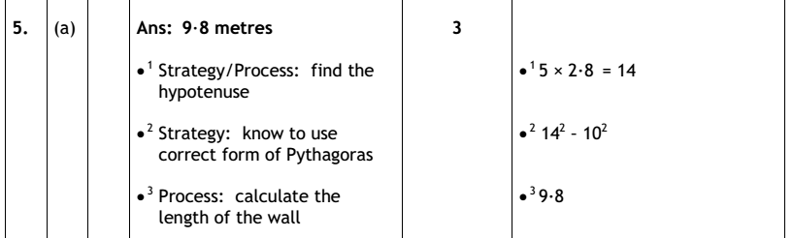
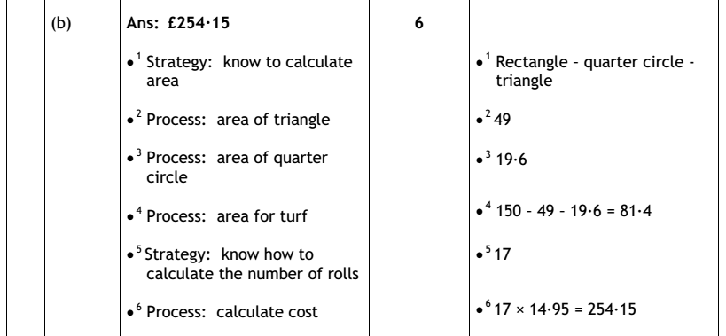
Main Grid

Slide 35
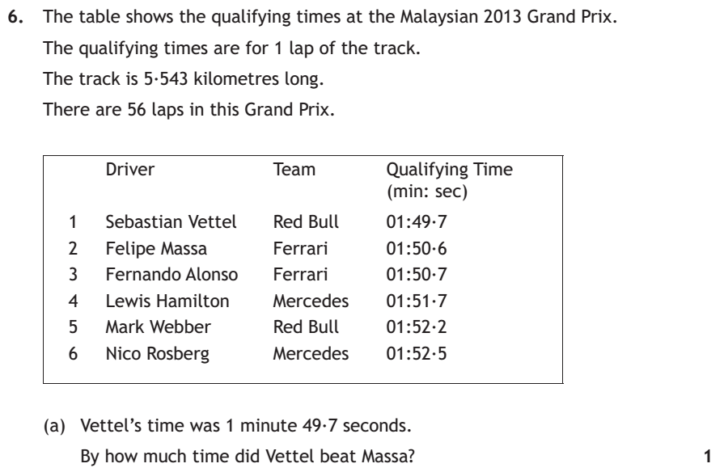
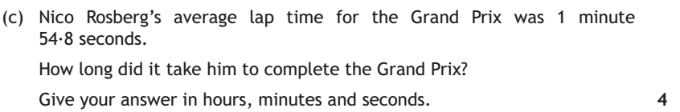
F
Solution
Main Grid

Slide 36



Main Grid

Slide 37





He makes a sketch of his drive to help him to calculate the cost of each type of surface.
Calculate the minimum total cost for each surface type.
Which is the moist cost effective?
9
3
F
Solution
Main Grid

Slide 38


Main Grid

Slide 39

F
Solution
Main Grid

Slide 40
Main Grid

Slide 41

F
Solution
Main Grid

Slide 42
Main Grid

Slide 43


F
Solution
Main Grid

Slide 44
Main Grid

Slide 45

F
Solution
Main Grid

Slide 46
Main Grid

Slide 47

F
Solution
Main Grid

Slide 48
Main Grid

Slide 49

F
Solution
Main Grid

Slide 50
Main Grid

Slide 51

F
Solution
Main Grid

Slide 52
Main Grid

Slide 53


F
Solution
Main Grid

Slide 54
Main Grid

Slide 55


F
Solution
Main Grid

Slide 56
Main Grid

Slide 57


F
Solution
Main Grid

Slide 58
Main Grid

Slide 59


F
Solution
Main Grid

Slide 60
Main Grid

Slide 61


The gauge below shows the reading when he checks his front tyre.
F
Solution
Main Grid

Slide 62

F
Solution
Main Grid

Slide 63
Main Grid

Slide 64



F
3b & c
Main Grid

Slide 65


F
Solution
Main Grid

Slide 66
Main Grid

Slide 67
F
Solution
Main Grid

Slide 68
Main Grid

Slide 69
F
5 b & c
Main Grid

Slide 70
F
Solution
Main Grid

Slide 71
More Solution
Main Grid

Slide 72
Main Grid

Slide 73
6. In a diving competition there are seven judges. Each judge gives the diver a raw score out of 10. Each dive has a difficulty rating. A rule is then applied which calculates the diver’s final score. The rule is:
Discard the lowest and highest raw scores
Work out the mean of the remaining raw scores
Multiply the mean by 3/5
Multiply this value by the difficulty rating
Round to one decimal place
The table shows the judge’s raw scores for two competitors.
F
Solution
Main Grid

Slide 74
Main Grid

Slide 75
F
Solution
Main Grid

Slide 76
Main Grid

Slide 77
F
Solution
Main Grid

Slide 78
Main Grid

Slide 79
F
Solution
Main Grid

Slide 80
Main Grid

Slide 81
3. Gary lives in Biggar and has to go to a meeting in Edinburgh. He plans to travel to his meeting by bus. His meeting starts at 11.30am. It will take him 25 minutes to walk from the Edinburgh bus stance to his meeting. What is the latest bus he can catch in Biggar to be at his meeting on time?
F
Solution
Main Grid

Slide 82
Main Grid

Slide 83
F
Solution
Main Grid

Slide 84
Main Grid

Slide 85
a) Complete the diagram below to show the tasks in the boxes
b) The company want this entire process to be completed in 2 years.
Based on the times given, is this possible?
Show working to justify your answer.
F
Solution
Main Grid

Slide 86
Main Grid

Slide 87
F
Solution
Main Grid

Slide 88
Main Grid

Slide 89
F
Solution
Main Grid

Slide 90
Main Grid

Slide 91
F
Solution
Main Grid

Slide 92
Main Grid

Slide 93
F
Solution
Main Grid

Slide 94
Main Grid

Slide 95
F
Solution
Main Grid

Slide 96
Main Grid

Slide 97
F
Solution
Main Grid

Slide 98
Main Grid

Slide 99
F
Solution
Main Grid

Slide 100
Main Grid

Slide 101
F
Solution
Main Grid

Slide 102
Main Grid

Slide 103
F
More Question
Main Grid

Slide 104
F
Solution
Main Grid

Slide 105
Main Grid

Slide 106
F
Solution
Main Grid

Slide 107
Main Grid

Slide 108
F
More Question
Main Grid

Slide 109
F
Solution
Main Grid

Slide 110
Main Grid

Slide 111
F
More Question
Main Grid

Slide 112
F
Solution
Main Grid

Slide 113
Main Grid

Slide 114
F
More Question
Main Grid

Slide 115
F
Solution
Main Grid

Slide 116
8c Solution
Main Grid

Slide 117
Main Grid

Slide 118
F
Solution
Main Grid

Slide 119
Main Grid

Slide 120
F
Solution
Main Grid

Slide 121
Main Grid

Slide 122
F
Solution
Main Grid

Slide 123
Main Grid

Slide 124
F
Solution
Main Grid

Slide 125
Main Grid

Slide 126
F
More Question
Main Grid

Slide 127
Jane’s personal trainer, Lynn, wants to buy one of each band A to G.
The recommended retail price (RRP) of the bands are shown in the table.
To buy all of the bands individually, the total RRP would be £75.80.
Lynn considers the following special offers.
F
Solution
Main Grid

Slide 128
Main Grid

Slide 129
F
Solution
Main Grid

Slide 130
Main Grid

Slide 131
F
Solution
Main Grid

Slide 132
Main Grid

Slide 133
8. Natalie is donating blood.
Whilst donating blood she notices a chart.
The chart states that not every blood type can be given to every patient.
The table shows which patients each blood type can help. Blood type can be either positive (+) or negative (-).
Natalie then notices a graph showing the blood type of a random sample of 100 people in Scotland.
Natalie’s blood type is B+.
What fraction of he people sampled could safely be given Natalie's blood
F
Solution
Main Grid

Slide 134
Main Grid

Slide 135
F
Solution
Main Grid

Slide 136
F
Solution
Main Grid

Slide 137
Main Grid

Slide 138
F
Solution
Main Grid

Slide 139
Main Grid

Slide 140
F
Solution
Main Grid

Slide 141
Main Grid

Slide 142
F
Solution
Main Grid

Slide 143
Main Grid

Slide 144
F
Solution
Main Grid

Slide 145
Main Grid

Slide 146
F
More Question
Main Grid

Slide 147
F
Solution
Main Grid

Slide 148
More Solution
Main Grid

Slide 149
Main Grid

Slide 150
F
More Question
Main Grid

Slide 151
F
Solution
Main Grid

Slide 152
Main Grid

Slide 153
F
More Question
Main Grid

Slide 154
F
Solution
Main Grid

Slide 155
Main Grid

Slide 156
F
More Question
Main Grid

Slide 157
F
Solution
Main Grid

Slide 158
More Solution
Main Grid

Slide 159
Main Grid

Slide 160

F
Solution
Main Grid

Slide 161

Main Grid

Slide 162


F
Solution
Main Grid

Slide 163

Main Grid

Slide 164

F
Solution
Main Grid

Slide 165

Main Grid

Slide 166



F
Solution
Main Grid

Slide 167

Main Grid

Slide 168



F
Solution
Main Grid

Slide 169

Main Grid

Slide 170

F
Solution
Main Grid

Slide 171

Main Grid

Slide 172

F
Solution
Main Grid

Slide 173

Main Grid

Slide 174

F
Solution
Main Grid

Slide 175

Main Grid

Slide 176

F
Solution
Main Grid

Slide 177

Main Grid

Slide 178



F
More Question
Main Grid

Slide 179

F
Solution
Main Grid

Slide 180

Main Grid

Slide 181

F
Solution
Main Grid

Slide 182

Main Grid

Slide 183

F
Solution
Main Grid

Slide 184

Main Grid

Slide 185

F
Solution
Main Grid

Slide 186




F
Solution
Main Grid

Slide 187

Main Grid

Slide 188
F
Solution
Main Grid

Slide 189
Main Grid

Slide 190
F
Solution
Main Grid

Slide 191
Main Grid

Slide 192
F
Solution
Main Grid

Slide 193
Main Grid

Slide 194
F
Solution
Main Grid

Slide 195
Main Grid

Slide 196
F
Solution
Main Grid

Slide 197
Main Grid

Slide 198
F
More Question
Main Grid

Slide 199
F
Solution
Main Grid

Slide 200
Main Grid

Slide 201
F
Solution
Main Grid

Slide 202
Main Grid

Slide 203
8. Fiona is panning to stay in New York, USA, for three days. The table below show the attractions she wants to visit and how much they cost.
Fiona plans to buy a discount card to reduce the cost of visiting these attractions. There are three different discount cards. Not all of the attractions are included in all of the cards. Fiona must pay full price for these.
Attraction | Full Price in US Dollars
Empire State Building | $32
Top of the Rock Observation Deck | £30
Statue of Liberty Cruise | $40
9/11 Memorial and Museum | $24
Waxworks | $37
One World Observatory | $32
F
Solution
Main Grid

Slide 204
F
Solution
Main Grid

Slide 205
Main Grid

Slide 206
F
Solution
Main Grid

Slide 207
Main Grid

Slide 208
F
More Question
Main Grid

Slide 209
F
Solution
Main Grid

Slide 210
Main Grid

Slide 211
Main Grid

Slide 212
F
Solution
Main Grid

Slide 213
Main Grid

Slide 214
F
Solution
Main Grid

Slide 215
Main Grid

Slide 216
F
Solution
Main Grid

Slide 217
Main Grid

Slide 218
F
Solution
Main Grid

Slide 219
Main Grid

Slide 220
F
Solution
Main Grid

Slide 221
Main Grid

Slide 222
F
Solution
Main Grid

Slide 223
Main Grid

Slide 224
F
Solution
Main Grid

Slide 225
Main Grid

Slide 226
F
Solution
Main Grid

Slide 227
Main Grid

Slide 228
F
Solution
Main Grid

Slide 229
Main Grid

Slide 230
F
Solution
Main Grid

Slide 231
Main Grid

Slide 232
F
Solution
Main Grid

Slide 233
Main Grid

Slide 234
F
Solution
Main Grid

Slide 235
Main Grid

Slide 236
F
Solution
Main Grid

Slide 237
Main Grid

Slide 238
F
Solution
Main Grid

Slide 239
Main Grid

Slide 240
F
Solution
Main Grid

Slide 241
Main Grid

Slide 242
F
Solution
Main Grid

Slide 243
Main Grid

Slide 244
F
Solution
Main Grid

Slide 245
Main Grid

Slide 246
F
Solution
Main Grid

Slide 247
Main Grid

Slide 248
F
Solution
Main Grid

Slide 249
Main Grid

Slide 250
F
Solution
Main Grid

Slide 251
Main Grid

Slide 252
F
Solution
Main Grid

Slide 253
Main Grid

Slide 254
F
Solution
Main Grid

Slide 255
Main Grid

Slide 256
F
More Question
Main Grid

Slide 257
F
More Question
Main Grid

Slide 258
F
Solution
Main Grid

Slide 259
Main Grid

Slide 260
F
Solution 9ab
Main Grid

Slide 261
F
Solution 9c
Main Grid

Slide 262
F
Solution
Main Grid

Slide 263
Main Grid

Slide 264
Main Grid

Slide 265
F
More Question
Main Grid

Slide 266
F
More Question
Main Grid

Slide 267
F
Solution
Main Grid

Slide 268
Main Grid

Slide 269
F
Solution
Main Grid

Slide 270
F
Solution
Main Grid

Slide 271
Main Grid

Slide 272

F
Solution
Main Grid

Slide 273

Main Grid

Slide 274


F
Solution
Main Grid

Slide 275


Main Grid

Slide 276


F
Solution
Main Grid

Slide 277

Main Grid

Slide 278

F
Solution
Main Grid

Slide 279

Main Grid

Slide 280

F
Solution
Main Grid

Slide 281

Main Grid

Slide 282

F
Solution
Main Grid

Slide 283

Main Grid

Slide 284



F
Solution
Main Grid

Slide 285



Main Grid

Slide 286

F
Solution
Main Grid

Slide 287


Main Grid

Slide 288
F
Solution
Main Grid

Slide 289
Main Grid

Slide 290
F
Solution
Main Grid

Slide 291
Main Grid

Slide 292
F
Solution
Main Grid

Slide 293
Main Grid

Slide 294
F
Solution
Main Grid

Slide 295
Main Grid

Slide 296
F
Solution
Main Grid

Slide 297
Main Grid

Slide 298
F
Solution
Main Grid

Slide 299
Main Grid

Slide 300
F
Solution
Main Grid

Slide 301
Main Grid

Slide 302
F
Solution
Main Grid

Slide 303
Main Grid

Slide 304
F
Solution
Main Grid

Slide 305
Main Grid

Slide 306
F
Solution
Main Grid

Slide 307
Main Grid

Slide 308
F
Solution
Main Grid

Slide 309
Main Grid

Slide 310
F
Solution
Main Grid

Slide 311
Main Grid

Slide 312
F
Solution
Main Grid

Slide 313
Main Grid

Slide 314
F
Solution
Main Grid

Slide 315
Main Grid

Slide 316
F
Solution
Main Grid

Slide 317
Main Grid

Slide 318
F
Solution
Main Grid

Slide 319
Main Grid

