Slide 1
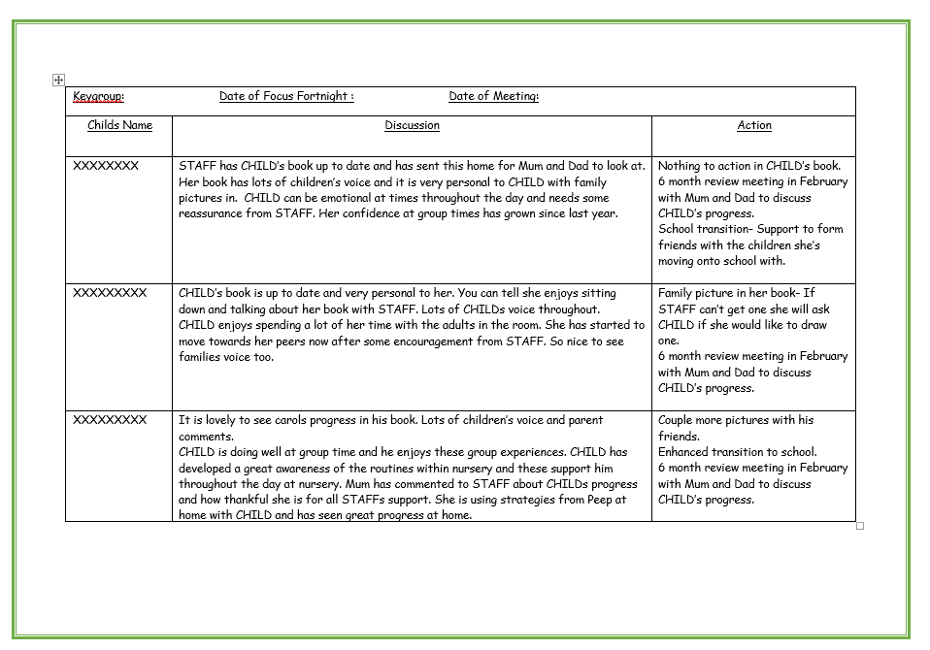
Quality assurance of children's individual learning journals to ensure all children have high quality evidence and progress is recorded over time

