Slide 1
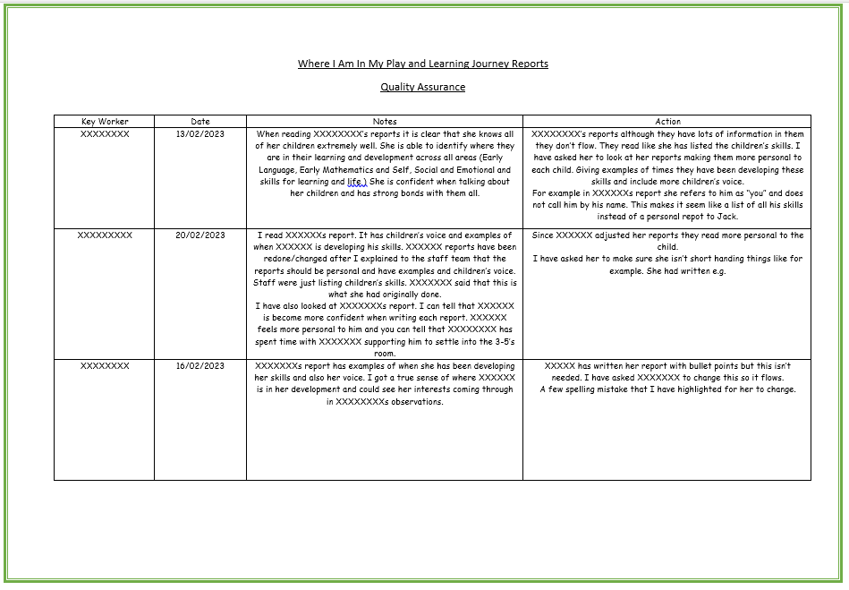
Example of monitoring Play and Learning Journey Reports
Quality assurance of reports to provide feedback on learning captured and evidenced gathered.

