Slide 1
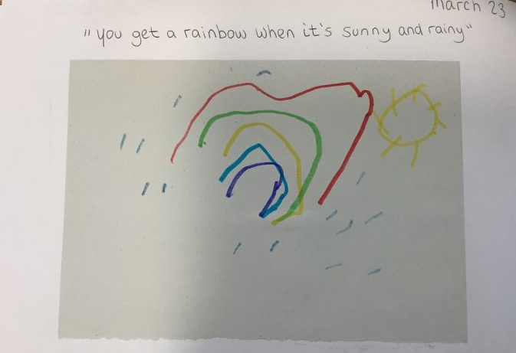
Capturing the child’s voice enables you to assess where they are in their learning. It empowers them to express their views and opinions and helps them feel involved and listened to.
Child’s voice is a powerful assessment of their own learning and promotes their expressive language development.
Child is learning to develop representational drawing skills, fine motor control, expressive language to describe drawing.
Discussing children’s art work with them makes them feel valued and respected. It gives them ownership of their achievements and allows them to share their thoughts. It promotes confidence and self worth.

