Slide 1
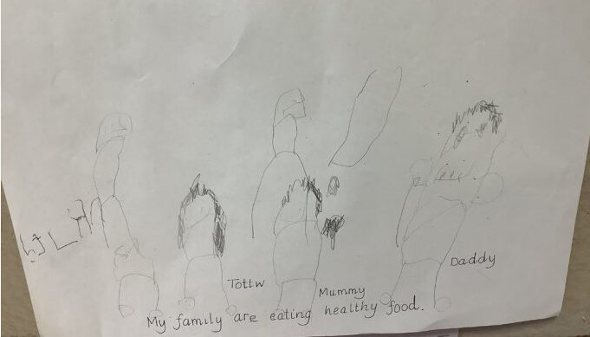
Children’s drawings and paintings can offer a wide range of assessment information.
Assessment of child’s mark making skills in both line drawings and letter formation!
Assessment of child’s confidence and ability to talk about their work!
What a child says about their drawings can give further assessment information – This child spoke confidently about healthy foods!
It is important that staff talk to children about their work!

