Slide 1
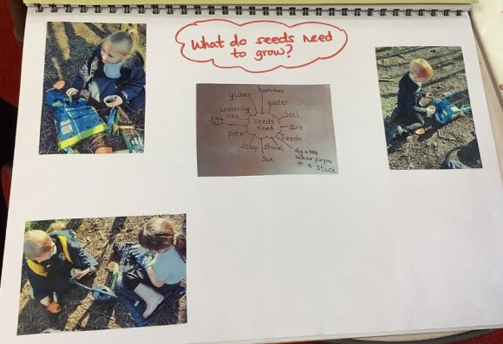
Mind maps can be a great child friendly way of assessing children’s knowledge around a specific subject. This is usually done best in situ, while children are naturally engaged/ participating in the experience.
Assessment information gathered in mind maps can enable staff to better plan next steps or new learning for children.

