Slide 1
Learning, Teaching & Assessment
Learning, Teaching and Assessment
Session 4

Slide 2
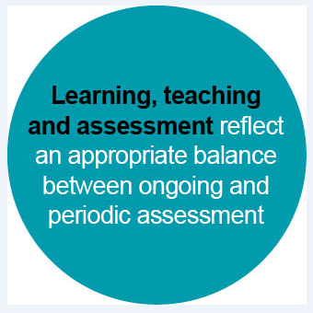
Learning, Teaching and Assessment (Moderation) Cycle
Notes:
The Learning, Teaching and Assessment (Moderation) Cycle
Learning, teaching and Assessment - bubble 4 on the cycle

Slide 3
Aims
To consider the key features of the learning, teaching and assessment process.
To develop an understanding of the importance of an integrated approach to planning learning, teaching and assessment.
To explore different approaches to assessment.
To evaluate current practice and identify areas for improvement.

Slide 4
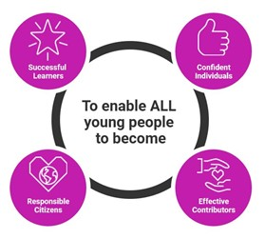
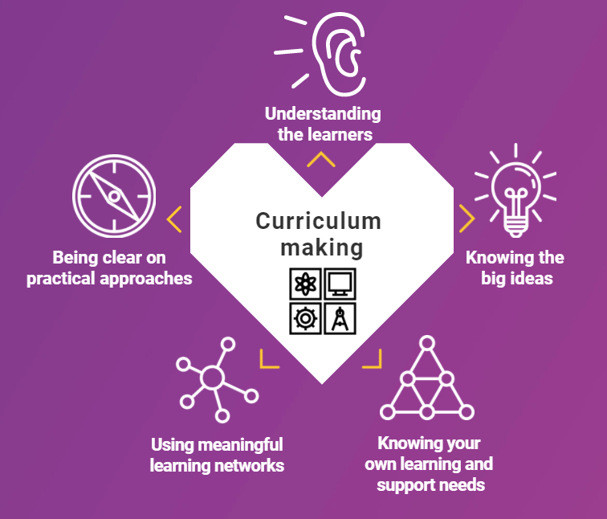
Refreshed Narrative on Scotland’s Curriculum (September 2019)
https://scotlandscurriculum.scot/
Resources to support the Refreshed Narrative
Published 2020
Notes:
This was an opportunity to revisit the Curriculum for Excellence narrative and look at it within the current context. It should stimulate fresh thinking about Scotland’s curriculum. It celebrates the successes for CfE and should build confidence for future development
It’s about placing the learner at the heart of education. CfE is about the 4 capacities that we should be enabling all young people to become. It’s about maximising and developing opportunities to meet the needs of our learners.
It’s about the totality of experiences that we plan for within the 4 contexts for learning. Learning supposed to be active and meaningful based on real life contexts​. Interdisciplinary learning is one of the 4 contexts for learning.
It’s about engaging in professional dialogue around curriculum design, and about inspiring, sharing and nurturing innovation. It mentions making meaningful learning networks to optimise impact - opportunities to engage in purposeful dialogue with colleagues.

Slide 5
The 7 Principles of Curriculum Design
Challenge and Enjoyment
Coherence
Breadth
These design principles assist practitioners and establishments in their practice and are a basis for continuing review, evaluation and improvement.
Relevance
Personalisation and choice
Progression
Depth
Building The Curriculum 3: A Framework for Learning and Teaching
The Scottish Government (2008)
Notes:
BTC 3 and HGIOS 4 state that the curriculum should be designed on the basis of the above 7 principles.
Along with the Es and Os, the seven design principles should form the basis of planned learning and, consequently, of the curriculum as a whole.
These design principles prove useful when reviewing learning experiences across the four contexts of learning and when evaluating the curriculum as a whole.

Slide 6
Effective use of assessment by staff and learners is an integral part of learning and teaching which ensures children and young people maximise their successes and achievements.
Assessment within the BGE: A Thematic Inspection
Education Scotland (2020)

Slide 7
Planning for learning and teaching includes planning for assessment.
The planning of assessment activities should be carried out at the same time as the planning of learning experiences.
When planning learning, teaching and assessment, practitioners use the Experiences and Outcomes to develop relevant Learning Intentions.
When planning learning, teaching and assessment, practitioners and learners use the agreed Learning Intention(s) to co-create relevant Success Criteria.
Practitioners should actively engage in professional dialogue around the standards and expectations, therefore engaging in moderation of the planning of learning, teaching and assessment.
Notes:
Planning learning, teaching and assessment
Emphasise the need to ensure that, regardless of ability, all learners should be able to influence the development of and fully understand the intended learning.
This can best be achieved through the co-construction of ‘pupil-friendly’ learning intentions.
Emphasise the need to ensure that, regardless of ability, all learners should be able to influence the development of and fully understand the intended learning.
This can best be achieved through the co-construction of ‘pupil-friendly’ success criteria which are based on learning intentions and, ultimately, on the agreed bundle of Es and Os.
To be successful, success criteria should fulfil the above.
The need for colleagues to work together to plan learning, teaching and assessment.
Working collaboratively with others is central to the moderation process.
Assessment should be planned for at the outset, alongside the planning of learning experiences.

Slide 8
Pause for thought
What are the key features of high quality learning and teaching?

Slide 9
Pause for thought
What are the key features of high quality learning and teaching?

Slide 10
Key features of high quality learning and teaching
The learning environment is supportive, nurturing and appropriately challenging.
Teaching approaches ensure learners are engaged and motivated.
Learners are encouraged to become increasingly independent in their learning.
Learners have opportunities to lead their own learning.
Teaching approaches are differentiated according to learners' needs.
Learning and teaching approaches promote higher order thinking.
Learners have opportunities to apply their learning in new and unfamiliar contexts.
Effective questioning and well-timed interventions are used throughout lessons to support and challenge learners.
Notes:
Possible answers to this discussion question might include the above. What other features of high quality learning and teaching would you include?

Slide 11
Key messages for planning learning, teaching and assessment
Long term plans - outline the structure of the year
Medium-term plans - short and focused on main learning activities from bundling the Experiences and Outcomes.
Take a collegiate approach to moderation of planning learning, teaching and assessment.
Review and reduce any unnecessary bureaucracy.
Provide space and time for depth of learning.
Consider how best the needs of individuals and groups of children will be met.
Prioritise health and wellbeing, literacy and numeracy across the curriculum to ensure that all learners make the best possible progress.
Plan IDL to make natural links across learning
Focus directly on enhancing the learner journey.
A Statement for Practitioners from HM Chief Inspector of Education (2016)
Notes:
Key messages are taken directly from the Education Scotland Curriculum for Excellence (CfE) Statement for Practitioners from HM Chief Inspector of Education (Aug 2016) document
Emphasise:
While being as efficient as possible, planning should also be unbureaucratic. Planning should inform learning, teaching and assessment and suit local needs.
The moderation of learning, teaching and assessment should always be carried out collaboratively. Professional dialogue is at the heart of the moderation cycle.
The planning process should take into consideration the needs of all children and young people
The coherent planning of literacy, numeracy and health and wellbeing across the curriculum should be prioritised
** Direct practitioners to the Statement for Practitioners to see the “What to Avoid” section.

Slide 12
Pause for thought
Why do we use assessment?
What makes a high quality assessment?

Slide 13
Why do we use assessment?
Creates consistent and smooth links through early learning, primary, secondary school and further education.
Assess progress to support learning and to flexibly meet learners’ individual needs.
To support learning – it helps teachers, learners, parents and others to understand the depth and breadth of learning undertaken so that progress and next steps can be discussed and planned.
Notes:
Taken from Education Scotland website

Slide 14
Ongoing assessment should be used to give feedback and plan next steps. Periodic assessments at the end of a sequence of lessons and those at points of transition are also important.
Practice is most effective where teachers use a range of assessment approaches flexibly to identify strengths, learning needs and appropriate support.
Assessment should not constrain learning but reflect and be driven by it, thereby giving responsibility and considerable scope for learners and those that guide them to design together how best to do it.
Building the Curriculum 5: A Framework Assessment - The Scottish Government (2011)​
Notes:
Building the Curriculum 5
The flexible use of a range of assessment approaches in order to meet learners’ needs
Assessment is at the heart of the learning and teaching process and can encourage learners to become responsible and more successful learners.

Slide 15
Types of Assessment
Diagnostic
Formative
Summative
BEFORE: assess particular skill to inform the teaching process
DURING: throughout learning process to monitor progress and give feedback
AFTER: assess the learning that has
taken place
Purpose of Assessment
Assessment FOR learning
Assessment AS learning
Assessment OF learning
Notes:
Diagnostic – assessment of a particular skill or knowledge to inform the teaching process (before) / identify current knowledge or misconceptions about a topic.
Formative – assessment that takes place throughout the learning to monitor learner progress (during) / gives feedback during the instructional process
Summative – final assessment of the learning that has taken place (after)
FOR – diagnostic, formative, guides next step in the process
AS – self assessing, learning by doing – students own metacognition, evaluating own progress and making adjustments
OF – summative, compare students, record progress.

Slide 16
Formative or Summative
 | Formative Assessment | Summative Assessment
Informal | Questioning Feedback Peer assessment Self-assessment | Essays in uncontrolled conditions Portfolios Coursework Teacher assessment
Formal | Further analysis of tests, exams, essays Target setting | Tests Exams Essays in controlled conditions
National Foundation for Educational Research report (NFER, 2007)
Notes:
The table, based on the UK’s National Foundation for Educational Research report (NFER 2007), classifies types of formative and summative assessment as either formal or informal. It can be argued that all of the assessment strategies in this table support AFL if their ultimate use is to help the student progress in terms of their learning. A good example of using a summative assessment strategy in an AFL context is where a test or exam is used to identify a lack of understanding (e.g. in a particular area of the syllabus) and subsequently targets are set to rectify this.

Slide 17
Although we typically speak of “formative assessment” and “summative assessment”, actually the same assessment can be used for both formative and summative purposes. What matters is how the information from an assessment is used.
What makes a good formative assessment? Daisy Christodoulou (2017)
There is one big idea to assessment …
to use evidence about learning to adapt what
happens in classrooms to meet student needs.
Assessment For Learning (Keynote Address) Dylan Wiliam (2008)
Notes:
Daisy Christodoulou (2017) - what matters is how the information from an assessment is used.
Building the Curriculum 5 says: “Evidence and feedback from any assessment can be used formatively to inform planning for improvements in learning, as well as contributing to periodic summaries of progress and achievement for reporting and monitoring.”

Slide 18
How can a summative assessment be used formatively?
formative
summative
assessment
Planned Assessment | SUMMATIVE | FORMATIVE
Numeracy Test on number facts | Teacher can make a judgement if learner knows their number facts or not. | Teacher can identify which number facts they are not secure with, eg 7x table, and focus on that next. Teacher can give feedback on this.
Writing Extended piece of descriptive writing | Teacher can make a judgement on learner’s effective use of descriptive language. | Teacher can identify techniques of descriptive language the learner is not using effectively, and build this into next lessons/targeted support. Teacher gives feedback on specific next steps.
Reading Comprehension | Teacher can make a summative judgement on levels. | Teacher can examine the overall data and identify trends in performance eg significant numbers of children having difficulty making inferences.
Notes:
A summative type of assessment can be used formatively to inform next steps and future learning.
The formative evaluation must be used to inform next steps/planning and time given for the learner to be able to act upon feedback.

Slide 19
Planning assessment approaches
When planning learning experiences, practitioners should include a range of approaches to assessment which best reflects learners’ circumstances.
Drawn from both ongoing and periodic assessment, and considers breadth, challenge and the application of learning.
This allows the learner to demonstrate what they know, understand and can do.
This enables practitioners to gather, reflect on and evaluate a wide range of assessment evidence, to inform their professional judgement of a learner’s progress and achievements, and inform next steps.
Notes:
Practitioners should use a range of approaches to assessment to assess different types of achievement. These should be drawn from ongoing and periodic assessment activities.
Planning for assessment should take place at the same time as planning of learning and teaching.
Approaches to assessment need to take consideration of breadth, challenge and the application of learning. Consequently, in the course of a block of learning, there should be opportunities for learners to demonstrate:
a breadth of learning across a number of Es and Os
that they are able to meets the demands of appropriately challenging learning
that they can apply what they have learned in new and unfamiliar contexts.
Appropriate approaches to assessment help engage learners
As with other aspects of the moderation process, learners should be involved in selecting those assessment approaches which they feel will best help them demonstrate their knowledge, understanding, skills, attributes and capabilities.

Slide 20
Ongoing Assessment
Conversations with learners
Peer assessment
Self-assessment
Teacher observations
Questioning approaches
a range of open and closed questions
hinge questions
Ongoing assessment approaches enable practitioners to:
Quickly determine prior knowledge and understanding.
Challenge and develop further learners’ thinking around key concepts and ideas.
Promote the range of Higher Order Thinking Skills.
Assess learners’ progress on an ongoing basis.
Provide ongoing formative feedback and next steps.
Make appropriate interventions to provide additional support.
Provide opportunities to broaden the range of learning.
Challenge individuals and groups of learners.
Provide opportunities for learners to apply their knowledge, understanding and related skills in a variety of ways.
Notes:
The most common ongoing assessment approaches include: teacher observations; learner conversations; peer and self assessment; self-assessment; questioning approaches such as a range of open and closed questions and hinge questions.
However, this is not an exhaustive list and participants may wish to add to it.
As well as providing opportunities for learners to apply their knowledge, understanding and related skills in a variety of ways, using a wide variety of ongoing and periodic assessment approaches helps practitioners to regularly assess learners’ progress and intervene in order to provide further support and challenge.
The richer the range of assessment approaches, the more feedback on learners’ progress this will yield.

Slide 21
Periodic Assessment
End of unit assessment
Standardised assessments
Carried out against specific criteria
Snapshot in time
Periodic assessment approaches enable practitioners to:
Take stock of learners’ progress and achievements.
Prioritise next steps in teaching and learning.
Plan ahead and put interventions in place where needed.
Record and report on progress.
Inform target setting.
Monitor and evaluate progress locally and nationally
Notes:
A range of assessment approaches should be used to build a profile of the learners’ progress and achievement.

Slide 22
To promote effective assessment, practitioners need to:
explain the learning aims to learners and check their understanding
demonstrate the standards learners are required to achieve and help them recognise when they have achieved that standard
give effective feedback on assessment decisions, so that learners know how to improve
demonstrate high expectations and make it obvious to learners that they believe that they can improve on their past performance
provide regular opportunities for teachers and learners to reflect on the last performance and review learners’ progress
develop learners’ self-assessment skills, so that they can recognise what aspects of their own work need to improve.
Assessment for Learning - Dr Cheryl A Jones (2005)
Notes:
Assessment for Learning - Dr Cheryl A Jones (2005)
https://dera.ioe.ac.uk/7800/1/AssessmentforLearning.pdf
Building the Curriculum 5 outlines:​
the process of sharing learning intentions and success criteria in order to allow learners to see what success looks like​
the need to allow learners the opportunity to develop the understanding and skills needed to help devise the success criteria​
Staff should discuss with learners what they are expected to learn. They should clarify and share learning intentions and success criteria and appropriate experiences for achieving these. Both staff and learners should foster a sense of achievement by sharing challenging and realistic expectations. Sharing success criteria along with learning intentions allows learners to ‘see what success looks like’. With practice, success criteria can often be devised by the learners themselves. (BTC 5)

Slide 23
What makes a high quality assessment?
Education Endowment Foundation - AMPP Great Assessment
Notes:
https://vimeo.com/156710795
EEF – Assessing and Monitoring Pupil Progress
3min video A Great Assessment
Purpose – Validity – Reliability - Value

Slide 24
Adapted from: Education Endowment Foundation
Assessing and Monitoring Pupil Progress
What makes a high quality assessment?
Validity
Reliability
Value
Purpose
Does the assessment measure what it was intended to measure?
What is the purpose of the assessment?
eg to measure a student’s ability or to inform differentiated support?
Are the assessments consistent over time for the purpose intended?
Does the assessment have a positive impact on children’s learning?
Notes:
A high quality assessment needs to have a clear purpose and have a value where it will have a positive impact on the learner’s progress. Assessment needs to be valid, where it measures what it intends to measure and gathers data for the intended interpretation. Assessment needs to be reliable, is it consistent over time for the purpose intended? A poor quality assessment may give misleading results and lead to poor quality decisions from the data.
Commercially available assessments are often considered more valid and reliable, however they are not necessarily better quality tests than those created by teachers in school.
When it comes to making decisions about pupil understanding and progress based on assessment data, the greater the validity and reliability of an assessment, the greater the trust that can be placed in the data it generates.
(covered further on) Formative and summative assessment are misleading terms: the tests are often the same, it is only the way the data is used that changes.

Slide 25
Assessment is valid if…
The activities planned reflect the intended learning in the experiences and outcomes chosen and​
Learning Intentions reflect the Es and Os accurately​
Planned activities reflect the Learning Intentions​
The success criteria measure the planned learning ​
Success criteria are clear and measurable and link clearly to the Learning Intentions ​
The activities planned are at an appropriate level of demand for the level​
Success Criteria measure how well the learner has achieved - quality as well as quantity​
Notes:
​There were many presumptions made about teachers and practitioners in creating CfE​
That staff would know how to:​
recognise and link the ‘learning’ intended in the Es&Os (use organisers to guide you if you are unsure)​
plan experiences which promote and support that learning ​
provide valid opportunities for learners to demonstrate what they’ve learned – and how well​
appreciate the purpose of moderation in assessment​
use what they’ve learned about assessment to move learning forward: ​
breadth, challenge and application within a level ​
progression through levels

Slide 26
QI 2.3 Learning, Teaching and Assessment
Challenge Questions
How Good Is Our School? 4th Edition
What actions are we taking to ensure learning and teaching is of a consistently high quality?
How do we plan learning to effectively meet all learners’ needs and to ensure appropriate pace and challenge in learning?
How effective are our approaches to monitoring and tracking across all curriculum areas, using data to:
set learning targets with children and young people;
evaluate their progress; and
put in place appropriate interventions to raise attainment and close any gaps?
To what extent do we use assessment information in the planning of learning and teaching?
How are our approaches to moderation and use of National Benchmarks improving the validity and reliability of professional judgements of learners’ progress and attainment?

Slide 27
Reflective Questions
Do the planned learning experiences:
Give learners the opportunity to develop and demonstrate their knowledge, understanding, skills, attributes and capabilities?
Take account of the seven principles of curriculum design?
Provide opportunities for breadth, challenge and the application of learning?
Motivate and engage learners by considering the different needs in the classroom or playroom?
Provide the best opportunity to ensure that learners achieve the learning intentions and fulfil success criteria?
Have you used a range of assessment approaches?
Does this include self and peer assessment?
Are the learners receiving ongoing feedback?
Is this based on the success criteria?
Have you planned any periodic/high quality assessment?
Does this allow the learner to demonstrate breadth, challenge and application?
Overall, how confident are you that all your learners experience activities which are varied, differentiated, active, and provide effective support and challenge?
Notes:
Education Scotland: with colleagues/staff, use these questions as a basis for reflection and discussion. You may wish to leave some time between delivering this presentation and considering these questions to allow colleagues time to think about what has been outlined.​

Slide 28
Further Information
Education Scotland - Moderation Hub - Learning, Teaching and Assessment
Education Scotland (2020) - Assessment within the BGE: A Thematic Inspection
Education Scotland (2020) - Assessment - What is working well?
Education Scotland (2021) - Assessment within the BGE 2020-21
Daisy Christodoulou (2017) - What makes a good formative assessment?
Dylan Wiliam - Self and Peer Assessment (3 minute video clip)
Maria Kampen (2021) 6 Types of Assessment (and How to Use Them)
Alison Peacock (2016) – TED talks: Learning without limits (10 minute video clip)
Shirley Clarke and John Hattie (2018) - Visible Learning: Feedback

