Slide 1
Learning, Teaching & Assessment
Evidence
Session 5

Slide 2
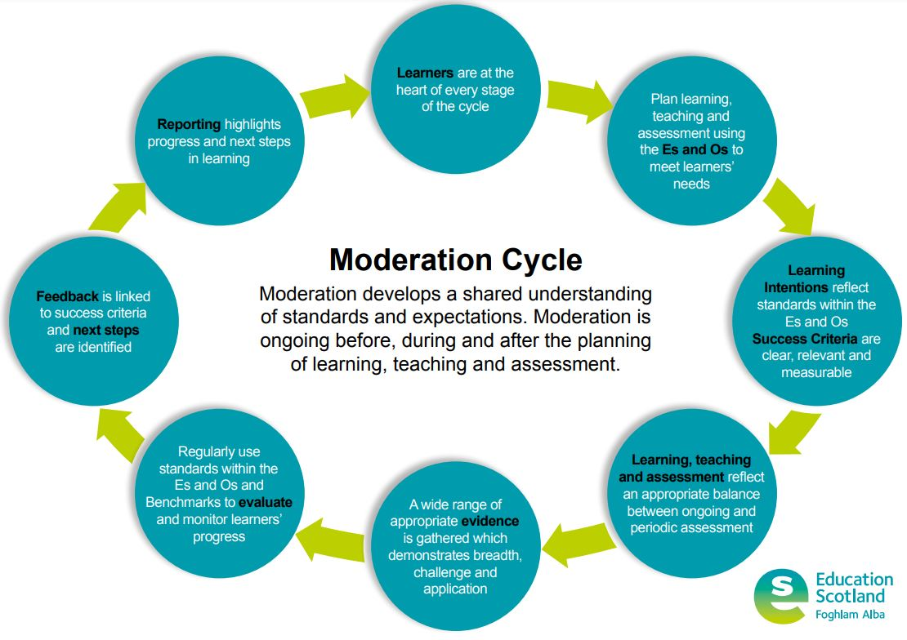
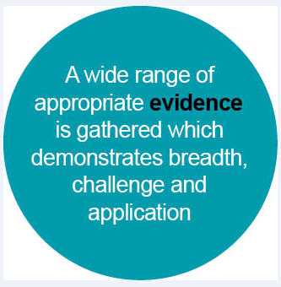
Learning, Teaching and Assessment (Moderation) Cycle
Notes:
The Learning, Teaching and Assessment (Moderation) Cycle
Evidence - Bubble 5

Slide 3

Aims
To develop an understanding of how to gather data to provide robust evidence.
To develop an understanding of the difference between qualitative and quantitative data.
To explore practical and manageable methods of gathering evidence.

Slide 4

Evidence of children and young people's progress and achievements will come from day to day learning and through the things they may write, say, make or do.
For example, evidence may emerge as a result of children and young people taking part in a presentation, discussion, performance or practical investigation. Evidence could also be a drawing, report, or piece of art work that they have produced. Evidence may be captured as a photograph, video or audio clip as part of a particular learning experience.
What is assessment, and when and how does it take place?
Education Scotland (ParentZone)
Notes:
Evidence is coming from a wide range of sources, all of which should inform teacher professional judgements.

Slide 5

Key features of highly effective practice
A range of assessment data is used very effectively to identify learners’ needs and plan learning across the school, specifically for targeted groups of learners.
Summary of inspection findings
Across primary and secondary schools, teachers are broadening the range of assessment evidence they gather to support their professional judgement … They need to build on this work to continue to improve the reliability and validity of teacher judgements of children’s progress and achievement across all aspects of their learning.
Education Scotland (2020) - Assessment within the BGE: A Thematic Inspection
Notes:
Where are we now in Scotland? What is the national picture?
Thematic Inspection was published in March 2020, just before school closures due to Covid-19.
There are signs that a range of assessment data is being used. However we still need to broaden the range of assessment evidence we are gathering. We still need to work on consistency of professional judgements around progress. These judgements should be informed by the assessment data.

Slide 6

Pause for thought
Why is evidence so important?
Indication of how well the learner has met the expected standards in the Es and Os and Benchmarks.
Demonstrates where the learner has experienced breadth, challenge and application of learning.
Indicates progress made over time and highlight areas for development.
Review of evidence supports professional judgement for progress through a level or achievement of a level.
Notes:
** Use the animations to bring in the answers after a time of discussion **
Evidence is produced every single day, in many different ways both formally and informally. Practitioners have access to a huge volume of data and information from their daily interactions and the learning and teaching that takes place. All of this helps to inform their professional judgement of the progress learners are making.

Slide 7
Data can play a critical role in supporting professional judgement.
Data is information that is collected and organised in a systematic way and can be used to make instructional or organisational decisions.
Data can be collected easily.
The challenge is to interrogate it to reveal the underlying story behind the facts and figures.
Ideas into Action - Bulletin #5 (Winter 2013-14)
Using Data: Transforming Potential into Practice
Notes:
http://www.edu.gov.on.ca/eng/policyfunding/leadership/ideasintoactionbulletin5.pdf

Slide 8
Data may be seen as a
tool to use or lens to look through in order to think about and understand teaching practice and student learning more fully.
Using data for inquiry and improvement
Dr Vicki Hargraves, The Education Hub, NZ
Notes:
Data is like a window to see what is really going on with the learner.

Slide 9
Integrated Approach to Learning, Teaching and Assessment
Data Informed Improvement
Where am I now?
Where am I going?
How will I get there?
assessment data
analysis of data
targeted intervention
Notes:
What is the purpose of the assessment data you collect? How do you use it?
Assessment data should be driving forward improved outcomes for our learners.

Slide 10
For learners to demonstrate that their progress is secure and that they have achieved a level, they will need opportunities to show they:
have achieved a breadth of learning across the experiences
and outcomes for an aspect of the curriculum
can respond to the level of challenge set out in the
experiences and outcomes and are moving forward to
more challenging learning in some aspects
can apply what they have learned in new and unfamiliar situations
Education Scotland (2011) - Building the Curriculum 5: A Framework for Assessment
Notes:
Breadth / challenge / application
The 3 actually overlap.

Slide 11
Breadth of learning
Breadth refers to the number and range of experiences and outcomes encountered by learners.
Challenge in learning
Challenge refers to the attributes, capabilities and skills, including higher order thinking skills, which are embedded in learning.
Application of learning
Application refers to how knowledge and understanding, attributes, capabilities and skills, including higher order thinking skills, are used in new and unfamiliar contexts so that they become transferable. This is about learners becoming flexible and adaptable in the way they apply their learning.
Notes:
Breadth
This means that assessment needs to make use of a broader range of approaches which match the nature of that learning and the way it was encountered. This will ensure that learners can show more accurately what they know, understand and can do. Assessment should not constrain learning but reflect and be driven by it, thereby giving responsibility and considerable scope for learners and those that guide them to design together how best to do it. A carefully planned blend of approaches to the kinds of evidence used, and the ways in which it is gathered, can give validity and show an accurate picture of progress in learning over time.
Challenge
Challenge is not something that should be provided for only high achievers
It is an important balance. That balance is that you’re providing a learning experience that is challenging without becoming frustrating.
Challenge is important for students because it forces them to grow.
Not too easy/not too difficult
Application
Application refers to how knowledge and understanding, attributes, capabilities and skills, including higher order thinking skills, are used in new and unfamiliar contexts so that they become transferable. This is about learners becoming flexible and adaptable in the way they apply their learning.

Slide 12
Gathering Robust Evidence
When gathering evidence to demonstrate that a learner has achieved a level or standard, it is important to keep three factors in mind:
Is the evidence relevant?
Only collect data/evidence if
it has a purpose and is directly
linked to planned learning
and teaching outcomes.
Is the evidence varied?
Demonstrate a range of
evidence gathered in a
variety of ways.
Is the evidence manageable?
Be selective and focused
on the evidence you gather. Keep it simple, easily
implemented and uncomplicated.
Notes:
This links back to the success criteria - these are the key ingredients for success, so this is what you should be looking for evidence of from the learner.

Slide 13
Is the evidence relevant?
Avoid collecting data that does not tell you anything more than you confidently already know.
What is it I want to know?
If the learner can….?
Where are the gaps in the learning?
Can they apply their learning in a different context?
How am I going to use this evidence?
To identify next steps
To demonstrate achievement
To demonstrate progress
Notes:
Before collecting data or evidence about a learner’s progress, always ask:
What is it I want to know?
How am I going to use this evidence?
After doing this, ask again, does this tell me what I wanted to know?

Slide 14
Is the evidence relevant?
Is there coherence between the learning that was planned and the evidence that has been produced?
The learning intentions have been understood.
The success criteria have been achieved.
The benchmarks have been met.
Planning evidence to demonstrate progress and achievement.
Notes:
The evidence that is gathered should be identified as part of the learning and teaching planning process. Therefore the evidence will likely be more relevant and demonstrate progress and achievement.
We do not want to over-assess the learners, so we need to plan for what evidence is going to be gathered. Only gather the relevant evidence. You want the evidence to demonstrate progress and achievement.

Slide 15
Is the evidence manageable?
How much evidence should be gathered to be a demonstration of achievement?
Quality rather than quantity should be the focus.
Plan for evidence that will demonstrate progress and achievement.
In short we need a richer mix of high-quality assessment formats, and we also need to reduce the overall burden of assessment for ourselves and for our students.
We need to measure less, but measure it better.
UK Centre for Bioscience Briefing on Assessment - Phil Race (2009)
Notes:
High quality assessment – measure less but measure better
Previously termed Holistic Assessment – people thought it had to be a big project style assessment.
High quality Assessment simplifies it. We are looking for an approach that bundles Es and Os properly, looking at a year overview and identifying key assessment points.
Bundling properly / looking at the year overview and identifying key assessment points

Slide 16
Is the evidence manageable?
Bundle the Experience and Outcomes.
Involve the learners in documenting their progress.
Keep the focus on the intended learning.
Sample a small, targeted group or individual.
At the planning stage, design the evidence to be gathered.
Record routine observations.
Use formative assessment strategies to check for understanding.
Use practical systems to track and analyse the data.
Notes:
To make gathering evidence more manageable, consider these things on the screen.
Effective practitioners are constantly vigilant in observing learning in action. Formative assessment strategies are routinely used to check for understanding and progress. Sometimes, though, the intelligence gathered can be lost in a busy classroom. Practical and simple systems can be put in place to help track and analyse the information practitioners gather on a daily basis.

Slide 17
Tips from classroom practitioners
Routine activity | Practical examples
Exit notes - before and after the teaching input | January - “I find equivalent fractions confusing.” | February - “I now understand how to find equivalent fractions.”
Comparing teacher or pupil written feedback in jotters | February “You need to add more connectives to your writing.” | March “I am impressed by the fact you are using more connectives - 3 wow connectives in this piece of writing!” | April “Your use of connectives means you are creating many more complex sentences.”
Learners scaling confidence on a chart Comparing at the end of the week to analyse progress | Monday 3 out of 10 | Tuesday 3 out of 10 | Wednesday 6 out of 10 | Thursday 9 out of 10 | Friday 10 out of 10
Learners/teachers assessing against success criteria | February Met 5 out of 12 of the writing criteria | March Met 10 out of 12 of the writing criteria.
Thumbs up/down Traffic Lights | Noting for targeted children to track progress. Looking for an increase in thumbs up or green lights.
Notes:
Know what you want to find out and who you want the information from, before you collect the evidence.
Observe and celebrate the small steps.
Remember this can be for a targeted individual or group of children.

Slide 18
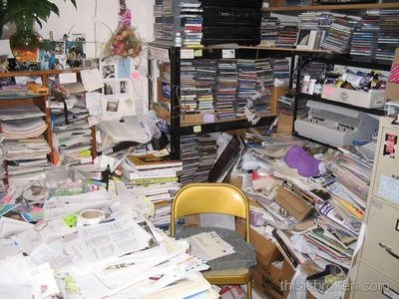
Is the evidence varied?
Evidence is not endless stacks of paper.
Evidence should come from a
variety of different sources.
observations
posters
assessment
dialogue
exit pass
presentations
journals
jotter work
reports
learning logs
show-me boards
Notes:
** Use the animation to bring in the suggestions after talking through the image **
Evidence should be proportionate and manageable. There is no requirement for files and files of paper based evidence. Practitioners should be clear about the evidence they are gathering and what it demonstrates.
There should be a clear and shared understanding of the purpose of the evidence and the need to be selective so that it is useful. Learner evidence informs professional judgement of progress and achievement, feeding into tracking and monitoring systems and processes.

Slide 19
Is the evidence varied?
Quantitative Data
Qualitative Data
numbers
descriptions
can be measured
observed, not measured
factual
helps understand the “why”?
analysed by grouping into meaningful themes
analysed using statistics
quantity = quantitative
quality = qualitative
Notes:
Different types of data - qualitative or quantitative
Quantitative data is when the data is expressed as a quantity, amount or range. It is countable: 3/10 in a test, achieved 12/15 on the criteria scale, 4/5 happy faces today. Quantitative data is often displayed through graph
Written assessments / standardised assessments / criteria based observations / tracking or scaling change / closed question based surveys / formative assessment strategies such as thumbs up and exit passes.
Qualitative data is descriptive. It is an exploratory approach and seeks to explain the whys? and hows? by directly asking individuals such as learners, parents or teachers. Qualitative data is often shared through descriptive phrases.
Focus groups / learner conversations / open ended questionnaires / interviews / observing learners / descriptive journals / learning logs
** This concept is be developed further in the next session about evaluating learners’ progress. **

Slide 20
Pause for thought
Is the evidence relevant?
When and how do you plan gathering evidence to demonstrate progress or achievement?
How do you ensure that there is coherence between your planning for teaching, learning and assessment and the evidence you gather?
Is the evidence manageable?
What routine systems do you have in place for gathering evidence? What systems would you recommend?
How do you involve learners in documenting their progress and achievements?
Is the evidence varied?
What methods do you use in the classroom/playroom to ask the why and how questions?
Consider the data/evidence you collect. What is qualitative and what is quantitative?
How do you plan the informal direct observation of learners? Do you use quantitative methods? Do you involve colleagues?

Slide 21
Teachers must take responsibility for their students’ learning, but they must also have the latitude to refine and develop their craft.
To build a collaborative culture and promote instructional improvement, the data-use process needs to be emphasising solving problems, not passing judgement.
Steele and Boudett (2008/2009)
The Collaborative Advantage - Education Leadership 66
Notes:
https://www.researchgate.net/publication/297775705_The_Collaborative_Advantage
Moderation activity should not be about passing judgement. It should be a collaborative process where we can refine and develop our craft, as well as focussing on the learner progress.
Teachers who monitor progress on a day to day basis are more likely to effectively drive progress for the learner.
Further information:
No point in collecting information if we are not going to act upon it. - TEDx Talk - Khurram Virani
https://www.youtube.com/watch?v=L3eO8gYmWCc

Slide 22
HGIOS 4: QI 2.3 - Learning, Teaching and Assessment
Level 5 illustration - Effective Use of Assessment
Our assessment evidence is valid and reliable. At key milestones, our assessments provide reliable evidence which we use to report on the progress of all children and young people.

Slide 23

Reflective Questions
  What are some of the sources of evidence you might gather?
  Do you gather a wide range of evidence, from a variety of sources and contexts?
  Does your evidence demonstrate breadth, challenge and application?
  Do you have an agreed approach to gathering, recording and storing evidence?
  Are your approaches to gathering evidence manageable?
  How do you include learners in the process of gathering and using evidence?
  Does your evidence show ‘latest and best’ or do you have an agreed time period for keeping evidence?
  Does your evidence show progress towards or achievement of a level or both?
  Is the evidence you have valid and reliable? What makes it so?
  How do you facilitate moderation of evidence across literacy/numeracy/ curriculum areas?
  How often do you review a body of evidence with colleagues?
Notes:
Education Scotland: with colleagues/staff, use these questions as a basis for reflection and discussion. You may wish to leave some time between delivering this presentation and considering these questions to allow colleagues time to think about what has been outlined.​

Slide 24
Further Information
Education Scotland (2020) - Assessment within the BGE: A Thematic Inspection
Education Scotland - How Good Is Our School? 4th Edition
Education Scotland (2011) - Building the Curriculum 5: A Framework for Assessment
Education Scotland - Moderation Hub - Evidence
Victoria State Government: Education and Training - Assessment in practice
Dr Vicki Hargraves, The Education Hub, NZ - Using data for inquiry and improvement

