Slide 1

Notes:
This is a front cover page and can only be used at the beginning of a PowerPoint presentation once. Do not add anything else to this screen if it is being used.

Slide 2


Learners
National support for moderation
For Scotland's learners, with Scotland's educators
Do luchd-ionnsachaidh na h-Alba, le luchd-foghlaim Alba

Slide 3
Aims
  Highlight the importance and value of placing the learner at the heart of the process of learning
  Identify the role of the learner at each stage of the moderation process and explore ways in which to maximise their input
  Ensure that the learner is an active participant in their own learning
  Reflect on existing practice and identify areas for improvement
For Scotland's learners, with Scotland's educators
Do luchd-ionnsachaidh na h-Alba, le luchd-foghlaim Alba
Notes:
Notes for presenter:
The purpose of this presentation is to develop further existing understanding of learning, teaching and assessment, reflect on the current national context, with current practices and plan for improvement.

Slide 4
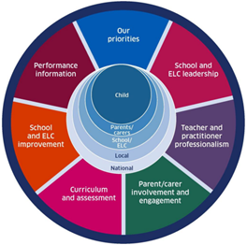
Setting the context for learning, teaching and assessment within the National Improvement Framework
For Scotland's learners, with Scotland's educators
Do luchd-ionnsachaidh na h-Alba, le luchd-foghlaim Alba
Notes:
Notes for presenter:
Why are learners so important? The NIF sets out the need for robust and consistent evidence to improve children and young people’s health and wellbeing, to raise attainment and close the poverty related attainment gap. teacher professional judgement is central to this and to develop the quality of teacher professional judgement we must ensure quality and consistency across the full cycle of planning for learning, teaching and assessment.
3 of the NIF drivers relate to the learning, teaching and assessment cycle (moderation cycle) curriculum and Assessment , school and ELC improvement and performance information. The NIF Plan has key activities that relate to improvement in learning and teaching particularly for those at risk of poor outcomes. These are: the need to focus on quality and consistency of assessment data; to provide support for practitioners and school leaders in relation to learning, teaching and assessment; the need to develop skills in the skilful use of data for improvement in learning and teaching and to share effective practice across school systems.
Effective Learning, teaching and assessment lies at the heart as the vehicle to do this.

Slide 5

National Thematic Inspection: Assessment within the Broad General Education
Signposts highly effective practice from
across Scotland.
https://education.gov.scot/education-scotland/what-we-do/inspection-and-review/chief-inspector-report/national-thematic-inspections/assessment-in-the-bge/
For Scotland's learners, with Scotland's educators
Do luchd-ionnsachaidh na h-Alba, le luchd-foghlaim Alba
Notes:
Notes for presenter:
The NIF as mentioned, sets out the need for effective practice to be shared across the system. This year, HM Inspection colleagues published the National Thematic Inspection on Assessment within the BGE – where effective practice was shared through case studies from across Scotland. The publication identifies 6 key features of effective practice which are:
Strong leadership and direction
Use of a range of assessment data
Well considered and carefully planned approaches to moderation
High quality professional learning to improve confidence and increase skills in accurate assessment
Skilled interrogation and analysis of data
Involvement of children and young people in assessment of learning, which includes high quality feedback and learner conversations.
Effective use of the learning, teaching and assessment cycle will help to develop this practice.

Slide 6


Updated Advice and Guidance
Assessment – what is working well?
https://education.gov.scot/improvement/scotland-learns/resources-for-practitioners/assessment-what-is-working-well/
Assessment within BGE 2020/21
https://education.gov.scot/improvement/learning-resources/assessment-in-the-broad-general-education-2020-21/
For Scotland's learners, with Scotland's educators
Do luchd-ionnsachaidh na h-Alba, le luchd-foghlaim Alba
Notes:
Notes for presenter:
Recently published advice and guidance on assessment can be found on the Moderation Hub and the National Improvement Hub: Assessment- what is working well? https://education.gov.scot/improvement/scotland-learns/resources-for-practitioners/assessment-what-is-working-well/
Assessment within BGE 2020/21
https://education.gov.scot/improvement/learning-resources/assessment-in-the-broad-general-education-2020-21/ This guidance is aims to support practitioners as they consider how they will approach assessment in the return to school.

Slide 7
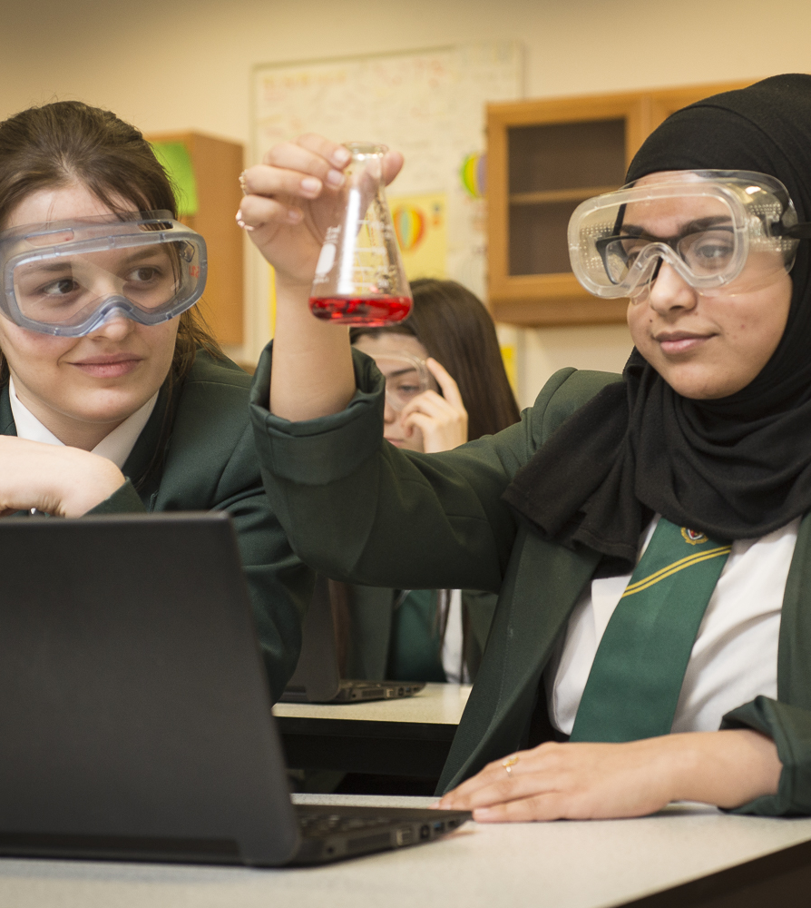
School
inspection
findings
2018-19
BRIEFING 1 – February 2020
Notes:
Notes for presenter:
The first in a series of briefings from the Chief Inspector, taking account of evidence from a sample of 252 primary, secondary and specialist provision schools over 2018-19. The briefing was designed to promote improvement at national, regional and local level. What does the briefing highlight about ‘Learners’?
https://education.gov.scot/education-scotland/what-we-do/inspection-and-review/chief-inspector-report/school-inspection-findings-2018-19/

Slide 8




QI 2.3 Learning, teaching and assessment
What is working consistently well?
What is
improving?
What are the challenges and areas for improvement?
Challenge
questions
Evaluations
◀ • • • • • • • • • • • ▶
For Scotland's learners, with Scotland's educators
Do luchd-ionnsachaidh na h-Alba, le luchd-foghlaim Alba
Notes:
Notes for presenter:
What did the School Inspection findings say about learners being involved in learning? What is working well? What is improving? What are the challenges and areas for improvement? Do the challenge questions provide any prompts to consider?

Slide 9

Learning, teaching and assessment
QI 2.3 What is working consistently well?
For learners
Staff provide a wide range of motivating learning environments which support children and young people to engage well and to apply and reinforce their learning.
◀ • • • • • • • • • • • ▶
For Scotland's learners, with Scotland's educators
Do luchd-ionnsachaidh na h-Alba, le luchd-foghlaim Alba
Notes:
Notes for presenter:
There is strong evidence that learners are considered when planning learning environments which supports engagement and application of learning

Slide 10
Learning, teaching and assessment
QI 2.3 What is improving?
For learners
The quality of oral feedback to children and young people is improving.
◀ • • • • • • • • • • • ▶
For Scotland's learners, with Scotland's educators
Do luchd-ionnsachaidh na h-Alba, le luchd-foghlaim Alba
Notes:
Notes for presenter:
There is evidence of improvement to the ways in which learners are provided feedback in learning, orally.

Slide 11
Learning, teaching and assessment
QI 2.3 What are the challenges and areas for improvement?
For learners
More needs to be done to ensure learners are clear about their next steps in learning.
For Scotland's learners, with Scotland's educators
Do luchd-ionnsachaidh na h-Alba, le luchd-foghlaim Alba
Notes:
Notes for presenter:
A challenge and an area for improvement is to further include learners in their next steps in learning.
There is evidence of improvement of learners receiving oral feedback of how well they are progressing but their next steps need to be

Slide 12
Learning, teaching and assessment
QI 2.3 Challenge questions
How well do we enable learners to articulate their developing skills and value these in terms of future learning and career pathways?
How effective are our planned opportunities for learners to discuss and reflect on their learning to empower them to lead and take increasing responsibility for their own learning?
How effectively do we actively involve learners in planning and leading their own learning?
How effective is our use of digital technologies to enhance learning and develop skills for learning, life and work?
For Scotland's learners, with Scotland's educators
Do luchd-ionnsachaidh na h-Alba, le luchd-foghlaim Alba
Notes:
Notes for presenter:
How do these challenge questions correlate with your practice?

Slide 13
The Learner - Planning Using Experiences and Outcomes
  Learners are at the heart of planning. Practitioners should consider their prior learning, strengths and next steps when planning for learning, teaching and assessment. Learners should have opportunities to be involved in planning for, and reflecting on, their learning. Some ideas for planning with learners include:
  Mind maps.
  Floor books and big books.
  Use of GLOW/ICT.
  Learning Logs.
  Interactive wall displays illustrating the learning journey.
  KWL grids (identifying what they Know, Want to find out, and, at the end of the block, what they have Learned).
  Discussing learner’s targets and/or next steps.
For Scotland's learners, with Scotland's educators
Do luchd-ionnsachaidh na h-Alba, le luchd-foghlaim Alba
Notes:
Notes for presenter:
Learners of all ages can be involved in the planning of their learning. From the Early Years where practitioners may use Floorbooks or ‘Talking Tubs’ to identify Possible Lines of Development (PLODS) which interest their learners, to learners in S3 who may review progress and discuss next steps with practitioners to identify how they are going to continue to improve.
When planning, it is important for the practitioner to be aware of learners’ prior learning, of their next steps and to offer opportunities to contribute to the plans for their learning as is age and stage appropriate. This helps learners to have a sense of ownership and motivation, as they have been involved in the process. However the practitioner should always have a clear view of the desired learning outcomes for each learner and ensure these are being delivered.

Slide 14


‘…all learners should be involved in planning and reflecting on their own learning.’
(Building the Curriculum 3)
‘Learners are fully involved in planning learning.’
(HGIOS4 QI 2.3 Learning, Teaching and Assessment Level 5 Illustration: Planning, tracking and monitoring)
For Scotland's learners, with Scotland's educators
Do luchd-ionnsachaidh na h-Alba, le luchd-foghlaim Alba
Notes:
Notes for presenter:
Learner involvement in planning and reflecting on their own learning was outlined in the original BTC 3 documentation.
It has been reinforced alongside the expectation that learning is differentiated as appropriate within the latest edition of How Good is Our School.

Slide 15

The Learner - Planning Using Experiences and Outcomes
  The refreshed narrative on Scotland’s Curriculum is a resource to stimulate fresh thinking about Scotland’s curriculum.
https://scotlandscurriculum.scot
For Scotland's learners, with Scotland's educators
Do luchd-ionnsachaidh na h-Alba, le luchd-foghlaim Alba
Notes:
Notes for presenter:
What does the curriculum look like in your context? Does it reflect your unique setting? Do you provide opportunities for personalisation and choice?

Slide 16
The Learner - Planning Using Experiences and Outcomes
Understanding learners means…
Knowing young people and where they are on their individual learner journeys.
Listening to learners and be informed by their motivations and aspirations.
Empowering learners to have agency in their learning with opportunities for personalisation and choice.
Using observations, assessments and feedback to design and develop the learning.
Engaging in professional dialogue and planning collaboratively where appropriate
For Scotland's learners, with Scotland's educators
Do luchd-ionnsachaidh na h-Alba, le luchd-foghlaim Alba
Notes:
Notes for presenter:
Do we plan for meaningful, relevant and coherent learning experiences involving learners in the process? Do we consider individual circumstances/needs when planning for learners.

Slide 17

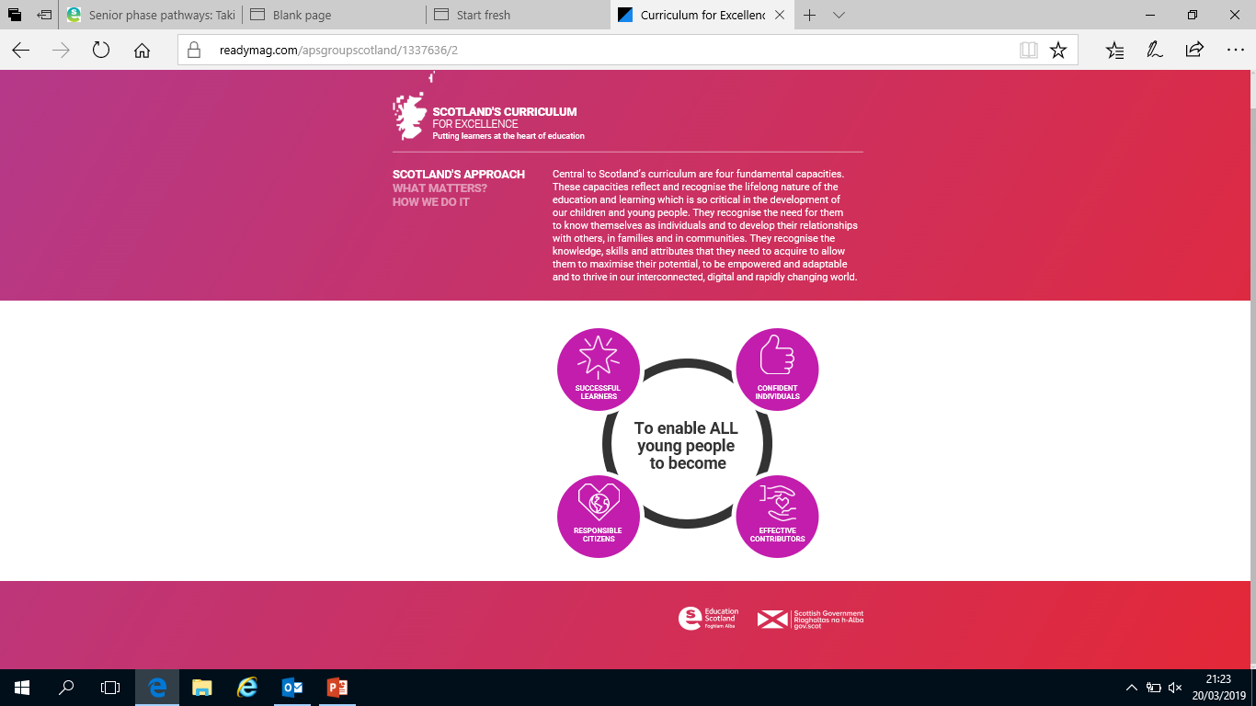
The Learner - Planning Using Experiences and Outcomes
  Do we plan with learners to provide opportunities for learning to take place across the four contexts for learning?
  Do we plan with learners to provide opportunities for learners to develop skills and attributes outlined in the four capacities?
For Scotland's learners, with Scotland's educators
Do luchd-ionnsachaidh na h-Alba, le luchd-foghlaim Alba
Notes:
Notes for presenter:
Four contexts of learning – opportunities for personal achievement, IDL, Ethos and life of the school as a community and curriculum areas and subjects. Experiences should be planned within the four contexts of learning to provide learners with opportunities to apply learning in new and unfamiliar contexts and across different learning spaces.
Four capacities – The purpose for the curriculum by providing children and young people with opportunities to develop the skills and attributes they require.

Slide 18
The Learner – Learning Intentions and Success Criteria
Sharing learning intentions ensures that learners have a clear understanding of the focus for learning. Learning intentions inform learning conversations at key points and support the profiling process.
Success criteria are clear, relevant and measurable definitions of success. Co-constructing success criteria with learners will:
  Ensure learners have a clear picture of what success looks like and how to achieve it.
  Encourage learners to be fully involved in the process and actively engaged with the success criteria throughout the learning.
For Scotland's learners, with Scotland's educators
Do luchd-ionnsachaidh na h-Alba, le luchd-foghlaim Alba
Notes:
Notes for presenter:
Again sharing the purpose and the intended outcome of the learning with learners is important in engaging them with the process. Involving them in co-constructing the Success Criteria, as appropriate, and referring to these throughout the learning, actively involves them in the assessment of their own progress and achievement.
When learners know what the intended outcomes are and the steps they need to take to be successful, they are more likely to succeed.

Slide 19

‘Staff should discuss with learners what they are expected to learn. They should clarify and share learning intentions and success criteria and appropriate experiences for achieving these. Both staff and learners should foster a sense of achievement by sharing challenging and realistic expectations. Sharing success criteria along with learning intentions allows learners to ‘see what success looks like’. With practice, success criteria can often be devised by the learners themselves.’
For Scotland's learners, with Scotland's educators
Do luchd-ionnsachaidh na h-Alba, le luchd-foghlaim Alba
Notes:
Notes for presenter:
This quotation from Building the Curriculum 5 outlines:
the process of sharing learning intentions and success criteria in order to allow learners to see what success looks like
the need to allow learners the opportunity to develop the understanding and skills needed to help devise the success criteria

Slide 20
The Learner – Learning, Teaching and Assessment
Learners are at the heart of learning, teaching and assessment.
Their prior learning and next steps are taken into account to provide rich learning experiences and valid assessments.
Learners’ interests and achievements should also be considered to ensure the learning is relevant and engaging.
Practitioners ensure the learning meets the needs of individuals and provides opportunities to demonstrate breadth, challenge and application.
Learners should be integral to the assessment process and know what they have to do to be successful. They should have opportunities for peer and self assessment, evaluating learning against agreed Success Criteria to support their understanding of the measures of success.
For Scotland's learners, with Scotland's educators
Do luchd-ionnsachaidh na h-Alba, le luchd-foghlaim Alba
Notes:
Notes for presenter:
Learning experiences and assessments should be planned with your learners in mind to ensure they are tailored to be the ‘best fit’ according to prior learning, next steps and context. Learners can contribute ideas to shape the learning and assessment at the planning stages as appropriate. They should be offered a wide range of rich learning experiences which make the most of opportunities afforded by the setting’s unique context.

Slide 21
The Learner – Learning, Teaching and Assessment
Learners should be integral to the assessment process and know what they have to do to be successful.
They should have opportunities for peer and self assessment, evaluating learning against agreed success criteria to support their understanding of the measures of success.
For Scotland's learners, with Scotland's educators
Do luchd-ionnsachaidh na h-Alba, le luchd-foghlaim Alba
Notes:
Notes for presenter:
Through the use of Learning Intentions and Success Criteria, learners can engage in self and peer assessment which helps them to develop a clearer understanding of the learning process and how to ensure they have included what they need to be successful. This supports their understanding of themselves as learners and their ability to talk about their learning.

Slide 22
Learners’ experiences are appropriately challenging and enjoyable and well matched to their needs and interests. Learners exercise choice, including the appropriate use of digital technology, and take increasing responsibility as they become more independent in their learning. They understand the purpose of their learning and have opportunities to lead the learning.
(HGIOS4 QI 2.3 Learning, Teaching and Assessment Level 5 Illustration: Learning and Engagement)
For Scotland's learners, with Scotland's educators
Do luchd-ionnsachaidh na h-Alba, le luchd-foghlaim Alba
Notes:
Notes for presenter:
This example from ‘How Good is Our School? 4’ identifies that in best practice, learners are actively involved and engaged in their learning.

Slide 23
The Learner – Evidence
Evidence is produced when learners demonstrate their learning.
  Gathering evidence should involve the learner.
  Discuss evidence with the learner to support ongoing progress and enable them to talk about their learning.
  Use evidence to identify strengths and next steps in learning and make sure these are shared with the learner.
  Where appropriate the learner can review evidence of their learning, see progress and identify these key areas for themselves.
For Scotland's learners, with Scotland's educators
Do luchd-ionnsachaidh na h-Alba, le luchd-foghlaim Alba
Notes:
Notes for presenter:
Evidence is produced every single day, in many different ways both formally and informally. Practitioners have access to a huge volume of data and information from their daily interactions and the learning and teaching that takes place. All of this helps to inform their professional judgement of the progress learners are making.
Learners should have opportunities to review their own evidence and contribute to how this is gathered. It helps if learners have a clear understanding of what the evidence demonstrates and why it is being collected. Again discussions with learners about evidence will be as appropriate to their age and stage and the format of these interactions will be structured accordingly.

Slide 24
The Learner – Evaluating Learning
Evaluation of learning involves reviewing evidence against agreed, shared standards in order to make judgements about learner progress. Involving learners in this process will ensure:
Learners’ views are fully considered.
Learners are given opportunities to reflect on their learning to support them, for example when identifying and creating longer term targets for profiling or personal learning planning.
Learners understand the progress they have made and their areas for improvement both in day to day learning and over a period of time.
For Scotland's learners, with Scotland's educators
Do luchd-ionnsachaidh na h-Alba, le luchd-foghlaim Alba
Notes:
Notes for presenter:
Evidence is produced every single day, in many different ways both formally and informally. Practitioners have access to a huge volume of data and information from their daily interactions and the learning and teaching that takes place. All of this helps to inform their professional judgement of the progress learners are making.
Learners should have opportunities to review their own evidence and contribute to how this is gathered. It helps if learners have a clear understanding of what the evidence demonstrates and why it is being collected. Again discussions with learners about evidence will be as appropriate to their age and stage and the format of these interactions will be structured accordingly.

Slide 25
The Learner – Feedback and Next Steps
The learner is integral to feedback and next steps. Learners should understand the purpose of feedback and be given time to act upon it. They should have opportunities to provide feedback to others, a process which will require modelling, scaffolding and practice as appropriate to their age and stage.
Feedback and next steps:
  Ensure learners are clear about their strengths and what they need to do next to improve.
  Involve engaging learners in high quality interactions throughout the learning process.
  Involve both quality dialogue and/or written comments.
  Are age and stage appropriate.
For Scotland's learners, with Scotland's educators
Do luchd-ionnsachaidh na h-Alba, le luchd-foghlaim Alba
Notes:
Notes for presenter:
The Learner is the key focus for feedback and should understand its purpose and value. Feedback should make clear what the Learner has done well (strengths) and what still needs work (areas for development.) Feedback can be verbal, written or both as suits the age and stage of the Learner and the context.
Learners may be asked to provide feedback to their peers. This will require them to have some input on how to give effective, constructive feedback based on success criteria and designed to promote improvement. Practitioners can model the process and scaffold early attempts, highlighting what effective feedback will include/involve. Learners will become more adept at this with practice.

Slide 26
‘We observe learners closely to inform appropriate and well-timed interventions and future learning. We use feedback effectively to inform and support progress in learning.’
(HGIOS4 QI 2.3 Learning, Teaching and Assessment Level 5 Illustration: Learning and Engagement)
For Scotland's learners, with Scotland's educators
Do luchd-ionnsachaidh na h-Alba, le luchd-foghlaim Alba
Notes:
Notes for presenter:
This example from ‘How Good is Our School? 4’ identifies that in best practice, learners are actively involved and engaged in their learning.

Slide 27
The Learner – Reporting
Learners should be involved in the reporting process through ongoing reflection and dialogue about their learning. Learners and their parents should have opportunities to discuss their strengths, progress, next steps and areas for development with practitioners.
To ensure that learners make continuous progress in their learning, reporting opportunities need to be regular and ongoing throughout the academic year.
When learners are part of the reporting process, they have a clearer understanding of, and can talk about, their learning.
This helps parents and carers to actively support learners’ progress, attainment and achievement.
Learner engagement in reporting may include:
learning logs, blogs, profiles, class assemblies, review meetings, soft starts, digital tools, open days
For Scotland's learners, with Scotland's educators
Do luchd-ionnsachaidh na h-Alba, le luchd-foghlaim Alba
Notes:
Notes for presenter:
Practitioners should have regular and ongoing dialogue with learners about their learning and progress, which encourages reflection and may contribute to learning journeys, profiling activity and/or target setting. They may be involved parent conferences/meetings and even contribute to written reports or updates.
Learners are a key element of this process and will benefit from the dialogue. There are a number of ways in which they can contribute to group/class/school reporting activities such as assemblies, curriculum workshops, displays, PATPAL sessions (Pupils as Teachers, Parents as Learners) and class newsletters.

Slide 28
VIDEO: Involving young people in planning and assessing their own learning
This video clip on the National Improvement Hub discusses how one primary school developed a range of ways to involve young people in planning and assessing their own learning:
https://education.gov.scot/improvement/practice-exemplars/woodmuir-primary-school-involving-children-in-planning-and-assessing-their-own-learning/
For Scotland's learners, with Scotland's educators
Do luchd-ionnsachaidh na h-Alba, le luchd-foghlaim Alba
Notes:
Notes for presenter:
N.B. To access this video clip on the National Improvement Hub, you may have to come out of the main presentation and go into the NOTES version (bottom right of screen).
This 4 minute video clip on the NIH, considers how one school involved learners in planning and assessing their own learning.

Slide 29
Sketchnote: Portmoak Primary School – Learning is better when children talk about their learning.
This sketch note on the National Improvement Hub discusses how one primary school developed a range of ways to involve young people in talking about their learning:
https://education.gov.scot/improvement/practice-exemplars/lead9-how-portmoak-primary-school-achieved-success
For Scotland's learners, with Scotland's educators
Do luchd-ionnsachaidh na h-Alba, le luchd-foghlaim Alba
Notes:
Notes for presenter:

Slide 30
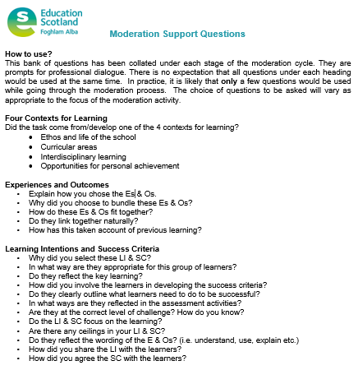
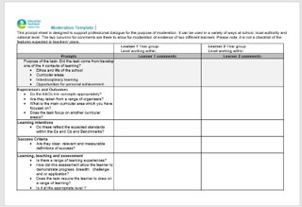
Further support for moderation
For Scotland's learners, with Scotland's educators
Do luchd-ionnsachaidh na h-Alba, le luchd-foghlaim Alba
Notes:
Notes for presenter:
The moderation support questions and moderation comment sheet will support the process of moderating learning, teaching and assessment. These resources can be found at the bottom of the ‘Learners’ page on the moderation hub.

Slide 31
Foghlam Alba
Taigh Denholm
Pàirc Gnothachais Almondvale
Slighe Almondvale
Baile Dhunlèibhe EH54 6GA
T +44 (0)131 244 5000
E enquiries@educationscotland.gsi.gov.uk
Education Scotland
Denholm House
Almondvale Business Park
Almondvale Way
Livingston EH54 6GA
T +44 (0)131 244 5000
E enquiries@educationscotland.gsi.gov.uk
For Scotland's learners, with Scotland's educators
Do luchd-ionnsachaidh na h-Alba, le luchd-foghlaim Alba
Notes:
This is a back cover page in blue. You may edit the address if needed only. It can only be once and at the end of the PowerPoint presentation. Use the corresponding blue internal and back pages if you are using this page.

