Slide 1
Learning, Teaching & Assessment
Learners
Session 1

Slide 2
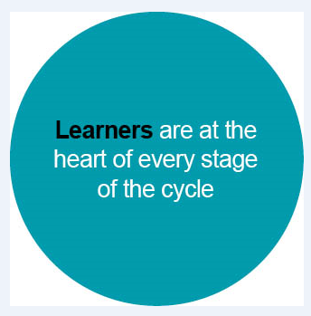
Learning, Teaching and Assessment (Moderation) Cycle
Notes:
The Learning, Teaching and Assessment (Moderation) Cycle
Learners are the first bubble in the cycle, showing their importance in the process.

Slide 3
Aims
To identify the role of the learner at each stage of the learning, teaching and assessment (moderation) cycle.
To explore and reflect on existing practice and identify areas for improvement.

Slide 4
All learners should be involved in planning and reflecting on their own learning.
Building the Curriculum 3:
A Framework for learning and teaching (The Scottish Government, 2008)
Learners are fully involved in planning learning.
How Good Is Our School 4
QI 2.3 - Learning, Teaching and Assessment (Level 5 illustration)
Scotland’s curriculum places learners at the heart of education.
Refreshed Narrative on Scotland’s Curriculum (Education Scotland, 2019)
Notes:
BTC 3 - one of the original Curriculum For Excellence documents, however still relevant in today’s context. Clear message that the learners should be involved in planning and reflecting on their own learning. https://education.gov.scot/Documents/btc3.pdf
HGIOS 4 - Level 5 illustration https://education.gov.scot/improvement/self-evaluation/hgios4/
Refreshed Narrative - published in 2019 https://scotlandscurriculum.scot/
Revisited the original narrative of CfE and sets it within the current context (pre-school closures).
It supports the process of engaging with the core principles of CfE and the development of practices that are fit for purpose.
As part of their learner journey, all children and young people in Scotland are entitled to experience a coherent curriculum from 3-18, in order that they have opportunities to develop the knowledge, skills and attributes they need to adapt, think critically and flourish in today’s world.

Slide 5
The United Nations Convention on the Rights of the Child (UNCRC)
Article 3
The best interests of the child must be a top priority in all things that affect children.
Article 12
Every child has the right to say what they think in all matters affecting them, and to have their views taken seriously.
Notes:
Scotland is in the process of incorporating the UNCRC into law. The Bill was challenged by Westminster, so the Bill is currently under review but it is expected that the UCNCR will be incorporated into law in some way in the near future.

Slide 6
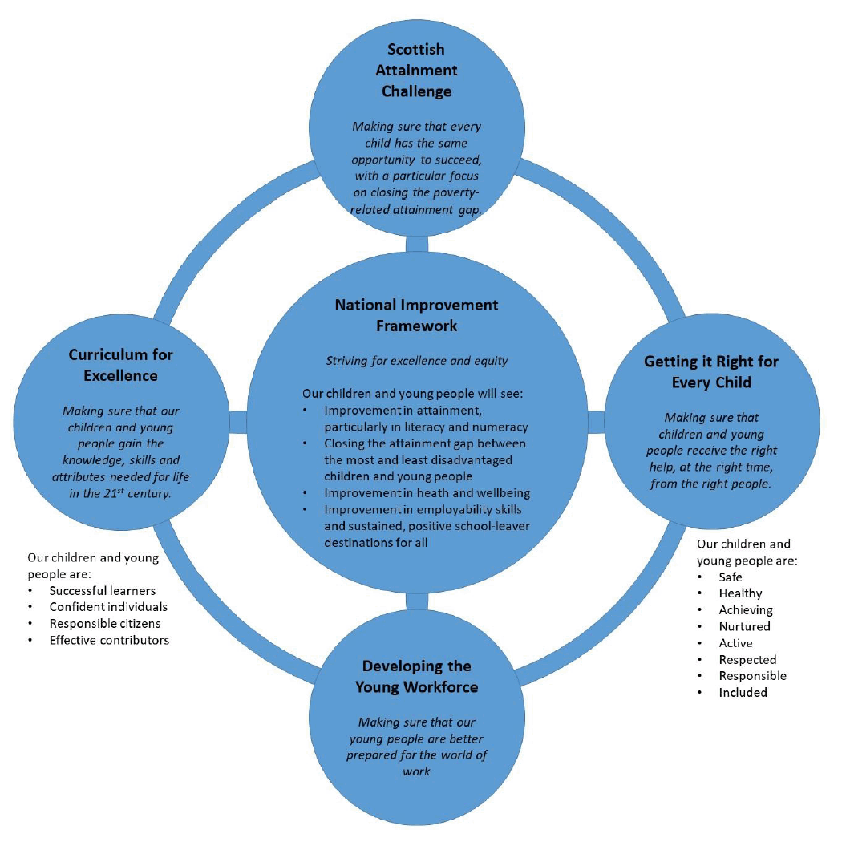
National Improvement Framework
3 supporting pillars of Scottish education
Curriculum for Excellence (CfE)
Getting It Right For Every Child (GIRFEC)
Developing the Young Workforce (DYW)
Vision for education in Scotland
Excellence through raising attainment
Achieving equity
Notes:
3 supporting pillars of Scottish education (John Swinney - 2020)
Each of these have the learners at the centre
Our vision for education in Scotland - aims for EVERY child
Excellence through raising attainment: ensuring that every child achieves the highest standards in literacy and numeracy, as well as the knowledge and skills necessary to shape their future as successful learners, confident individuals, responsible citizens, and effective contributors;
Achieving equity: ensuring every child has the same opportunity to succeed, with a particular focus on closing the poverty related attainment gap.

Slide 7
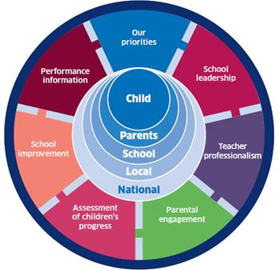
National Improvement Framework
Drivers for Improvement
Assessment of Children’s Progress
School Improvement
Performance Information
Notes:
Why are learners so important?
The child is at the centre of this diagram - all of these drivers for improvement should lead to improved outcomes for the learner.
3 of the drivers relate to learning, teaching and assessment - Assessment of Children’s Progress / School Improvement / Performance Information.
Effective learning, teaching and assessment lies at the heart of improving these outcomes for learners.

Slide 8
Pause for thought
Consider the whole Learning, Teaching and Assessment cycle.
In what ways do you involve learners at each of the stages of the cycle?
Learning, Teaching and Assessment (Moderation) Cycle
Notes:
Activity - pause for individual reflection, or if in a group, discuss with others.

Slide 9
Involving learners when planning Experiences and Outcomes
Involving pupils is a key element of the “learning culture” within a classroom
By involving them you recognise their importance in their learning and that they opinion matters
Gives learners a sense of ownership and belonging
Helps learners to connect with their learning
Shirley Clarke (2009) Involving Pupils in Planning
Notes:
https://www.shirleyclarke-education.org/research/involving-pupils-in-planning-2009/
Shirley Clarke (2009)
If you wait until the day you introduce the topic to ask the learners “what do you already know?” then it is too late, as you will likely have already done the bulk of the topic planning.
By involving learners before you have completed the planning, you ensure maximum impact on the learners’ motivation. You can take into account the prior knowledge of the learner fully.
The learners will be invested in the learning as they feel they can influence it and help to drive it forward.
This also ensure that you have pitched the lesson correctly, as you will have taken into account the prior knowledge.

Slide 10
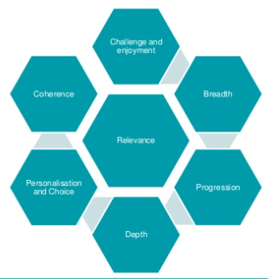
Refreshed Narrative on Scotland’s Curriculum (Education Scotland, 2019)
The Refreshed Narrative on Scotland’s Curriculum reminds us to consider the
4 Contexts for Learning, the 4 Capacities and the 7 Design Principles when planning.
Notes:
Practitioners should never lose sight of the 4 capacities, the 4 contexts for learning and the 7 design principles and what these look and feel like in their classroom/playroom. These aspects should be taken into consideration when planning children’s learning experiences using the experiences and outcomes.
Practitioner should guide the learning according to the requirements of what the learners have yet to experience and learn, as well as their next steps for progression.
The learner can be involved in discussions, particularly in line with personalisation and choice, and the context for the learning.

Slide 11
Involving learners when planning Experiences and Outcomes
Learners could be involved through:
Mind maps
KWL Grids
Feedback discussions
Observations and interactions
Stimulus for discussion
Learning Conversations
Floor books
Talking Partners
Notes:
Floor books / big books for planning together
KWL Grids - What do pupils know, want to find out, have learned
Learning conversations that discuss progress and next steps
Feedback discussions that focus on progress and next steps
Stimulus - hook their interest with a stimulus (prop/question etc)

Slide 12
Pause for thought
Do we plan with learners to provide opportunities for learning to take place across the 4 contexts for learning?
Do we plan with learners to provide opportunities for learners to develop skills and attributes outlined in the 4 capacities?
Do we plan with learners to provide opportunities for learning to take place across the 7 design principles?
Notes:
Activity - pause for individual reflection, or if in a group, discuss with others.

Slide 13
Involving learners in creating the Learning Intentions and Success Criteria
Learning Intentions identify the new learning for the learners. Learners should be able to make connections between their learning and other areas of school and life, taking the learning to apply it in other contexts.
Success Criteria outline the ways the learner can achieve success. This improves the learner’s understanding of the process and how they will be assessed. Sharing the success criteria gives the learner ownership by involving them in their own performance and learning.
Notes:
LI and SC are a crucial part of the learning, teaching and assessment process.
This is the part where the learners can get a clear understanding of the intended learning and how they can be successful.

Slide 14
If learners are to take more responsibility for their own learning, then they need to know what they are going to learn, how they will recognise when they have succeeded and why they should learn it in the first place.​
An Introduction into Assessment For Learning
Learning Unlimited (2004)​

Slide 15
Pause for thought
How do you share the learning intentions and success criteria with your learners?
What works well?
What needs improvement?
Notes:
Activity - pause for individual reflection, or if in a group, discuss with others.

Slide 16
Involving learners in creating the Learning Intentions and Success Criteria
How to co-construct and share
Invest time in training and supporting the learners with this
Ensuring learners are clear about the intended learning
Demonstrating or modelling a technique
Engage in dialogue with the learners
Scaffolding through looking at finished examples of work
Improving poor examples
Comparing 2 examples of differing quality
Complete a task first and then evaluate how to improve
Notes:
Just some examples of how to co-construct.
Task on previous slide should have set the scene for this.

Slide 17
Involving learners in learning, teaching and assessment
Learners are at the heart of learning, teaching and assessment.
Learner’s experiences are appropriately challenging and enjoyable and well matched to their needs and interests. Learners exercise choice … and take increasing responsibility as they become more independent in their learning. They understand the purpose of their learning and have opportunities to lead the learning.
HGIOS 4 - QI 2.3 Learning, Teaching and Assessment
Level 5 Illustration: Learning and Engagement

Slide 18
Involving learners in learning, teaching and assessment
Prior knowledge and next steps
Interests and achievements
Needs of individuals
Learning, Teaching and Assessment
The 4 Contexts for Learning
The 7 Design Principles
The 4 Capacities
Notes:
When planning the learning, teaching and assessment, all of these components need to be considered.
The learners’ prior knowledge and next steps should be taken into account. This will ensure we provide rich learning experiences and valid assessments.
The learners’ interests and achievements should be considered to ensure learning is relevant and engaging.
Ensuring that the learning meets the needs of individuals and provides opportunities for breadth, challenge and application.
These echo the 7 design principles.
Learners can contribute ideas to shape the learning and assessment at the planning stages.

Slide 19
Involving learners in learning, teaching and assessment
Learners should be integral to the assessment process.
Opportunities for peer and self assessment
Evaluating learning against the agreed success criteria
Identify next steps in learning
Notes:
Through the use of Learning Intentions and Success Criteria, learners can engage in self and peer assessment which helps them to develop a clearer understanding of the learning process and how to ensure they have included what they need to be successful. This supports their understanding of themselves as learners and their ability to talk about their learning.

Slide 20
Involving learners in gathering evidence
Evidence is generated by the learners - both formally and informally.
Learners could help decide how the assessment evidence is gathered.
Part of the assessment process should be to discuss the evidence in line with the agreed success criteria.
Evidence helps to identify the learners’ next steps.
Learners can review the evidence, see progress and identify next steps in their learning journey.
Notes:
A huge amount of assessment evidence is generated every day. Practitioners just decide how to use this data to drive forward the learning.
The learners can also be a part of this review, where appropriate. They should have opportunities to review their data, and could be involved in deciding what way the assessment evidence is gathered.

Slide 21
Involving learners in evaluating learning
This is where the assessment evidence is reviewed against agreed standards.
Practitioners can then make judgements on learner progress.
Learners’ views should be fully considered.
Learners should have opportunities to reflect on their learning and engage in dialogue with the teacher and peers to support.

Slide 22
Involving learners in evaluating learning
On average, using metacognition added the equivalent of an extra eight months of schooling to children’s performance.
Self-regulated learners are aware of their strengths and weaknesses, and can motive themselves to engage in, and improve, their learning.
Pupil-to-pupil and pupil-teacher talk can help build knowledge and understanding of cognitive and metacognitive strategies.
Metacognition and Self-Regulation
The Education Endowment Foundation (2018)
Notes:
Meta-cognition
Thinking about your thinking
Processes used to plan, monitor and assess your understanding and performance
Helps the learner understand their own learning processes
EEF - Teaching and Learning Toolkit - https://educationendowmentfoundation.org.uk/education-evidence/teaching-learning-toolkit/metacognition-and-self-regulation
EEF - Guidance Reports - https://educationendowmentfoundation.org.uk/education-evidence/guidance-reports/metacognition

Slide 23
Involving learners in feedback and identifying next steps
The learner is integral to effective feedback and next steps.
Learners need time to be able to process and act upon the feedback.
Learners can be involved in high quality dialogue about their learning.
Where is the learner going?
Where is the learner now?
How does the learner get there?
Hattie and Timperley (2007)
Black and Wiliam (1998)
Notes:
The Learner is the focus for feedback, therefore they should be involved and understand the purpose.
Both the teacher and the learner should be involved in considering the 3 questions
Where is the learner going? / Where am I going?
Where the learner now? / Where am I now?
How does the learner get there? / How do I get there?
From Hattie and Timperley and from Black and Wiliam

Slide 24
Pause for thought
Read the statement below.
Why do you think this is the case?
What opportunities do you provide for
learner-to-teacher feedback?
Learner-to-teacher feedback is more important than teacher-to-learner feedback.
Visible Learning: Feedback
Hattie and Clarke (2019)
Notes:
Learner to teacher feedback - if the learner can articulate their progress and their next steps, then you can be sure they have a clearer understanding of their learning journey.
Similarly, learner-to-learner feedback also shows a deeper understanding of progress.

Slide 25
Involving learners in reporting
The learner should be involved in ongoing dialogue around their learning, progress, next steps and areas for development.
This in turn can support parents having a clearer understanding of their child’s progress.
Learning Logs
Displays
Class Blog or Newsletter
Review Meetings
Profiling
Target Setting
Class Assemblies
Curriculum Workshops
Notes:
There should be ongoing dialogue between teacher and learner about their progress.
This should encourage reflection.
This may lead to contributions in learning journals, profiling activities, target setting.

Slide 26
HGIOS 4: QI 2.3 Learning, Teaching and Assessment
Challenge Questions
How well do we enable learners to articulate their developing skills and value these in terms of future learning and career pathways?
How effective are our planned opportunities for learners to discuss and reflect on their learning to empower them to lead and take increasing responsibility for their own learning?
How effectively do we actively involve learners in planning and leading their own learning?
How effective is our use of digital technologies to enhance learning and develop skills for learning, life and work?

Slide 27
How Good Is OUR School? Theme 2 - Our Learning and Teaching
Features of Highly-Effective Practice
We are actively involved in planning what and how we learn. We get to make choices about our learning.
Our learning is planned so we can each build on what we already know and can do. Our learning is differentiated to meet our needs. It isn’t always the same task for everyone in the class.
We get helpful feedback on our work. We all understand what we have done well and what we need to do to improve.
We are able to talk confidently about the skills we are developing. We understand how these skills are helping us to achieve more in school, in the community and as we prepare for the world of work.

Slide 28
Pause for thought
Reconsider the whole Learning, Teaching and Assessment cycle.
In what areas do you need to improve on how you involve learners?
Learning, Teaching and Assessment (Moderation) Cycle
Notes:
Revisit the original Pause. What has changed? What do we need to improve on?
Activity - pause for individual reflection, or if in a group, discuss with others.

Slide 29
Further Information
Portmoak Sketchnote - Learning is better when children talk about their learning
Education Scotland (2018)
Woodmuir Primary - Involving children in planning and assessing their own learning
Education Scotland (2018)
Education Scotland - Moderation Hub - Learners
Education Scotland - How Good Is OUR School? 4

