Slide 1


Falkirk Learning to Achieve Moderation Support Programme
Antonine PS
SESSION 1 – 02.02.22
For Scotland's learners, with Scotland's educators
Do luchd-ionnsachaidh na h-Alba, le luchd-foghlaim Alba

Slide 2
Session Aims
To have an understanding of the current national picture relating to assessment in the Broad General Education.
To visit key messages related to learning, teaching and assessment.
To begin to look at an overarching framework for assessment in Antonine PS.
For Scotland's learners, with Scotland's educators
Do luchd-ionnsachaidh na h-Alba, le luchd-foghlaim Alba

Slide 3





1
2
3
4
5
Notes:
Connector- choose photo that best fits where you are now- personally or professionally- option to share
Going to start tonight with a connector – check in to see where we are at. If you would like, Please type into the chat pane the number of the picture which resonates with you. Can also feel free to raise your hand – come into the chat or just reflect.
However you are, coming to this professional learning session tonight, it is great to have you along and hopefully you will find it worthwhile, you will get something from it and you will have a chance to collaborate with others.
Connectors/Starters should be relatively light hearted and not overly cognitively demanding. They should ease people into the learning space and help build up to the focus of the day. You can do a task or just have a discussion. A task would be something more structured; we have previously done something like ‘The Columbo Dash’ where people have 2 minutes to find an object in their house/bag that tells us something about them. Or we sometimes just separate people into breakout rooms and give them 2 questions to discuss- one is usually personal i.e. tell us about your favourite holiday and one is more work focussed- i.e. why did you become a teacher.

Slide 4
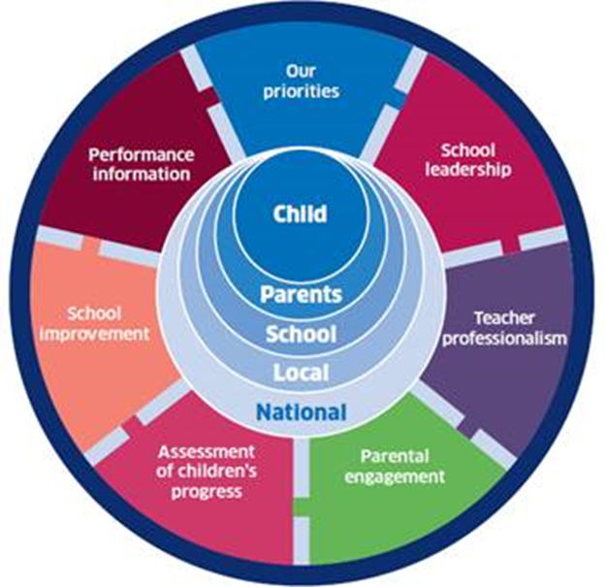
Context: The National Improvement Framework
Improvement in attainment, particularly in literacy and numeracy
Closing the attainment gap between the most and least disadvantaged children
Improvement in children and young people’s health and wellbeing
Improvement in employability skills and sustained, positive school leaver destinations for all young people
For Scotland's learners, with Scotland's educators
Do luchd-ionnsachaidh na h-Alba, le luchd-foghlaim Alba
Notes:
The National Improvement Framework was created as a result of the OECD report in 2015 to gather evidence to inform the education system in Scotland. Report from current OECD review will be published on 21st June 2021.
National Improvement Framework aims to bring together key performance information to improve outcomes for every learner in Scotland.
Builds on the best practice in Scotland in using a range of data and evidence to report and plan improvements for learners.
Activity informed by local and school-level priorities drawn from the regional improvement and recovery plans produced by the six RICs, as well as the 32 local authority 2020/21 improvement and recovery plans. Plan also been informed by the data in the NIF Interactive Evidence Report, evidence from school inspections and local authority self-evaluation reports, and recommendations and advice from the ICEA.
Key NIF drivers related to Learning, Teaching and Assessment:
Assessment of children’s progress - includes a range of evidence on what children and young people learn and achieve throughout their education and how well this prepares them for life beyond school.
School Improvement - the overall quality of education provided by each school in Scotland and its effectiveness in driving further improvement (QI 2.3 – Learning, Teaching and assessment)
School leadership - the quality and impact of leadership within schools – at all levels and roles.
Teacher professionalism - the overall quality of the teaching workforce in Scotland and the impact of their professional learning on children and young people’s progress and achievement.
Performance Information - all of the information and data from each of the drivers needed to get a full picture of how well Scottish education is improving.

Slide 5
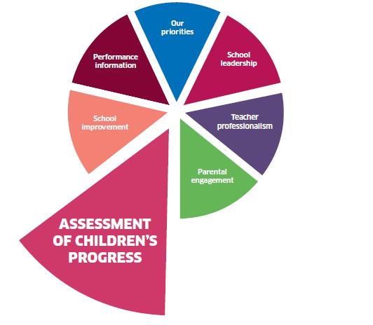
National Standardised Assessments (SNSA)
Assess progress in skills and knowledge in reading, writing and numeracy
Assess pupils in P1, P4, P7 and S3 in line with nationally developed expectations
Provide individual, diagnostic reports on each child’s and young person’s progress, based on an on-line and adaptive assessment
As part of a range of evidence, contribute to teachers’ professional judgement
Inclusive - allow all pupils to be fairly assessed, no matter their background, experience, additional support needs or level of ability
Administered at a time of the teacher and school’s own choosing in line with guidance from local authority
For Scotland's learners, with Scotland's educators
Do luchd-ionnsachaidh na h-Alba, le luchd-foghlaim Alba
Notes:
Another area included within the Assessment of children’s progress driver is National Standardised Assessments – these can be considered as part of the evidence base of learners’ progress but they are only one small piece of evidence. Only assesses elements of reading, writing and numeracy.
National policy positions are outlined on screen. Can be done at any point in the year, The SNSAs are a diagnostic tool to support improvement in children’s learning and to inform teachers' professional judgement on pupil progress.
Won’t tell us achievement of a level or breadth, challenge, application – teacher judgement based on a range of evidence does this.

Slide 6
NIF Improvement Plan 2021
Assessment of children's progress
Assessment should take into account the need to establish children’s next steps in learning across the curriculum, with a particular focus on literacy and numeracy.
Continue to embed a self-improving system to improve outcomes for learners and raise attainment and achievement through improved learning, teaching and assessment.
Performance information
It is everyone’s responsibility to gather and use performance information to intervene to secure improvement for all children and young people.
For Scotland's learners, with Scotland's educators
Do luchd-ionnsachaidh na h-Alba, le luchd-foghlaim Alba
Notes:
Common themes from regional and local authority plans
School leadership – promote a culture of leadership at all levels and in a range of contexts
Teacher Professionalism – improve skills, and increase confidence of teachers in using digital tools
School Improvement – support schools and settings to harness the potential of digital technologies to enhance learning, teaching and assessment.
There are also a number of SG and ES actions included for each driver
One of which is…
‘There is a need to continue to support the moderation of learning, teaching and assessment to support teacher’s professional judgements…Education Scotland will support a more localised and digital approach.’

Slide 7
The Quality Assurance and Moderation Support Officer (QAMSO) programme
2016/17 – National programmes for numeracy and writing
2017/18 – National programmes for numeracy, writing and reading
2018/19 – National programmes for numeracy, writing, reading, listening and talking and additional sessions for existing QAMSOs.
2019/20 – Single national programme for all curriculum areas (2 cohorts). Day 4 postponed and delivered in December 2020.
2020/21 – Paused with support provided through a more localised and digital approach.
2021/2022 – New online programmes developed and delivered regionally with additional sessions for existing QAMSOs.
For Scotland's learners, with Scotland's educators
Do luchd-ionnsachaidh na h-Alba, le luchd-foghlaim Alba
Notes:
Here is an overview of the QAMSO programme – when it began and how it developed to where we are now.
There were also level specific events hosted in 2019/20 for additional practitioners.

Slide 8
Moderation Lead Programme Overview
Course | Content
Intro June 2021 | Role of a Moderation Lead, Policy context, Key messages, Digital approach to moderation
2. Guided Moderation Early September 2021 | Closer look at the Moderation Cycle. Collaborate with colleagues through participating in a guided moderation activity using breakout channels and PLC Notebook.
3. Moderation Activity (own material) Early November 2021 | Moderation activity to review own moderation material (planning for learning, teaching and assessment and learner evidence)
4. High Quality Assessment (HQA) Late November 2021 | Re-visit key principles of assessment, Input on evidencing progress through and achievement of a level through HQA.
5. HQA Moderation Activity February 2022 | Moderation activity to review high quality assessment, introduction to adult learning theories and approaches to support facilitation of moderation activities.
6. Facilitation and action planning March 2022 | Facilitation considerations of moderation activities in own context, Moderation Lead role in practice.
For Scotland's learners, with Scotland's educators
Do luchd-ionnsachaidh na h-Alba, le luchd-foghlaim Alba
Notes:
Dates TBC soon
The Moderation Lead programme aims to support local authorities and schools to develop a better understanding of standards, share good practice and support effective assessment and moderation.
On the slide is an overview of what we intend to cover….
After Session 1 – Practitioners set up Online Moderation Space within their setting and identify a group of practitioners to work with.
After Session 2 – Practitioners lead guided moderation activity in their own setting. Practitioners plan learning, teaching and assessment and gather learner evidence, all of which is uploaded to PLC Notebook before Session 3. This can also be replicated within their setting.
After Session 3 – Practitioners lead ongoing moderation of planning of learning, teaching and assessment and learner evidence within their setting using PLC Notebook.
After Session 4 – Practitioners are required to create a High Quality Assessment by selecting a bundle of Es and Os which reflect the learning happening in their classroom.
Create one high quality assessment which requires:-
- the learner to draw on a range of learning
- appropriate level of challenge
- higher order thinking skills
- application of learning in a new and unfamiliar situation
- come from one of the four contexts of learning.
Pilot the high quality assessment with the learners in your context and bring learner evidence to Session 5 for moderation.
After Session 5 – Practitioners can replicate Sessions 4 and 5 within their own settings. Time given between Session 4 and 5 to allow for planning, delivery, feedback and the gathering of evidence.
Session 6 – Input required from the local authority on how the Moderation Lead role will complement existing local authority / regional moderation processes and practice.

Slide 9
Role of a Moderation Lead
Someone who…
Understands fully the process of moderation, including digital moderation that can enable easier moderation across their setting or wider.
Is trained in high quality assessments.
Has a network to support them – other Leads, QAMSOs and NIF Officer.
Can lead moderation practice in their setting.
Can support wider moderation processes leading to greater consistency across the local authority and beyond.
For Scotland's learners, with Scotland's educators
Do luchd-ionnsachaidh na h-Alba, le luchd-foghlaim Alba

Slide 10
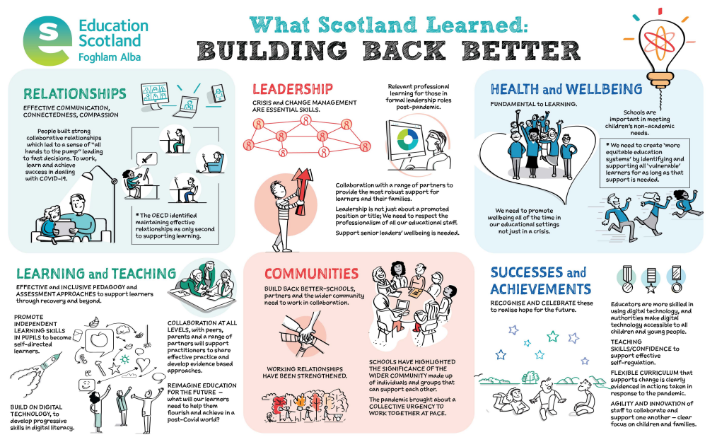
For Scotland's learners, with Scotland's educators
Do luchd-ionnsachaidh na h-Alba, le luchd-foghlaim Alba
Notes:
What Scotland Learned: building back better (education.gov.scot)
Within our current context – what will support recovery
Published in January 2021 – this is the sketchnote from the professional learning paper that accompanies the publication ’What Scotland Learned, 100 stories of lockdown’. Takes the inspiring stories from the book and synthesises them with education research to identify 6 key themes to support recovery.
Learning and Teaching – Effective and inclusive pedagogy and assessment approaches to support learners through recovery and beyond.
(Chapman and Bell, 2020)
Formative approaches to assessment will support educators to plan appropriate next steps. It is important to focus on what learners can do and build from this. As we support recovery in education we need effective and inclusive practice to overcome increased inequities.
(Sahlberg (2020a, p.7)
An important lesson from the COVID-19 pandemic is that schools and students who are more self-directed in their own teaching and learning often do better in both normal and crisis situations, than those who haven’t learned to do so.

Slide 11

Context: Building the Curriculum 5 – A Framework for Assessment
Principles of assessment: Why we assess?
Supporting learning
Sharing learning intentions and success criteria
High quality interactions and feedback
Promoting learner engagement
Learner involvement in reflection, setting learner goals and next steps including through personal learning planning
Self and peer assessment
Ensuring appropriate support
To be fair and inclusive
To enable learners to have the best chance of success
For Scotland's learners, with Scotland's educators
Do luchd-ionnsachaidh na h-Alba, le luchd-foghlaim Alba
Notes:
Principles of Assessment have not changed
Assessment is an integral part of learning and teaching. It helps to provide a picture of a child’s or young person's progress and achievements and to identify next steps in learning. Assessment approaches need to promote learner engagement and ensure appropriate support so that all learners can achieve their aspirational goals and maximise their potential.

Slide 12

Context: HGIOS 4 QI 2.3
‘Our assessment evidence is valid and reliable. At key milestones, our assessments provide reliable evidence which we use to report on the progress of all children and young people. Across our learning community we have shared expectations for standards to be achieved, and have robust arrangements for moderation across stages and across the curriculum.’
HGIOS 4 QI 2.3 Learning, Teaching and Assessment
Level 5 Illustration: Effective use of assessment
For Scotland's learners, with Scotland's educators
Do luchd-ionnsachaidh na h-Alba, le luchd-foghlaim Alba
Notes:
For each quality indicator in the framework there is an illustration of what an evaluation of “very good” might look like. These level 5 illustrations are intended to support professional dialogue and critical reflection during ongoing self-evaluation.
2.3 Learning, Teaching and Assessment
Theme: Effective use of assessment
Assessment is integral to our planning of learning and teaching. We use a variety of assessment approaches to allow learners to demonstrate their knowledge and understanding, skills, attributes and capabilities in different contexts across the curriculum. Our assessment evidence is valid and reliable. At key milestones, our assessments provide reliable evidence which we use to report on the progress of all children and young people. Across our learning community we have shared expectations for standards to be achieved, and have robust arrangements for moderation across stages and across the curriculum.

Slide 13
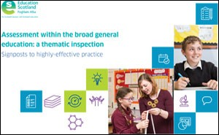
Context: Assessment within the Broad General Education: a Thematic Inspection
6 key features of effective practice…
Strong leadership and direction
Use of a range of assessment data
Well considered and carefully planned approaches to moderation
High quality professional learning to improve confidence and increase skills in accurate assessment
Skilled interrogation and analysis of data
Involvement of children and young people in assessment of learning, which includes high quality feedback and learner conversations.
For Scotland's learners, with Scotland's educators
Do luchd-ionnsachaidh na h-Alba, le luchd-foghlaim Alba
Notes:
Assessment within the broad general education: a thematic inspection | National Thematic Inspections | HM Chief Inspector Report | Inspection and review | What we do | Education Scotland
HM Inspection colleagues published the National Thematic Inspection on Assessment within the BGE – where effective practice was shared through case studies from across Scotland. The publication identifies 6 key features (section 2 focuses on evidence) of effective practice which are:
Strong leadership and direction
Use of a range of assessment data
Well considered and carefully planned approaches to moderation
High quality professional learning to improve confidence and increase skills in accurate assessment
Skilled interrogation and analysis of data
Involvement of children and young people in assessment of learning, which includes high quality feedback and learner conversations.
Effective use of the learning, teaching and assessment cycle will help to develop this practice.
https://education.gov.scot/education-scotland/what-we-do/inspection-and-review/chief-inspector-report/national-thematic-inspections/assessment-in-the-bge/

Slide 14
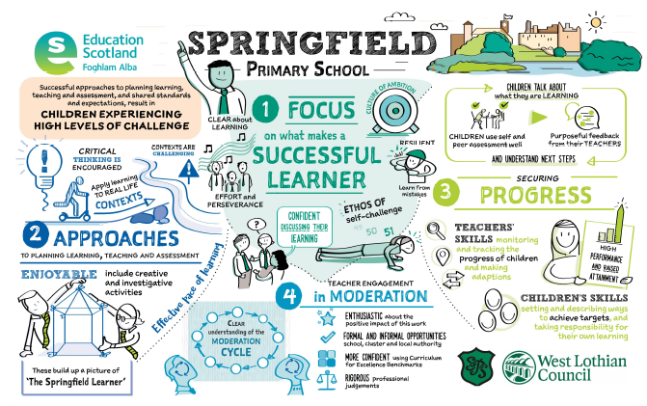
Notes:
https://education.gov.scot/improvement/practice-exemplars/sketchnote-springfield
Started with staff developing a clear understanding of the moderation (learning, teaching and assessment) cycle.
Teachers know the purpose of assessment. There is a shared understanding across the school that teachers will use a range of assessments including ongoing and periodic assessment, standardised assessment and self-assessment to build a clear picture of progress for all children. As a result, teachers use a wide range of formative and periodic assessments to help them determine children’s progress, plan ongoing learning and teaching, and support their professional judgement. Teachers are highly skilled in monitoring and tracking the progress of learners. This informs adaptations when planning future learning, where teachers use appropriate interventions effectively to ensure all children remain on track to make progress.

Slide 15

What is moderation?
‘Moderation is the way in which practitioners arrive at a shared understanding of standards and expectations.’
Moderation is integral to the planning of learning, teaching and assessment
Moderation takes an ongoing, collegiate approach to learning, teaching and assessment
Practitioners moderate assessment judgements by taking account of a sample of evidence from different sources to discuss standards and the progress of learners
The process of moderation is not an activity that happens only at the end of a block or year
For Scotland's learners, with Scotland's educators
Do luchd-ionnsachaidh na h-Alba, le luchd-foghlaim Alba
Notes:
A Statement for Practitioners from HM Chief Inspector of Education (August 2016) | Policy drivers | Policy for Scottish education | Scottish education system | Education Scotland
This is an extract from the statement for practitioners from the then HM Chief Inspector of Education – August 2016
It states that moderation is integral to planning learning, teaching and assessment and is a process rather than a one-off activity or event.
Moderation is on-going throughout the learning and teaching process.
Discussions take place regularly about Learning, Teaching & Assessment. These discussions are moderation.
Moderation Supports:
Understanding and sharing of standards
Sharing of good practice
Progression
Robust, valid and reliable teacher professional judgement

Slide 16
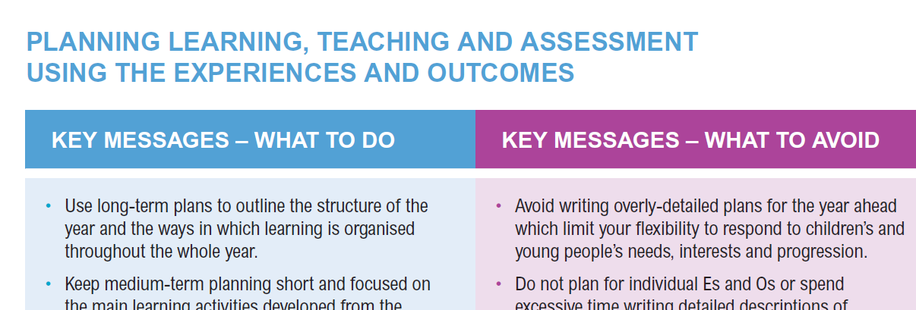
For Scotland's learners, with Scotland's educators
For Scotland's learners, with Scotland's educators
Do luchd-ionnsachaidh na h-Alba, le luchd-foghlaim Alba
Notes:
Too much support material and guidance for practitioners. As a result, Education Scotland attempted to streamline support and guidance materials for the curriculum. This statement and publication of the benchmarks are key to this streamlined approach.
Moving forward, the two key resources which teachers should use to plan learning, teaching and assessment are: Experiences and Outcomes & Benchmarks.

Slide 17
Moderation
Moderation takes place at local, regional and national levels, including:
• teachers and practitioners at the same curriculum level;
• across a school or setting;
• across a group of schools/settings;
• within local authorities;
• through regional groups; or
• via national groups.
For Scotland's learners, with Scotland's educators
Do luchd-ionnsachaidh na h-Alba, le luchd-foghlaim Alba
Notes:
Does it? Discussion in Groups
Support in the system
Assessment Co-ordinators
QAMSO (Quality Assurance and Moderation Support Officers) since 2016
Regional Improvement Collaborative Networks
National Moderation Events

Slide 18

Importance of Planning Learning, Teaching and Assessment
A shared understanding of standards and expectations is developed when practitioners actively engage in professional dialogue i.e. they moderate the planning of learning, teaching and assessment.
The planning of learning, teaching and assessment is a vital part of the cycle of moderation:
Planning should be carried out collaboratively with colleagues.
The planning of assessment activities should be carried out at the same time as the planning of learning experiences.
Discussions about the planning of learning experiences should include discussions of what learners’ progress looks like and how and when assessment evidence will be gathered.
For Scotland's learners, with Scotland's educators
Do luchd-ionnsachaidh na h-Alba, le luchd-foghlaim Alba
Notes:
We would like to highlight the importance of planning for learning, teaching and assessment –
By working collaboratively, it allows practitioners to:
plan learning, teaching and assessment
check that assessment tasks and activities provide learners with fair and valid opportunities to meet the standards and expectations before assessments are used – moderation at the planning process and discussion with colleagues is helpful.
sample evidence from learners’ work and review teachers’ judgements
agree strengths in learners’ performances and next steps in learning
provide feedback on teachers’ judgements to inform improvements in practices
Moderation is the professional dialogue around learning, teaching and assessment, - coming together to plan L, T, A and to review learner evidence. And it helps to ensure that there is an appropriate focus on outcomes for learners, that learning is at the appropriate level and that learners develop breadth, challenge and application of learning. We achieve consistency in our understanding of assessment through moderation, allows processes to be more robust and not dependent upon the judgement of one individual.

Slide 19
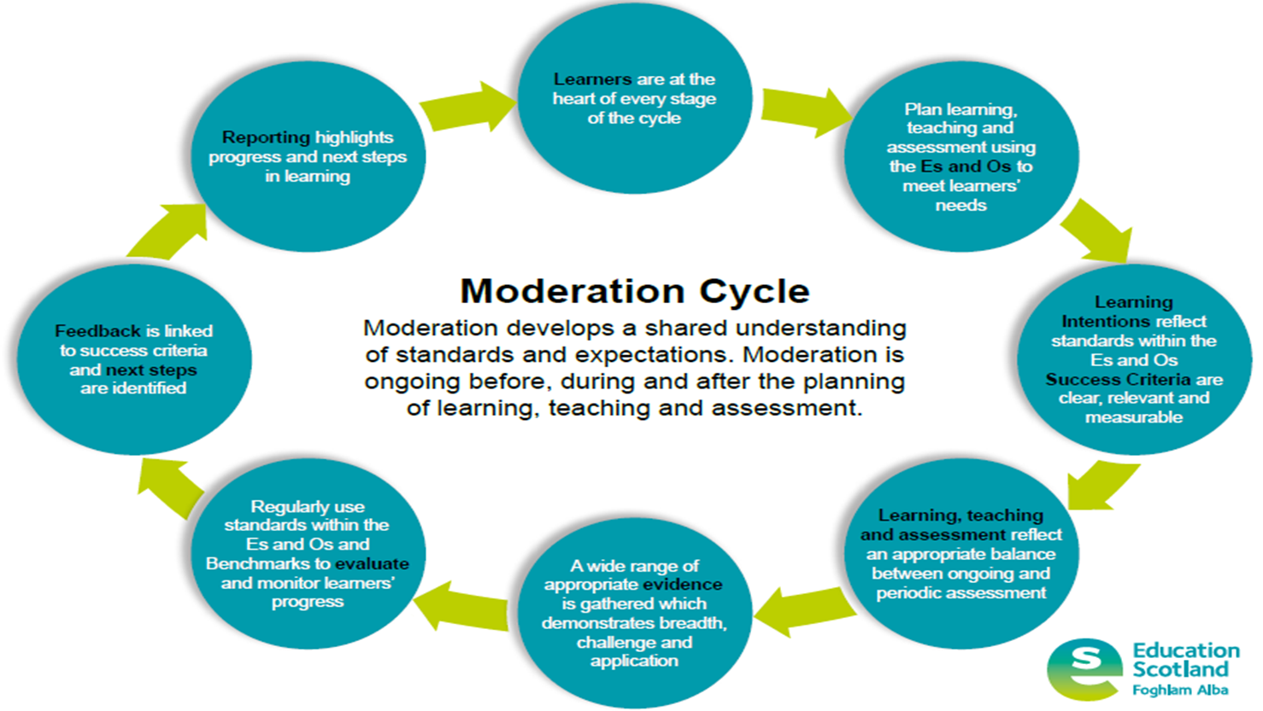
Learning, Teaching and Assessment Cycle
For Scotland's learners, with Scotland's educators
Do luchd-ionnsachaidh na h-Alba, le luchd-foghlaim Alba
Notes:
Moderation Cycle also know as the Learning, Teaching and Assessment Cycle.
This a cycle for collaboration for Learning, Teaching & Assessment. Moderation should not be considered as an ‘event’ or completed at special times of the year but rather the discussions which take place regularly about Learning, Teaching & Assessment.
We will cover the moderation cycle in depth during our next session.

Slide 20
Pause for thought – Breakout discussion
Do staff engage positively with moderation – do they view it as a key element to their planning, learning and teaching or an activity that is bolted on?
Is moderation activity in school ‘well considered and carefully planned’?
Do staff have opportunities for high quality professional learning to improve confidence and increase skills in accurate assessment?
Do school leaders promote the importance and place of moderation by allocating time to it? Is time built in to your WTA for moderation and for system leadership / ‘self improving system’ opportunities?
Collegiate sessions – is there an allocation to assessment and moderation as a school team, or wider?
Is there an assessment strategy/framework that clearly shows the ‘key milestones’…where moderation activity relates to school policy and guidance around other aspects of assessment and reporting throughout the year? e.g. prior to tracking and monitoring meetings, parents evenings, report writing? – Also therefore reducing bureaucracy.
Are staff involved in ‘moderation mates’ type activities? System leadership/self improving... encouraging conversations that support and challenge pedagogy and practice, enabling deeper professional dialogue around moderation/assessment activity.
For Scotland's learners, with Scotland's educators
Do luchd-ionnsachaidh na h-Alba, le luchd-foghlaim Alba
Notes:
Is moderation seen as a bolt on = or integral? How do you help staff see it is integral? Do they need to revisit the learning, teaching and assessment (moderation cycle) or where this sits in the bigger picture of Learning, Teaching and Assessment?
Collegiate sessions – do we enable staff to meet during these for system leadership / moderations mates / joint planning etc…do we ensure they have a shared framework for discussions?
Assessment strategy – do staff see where it helps inform…cuts bureaucracy…E.g. School Assessment Framework – staff know the assessments we do, when, what for and what we use them for and they have a timeline of when activities take place and where they inform and support other activities.
Systems leadership…staff leading own learning and developing consistency across their own school (LC/LA)…time credited to enable them to visit each other’s classes, agree a focus for observation and discussion…linked to assessment and moderation work?

Slide 21

Break
For Scotland's learners, with Scotland's educators
Do luchd-ionnsachaidh na h-Alba, le luchd-foghlaim Alba
Notes:
5 minute comfort break

Slide 22
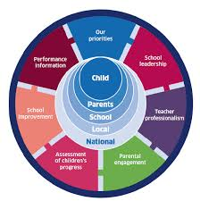
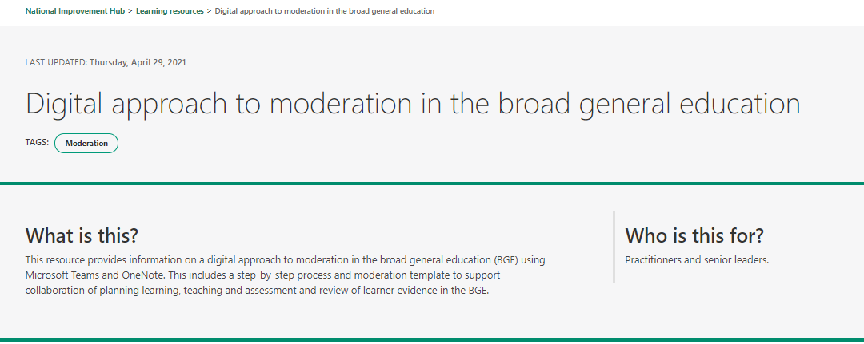
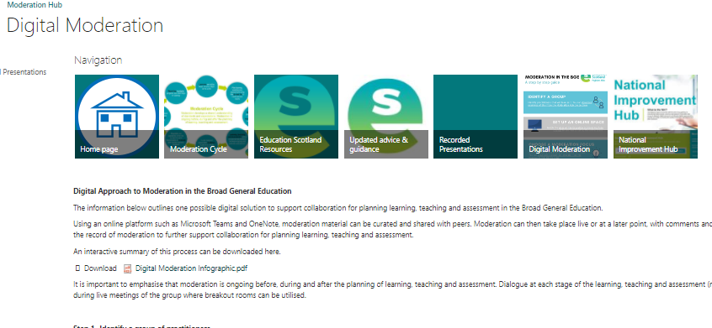
Digital Approach to Moderation in the BGE using Microsoft Teams and OneNote
Digital approach to moderation in the broad general education | Learning resources | National Improvement Hub
For Scotland's learners, with Scotland's educators
Do luchd-ionnsachaidh na h-Alba, le luchd-foghlaim Alba

Slide 23
Benefits of a Digital Approach
Using Teams and PLC Notebook (OneNote) provides a digital approach to moderation in which practitioners can set their own structure and focus appropriate to their context.
PLC Notebook as part of Microsoft Teams provides easy access to planning, learner evidence and moderator comments during live online moderation meetings.
Allows audio, video, images, PDF's etc. to be uploaded.
For Scotland's learners, with Scotland's educators
Do luchd-ionnsachaidh na h-Alba, le luchd-foghlaim Alba
Notes:
Using teams and PLC notebook provides an approach – there are other approaches that can be used.

Slide 24
Benefits of a Digital Approach
All members of the Team have access to the growing body of moderated material and comments that are added.
Templates can be used to direct practitioners towards resources and key questions to help keep moderation discussions and feedback focussed for practitioners.
Increases confidence that practitioners have engaged in the process of moderation to develop shared understanding of standards.
For Scotland's learners, with Scotland's educators
Do luchd-ionnsachaidh na h-Alba, le luchd-foghlaim Alba
Notes:
It is important to emphasise that moderation is ongoing before, during and after the planning of learning, teaching and assessment. Dialogue at each stage of the learning, teaching and assessment (moderation) cycle can take place online to strengthen digital moderation processes. This can be done during live meetings of the group where breakout rooms can be utilised.

Slide 25
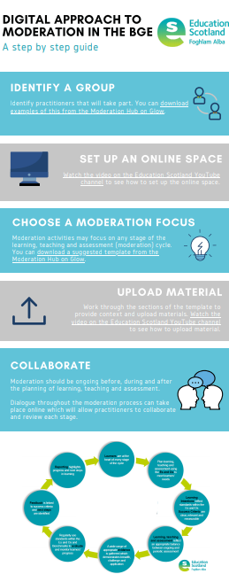
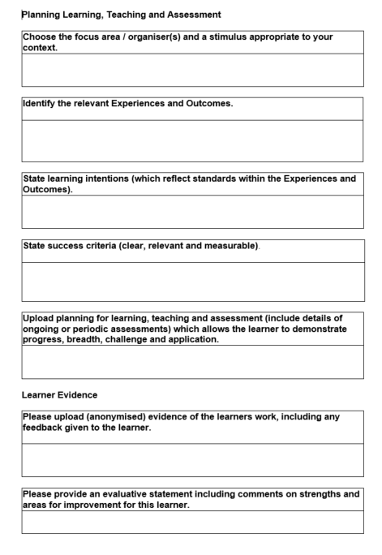
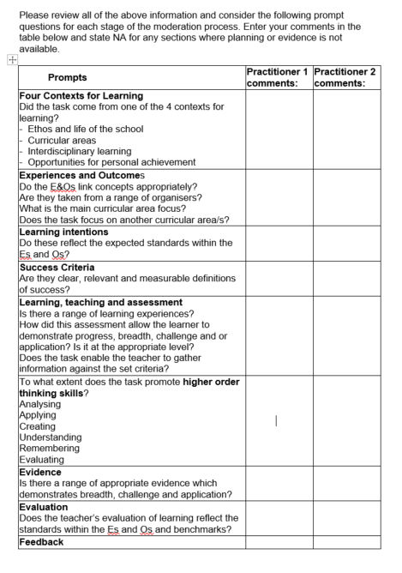
Resources
For Scotland's learners, with Scotland's educators
Do luchd-ionnsachaidh na h-Alba, le luchd-foghlaim Alba
Notes:
The Digital Moderation tab on the moderation hub contains an infographic to explain the process, and contains the templates,
​There are also helpful notes about learner evidence to consider:
OneNote allows a wide variety of media to be stored on each page. It is important to mindful about data protection and copyright.
• Ensure that learners cannot be identified – remove any personally identifiable content e.g. names from images, documents etc.
• Avoid uploading assessment materials which have been commercially created. The focus should be retained on practitioner designed and implemented approaches to assessment

Slide 26
Step 1 – Identify a group of practitioners
Identify a group of practitioners who will work together. For example, trios of practitioners from across a school, cluster, local authority or regional improvement collaborative.
Practitioners may find it useful and more manageable to work in smaller groups.
Invite/share the team code with the group of practitioners
For Scotland's learners, with Scotland's educators
Do luchd-ionnsachaidh na h-Alba, le luchd-foghlaim Alba

Slide 27
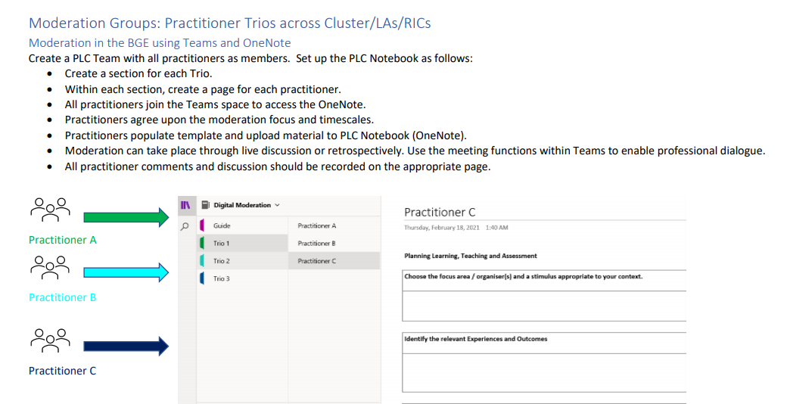
Step 1 – Example A
For Scotland's learners, with Scotland's educators
Do luchd-ionnsachaidh na h-Alba, le luchd-foghlaim Alba

Slide 28
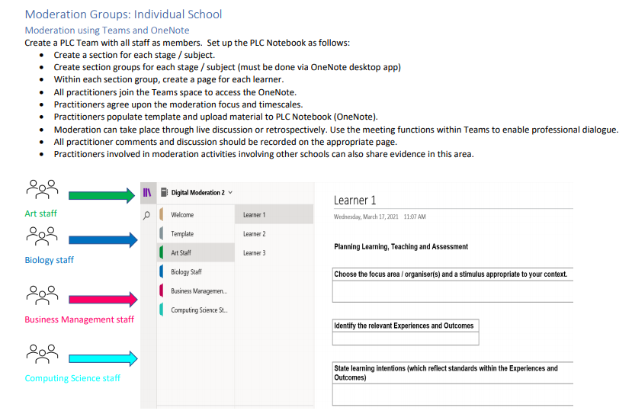
Step 1 – Example B
For Scotland's learners, with Scotland's educators
Do luchd-ionnsachaidh na h-Alba, le luchd-foghlaim Alba

Slide 29
Step 2 – Set up a PLC team in MS Teams
One person from each group will set up a team and create a OneNote notebook to support the moderation process.
A template page can be created to ensure consistency.
NIH has a short video provides an outline of the process to create a PLC Team and a structure for the OneNote notebook. https://youtu.be/2QIYQBUE-Bw
On the welcome page, you may also wish to add some instructions, links to Curriculum for Excellence experiences and outcomes, benchmarks, local authority policies or progression pathways, or embed the adding learner content videos
For Scotland's learners, with Scotland's educators
Do luchd-ionnsachaidh na h-Alba, le luchd-foghlaim Alba
Notes:
Takeaway task

Slide 30
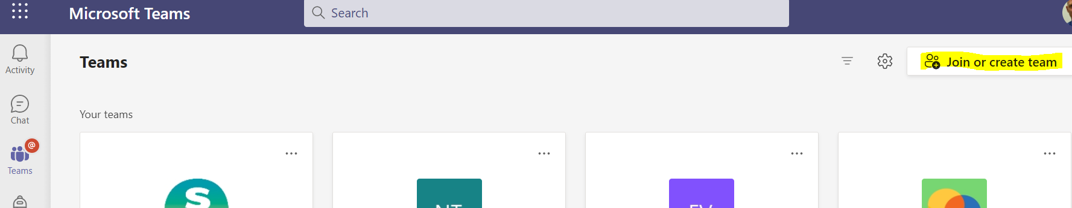
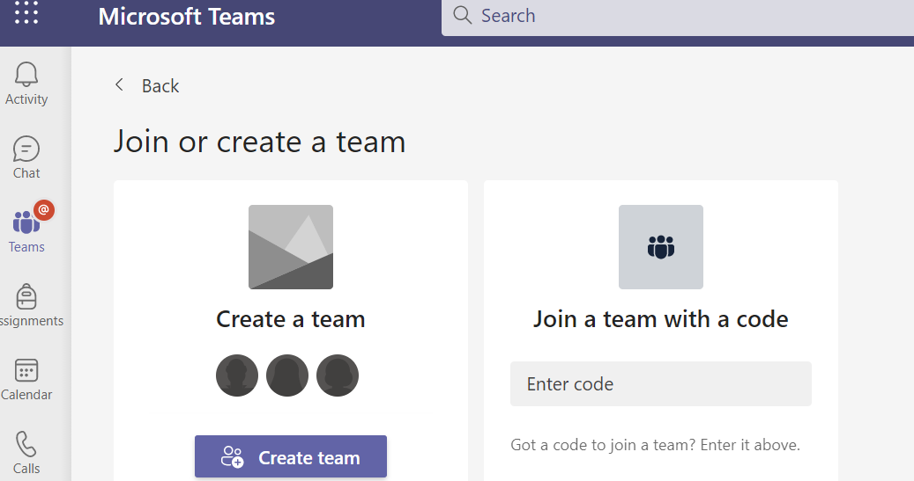
Microsoft Teams Create a team
For Scotland's learners, with Scotland's educators
Do luchd-ionnsachaidh na h-Alba, le luchd-foghlaim Alba

Slide 31
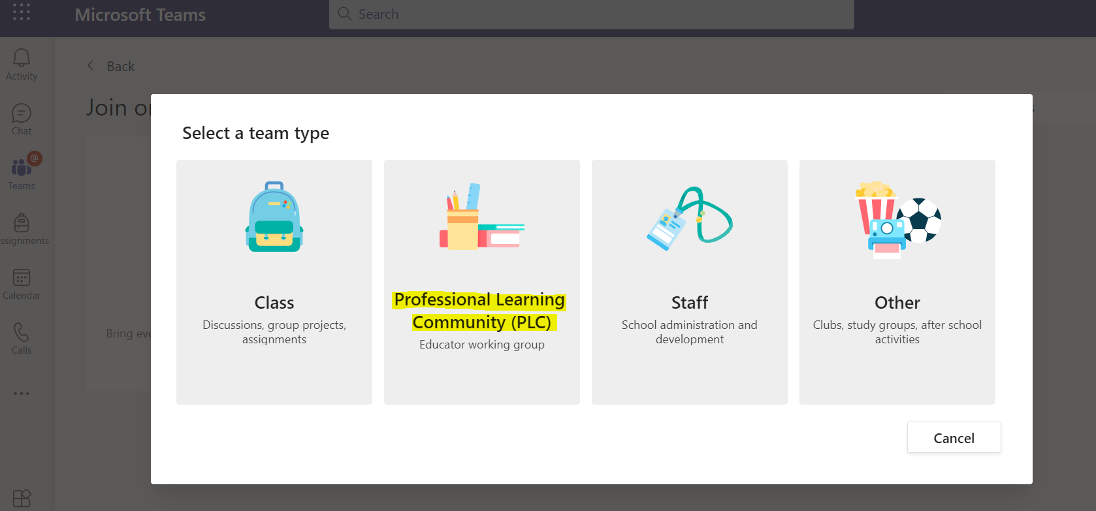
Select PLC team type
For Scotland's learners, with Scotland's educators
Do luchd-ionnsachaidh na h-Alba, le luchd-foghlaim Alba

Slide 32
Step 3 – Choose a moderation focus
Moderation takes place at all stages of the learning, teaching and assessment (moderation) cycle.
Digital approaches to moderation can be used to support this process allowing practitioners to collaborate and review each stage. For example, you may choose to focus on planning learning, teaching and assessment using the experiences and outcomes to meet learners' needs.
You may also consider using digital approaches to review a range of learner evidence in order to develop a shared understanding of progress in learning.
For Scotland's learners, with Scotland's educators
Do luchd-ionnsachaidh na h-Alba, le luchd-foghlaim Alba

Slide 33
Step 4 – Upload material
Planning for learning, teaching and assessment, as well as learner evidence, feedback and reporting comments can be uploaded.
This can be done by individual practitioners.
However, it may be that a representative from a department, school or group of schools will upload moderation material on behalf of the group.
https://youtu.be/NxPJEdG0T0s
For Scotland's learners, with Scotland's educators
Do luchd-ionnsachaidh na h-Alba, le luchd-foghlaim Alba

Slide 34
Step 4 – Important notes about learner evidence
OneNote allows a wide variety of media to be stored on each page. It is important to mindful about data protection and copyright.
Ensure that learners cannot be identified remove any personally identifiable content e.g. names from images, documents etc.
If using video content, do not embed videos where a pupil is visible. In these cases, you can play the video in a live meeting, have the discussion and record the outcome in OneNote. You should make a note of this in the template.
Video content such as a walkaround of a product that a pupil has created can be stored on pages, as long as it is anonymous as with photo/text based content.
If you are using assessment materials that have been commercially created, do not upload them to the pages.
Avoid uploading assessment materials which have been commercially created. The focus should be retained on practitioner designed and implemented approaches to assessment.
For Scotland's learners, with Scotland's educators
Do luchd-ionnsachaidh na h-Alba, le luchd-foghlaim Alba

Slide 35
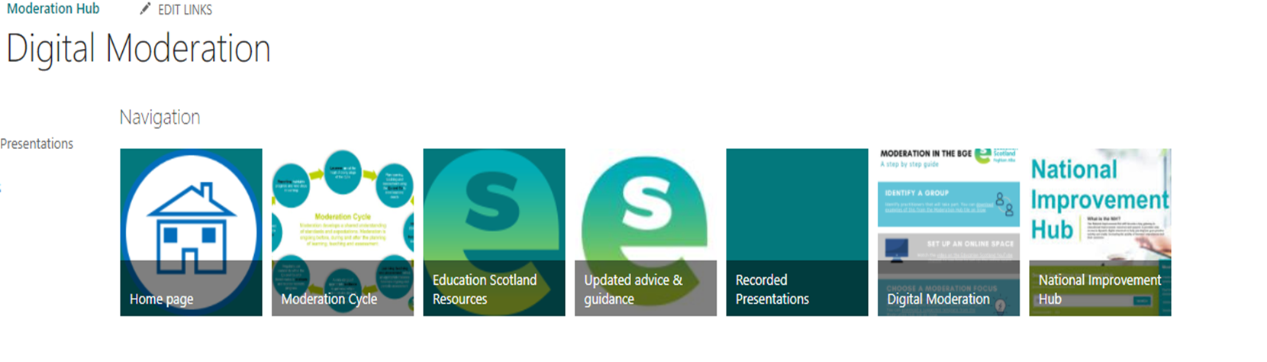

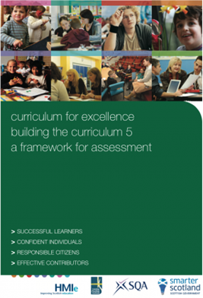


Support available
For Scotland's learners, with Scotland's educators
Do luchd-ionnsachaidh na h-Alba, le luchd-foghlaim Alba
Notes:
The Moderation Cycle tile on the Moderation Hub provides presentations with notes to be used for professional learning and these can also be used as a starting point for any moderation activities. Self evaluation resources, moderation templates and workshop presentations are included for each stage of the Moderation Cycle.
Key documentation and updated advice and guidance such as Assessment within the BGE 2020/21 can also be found on the Moderation Hub.
https://education.gov.scot/improvement/learning-resources/assessment-in-the-broad-general-education-2020-21/
In this tile, please also check out the Guided Moderation audio recording - this presentation explains each stage of the moderation cycle in more detail and can be used to support collegiate planning for learning, teaching and assessment or review of learner evidence.

Slide 36
Course Overview
  Session 2 – Closer look at moderation cycle and guided moderation
  Session 3 – Moderation activity
  Session 4 – High Quality Assessments and evidencing progress through and achievement of a level
  Session 5 – Moderation activity
  Session 6 – Facilitating online sessions and action planning
For Scotland's learners, with Scotland's educators
Do luchd-ionnsachaidh na h-Alba, le luchd-foghlaim Alba

Slide 37
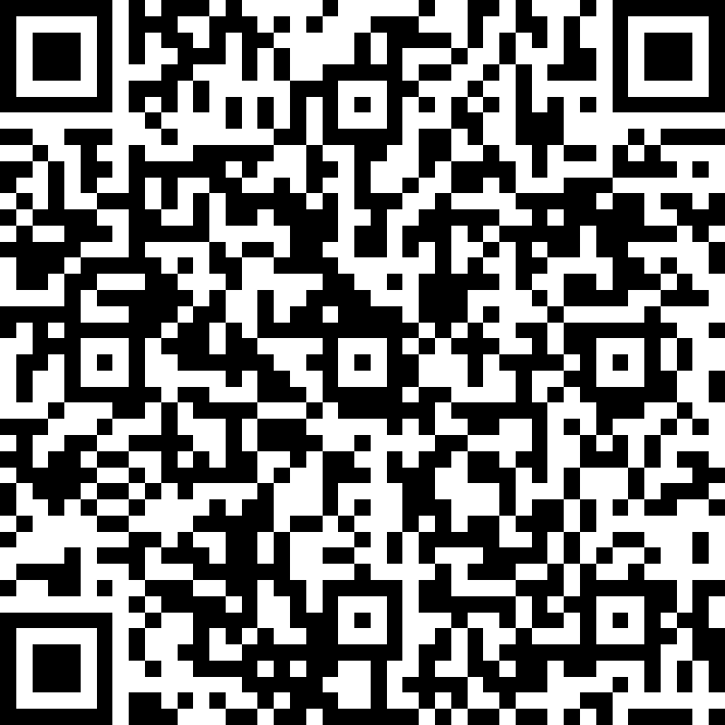
Evaluation
Please take the time to complete the very short evaluation that can be accessed via the QR code or link below.
For Scotland's learners, with Scotland's educators
Do luchd-ionnsachaidh na h-Alba, le luchd-foghlaim Alba
Notes:
https://forms.office.com/r/dp3bC1PrEY

Slide 38
Plenary
Aims
To explore the role of a Moderation Lead.
To have an understanding of the current national picture relating to assessment in the Broad General Education.
To visit key messages related to learning, teaching and assessment.
To become familiar with a digital approach for supporting moderation
For Scotland's learners, with Scotland's educators
Do luchd-ionnsachaidh na h-Alba, le luchd-foghlaim Alba
Notes:
Check Car Park

Slide 39


