Slide 1


Falkirk Learning to Achieve Moderation Support Programme
Session 4 Cohort 1
We will begin at 3:45pm.
Feel free to grab a refreshment before we get started.
For Scotland's learners, with Scotland's educators
Do luchd-ionnsachaidh na h-Alba, le luchd-foghlaim Alba

Slide 2
Protocols
  Please turn OFF your microphone when you are not speaking – this will prevent any background noise interference.
  If you wish to feed into the discussion please indicate this by using the ‘raise your hand’ tool on the control bar or by commenting into the chat pane.
  Please feel free to turn your camera ON and microphone ON for individual discussions in your breakout sessions.
For Scotland's learners, with Scotland's educators
Do luchd-ionnsachaidh na h-Alba, le luchd-foghlaim Alba

Slide 3
Aims
  Re-visit some of the key principles of assessment.
  Explore and understand the importance of high quality assessments as part of learning and teaching.
For Scotland's learners, with Scotland's educators
Do luchd-ionnsachaidh na h-Alba, le luchd-foghlaim Alba
Notes:
Focus of the session – High Quality Assessment
Re-visit some of the key principles of assessment – by providing an overview and explaining where High Quality Assessments fits
Explore and understand the importance of high quality assessments as part of learning and teaching – particularly that assessment is planned for along with learning and teaching and is the central to the moderation process – breakout activity to provide an opportunity to engage in professional dialogue and consider various assessment examples.

Slide 4
Our Group Agreement
Learning from and with each other.
Safe space to share ideas and experiences.
Open and honest dialogue.
Respect and support each other.
For Scotland's learners, with Scotland's educators
Do luchd-ionnsachaidh na h-Alba, le luchd-foghlaim Alba

Slide 5



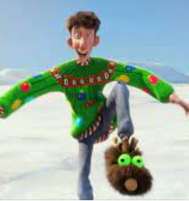

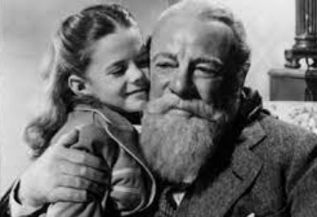
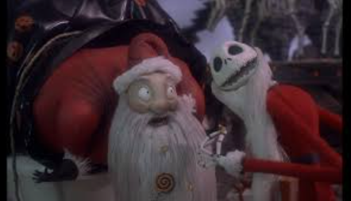
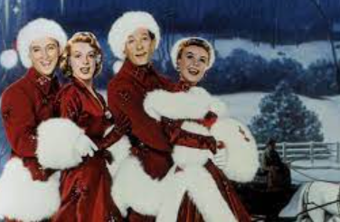
Name the Christmas Movie
1
2
3
4
5
6
7
8
What is your favourite Christmas Movie?
Notes:
Connector
1. Home Alone (Home Alone 1 if we are being specific)
2. Polar Express
3. Scrooge
4. Arthur Christmas
5. Elf
6. Miracle of 34th Street
7. The Nightmare Before Christmas
8. White Christmas

Slide 6

Review Preview
For Scotland's learners, with Scotland's educators
Do luchd-ionnsachaidh na h-Alba, le luchd-foghlaim Alba
Notes:
Session 3 – uploading own moderation material to the PLC notebook and using the templates to collaborate and record feedback. Reminder to review other groups.
You may recall at the end of the last session – we had a Jamboard plenary structured what went well and even better if…

Slide 7
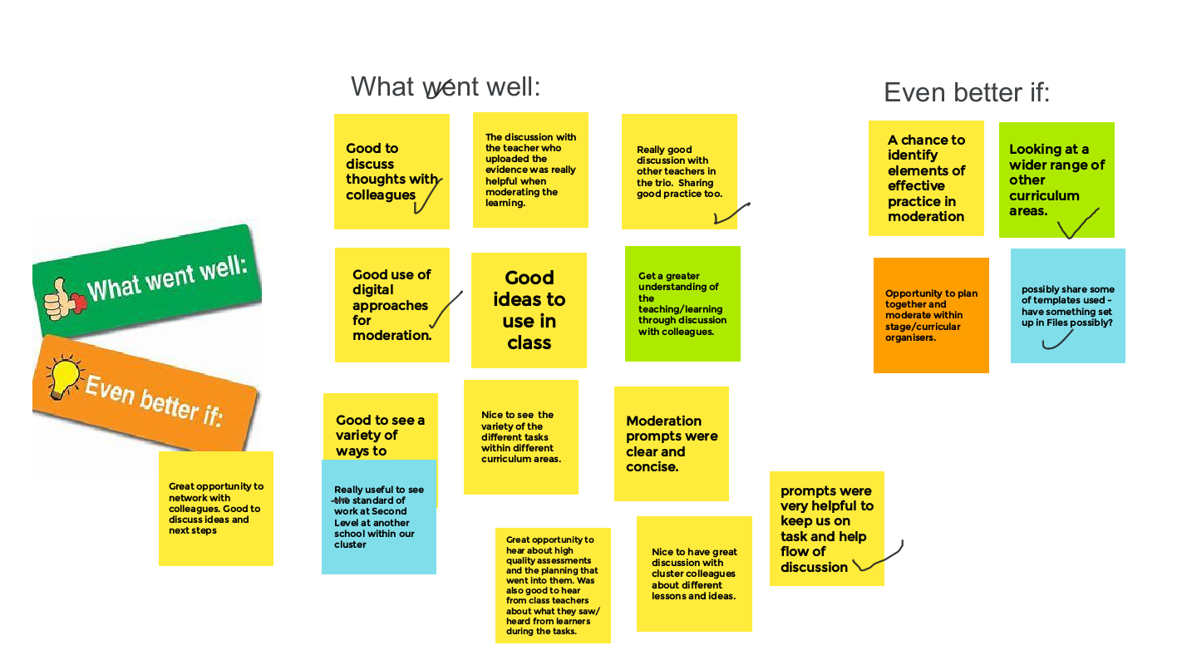
For Scotland's learners, with Scotland's educators
Do luchd-ionnsachaidh na h-Alba, le luchd-foghlaim Alba
Notes:
Breakout discussions valued so this afternoon there will be a further opportunity to work together in groups to explore HQA.

Slide 8
The teaching-learning gap
Assessment bridges the teaching-learning gap and provides us with robust evidence.
Assessment
Teaching
Learning
Teaching and learning are not the same thing – what is taught is not necessarily learned. In other words, there is usually a gap between what is taught and what is learned. The key to bridging this gap is assessment.
Robertson, B. (2020) The Teaching Delusion
For Scotland's learners, with Scotland's educators
Do luchd-ionnsachaidh na h-Alba, le luchd-foghlaim Alba
Notes:
Assessment is the bridge between teaching and learning.
It is only through assessment that we know if - what has been taught has been learned - therefore important to plan assessment as part of learning and teaching as we need to understand what assessment approaches are going to provide us with that feedback and evidence of learners progress.
In his book, The Teaching Delusion, Bruce Robertson stresses that
‘As teachers, we need to be relentless in measuring the gap between what is taught and what is learned, and on closing this, so that what is taught is learned. It isn’t enough for us to think that learning has happened. We need to know that it has. We can know this if we generate evidence of this.’

Slide 9
Ongoing and Periodic Assessments
Ongoing assessment opportunities might include:
Teacher observations
Conversations with learners
Peer assessment
Self assessment
Questioning approaches: a range of open and closed questions
Periodic assessment includes:
Written outcomes e.g. project, essay, report
Coursework, including class tests
Information from Scottish National Standardised Assessments
High quality assessments
.
For Scotland's learners, with Scotland's educators
Do luchd-ionnsachaidh na h-Alba, le luchd-foghlaim Alba
Notes:
When we think of different assessment approaches we can consider - Ongoing assessment (continuous/day to day) and periodic assessment – from time to time. And at points of transition – between establishments (ELC/PRIMARY/SECONDARY/BEYOND SCHOOL TO POSITIVE DESTINATIONS)
Ongoing assessments
Effective ongoing assessment (continuous/day to day) is about establishing where children and young people are in their learning, where they are going and how best to get there. It is important that we use the evidence about learning to provide useful feedback to learners, to adapt learning and teaching approaches to meet their needs and to revisit areas where required.
Periodic assessments - From time to time we also take stock of their learners’ progress and achievements in order to be able to plan ahead and periodic assessment are important in ensuring that learners’ progress is reviewed.
Periodic assessments can be used by practitioners to engage in moderation processes when reviewing learner evidence- to evaluate a range of evidence to provide a summary of progress and achievement. (progress through and achievement of a level) – taking account of breadth, challenge and application of learning.
Similarly, like ongoing approaches to assessment, periodic assessment should be planned for when collaboratively planning learning, teaching and assessment. (not a bolt on at the end – but planned as part of learning and teaching)
This includes the use of high quality assessments – which we will look at more closely and will be the focus for our breakout today.

Slide 10
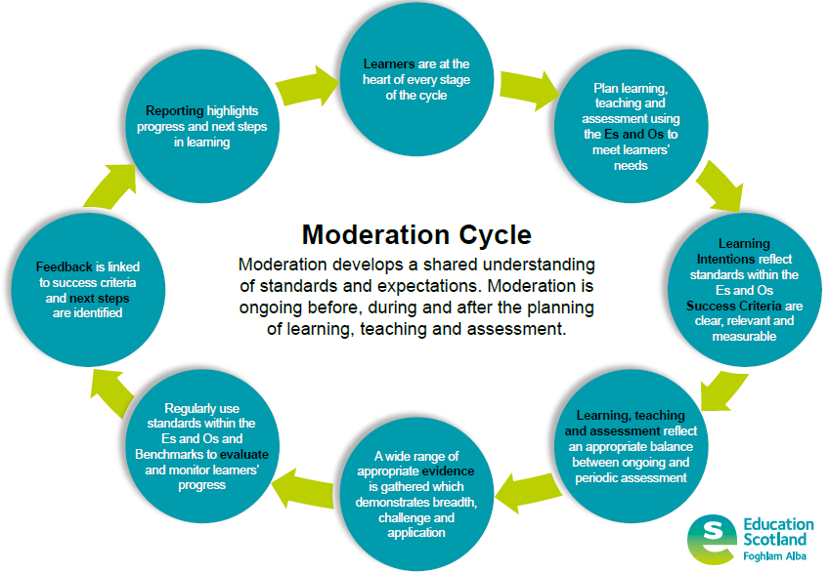
High Quality Assessments should be planned as part of the planning, learning, teaching and assessment cycle
For Scotland's learners, with Scotland's educators
Do luchd-ionnsachaidh na h-Alba, le luchd-foghlaim Alba
Notes:
High Quality Assessments should be planned as part of learning and teaching – assessment is part of that planning process and is considered when we work through the moderation cycle. We can use the moderation cycle to plan learning, teaching and assessment and to review learner evidence, generated by HQAs.
So HQAs – can provide the basis for moderation – when we plan learning and teaching we are planning also for assessment.
Planning assessments that are right for the learners,
Consider the Es and Os not only to plan learning and teaching but also to consider the Es and Os to be assessed that will provide information and evidence of progress in learning,
You will have ongoing and continuous assessment but also need to ensure planning for the periodic high quality assessments.
We need to consider at the planning stage for what evidence you need, to determine progress.

Slide 11
What are High Quality Assessments and what are they not?
High quality assessments ARE:
considered assessments, used periodically, throughout the year and across a level to form part of the evidence base for progress through and achievement of a level;
created when planning for learning and teaching;
carefully constructed selecting Es and Os from planned learning to assess breadth of previously taught concepts and for planned new contexts for learning;
carefully constructed to provide the appropriate level of challenge i.e. what skills are required from learners;
carefully constructed to provide application of prior learning (knowledge and skills) to new and unfamiliar contexts.
For Scotland's learners, with Scotland's educators
Do luchd-ionnsachaidh na h-Alba, le luchd-foghlaim Alba

Slide 12
What are High Quality Assessments and what are they not?
High quality assessments are NOT:
unnecessary stacks of evidence;
an end of unit assessment;
the only assessment evidence to be considered as part of achievement of, and progress through, CfE levels.
For Scotland's learners, with Scotland's educators
Do luchd-ionnsachaidh na h-Alba, le luchd-foghlaim Alba
Notes:
HQA are used alongside other evidence as part of a range of evidence to determine progress through and achievement of a level.
Evidence of achievement of a level includes: Observations of day-to-day learning within, and out with, the classroom, Coursework, including tests, Learning conversations, Planned periodic assessments, Information from the Scottish National Standardised Assessments (SNSA) and MCNG.

Slide 13
Why use High Quality Assessments?
By providing opportunities to gather evidence of breadth, challenge and the application of learning, well designed High Quality Assessments complement ongoing assessment by helping to evidence learners’ progress.
For Scotland's learners, with Scotland's educators
Do luchd-ionnsachaidh na h-Alba, le luchd-foghlaim Alba
Notes:
If well planned, HQAs complement other ongoing assessments (which informs that continuous review of learning) – but key difference of a HQA - is drawing learning across a broad range, clear focus of skills to provide challenge and that opportunities to apply learning are considered.

Slide 14
What are key features of High Quality Assessments?
High Quality Assessments can be taken from one of the four contexts of learning:
    Ethos and life of school as a community
    Curriculum areas and subjects
    Interdisciplinary learning (IDL)
    Opportunities for personal achievement
For Scotland's learners, with Scotland's educators
Do luchd-ionnsachaidh na h-Alba, le luchd-foghlaim Alba
Notes:
Focussing on the four contexts of learning provides scope for application to new and unfamiliar contexts, in a meaningful way i.e. IDL literacy across learning, applying learning to ethos and life of the school, or for opportunities for personal achievement.

Slide 15
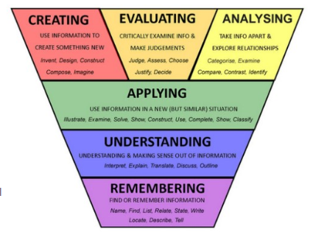
What are key features of High Quality Assessments?
Demonstrate breadth of learning
  Require the learner to draw on a range of learning from a number of Es and Os across different organisers
Demonstrate challenge
  Promote higher order thinking skills – creating, evaluating, analysing
Demonstrate application of learning in new and unfamiliar situations (4 contexts of learning)
For Scotland's learners, with Scotland's educators
Do luchd-ionnsachaidh na h-Alba, le luchd-foghlaim Alba

Slide 16
High Quality Assessment – Second Level Writing
Prior learning - Learners have:
Had opportunities to practise their writing skills in a range of genres, including persuasive writing
Engaged with and analysed a range of texts and used these as models to help inform the production of their own extended writing
Had opportunities to refine their note making skills
Used self and peer assessment opportunities and teacher feedback to improve their written work
Are aware of their next steps in writing and can use this information to plan, write and edit subsequent pieces.
Learners have had the opportunity to read information from organisations and venues offering activities that they could participate in.
For Scotland's learners, with Scotland's educators
Do luchd-ionnsachaidh na h-Alba, le luchd-foghlaim Alba
Notes:
Example links to Literacy / English Curriculum Area and Ethos and life of the school

Slide 17
High Quality Assessment – Second Level Writing
Literacy - Writing | Plan learning, teaching and assessment using the Experiences and Outcomes
Enjoyment and choice | I enjoy creating texts of my choice and I regularly select subject, purpose, format and resources to suit the needs of my audience. LIT 1-20a / LIT 2-20a
Tools for writing | Throughout the writing process, I can check that my writing makes sense and meets its purpose. LIT 2-23a
Organising and using information | By considering the type of text I am creating, I can select ideas and relevant information, organise these in an appropriate way for my purpose and use suitable vocabulary for my audience. Lit 2-26a
Creating texts | I can persuade, argue, explore issues or express an opinion using relevant supporting detail and/or evidence. Lit 2-29a
Assessment The pupil council receives a budget to spend on one of three activities for the school to participate in at the end of term. Choose one of these activities and produce a piece of writing persuading the pupil council to select your choice of activity. You should consider: The educational benefits How much pupils will enjoy the experience Value for money
For Scotland's learners, with Scotland's educators
For Scotland's learners, with Scotland's educators
Do luchd-ionnsachaidh na h-Alba, le luchd-foghlaim Alba

Slide 18
Pause for thought
Does the High Quality Assessment:
Cover a breadth of learning?
Provide appropriate challenge? i.e. Higher order thinking skills?
Provide opportunities for application of learning in new and unfamiliar contexts?
Focus on one of the four contexts of learning?
For Scotland's learners, with Scotland's educators
For Scotland's learners, with Scotland's educators
Do luchd-ionnsachaidh na h-Alba, le luchd-foghlaim Alba

Slide 19
High Quality Assessment – Second Level Numeracy
I can manage money, compare costs from different retailers, and determine what I can afford to buy. MNU 2-09a
Having determined which calculations are needed, I can solve problems involving whole numbers using a range of methods, sharing my approaches and solutions with others. MNU 2-03a
I can extend and enhance my knowledge of digital technologies to collect, analyse ideas, relevant information and organise these in an appropriate way. TCH 2-01a
For Scotland's learners, with Scotland's educators
Notes:
For this second level example the practitioner has bundled together 2 numeracy Es and Os and a Technologies E and O.

Slide 20


High Quality Assessment – Second Level Numeracy
We have been given a budget of £500 to create a ‘maths outdoors’ box for each stage of the school. Each box should contain at least some of each of the following:
Chalk
Measuring tapes
Rope cut into metres
Ten frames
Magnifying glasses
Things to consider:
How many boxes do we need?
How much of each item will we need for each box?
Are there resources that are already in the school/natural resources that we can use?
How can we ensure that our boxes are as sustainable as possible?
Are there delivery costs?
If we have money left, what could we purchase?
Tasks
Use catalogues (provided by the school office) to select items to help create the outdoor boxes. The boxes must include the above but additional resources can be added.
You should record your plan on a spreadsheet.
For Scotland's learners, with Scotland's educators
Notes:
Using these Es and Os the practitioner has created an assessment that could be used at second level.
In this assessment learners are being provided with a budget to create an outdoor box for each of the classes within their setting. You could substitute ‘maths outdoors box’ for a general outdoor box or any other resources that you happen to be planning to purchase for your establishment. The important element is that it is related to real life and provides opportunities for learners to apply their learning into a new or unfamiliar context.
Learners are provided with a budget and a minimum requirement for each box. They are then expected to create a spreadsheet to plan out how they are going to spend the money.
The blue box on the right hand side highlights some points that learners could be encouraged to think about as part of this task.
The activity provides an opportunity for learners to apply their learning of money, the four operations and spreadsheets in a new and unfamiliar context.

Slide 21
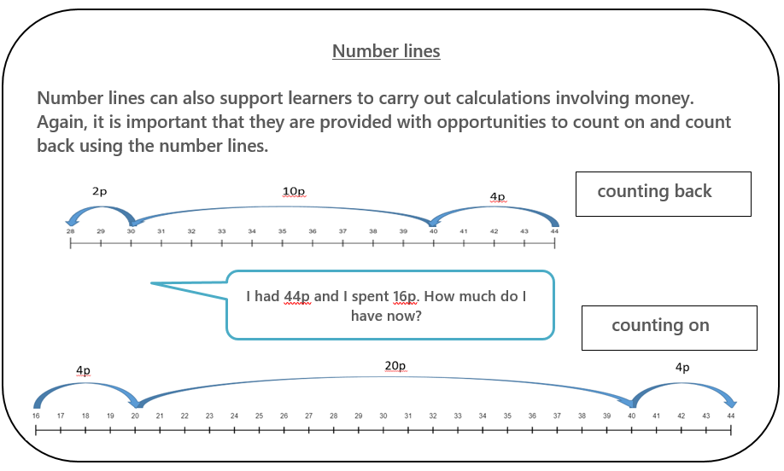
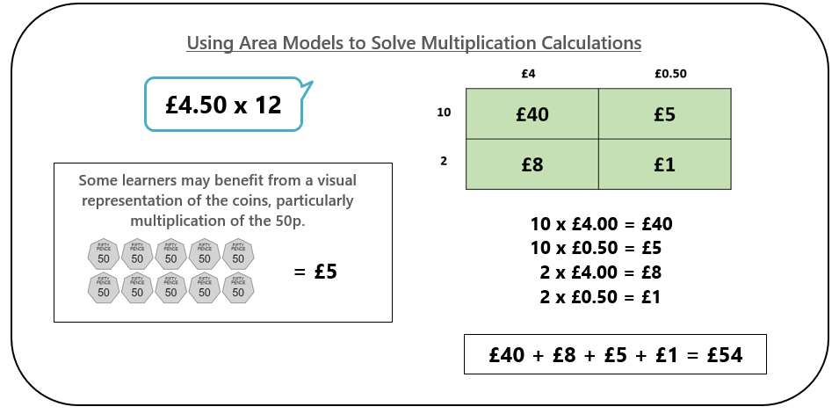
High Quality Assessment – Second Level Numeracy
Scaffolding:
Some learners may need support in getting started or
in organising their thinking.
Additional adult support
Provide templates for budget
Provide an example
Further Differentiation:
Less/more classes to buy for
Smaller/greater budget
Less/more specifications
Remove spreadsheet element
Incorporate percentages by introducing a discount
Provide scenarios e.g. ‘buy one/get one free’, buy in
bulk and receive a discount
Use of visual representations e.g. an open number
line or bar models to support calculations. (see images)
Notes:
Like all exemplars, it is unlikely that this task can be picked up and used with all learners exactly as it is. Some learners will require further scaffolding and differentiation will need to be built in to ensure that it is appropriate for all learners.
This slide demonstrates some of the scaffolding that may be required and that will depend very much on the needs of each learner. For example, some learners will need extra adult support. Some learners will require greater structure and a template or a worked example could be provided.
The task could be further differentiated by reducing the number of boxes that need to be created, by providing a smaller or greater budget or by providing less or more specifications. For some learners it may be appropriate to remove the spreadsheet element and for others you could extend it by introducing percentages or making use of the calculations tool within excel.
Some learners will benefit from using visual representations to solve the calculations and there are examples of how empty number lines and area models can be used in the context of money.
All learners are different and this activity may or may not be suitable for specific learners but the intention is provide food for thought.

Slide 22
What could be assessed?
I can manage money, compare costs from different retailers, and determine what I can afford to buy. MNU 2-09a
Having determined which calculations are needed, I can solve problems involving whole numbers using a range of methods, sharing my approaches and solutions with others. MNU 2-03a
I can extend and enhance my knowledge of digital technologies to collect, analyse ideas, relevant information and organise these in an appropriate way. TCH 2-01a
Can learners:
select and communicate processes and solutions
justify choice of strategy used
link mathematical concepts
determine the reasonableness of a solution?
Calculation of simple percentages
Budgeting skills
Comparison of costs
Use of spreadsheets to organise information
Addition, subtraction, multiplication and division of whole numbers and decimal fractions to two decimal places
Notes:
This slide demonstrates the specific knowledge and skills being assessed.
In relation to what numeracy could be specifically assessed using this type of activity, the top left box highlights the skills that are not named within specific Es and Os but should be embedded across all learning. These are typically associated with developing a problem solving approach and lend themselves nicely to providing opportunities for learners to apply their learning to new or unfamiliar contexts. This approach could also provide opportunities to assess how well learners can use the four operations to carry out calculations, make comparisons and use their budgeting skills. There is also potential to assess whether learners can carry out calculations using simple percentages.

Slide 23
Pause for thought
Does the High Quality Assessment:
Cover a breadth of learning?
Provide appropriate challenge? i.e. Higher order thinking skills?
Provide opportunities for application of learning in new and unfamiliar contexts?
Focus on one of the four contexts of learning?
Applying | Provides opportunities for learners to apply their learning in relation to the four operations, budgeting and spreadsheets to a new or unfamiliar context. The context is relevant to real life and encourages a strong pupil voice in relation to the resources purchased for their establishment.
Analysing | Learners are provided with the opportunity to organise, categorise and make comparisons between different retailers and options available.
Creating | Learners are provided with the opportunity to use the information they have gathered to create a budget.
Evaluating | Learners are provided with an opportunity to justify their decisions.
For Scotland's learners, with Scotland's educators
Notes:
What range and breadth of learning does it draw on? Please note your answers in the chat.
What higher order thinking skills could learners use in this activity? Please note your answers in the chat.
In what ways are learners being asked to apply previous learning into new or unfamiliar contexts? Please note your answers in the chat.
Which of the four contexts of learning does the assessment link with and why do you think so? Please note your answers in the chat.

Slide 24
Activity
For Scotland's learners, with Scotland's educators
Do luchd-ionnsachaidh na h-Alba, le luchd-foghlaim Alba

Slide 25
High Quality Assessment Task - Jamboard
In groups, traffic light elements of the High Quality Assessments into those you feel are ‘high quality’ and those you feel ‘could be improved.
Record reasons for your responses.
Look at those that ‘could be improved’ and suggest improvements to make them better.
They are not perfect!
Not to be used as examples out with this training.
Approx. 45 mins
For Scotland's learners, with Scotland's educators
For Scotland's learners, with Scotland's educators
Do luchd-ionnsachaidh na h-Alba, le luchd-foghlaim Alba
Notes:
Group activity to review a selection of HQA examples.
These are NOT planners these are a format to make it easier for you to look at we would NOT recommend you use this format for anything other than this training exercise.
The information is presented in a linear fashion – to focus in on breadth, challenge and application. They are not reflective of how you would plan – i.e. LI/SC and if you were planning a HQA you would plan taking account of the stages of the moderation cycle but again this is just to provide information of example of HQA tasks, there would be LI/SC, sitting behind this. Main focus for this activity is on breadth, challenge and application!

Slide 26
High Quality Assessment Task
Select a green ‘post it’ note if you feel that an element of the assessment is strong – and note strengths.
Select an amber ‘post it’ note if the assessment could be improved and note any suggestions to improve the assessment.
Select a pink ‘post it’ if you feel the assessment is not high quality and state your reasons why.
For Scotland's learners, with Scotland's educators
For Scotland's learners, with Scotland's educators
Do luchd-ionnsachaidh na h-Alba, le luchd-foghlaim Alba
Notes:
Trio 1 - https://jamboard.google.com/d/1mzltJ6wP4PiKmO1GTe9_GLrdVUy81iHQ38wgweMZNFI/edit?usp=sharing
Trio 2 - https://jamboard.google.com/d/1W1Ox124m5h6jeZh4_02fk9I8z0F23g7OskOjP-RUi9Q/edit?usp=sharing
Trio 3 - https://jamboard.google.com/d/1u742RBzvXDPYL5Nh-R7mn9KhaVRku6vRYCgS3FyVO5o/edit?usp=sharing
Trio 4 - https://jamboard.google.com/d/1RuRtCL7_Z4wI1sTz4RdC0XPmeYjX5Y7N_fxODNovU9c/edit?usp=sharing
Trio 5 – https://jamboard.google.com/d/1YZDOuObC5qALkX92zwo5JSLgRjw3J7Kbndw3VL7TOdU/edit?usp=sharing
Trio 6 – https://jamboard.google.com/d/1cqBEM4qB8OyHNYN1ZS7vTJXRELGJypZVk-6VRZ5wpeo/edit?usp=sharing
Trio 7 – https://jamboard.google.com/d/12bIrX9kj_SxtVhGPLCZjftGdYQr3rcTqUUmY8uEa1VA/edit?usp=sharing
Trio 8 – https://jamboard.google.com/d/1BZ0S8JropUNfURnR8EH64Iqkti5WBV27wUiWMlAWFjE/edit?usp=sharing
Trio 9 – https://jamboard.google.com/d/14lHRTwecRk1TSzn4kGRPCHLoHCxbS3R4EGg6WO7mPrU/edit?usp=sharing

Slide 27
Considerations
Does the High Quality Assessment:
Cover a breadth of learning?
Provide appropriate challenge? i.e. Higher order thinking skills
Provide opportunities for application of learning in new and unfamiliar contexts?
Focus on one of the four contexts of learning?
For Scotland's learners, with Scotland's educators
For Scotland's learners, with Scotland's educators
Do luchd-ionnsachaidh na h-Alba, le luchd-foghlaim Alba

Slide 28
Preparation for Session 5:
Begin to create a High Quality Assessment (no upload required)
Create one High Quality Assessment which requires:-
  the learner to draw on a range of learning;
  appropriate level of challenge;
  higher order thinking skills;
  application of learning in a new and unfamiliar situation;
  focuses on one of the four contexts of learning.
  Moderate this High Quality Assessment with colleagues.
For Scotland's learners, with Scotland's educators
Do luchd-ionnsachaidh na h-Alba, le luchd-foghlaim Alba
Notes:
As a follow on to today’s session we are going to ask you – not to create a HQA and use with learners and come back and moderate – but I would ask you to think about a HQA – begin to think about an example, Es and Os you would select, how would you ensure breadth of learning? How would you provide challenge and how could you apply learning to new and unfamiliar contexts?
We will start off the next session by having a discussion within your breakout rooms of examples. No need to prepare and upload anything but come prepared to have a discussion with colleagues about your ideas and we could then perhaps collectively create an assessment together in breakout rooms.

Slide 29
Course Overview
  Session 5 – Evidencing progress through and achievement of a level
  Session 6 – Facilitating online sessions and action planning
For Scotland's learners, with Scotland's educators
Do luchd-ionnsachaidh na h-Alba, le luchd-foghlaim Alba

Slide 30

Plenary
https://jamboard.google.com/d/1SVNIo2w7MGZHaPGouMEVNAs4aYBZ1ANTqMk_Hi5c8V0/edit?usp=sharing
For Scotland's learners, with Scotland's educators
Do luchd-ionnsachaidh na h-Alba, le luchd-foghlaim Alba
Notes:
Need to know
Excited
Stance
Worrisome
https://jamboard.google.com/d/1SVNIo2w7MGZHaPGouMEVNAs4aYBZ1ANTqMk_Hi5c8V0/edit?usp=sharing

Slide 31


