Slide 1


Falkirk Learning to Achieve Moderation Support Programme
Session 3 Cohort 1
We will begin at 3:45pm.
Feel free to grab a refreshment before we get started.
For Scotland's learners, with Scotland's educators
Do luchd-ionnsachaidh na h-Alba, le luchd-foghlaim Alba

Slide 2
Protocols
  Please turn OFF your microphone when you are not speaking – this will prevent any background noise interference.
  If you wish to feed into the discussion please indicate this by using the ‘raise your hand’ tool on the control bar or by commenting into the chat pane.
  Please feel free to turn your camera ON and microphone ON for individual discussions in your breakout sessions.
For Scotland's learners, with Scotland's educators
Do luchd-ionnsachaidh na h-Alba, le luchd-foghlaim Alba

Slide 3
Aims
To continue to develop knowledge of the learning, teaching and assessment cycle and moderation processes.
To collaborate with colleagues to use the moderation process.
To become familiar with using digital approaches to support moderation activities.
For Scotland's learners, with Scotland's educators
Do luchd-ionnsachaidh na h-Alba, le luchd-foghlaim Alba

Slide 4

Group Agreement
Learning from and with each other.
Safe space to share ideas and experiences.
Open and honest dialogue.
Respect and support each other.
For Scotland's learners, with Scotland's educators
Do luchd-ionnsachaidh na h-Alba, le luchd-foghlaim Alba

Slide 5

Connector
  What was the highlight of your day?
For Scotland's learners, with Scotland's educators
Do luchd-ionnsachaidh na h-Alba, le luchd-foghlaim Alba
Notes:
Share on the chat pane

Slide 6
Context: OECD- Independent review of the Curriculum for Excellence (2021)
Provide dedicated time to lead, plan and support CfE at school level. In support of the next phase of development of CfE, Scotland could consider the provision of additional dedicated and ring-fenced time for all teachers, for curriculum planning, for monitoring of student achievement and in support of moderation of assessment outcomes.
Align qualifications, system evaluation and curriculum to deliver on the commitment of Building the Curriculum 5. Scotland could first identify modes of student assessment that could be used in school and external settings at Senior Phase levels, in alignment with the four capacities and CfE philosophy; and second, re-develop a sample-based evaluation system to collect robust and reliable data necessary to support curriculum reviews and decision making
For Scotland's learners, with Scotland's educators
Do luchd-ionnsachaidh na h-Alba, le luchd-foghlaim Alba
Notes:
In 2020, the Organisation for Economic Co-operation and Development (OECD) were commissioned by the Scottish government to carry out an independent review of CfE to help us better understand how the curriculum is being designed and implemented in school, and to identify areas for improvement. The OECD published its findings in June 2021.
Second report published 31st August - https://www.oecd-ilibrary.org/education/upper-secondary-education-student-assessment-in-scotland_d8785ddf-en

Slide 7
Implementation framework for the OECD’s 2021 review of Curriculum for Excellence
Review and clarify current national guidance on breadth and depth of learning. Exemplify good practice in the ways in which different schools achieve breadth and depth of learning across their curriculum, which meets the needs and aspirations of learners.
The advice set out in Building the Curriculum 5 and in other relevant sources will be reviewed and updated as necessary.
Short-life sub-group of the Curriculum and Assessment Board to explore options for introducing a sample-based survey with the potential to gather data across the four capacities and how this would align with data collected at present. The sub-group will be specifically tasked with considering the workload implications for staff of any potential survey.
Commitment to teacher professional judgement as the means of assessing progress in the BGE with consideration of how to better support that and the Achievement of CfE Levels data in future. National standardised assessments will continue to have a role to play in this.
For Scotland's learners, with Scotland's educators
Do luchd-ionnsachaidh na h-Alba, le luchd-foghlaim Alba
Notes:
Scotland’s Curriculum: Into the Future: Implementation framework for the OECD’s 2021 review of Curriculum for Excellence (www.gov.scot)

Slide 8
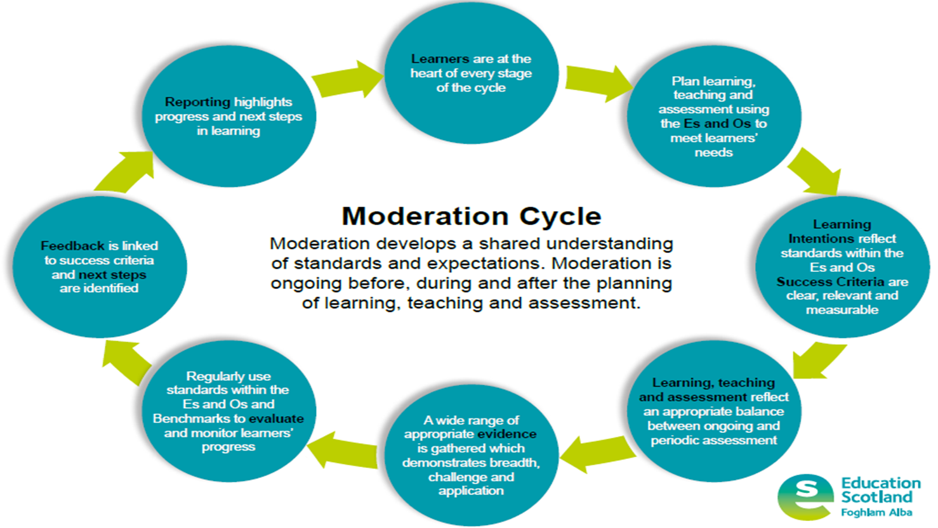
Learning, Teaching and Assessment Cycle
For Scotland's learners, with Scotland's educators
Do luchd-ionnsachaidh na h-Alba, le luchd-foghlaim Alba
Notes:
In session 2, we considered involved learners at each stage of the cycle, planning using Es and Os and the key features of Learning Intentions and Success Criteria.
We will look more closely at ongoing and periodic assessment and sources of evidence in session 4 during the input on High Quality Assessments. The next few slides focuses on feedback and next steps as there was limited evidence of this in the guided moderation example we used in Session 2.

Slide 9
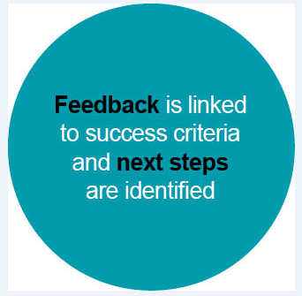
Feedback and Next Steps
Based on clear, relevant and measurable success criteria.​
Appropriately timed and based on observation of learning.​
Focused and manageable.​
Based on learner progress both in the short term and over a longer period of time.​
Focussed on areas of strength and next steps.​
Indicates both what and how the learner can move forward. ​
Time/opportunities must be planned for to allow learners to reflect and act upon feedback.​
Questioning used effectively to encourage learners to think, reflect on and reconsider their own learning.
For Scotland's learners, with Scotland's educators
For Scotland's learners, with Scotland's educators
Do luchd-ionnsachaidh na h-Alba, le luchd-foghlaim Alba
Notes:
Feedback and next steps:
Ensures learners are clear about what they have done well and what they need to do to move forward with their learning.
Ensures appropriate, pace, progression and challenge.
Feedback is key to developing next steps and raising attainment. Educational Endowment Fund (charitable research organisation which focuses on what works well in education) – Feedback is one of the most effective and cheapest interventions. – however it needs to be specific to more learners forward in their learning
The key features of effective feedback: allow participants to read slide.

Slide 10
Moderation Hub
Notes:
The Moderation Cycle tile on the Moderation Hub provides presentations with notes to be used for professional learning and these can also be used as a starting point for any moderation activities. Self evaluation resources, moderation templates and workshop presentations are included for each stage of the Moderation Cycle.

Slide 11
Moderation Activity
For Scotland's learners, with Scotland's educators
Do luchd-ionnsachaidh na h-Alba, le luchd-foghlaim Alba

Slide 12
Reminder
Feedback to each other should:
Be formative and helpful.
State areas of strength e.g. LI were clearly based on the learning within the E&Os
State areas for development e.g. SC focused on task and not the learning.
Note any areas missing by N/A.
Complete each section and provide an overall comment.
For Scotland's learners, with Scotland's educators
Do luchd-ionnsachaidh na h-Alba, le luchd-foghlaim Alba

Slide 13
Online moderation activity – own material
Accessing PLC Notebook and breakout channels
Assign Presenter, Scribe, Facilitator
Each school will have 10-15 minutes to present and receive feedback.
Change roles for each moderation task
For Scotland's learners, with Scotland's educators
Do luchd-ionnsachaidh na h-Alba, le luchd-foghlaim Alba
Notes:
Following on from Session 2, we will now spend time moderating the evidence that you have uploaded in your allocated space in the PLC Notebook.
The presenter should discuss the plans/approaches they have for learning, teaching and assessment and evidence gathered.
The facilitator for the group should use the moderation support questions to generate discussion and keep an eye on time.
The scribe should note the feedback and main points on the moderation comment template.
Extra moderation material is provided in each Trio Section if you finish this task before the time is up.
LIVE DEMONSTRATION OF HOW TO ACCESS BREAKOUT CHANNEL – REPORT TO GENERAL CHANNEL AT 5PM.

Slide 14


Plenary
To continue to develop knowledge of the learning, teaching and assessment cycle and moderation processes.
To collaborate with colleagues to use the moderation process.
To become familiar with using digital approaches to support moderation activities.
For Scotland's learners, with Scotland's educators
Do luchd-ionnsachaidh na h-Alba, le luchd-foghlaim Alba
Notes:
Each person / group to share something that worked well / liked about the process and one thing they would do differently.
https://jamboard.google.com/d/1SabJIS3VL1Q-n_uxDNQWen87fFeXhUFJaHTGCNajHc0/edit?usp=sharing

Slide 15
Course Overview
  Session 4 – High Quality Assessments and evidencing progress through and achievement of a level
  Session 5 – Moderation activity
  Session 6 – Facilitating online sessions and action planning
For Scotland's learners, with Scotland's educators
Do luchd-ionnsachaidh na h-Alba, le luchd-foghlaim Alba
Notes:
Session 4 – Tuesday 23rd November

Slide 16


