Slide 1
Specialist Provision in Falkirk Council Additional Support Needs Service

Slide 2
Specialist Provision in Falkirk Council Additional Support Needs Service
The information given is an example of what you may find within a type of specialist setting. Whilst we work to ensure equity of service and access, these may be limited by the limitations of the building and other factors which may vary. Specific information about a provision can be sought from the school’s website or by contacting them directly.

Slide 3
What do we have?
Primary Education
Enhanced Provision Units
Additional Support Centres (Primary)
Severe and Complex Wings
Inclusion and Wellbeing Service
Windsor Park School (Primary)
Secondary Education
Additional Support Centres
Carrongrange High School
Inclusion and Wellbeing Service
Windsor Park School

Slide 4
Accessing Specialist Provision In Falkirk Council
If you have accessed this presentation prior to discussing specialist provision with your child’s Key Teacher, please contact them to discuss transition planning for your child’s education.
The majority of children in Falkirk Council can be supported in mainstream education. *Further Information
Specialist provision in Falkirk Council is accessed by your child’s establishment making a referral to the Placement Change Panel, which is operated by the Additional Support Needs Service.
* https://www.gov.scot/publications/guidance-presumption-provide-education-mainstream-setting/

Slide 5
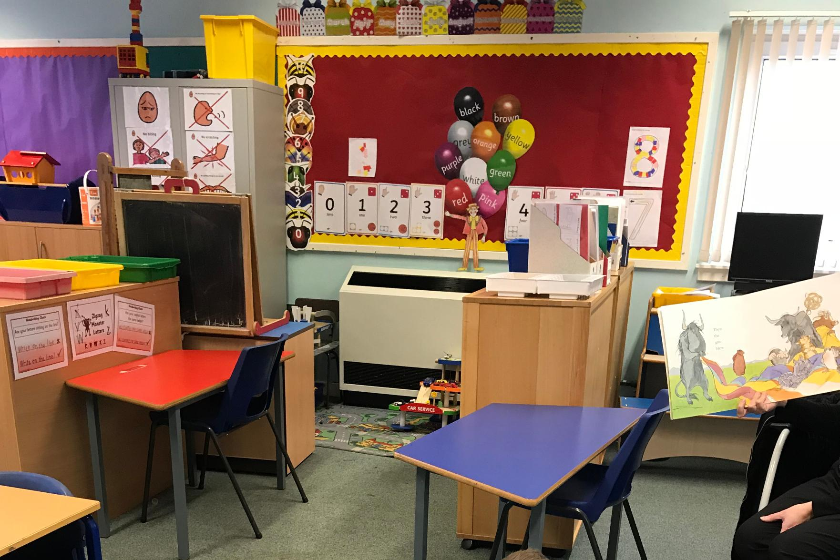
Primary Enhanced Provision
This resource seeks to enable pupils who require significant additional support to access the mainstream curriculum and classes, and be included optimally in the life of the school.
Enhanced Provision is positioned in 15 of the authority’s 50 primary schools:
Bainsford Primary School
Carronshore Primary School
Deanburn Primary School
Easter Carmuirs Primary School
Grange Primary School
Hallglen Primary School
Langlees Primary School
Larbert Village Primary School
Moray Primary School
Nethermains Primary School
Slamannan Primary School
Shieldhill Primary School
Stenhousemuir Primary School
St Patrick’s Primary School
Victoria Primary School
Enhanced provisions are under the leadership of the school Headteacher. Contact details can be found on Falkirk Councils website: https://www.falkirk.gov.uk/services/schools-education/

Slide 6
Enhanced Provision
Carronshore Primary School Enhanced Provision have provided an example of what you might expect from an Enhanced Provision.
Please note that not all features are found in every Enhanced Provision.
Video content correct at the time of creation.

Slide 7
Primary Additional Support Centre
ASCs are based within a mainstream primary schools, this facility provides additional support for pupils whose needs arise from significant social and communication difficulties, including those who have a diagnosis of Autism Spectrum Disorder. This resource seeks to enable pupils who require significant additional support to access a differentiated mainstream curriculum, through a carefully managed learning environment and structure of the day.
Where possible pupils in the ASC may be supported into mainstream classes, and will be included in the life of the school.
Primary ASCs are based in the following schools:
Ladeside ASC
Easter Carmuirs ASC
Sacred Heart ASC
Primary ASCs are under the leadership of the school Headteacher. Contact details can be found on Falkirk Councils website:
https://www.falkirk.gov.uk/services/schools-education/

Slide 8
Primary Additional Support Centre
Ladeside Primary School ASC have provided an example of what you could expect from an ASC. Click on the thumbnail picture below to access their information presentation!
Information correct at the time of creation.

Slide 9
Primary Severe and Complex Wings
Based within two mainstream primary schools these facilities provide support for children with enduring and lifelong physical, intellectual, communication, sensory or social, emotional and behavioural additional support needs.
Where possible, these facilities are involved and included in the wider school community.
The Time Zone, based within Maddiston Primary School, largely though not exclusively, serves the east of Falkirk.
The Thistle Wing, based within Kinnaird Primary School, largely though not exclusively serving the west. The Thistle Wing has two campuses, with the Annexe sited in the previous school building of Carrongrange (next to Larbert High School). This facility provides support in the same manner as the Thistle Wing and Timezone.
Thistle Wing and Annexe (Kinnaird Primary School)
Timezone Wing (Maddiston Primary School)
Contact details can be found on Falkirk Councils website: https://www.falkirk.gov.uk/services/schools-education/

Slide 10
Primary Severe and Complex Wings
An example of the facilities you may find within our severe and complex wings are shown here in a virtual tour of Timezone, Maddiston Primary School:
Video content correct at the time of creation.

Slide 11
Windsor Park School (Primary/Secondary)
Windsor Park (Primary) school is purpose built and situated alongside Bantaskin Primary, providing education for deaf learners who require a very significant level of specialist support from highly specialised staff in order to access the curriculum.
Windsor Park (Secondary) resource is based within Falkirk High School and provides education to deaf learners who require a very significant level of specialist support from highly specialised staff in order to access the curriculum. It seeks to enable pupils to access the mainstream curriculum and classes (where appropriate) and be included optimally in the life of mainstream school.
Contact details can be found on Falkirk Councils website: https://www.falkirk.gov.uk/services/schools-education/

Slide 12
Windsor Park School (Primary/Secondary)
Further information regarding Windsor Park School can be found here:
https://www.windsorpark.falkirk.sch.uk/
Video content correct at the time of creation.

Slide 13
Additional Support Centre (Secondary)
Falkirk currently has three mainstream secondary schools offering additional specialist support to pupils experiencing severe specific learning and communication difficulties and in most cases related to the triad of impairments associated with Autism Spectrum Disorders. These facilities enable pupils who require additional support to access the mainstream curriculum and classes, and be included optimally in the life of the school, as well as providing close support for communication and social development.
Denny HS (known as Northfield)
Grangemouth HS
Larbert HS
Contact details can be found on Falkirk Councils website: https://www.falkirk.gov.uk/services/schools-education/

Slide 14
Secondary ASC
Larbert High School Additional Support Centre have provided an example of what you could expect from an ASC. Click on the thumbnail picture below to access the Parent handbook and their own Welcome presentation!

Slide 15
Carrongrange HS
This resource seeks to support secondary-aged pupils with enduring and lifelong physical, cognitive, communication, sensory needs which at times can lead to social, emotional and behavioural needs.
Pupils are supported to be included in a range of activities within school, colleges and the community.
The school is purpose-built, with a full range of facilities, and has excellent access for children with physical disabilities.
School Website - https://www.carrongrange.falkirk.sch.uk/

Slide 16
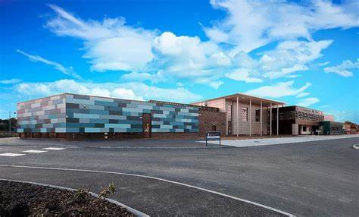
Carrongrange High School
Click on the link below to access Carrongrange High School’s video tour:
Carrongrange HS Video Tour
Video content correct at the time of creation.

Slide 17
Inclusion and Wellbeing Service (Primary/Secondary)
The Inclusion and Wellbeing Service is an integral part of the Additional Support Needs provision of Falkirk Council. The Service Campus is located within the Laurieston area of Falkirk and provides a flexible and holistic approach to meeting the needs of children and young people experiencing a range of significant/complex Social, Emotional and Behavioural needs that often arise from developmental trauma, Adverse Childhood Experiences and difficult family circumstances. The service is supported by a multi-disciplinary team including Inclusion Support Workers, Early Years Officers, Family Support Workers and Community Learning and Development staff. The service works in partnership with mainstream schools and nurseries to offer individual packages of support for the children and young people and the referring establishment.
The package of support can include:
Staff training and development;
Consultation;
An Outreach service;
Small group work;
Direct support to children and young people;
Shared placement between IWS and a mainstream school or nursery school;
In very exceptional circumstances a full time placement may be offered at IWS with pupils remaining on the role of their mainstream school.
Secondary Pupils:
Full time alternative educational provision will only normally be considered for the last 18 months of statutory education.
School Website - https://blogs.glowscotland.org.uk/fa/inclusion/

Slide 18
Inclusion and Wellbeing Service (Primary/Secondary)

Slide 19
If you have any additional queries/questions, please contact your child’s current establishment.
Falkirk Council Specialist Provision

