Slide 1
Structured Learning at Home
Numeracy Academy
@FVWLNumerac1

Slide 2
FVWL RIC Numeracy:
Structured Learning At Home
For more ideas visit https://blogs.glowscotland.org.uk/glowblogs/fvwlric/
Structured Learning
At Home

Slide 3
FVWL RIC Numeracy:
Structured Learning At Home
We’ve selected a range of websites that have
structured learning at a range of levels, including:-
Khan Academy | Matholia | White Rose Maths
Mathantics | Mathplayground | Greg Tang
Number Blocks | Dreambox | NCTM Illuminations
Notes:
Show Video (Mohammad counts 8 bears)
When accomplished easily counting can appear to be quite simple. However, unpacking the details of what children do as they count reveals their understanding of a complex, interconnected process – a process that is anything but simple!
The importance of counting cannot be underestimated. Counting is the foundation upon which number concepts and skills are built. The ability to count accurately, flexibly and with understanding support’s children’s future success in mathematics.
Learning to count involves more than learning to recite a sequence of number names.
Brainstorming Activity
What is your understanding of counting?
What does it involve?
What difficulties do children have when counting? Possible counting mistakes
What does meaningful counting look like?
Etc
Feedback and discuss

Slide 4
Khan Academy Overview
Grade Comparison to Scotland.
IMPORTANT NOTICE: Khan Academy is based on the US Grade System. Please be aware that while in general we feel the content is very useful, there are some differences with the timing of when content is introduced and the way that some content is taught.
Grade | Level | Primary
➔ Kindergarten | Early/First | P1 + P2
➔ First | First | P3
➔ Second |  | P4
➔ Third | Second | P5
➔ Fourth |  | P6
➔ Fifth |  | P7
➔ Sixth | Third and Fourth | S1
➔ Seventh |  | S2
➔ Eighth |  | S3

Slide 5
Khan Academy Overview
khanacademy.com/math
Free sign-up – simple to do
Contains lots of structured numeracy and maths activities including:
Video Tutorials
Follow Up Questions
Quizzes.
Khan Academy Kids https://khankids.zendesk.com/hc/en-us can only be downloaded as an app on some devices (may be more suitable for P1/2)
Content for P1 on Khan Academy can be found in the pre-school and K-2nd Grade section but note that this section covers all the way up to P4.
Content for P2-P4 on Khan Academy can be found in the K-2nd Grade Section
Content for P5-P7 on Khan Academy can be found in the 3rd Grade, 4th Grade and 5th Grade Sections
If you use the quiz section, this will give the learner an idea of what they can do confidently and what they may need to learn/revisit. The Khan Academy then suggests the content that would be useful for them to work on. These are marked with a yellow star.

Slide 6
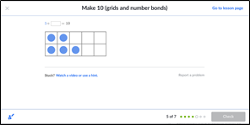
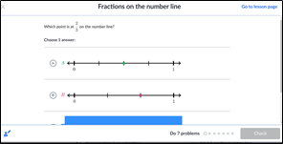
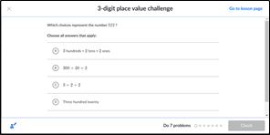
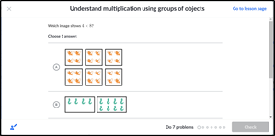
Khan Academy Overview
Examples of practice questions –

Slide 7
Matholia Overview
Matholia Overview
Matholia is an online mathematics learning portal providing pupils, teachers and parents with dedicated content based on the latest primary maths syllabus from the Singapore Ministry of Education.
The platform supports a number of national curriculums. The UK curriculum which is available on the platform is based on the English Curriculum.
Subscription to this platform is free until the end of the school year. Subscription is very quick and easy to complete on www.matholia.com. Pupils/ class can be added to your subscription.
This simple guide provides an overview of how Matholia can be used effectively as a digital platform for learners.
Matholia Platform
The Matholia learning portal consists of 5 main components:
Interactive practice modules.
Instructional videos
Explanatory topical fact sheets and fully-worked solutions
Detailed assessment of concepts and skills
Syllabus-based mathematics games

Slide 8
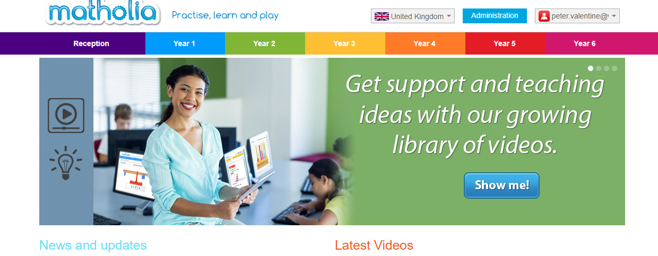
The home page image below shows tabs from reception year to year 6. This broadly relates to our P1-P7 curriculum.

Slide 9
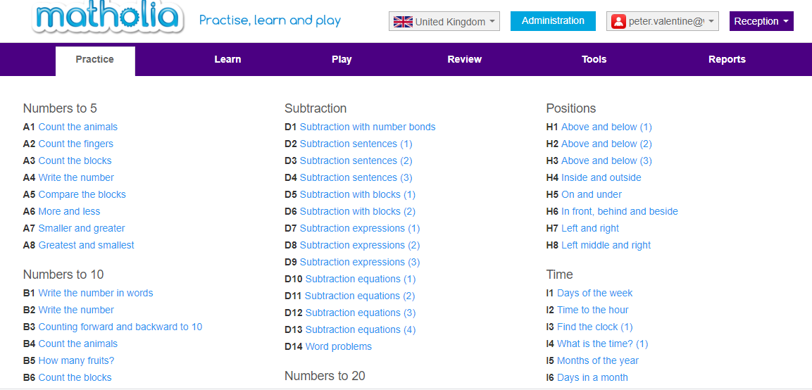
Front Page The image below shows the page image when clicking on any of the year tabs from the main page. There are 6 subheadings on the purple bar at the top of the page. They are Practice, Learn, Play, Review, Tools, and Reports. It is important that when learners use this platform that they do not rush through each module. There are opportunities for learners to practice, learn, and play relating to each mathematical idea.

Slide 10
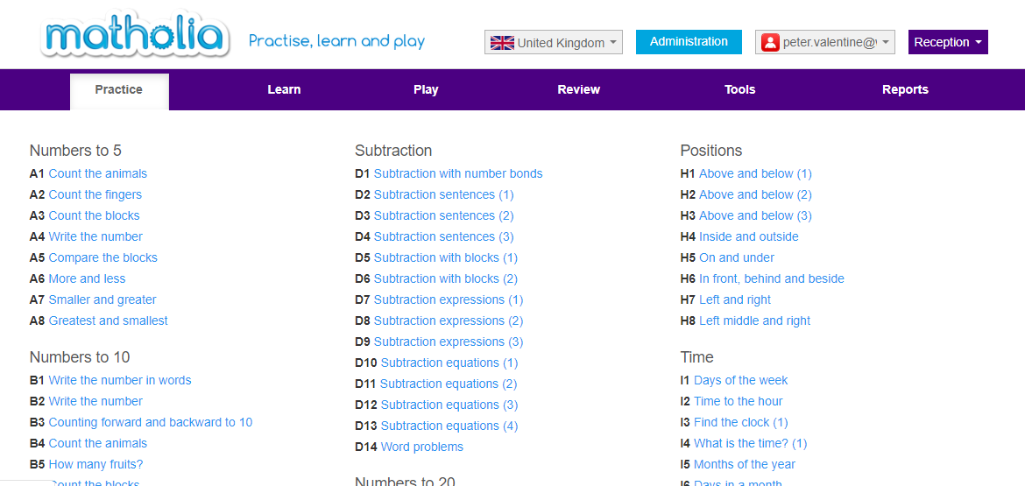
Practice Modules Each practice module above is broken down into ‘micro-modules. Each micro-module addresses a specific learning area, concept or skill from the syllabus E.g. Numbers to 5, Numbers to 10. Tasks within each micro-module are dynamic and have unlimited questions meaning pupils can practise across the entire syllabus without experiencing question repetition

Slide 11
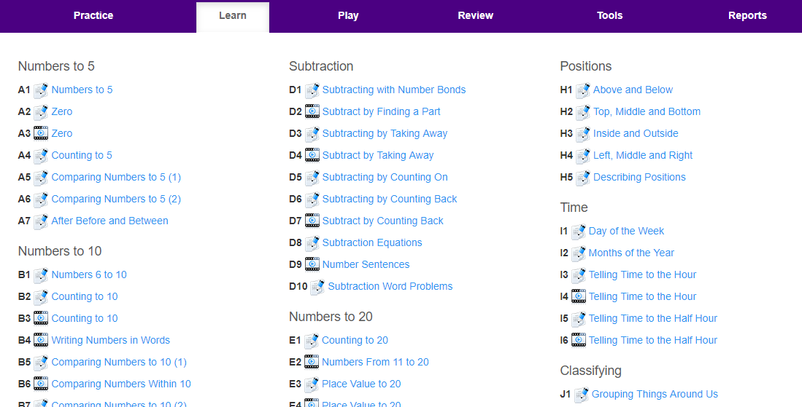
Learn The Matholia ‘Learn’ environment above consists of a comprehensive collection of step by step instructional videos. These lessons can be accessed, played and re-watched any time. Pupils can learn at their own pace allowing them to reinforce conceptual and procedural knowledge, whilst building confidence in mathematics. More capable pupils can also benefit from the Matholia videos as they are able to access material at their own pace and begin topics that are above and beyond those currently taught in class.

Slide 12
Play The Matholia learning portal below (image 5) includes over 250 mathematics games that closely follow the achievement goals of the Singapore primary mathematics syllabus and links to the CfE.

Slide 13
Tools The tools section of the programme below has many virtual manipulatives that can be used by learners. These include 10 frames, number bond builders, base 10 blocks etc.
Subscription
Subscription is free until the end of the school year and is easy to complete on the home page.
Please bear in mind that if you are creating a pupil account then please use a pseudonym in each case.

Slide 14
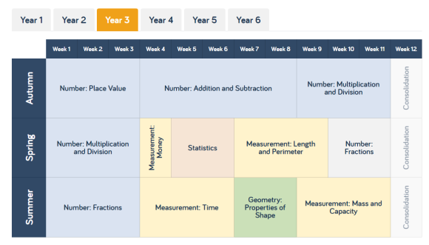
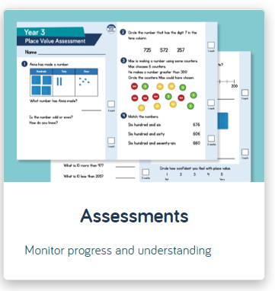
White Rose Maths Overview
White Rose Maths Hub offers free schemes of learning and assessments for Early Years to Secondary level students. There are now some free Home Learning packages which include video tutorials. https://whiterosemaths.com/
Teachers
Schemes of Learning and progression resources – written for English Curriculum. See below Year 3 (Primary 4)
You will also find primary assessments and secondary assessments for end of block and end of term. Assessment are FREE to use.

Slide 15
White Rose Maths Overview
Parents and carers https://whiterosemaths.com/homelearning/
The White Rose Maths Team has prepared a series of five maths lessons for each year group from Year 1-8. W They will be adding five more each week for the next few weeks.
Every lesson comes with a short video showing you clearly and simply how to help your child to complete the activity successfully. Year 5 (Primary 6)

Slide 16
MAhantics
This is a very good maths video website which animates maths which is highly engaging for learners. There is a wide range of mathematical concepts covered in this website. (1st level – S4)
Mathantics Overview
Have a look at these videos and many more
Place Value
https://mathantics.com/lesson/place-value
Shows the development of the Base 10 number system – using different number places to represent different sized groups. Each time we have a new number place to count larger groups we place each it to the left of previous number place. Each new number place represents groups that are exactly 10 times bigger than previous number place. Progression from ten to a billion. (First Level to Third Level)
Decimal Place Value
https://mathantics.com/lesson/decimal-place-value
Decimal places are a way of extending the base 10 number system so that it can represent amounts that are in between whole amounts. Just as whole number places can go on forever to the left counting bigger and bigger groups, decimal number place can go on forever to the right counting smaller and smaller parts or fractions. When we move to the right of the decimal point, the new number places are ten times smaller than the previous place. (Second and Third Level)

Slide 17
MAhantics
This is a very good maths video website which animates maths which is highly engaging for learners. There is a wide range of mathematical concepts covered in this website. (1st level – S4)
Mathantics Overview
Have a look at these videos and many more
Rounding
https://mathantics.com/lesson/rounding
Rounding a number means making a less precise version of it. Rounding numbers can make it easier to do calculations. We generally round to a specific number place e.g. the nearest ten, one hundred, tenth, hundredth or the nearest whole number, The number place we round to is called the target number. The general rule is that the digit to the right of the target is less than 5 we leave the target digit the same. If its 5 or more we increase the target digit by 1 even if that causes a chain reaction with the bigger number places. Such an important Maths Skill. (First Level to Third Level)

Slide 18
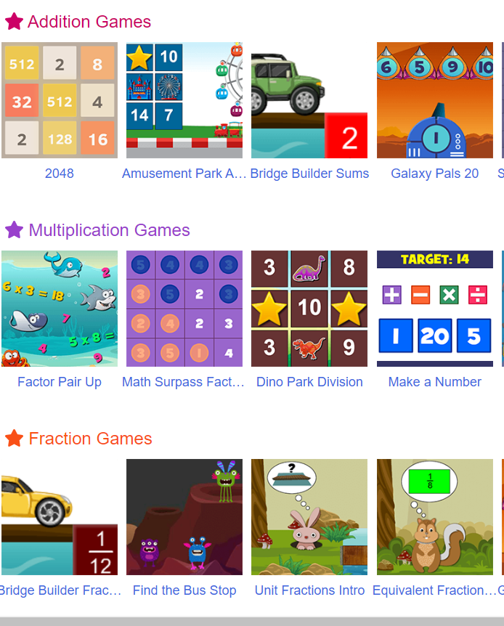
Mathplayground Overview
Mathplayground
https://www.mathplayground.com/
An extensive range of maths games covering addition, subtraction, multiplication, division, fractions, money and time, ratio, pre-algebra and geometry
Also featuring a range of step by step teaching videos on a range of concepts including data handling, multiplication and division, area and perimeter, and fractions
(Early to Second Level)

Slide 19
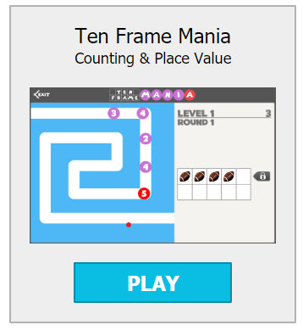
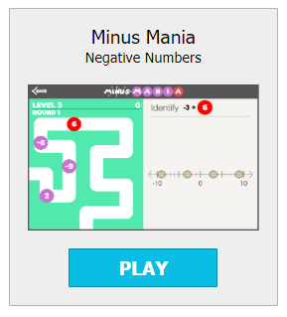
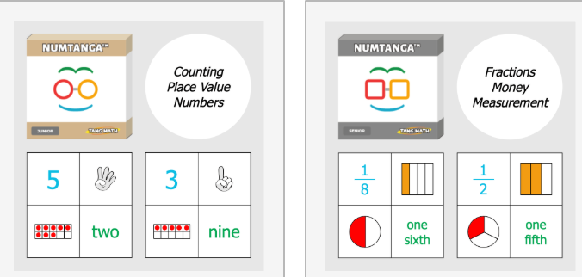
Greg Tang Overview
Greg Tang
https://www.gregtangmath.com/
A fantastic range of games from (Early through to Second Level ) including:-
Ten frame Mania – counting and place value Minus Mania – negative numbers
Numtanga (Junior) – counting, place value and number identification
Numtanga – fractions, money and measurement

Slide 20
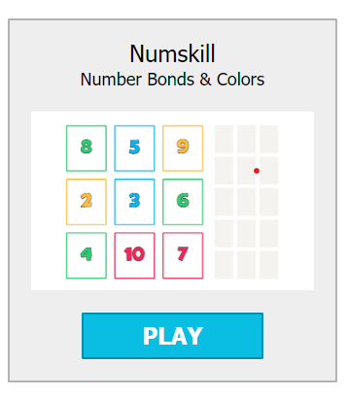
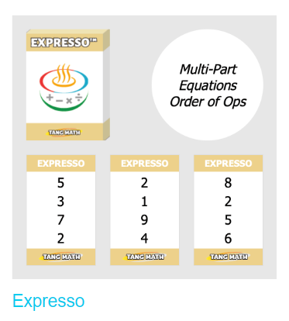
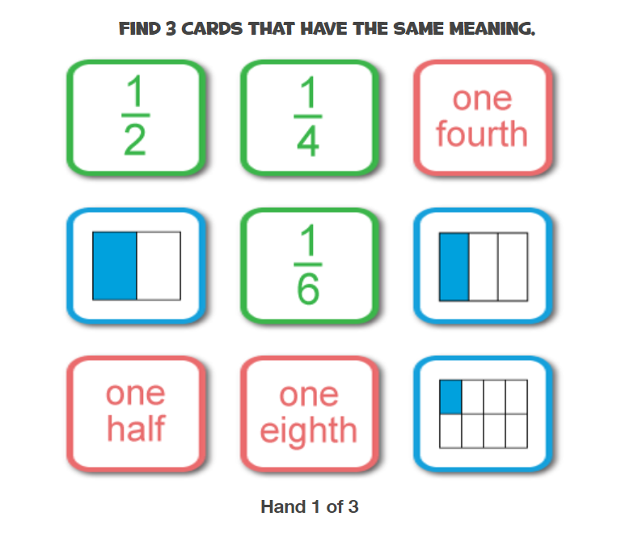
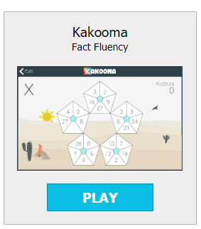
Greg Tang Learning Games Overview
Numskill – number bonds, sequences, Expresso – multi part equations, order of
colours , patterns , problem solving operations
SATfraction – identify, simplify, compare and
calculate fractions
Kakooma Plus – fact fluency, addition and subtraction
Kakooma Times – fact fluency multiplication and division
Check out various puzzles at all levels
Tangy Tuesdays

Slide 21
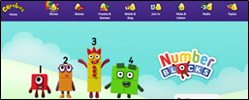
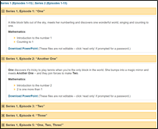
Number Blocks Overview
https://www.bbc.co.uk/cbeebies/shows/numberblocksVideos of episodes can also be found on youtube EARLY LEVEL
The aim of the Number Blocks series is to introduce concepts of number to support early mathematical understanding.
To support the Numberblocks Series, the National Centre for Excellence in Teaching mathematics (NCETM) have produced materials to be used in conjunction with the Numberblocks episodes. https://www.ncetm.org.uk/resources/52060
They highlight and develop the key mathematical ideas that are embedded in the programmes.
Each set of materials comes in the form of a PowerPoint file, and includes:
Practitioner Notes, consisting of an episode description, the maths in the episode and the use of mathematical language.
Talk and Discuss Together provides a set of slides, designed to be used with children after they have watched the episode.
Enabling Environments gives suggestions for extending the mathematics into the wider Early Years environment where children engage in meaningful activity and explore mathematical concepts.
Overviews of each series, their storylines and the mathematics addressed, are available as downloadable PDFs:

Slide 22
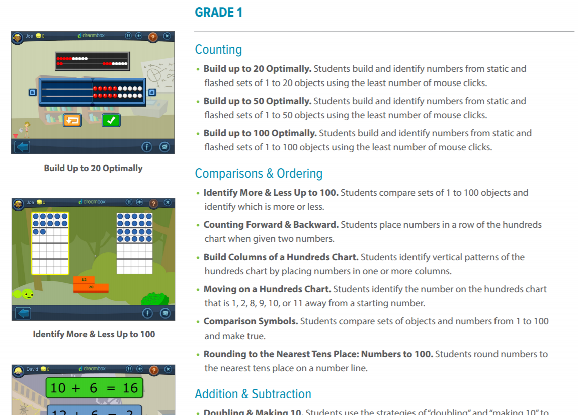
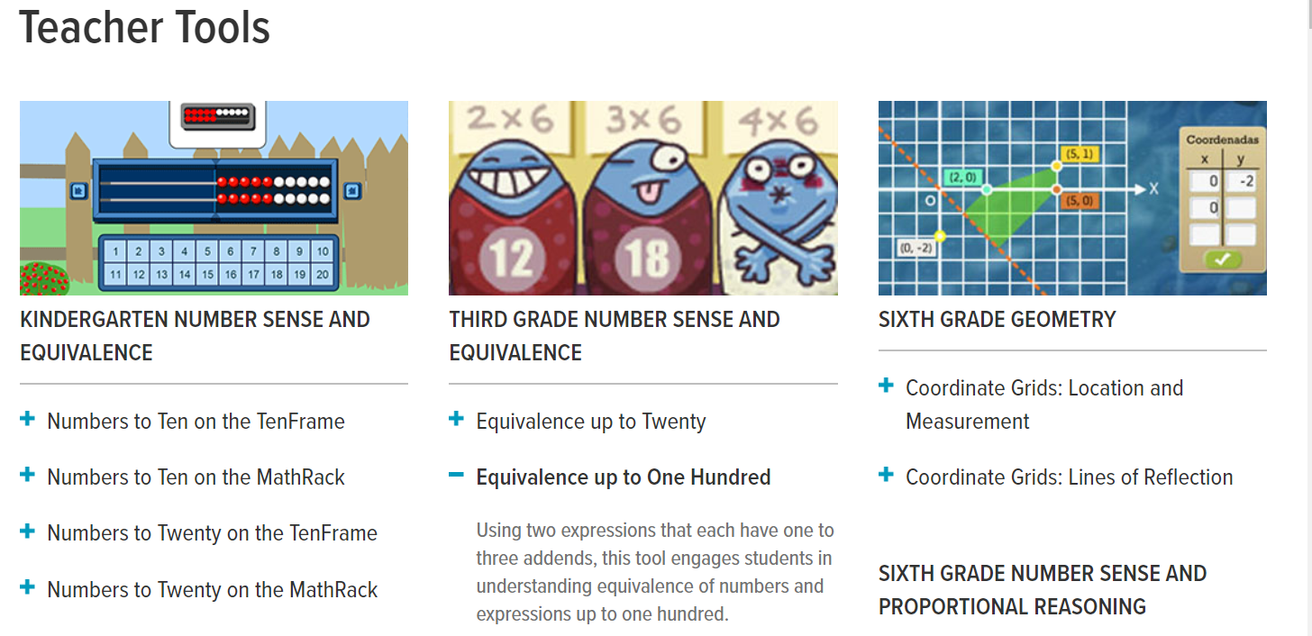
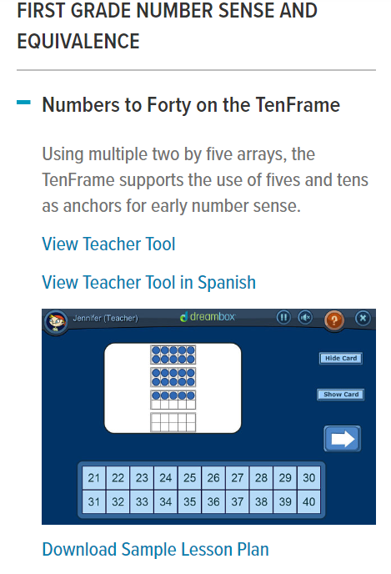
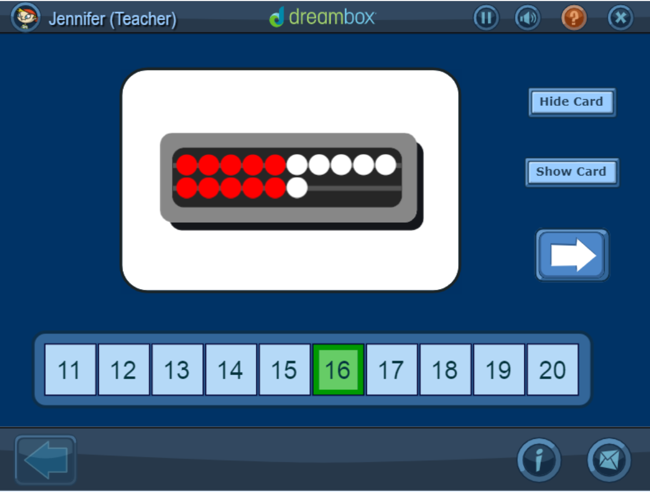
Dream Box Overview
DREAMBOX https://www.dreambox.com/
EARLY-THIRD LEVEL (Kindergarten – P1, Grade 1 – P2, etc)
FREE teaching tools (students can also use them independently) that cover counting, addition and subtraction, multiplication and division, fractions and decimals, place value, etc.
For a limited time, parents can get a 90 day FREE trial of Dreambox so children can learn at home. Sign up by April 30th – more details on the website. (no obligation) Example of curriculum guide –
http://go.dreambox.com/rs/715-ORW-647/images/SL-curriculum_guide.pdf
The teaching tools include a sample lesson plan –

Slide 23
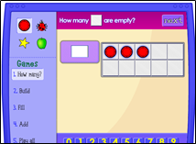
Illuminations Overview
Illuminations https://illuminations.nctm.org/ is a project designed by the National Council of Teachers of Mathematics (NCTM), in America. It provides resources and materials that improve the teaching and learning of mathematics for all students, including interactive tools for students and instructional support for teachers. All activities are graded and include an explanation of the task and instructions.
Examples of interactive tasks -
Five Frame https://www.nctm.org/Classroom-Resources/Illuminations/Interactives/Five-Frame/
Grade: PreK to 2nd (N-P3) - HIGHLY RECOMMENDED
Thinking about numbers using frames of 5 can be a helpful way to learn basic number facts. The four games that can be played with this applet help to develop counting and addition skills.
Ten Frame https://www.nctm.org/Classroom-Resources/Illuminations/Interactives/Ten-Frame/
Grade: PreK to 2nd (N-P3) – HIGHLY RECOMMENDED
Thinking about numbers using frames of 10 can be a helpful way to learn basic number facts. The four games that can be played with this applet help to develop counting and addition skills.
Equivalent Fractions https://www.nctm.org/Classroom-Resources/Illuminations/Interactives/Equivalent-Fractions/
Grade: 3rd to 5th (P4-7)
Create equivalent fractions by dividing and shading squares or circles, and match each fraction to its location on the number line.
Concentration https://www.nctm.org/Classroom-Resources/Illuminations/Interactives/Concentration/
Grade: PreK to 2nd, 3rd to 5th (N to P3, P4-P6)
By yourself or against a friend, match whole numbers, shapes, fractions, or multiplication facts to equivalent representations. Practice with the clear panes or step up the challenge with the windows closed. How many socks can you win?

Slide 24
Additional Websites
You Cubed
https://www.youcubed.org/tasks/
‘Inspiring Maths Success for all Students through Growth Mindsets and Innovative Teaching’
A fabulous range of research based teaching methods, maths tasks, videos, and ideas
intended to significantly reduce math failure and inequality and beyond, inspiring teachers
and empowering all students to success (Early – Second Level)
Steve Wyborney
https://stevewyborney.com - ·
Brilliant progressive resources to develop number skills
Esti Mysteries @ 4 challenge levels
Subitising Slides
Splat series (including fractions)
20 Days of Number Sense and Rich Math Talk (Early – Second Level)

Slide 25
Additional Websites
I See Maths
Early Number Sense - free resources that will help children to recognise small quantities. A range of different visual representations are used. Presentations and resources also help to introduce key maths concepts and ideas.
http://www.iseemaths.com/early-number/ (Early/First Level)
Times Tables - The times tables cards represent multiplication visually, helping children to make connections between multiplication facts. The corresponding PowerPoint games can be used to show children these connections
http://www.iseemaths.com/tables/ (First/Second Level)
Games and Resources - The games below help children to develop a strong 'number feel' and develop early calculation strategies
http://www.iseemaths.com/games-resources/ ( First and Second Level)
3 Act Tasks (Graham Fletcher) 3-Act tasks provide engaging, thought-provoking contexts for mathematical enquiry. Act 1 shows the context for the enquiry and allows children to generate questions – what do they wonder? What extra information do they need? In Act 2, more information is provided: children are then given the chance to speculate and calculate before the solution is revealed in Act 3.
http://www.iseemaths.com/3-act-tasks/ (Early - Second Level)

Slide 26
Additional Websites
Sumdog
https://pages.sumdog.com/ provides personalised maths and spelling practice for 5-14 year olds.
All areas of Sumdog, including the ability to easily set work remotely, is now free for the next two weeks. This is to allow for planning for the use of Sumdog incase of school closure.
They also invite you to join one of their daily 15 minute webinars providing practical tips for home learning. In addition, schools will get free access to all of Sumdog during a closure.
Sumdog's games engage children in personalised mathematics, spelling and grammar practice. Call on 0131 226 1511 or email support@sumdog.com if you need any help
nRich – https://nrich.maths.org/13786
Free curriculum-linked resources to develop mathematical reasoning and problem-solving.
(Early years to Secondary)

Slide 27
Additional Websites
Mangahigh https://www.mangahigh.com/en-gb/ is offering free full access for 60 days to all schools impacted by COVID-19. This includes access to 100% of Mangahigh's mathematics content and full access to reports for teachers.
They have a variety of educational games and quizzes for 7-16 year olds that can be assigned by class teachers for students to complete at home. Additionally, Mangahigh automatically creates a list of recommended activities, to support every student with their learning needs.
It works on any device with an internet connection and is available to use at home 24 hours a day, 7 days a week. Teachers will be able to track a child’s progress to ensure their learning continues and remains targeted.
There is also a downloadable guide for distance learning on their website.
Please contact support@mangahigh.com if you have any questions about how to use Mangahigh.
(Early years to Secondary)

Slide 28
Additional Websites
Mathscircle http://mathscircle.com/ are offering primary schools affected by COVID-19 free full access to Times Tables Rock Stars – a platform for multiplication and division – and free full access to NumBots – a sister platform that tackles addition, subtraction and number bonds - throughout any period of school closure*.
To take advantage of this offer please sign up for a trial and email support@mathscircle.com with the dates of your school’s closure so that they can extend access as needed. No payment details are required.
Both NumBots and Times Tables Rock Stars are easily accessible for pupils to play from home via the free apps or browsers and both provide teachers with access to statistics to enable them to follow and praise pupil progress.
*Free full access is available to schools (who do not currently have a subscription) who are forced to close due to Covid-19, for up to a maximum of 60 days. If your school is closed for a longer period, please contact us at support@mathscircle.com.

Slide 29
Follow us …
FVWLricNumeracyAcademy
@FVWLNumerac1
https://blogs.glowscotland.org.uk/glowblogs/fvwlric/

