Slide 1
Country: France Capital City: Paris Language: French Currency: Euro

Slide 2
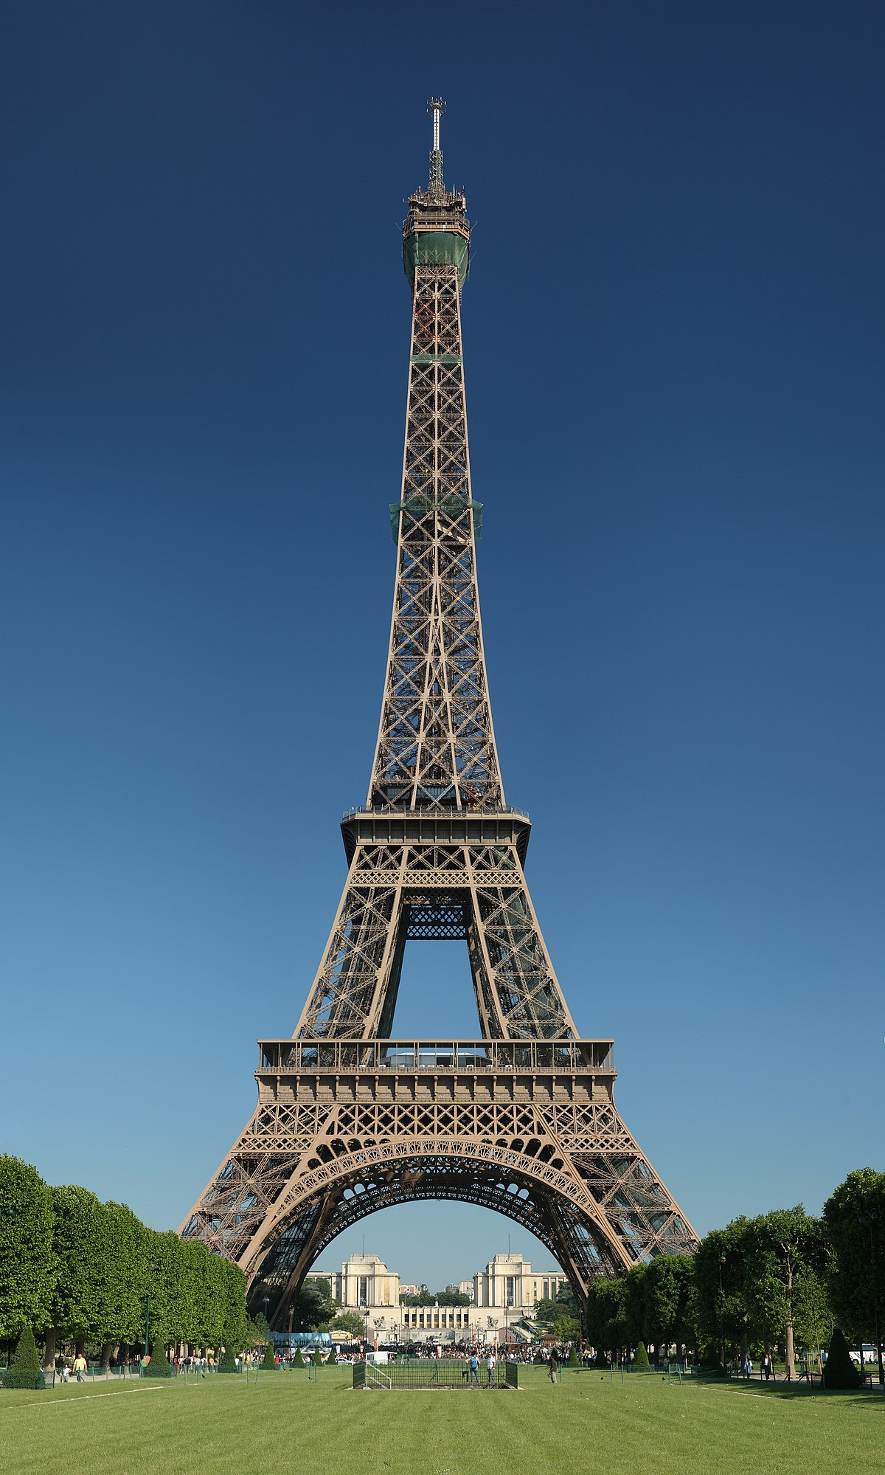
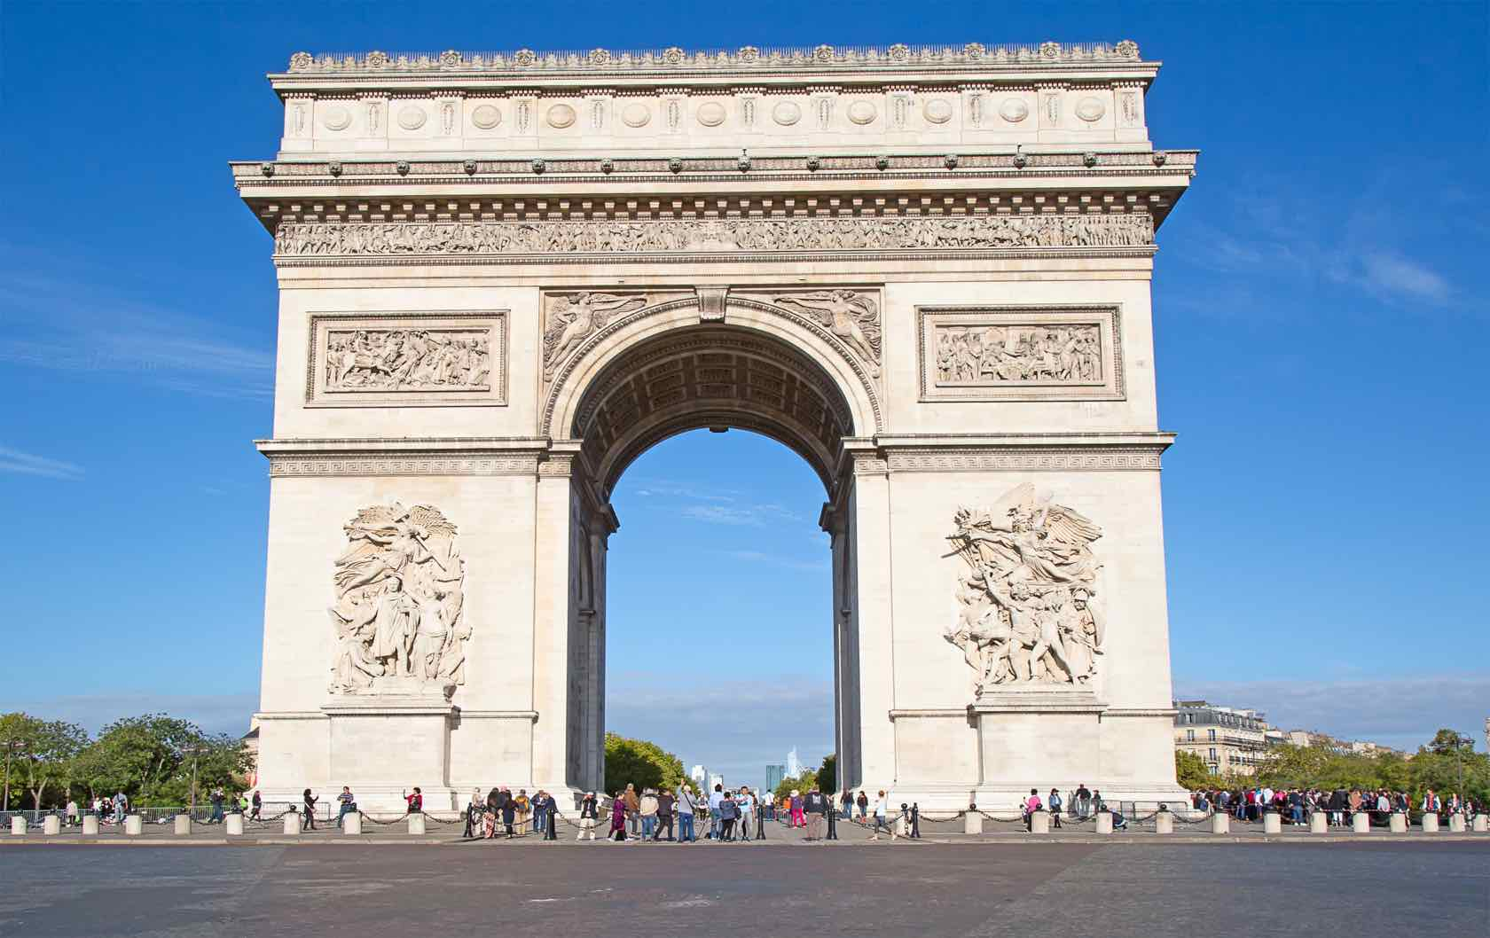
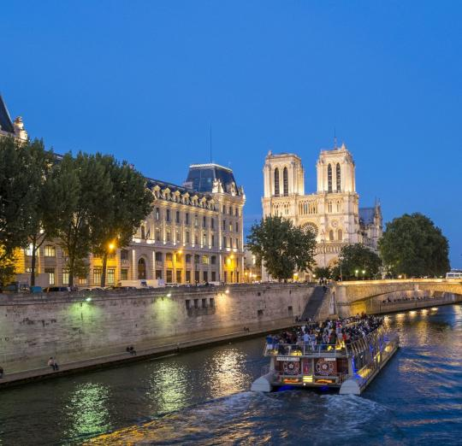
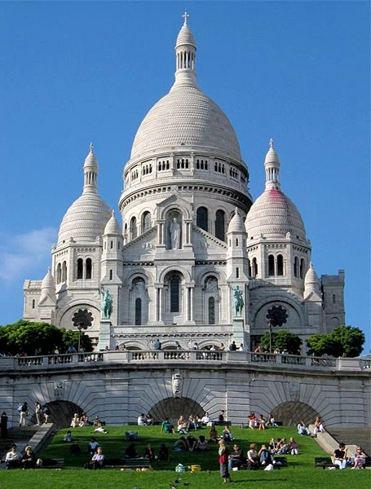
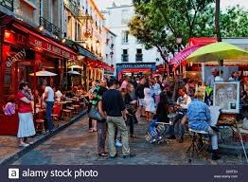
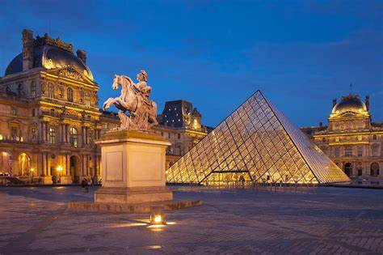
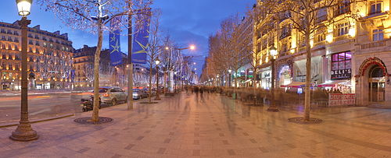
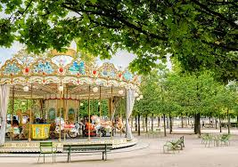
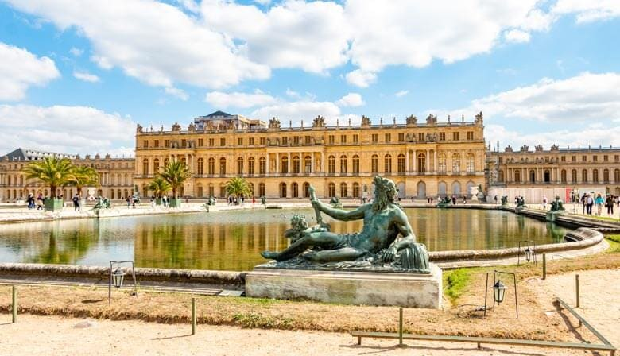
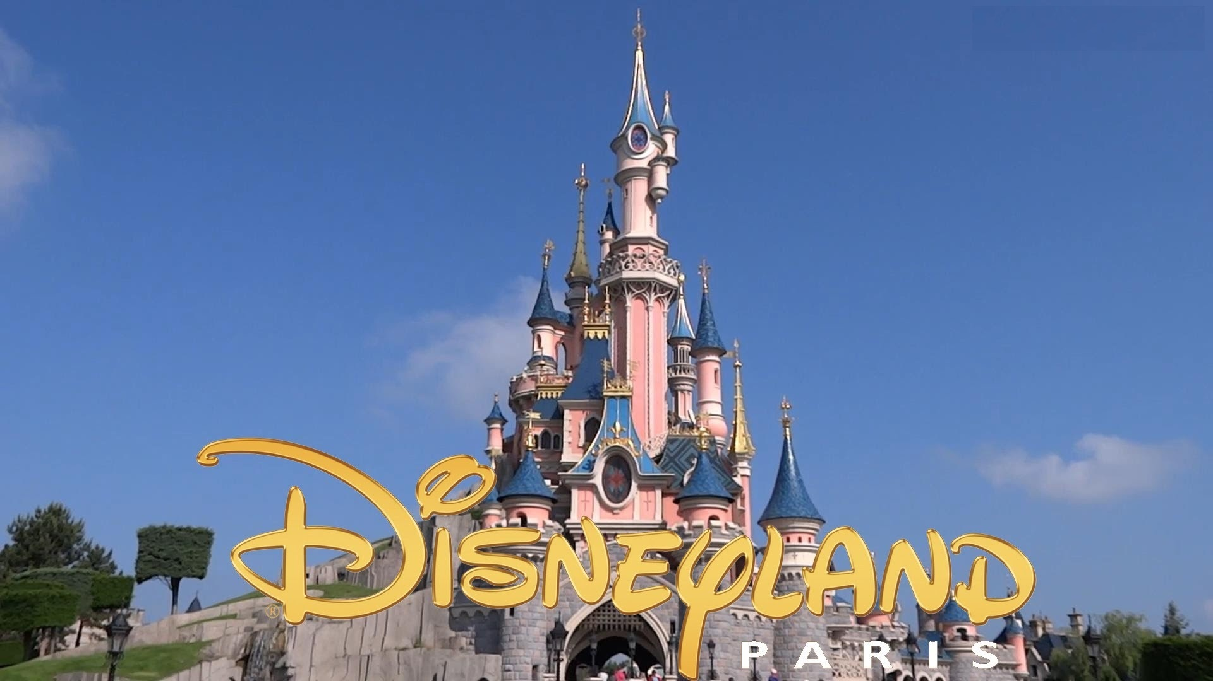
Places to visit
La Tour Eiffel | La
L’Arc de Triomphe
La cathédrale de Notre Dame Tour en bateau-mouche
Le Sacré Coeur et Montmartre
Le Louvre
Les Champs Elysées Les Jardins de Tuileries
Le Château de Versailles
Disneyland Paris

Slide 3
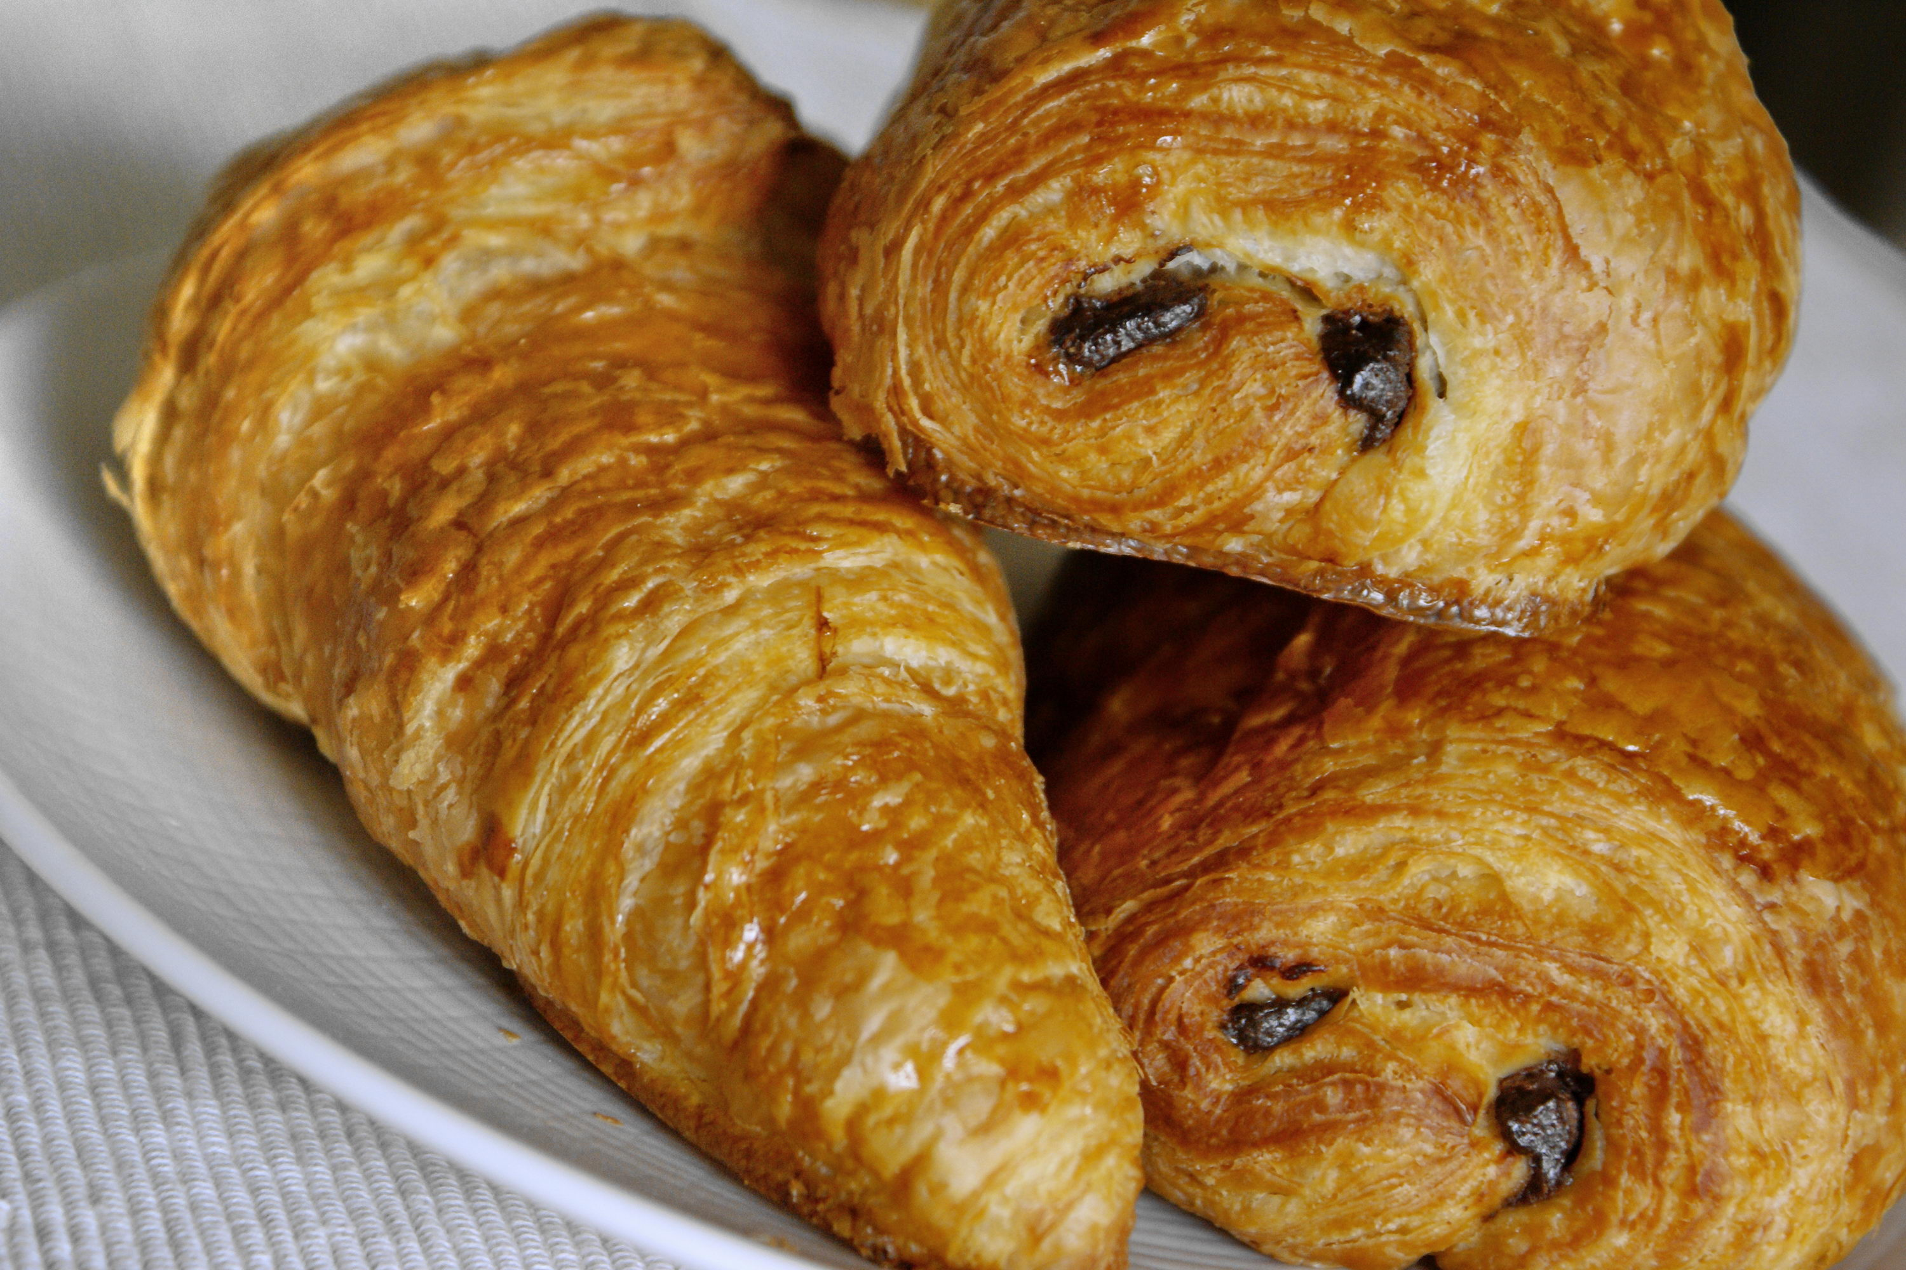
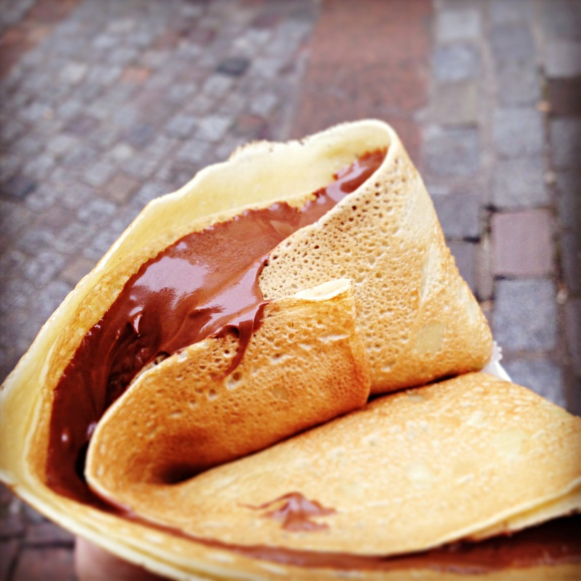
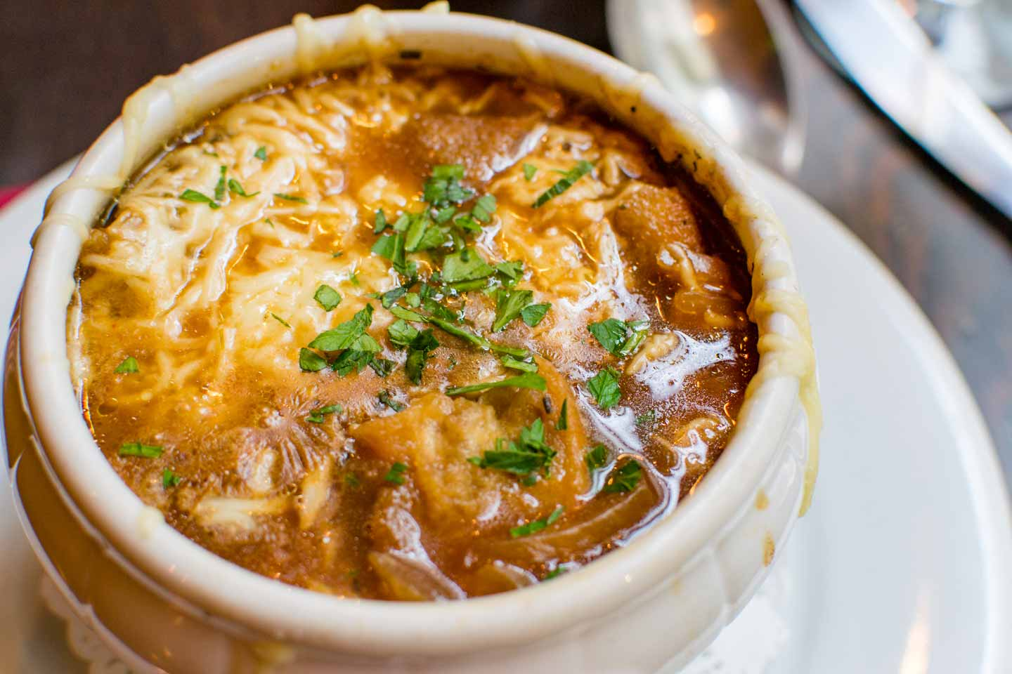
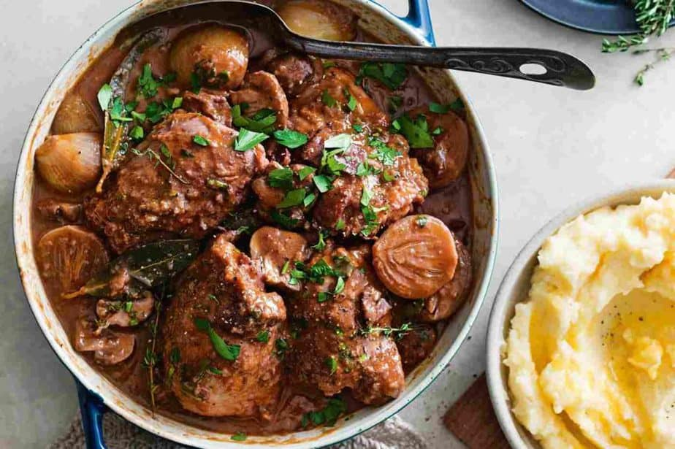
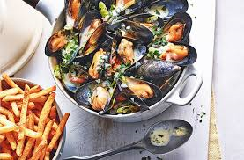
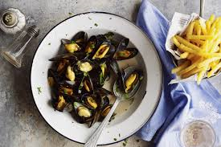
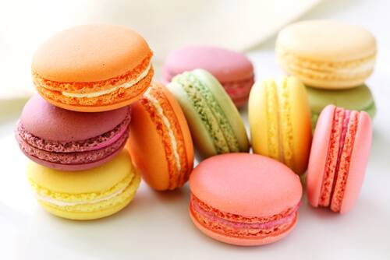
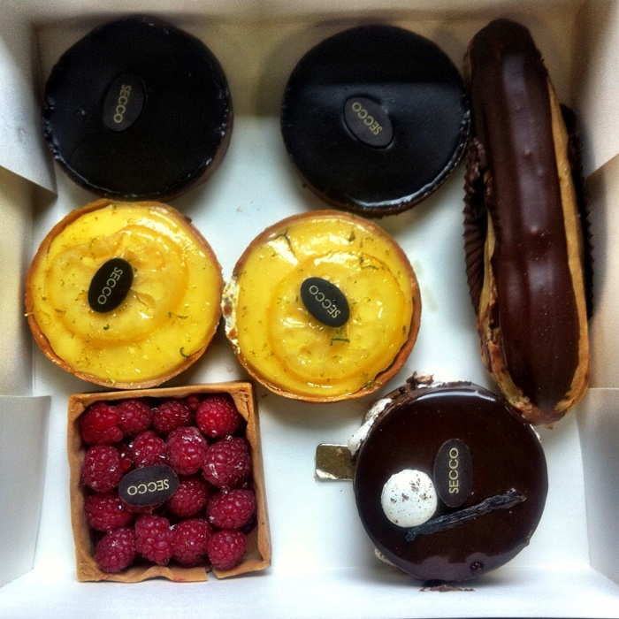
Specialities
une baguette
un croissant / pain au chocolat
une crêpe
la soupe à l’oignon
Coq au vin
Moules frites
les escargots
un croque-monsieur
les macarons
les pâtisseries

Slide 4
Language
English | French | Audio
Hello | Bonjour
How are you? | Ça va?
Goodbye | Au revoir
Please | S’il vous plaît
Thank you | Merci
Yes | Oui
No | Non
I would like an ice-cream | Je voudrais une glace
I would like an orange juice | Je voudrais un jus d’orange
I would like a bottle of water | Je voudrais une bouteille d’eau
I would like a tea | Je voudrais un thé
I would like a coffee | Je voudrais un café
I would like a hot chocolate | Je voudrais un chocolat chaud
I would like a sandwich | Je voudrais un sandwich

Slide 5
I would like chips | Je voudrais des frites
I would like a cake | Je voudrais un gâteau
How much is it? | C’est combien?
The bill please | L’addition , s’il vous plaît
Where are the toilets? | Où sont les toilettes?
I am looking for … | Je cherche …..
a chemist | une pharmacie
a doctor | un médecin
Go straight ahead | Allez tout droit!
Turn right | Tournez à droite
Turn left | Tournez à gauche
Excuse me | Excusez-moi / Pardon
Sorry | Désolé

Slide 6
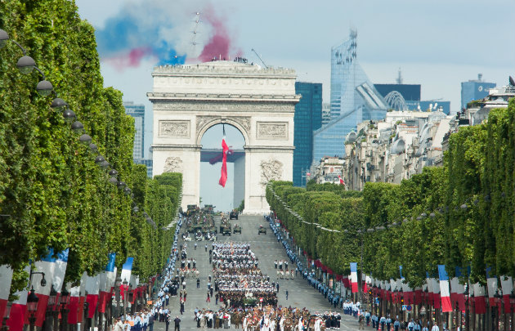
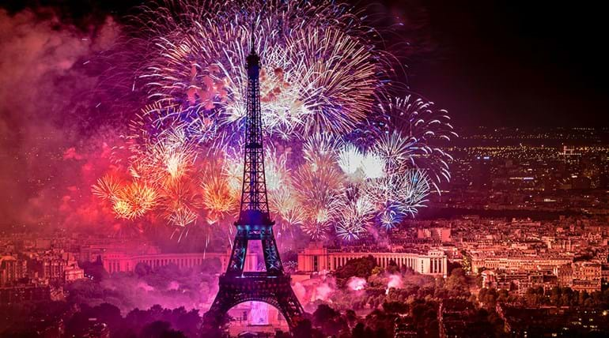
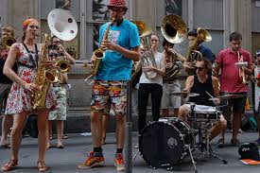
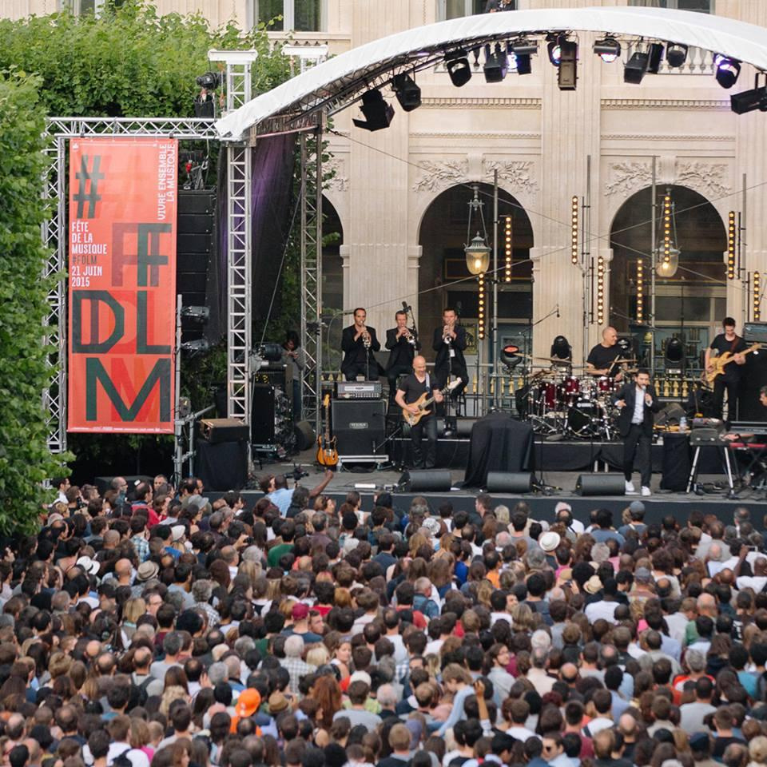
Other Information
La Fête Nationale
Every July 14th, France celebrates its "Fête Nationale“ or
Bastille Day. It is the anniversary of the beginning of the
French Revolution which began with the storming of the
Bastille prison.
It is a day of celebration all over France.
In Paris there is a military parade down the Champs Elysées
and a huge fireworks display at the Eiffel tower.
Fête de la musique
The Fête de la Musique is a lively street music festival that
takes place on 21st June. All over Paris musicians, singers,
live bands and DJs play in the streets and parks of Paris.

Slide 7
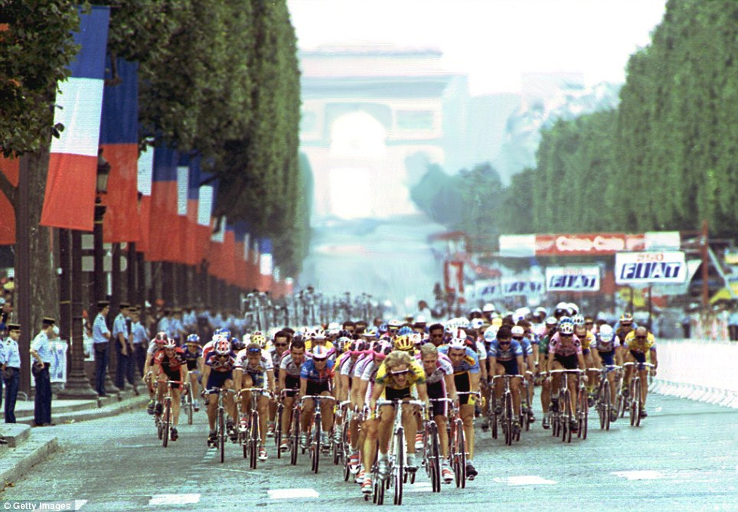
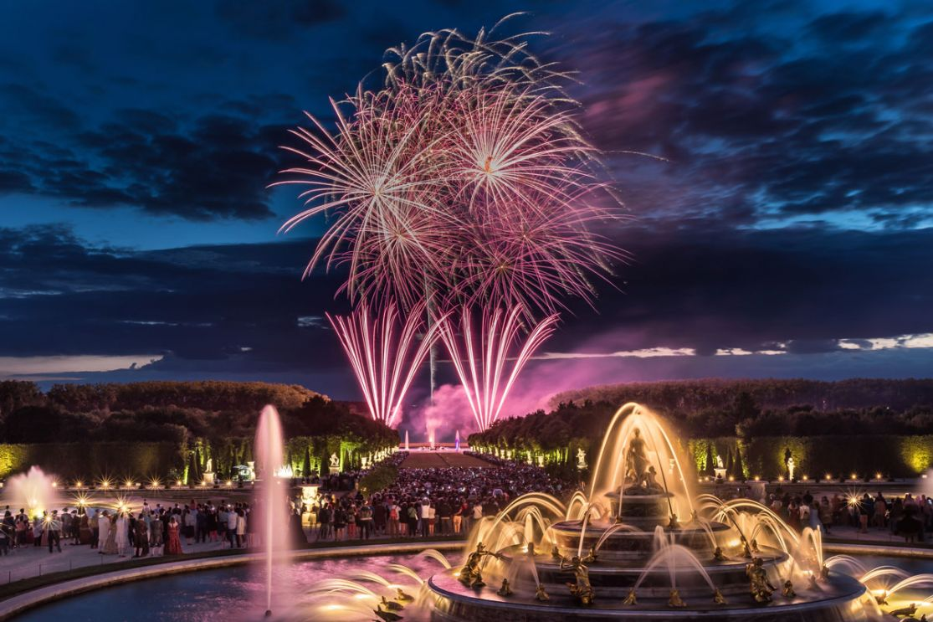
Other Information
Tour de France
The Tour de France is the world famous long-distance
cycling event which finishes in Paris in July.
It lasts 21 days and covers 3,500km.
Huge crowds wait to see the winner ride along the Champs
Elysées to the finish line .The winner wears a yellow jersey.
Les Grandes Eaux musicales – Chateau de Versailles
Every Saturday evening throughout the summer, the famous
fountains and water features in gardens of the Palace of
Versailles come to life to music. The enchanting light and music
show finishes with an impressive fireworks display

