Slide 1
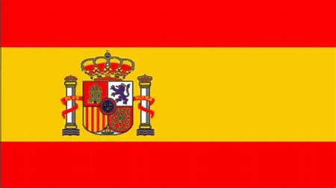
Country: Spain City: Barcelona Language: Spanish Currency: Euro
Add in flag here

Slide 2
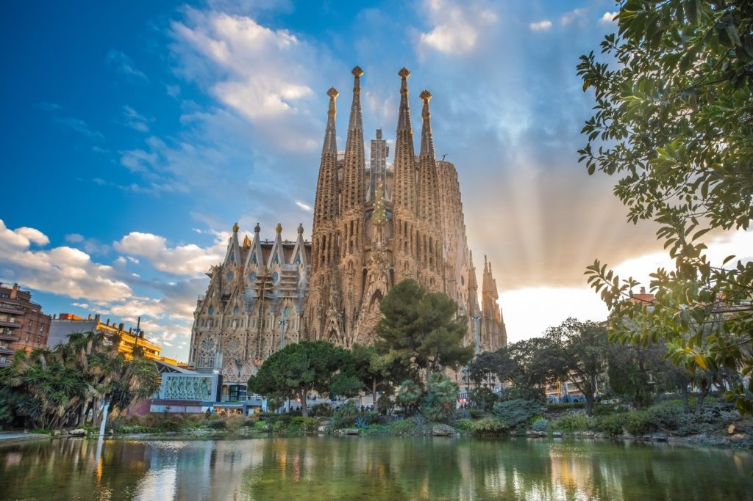
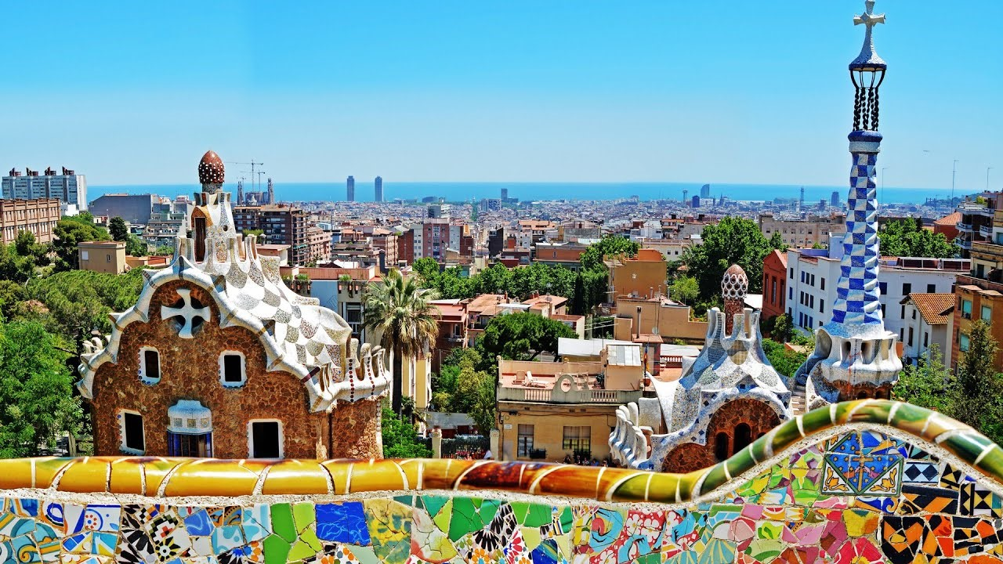
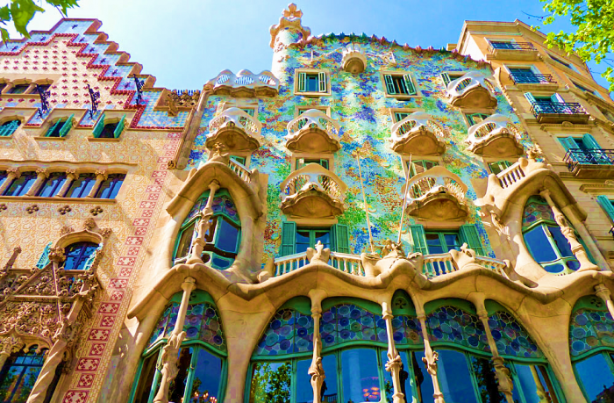
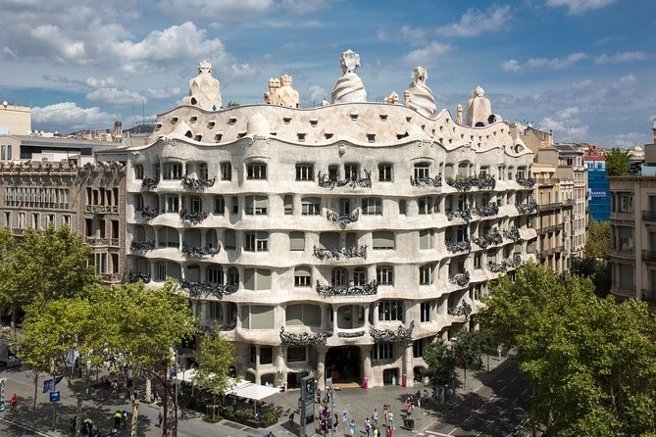
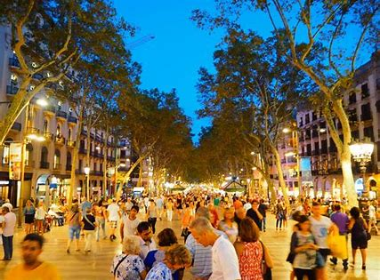
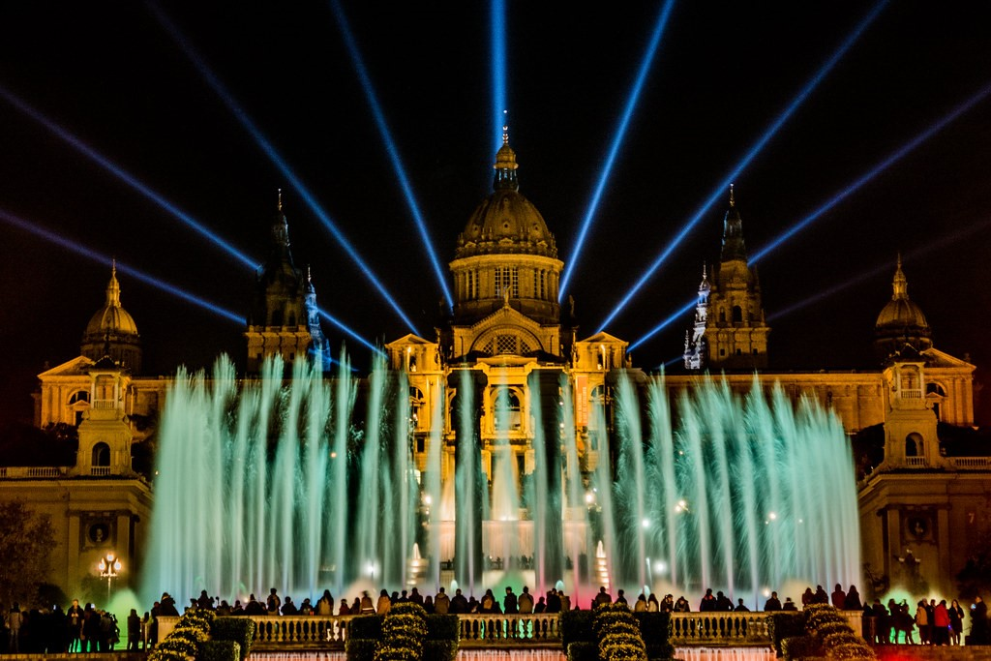
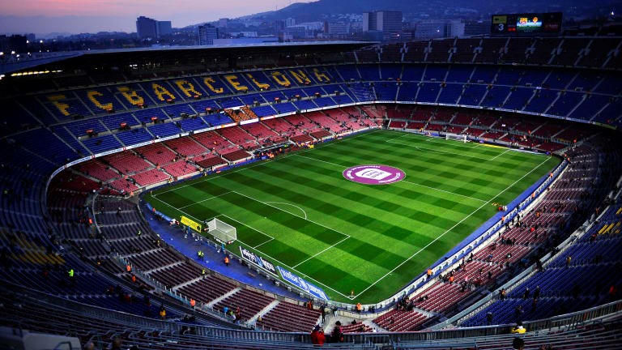
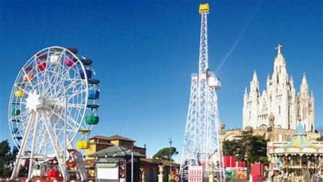
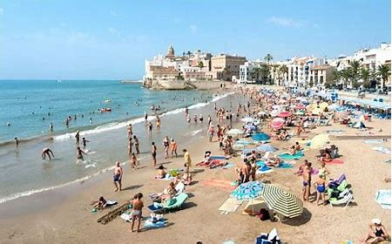
Places to visit
 | La Sagrada Familia
 | Park Güell
 | Casa Batlló Casa Milà
 | La Rambla
 | Font Màgica de Montjuïc
 | Camp Nou
 | Parc d’Atraccions Tibidabo
 | Barceloneta

Slide 3
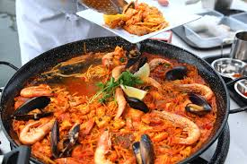
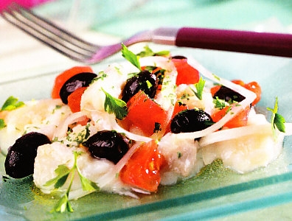
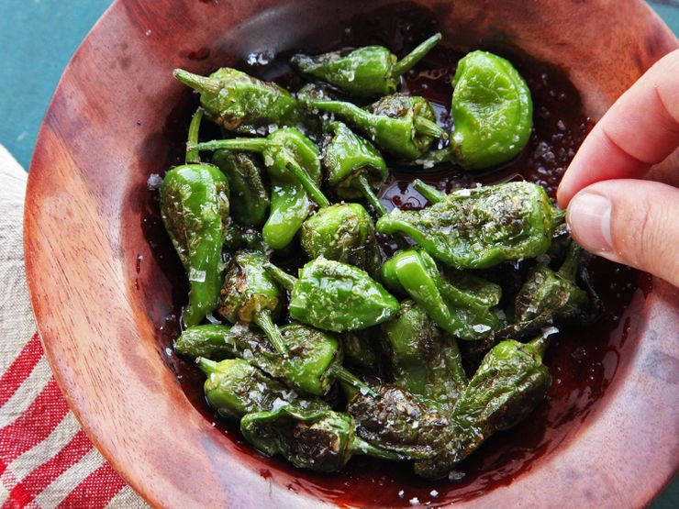
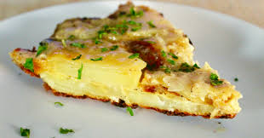
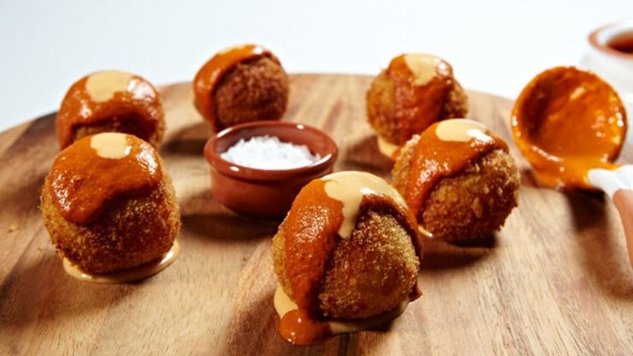
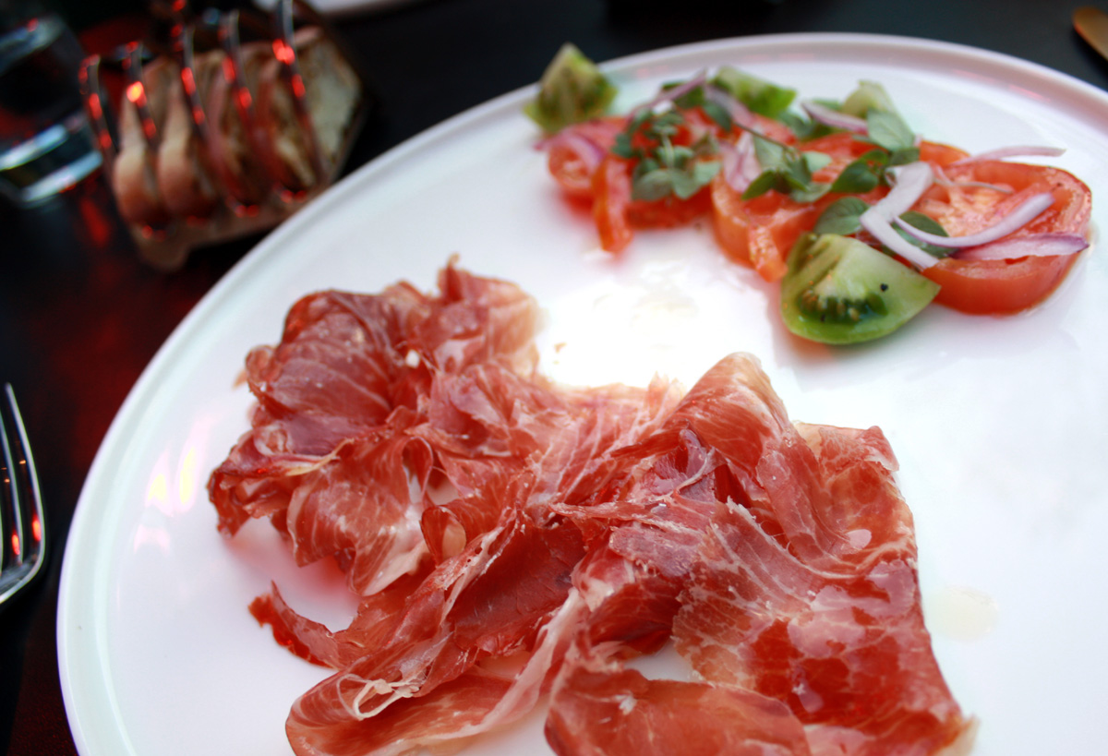
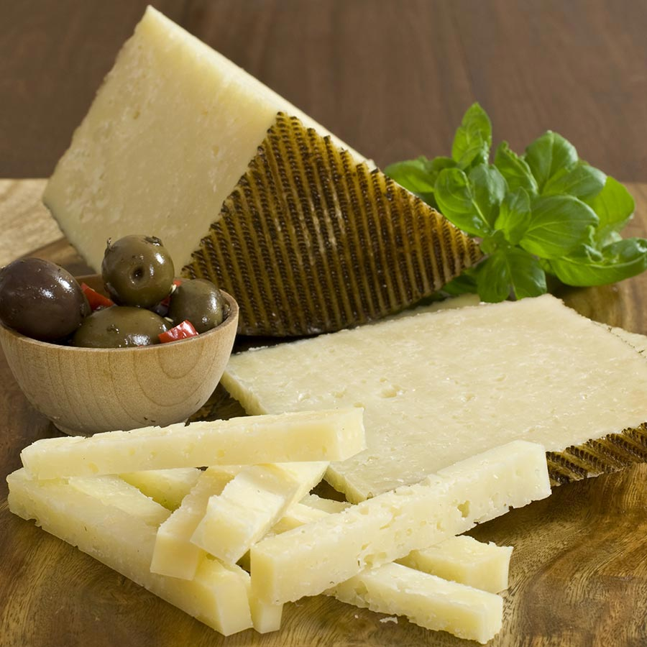
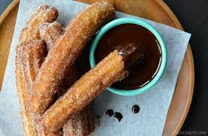
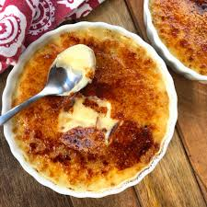
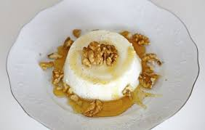
Specialities
 | Fideuà ( Similar to Paella but noodles instead of rice)
 | Esqueixada Cod salad)
 | Pimientos de Padrón (served as a tapa)
 | Patatas bravas (served as a tapa)
 | Tortilla española (served as tapa)
 | Croquetas y Bombas (served as a tapa)
 | Jamon ibérico y queso manchego
 | Churros y chocolate
 | Crema Catalana
 | Meli i mató

Slide 4
Language
English | Spanish | Audio
Hello | Hola Buenos días
How are you? | ¿Cómo estás? ¿Qué tal?
Goodbye | Adiós Hasta luego
please | por favor
Thank you | gracias
Yes | Si
No | No
I would like an ice-cream | Quiero un helado
I would like an orange juice | Quiero un zumo de naranja
I would like a bottle of water | Quiero una botella de agua
I would like a tea | Quiero un té
I would like a coffee | Quiero un café
I would like a hot chocolate | Quiero un chocolate caliente
I would like a sandwich | Quiero un bocadillo

Slide 5
I would some chips | Quiero unas patatas fritas
I would like a cake | Quiero un pastel
How much is it? | ¿Cuánto es?
The bill please | La cuenta por favor
Where are the toilets? | ¿Donde están los aseos?
I am looking for … | Busco
a chemist | una farmacia
a doctor | un médico
Go straight ahead | Todo recto
Turn right | a la derecha
Turn left | a la izquierda
Excuse me | Perdón
Sorry | Lo siento

Slide 6
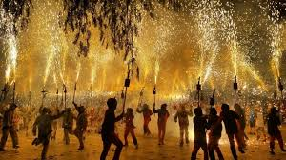
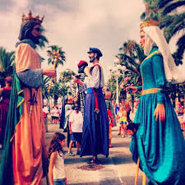
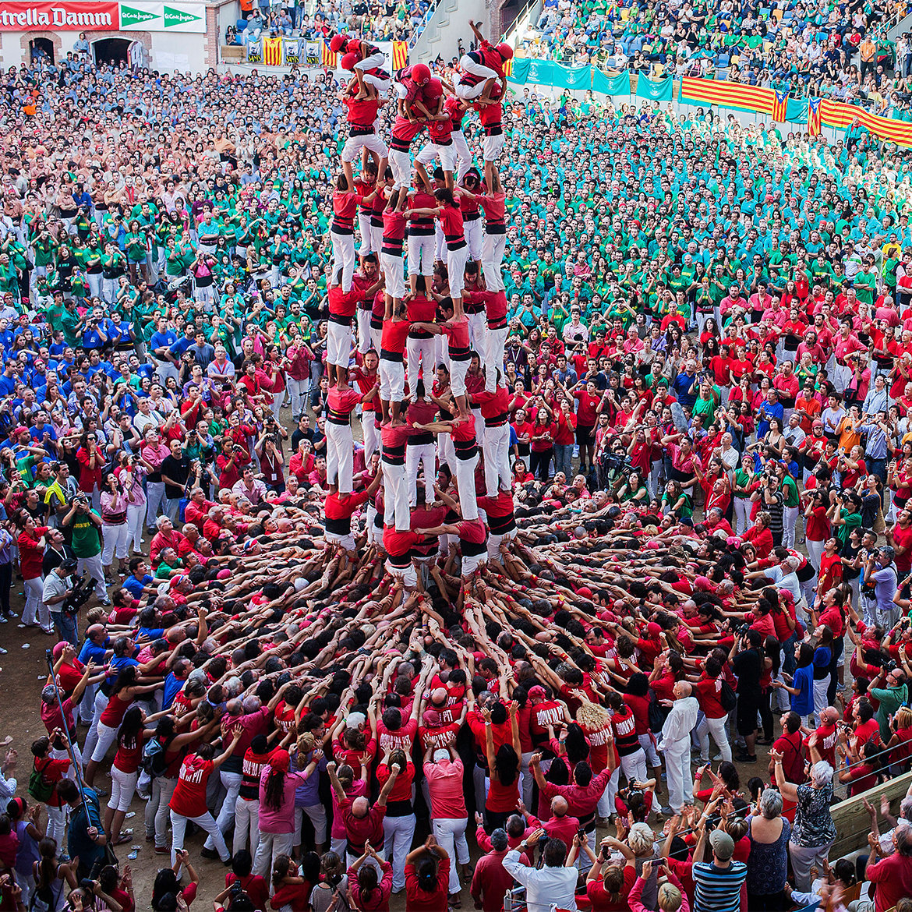
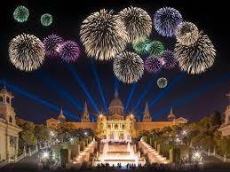
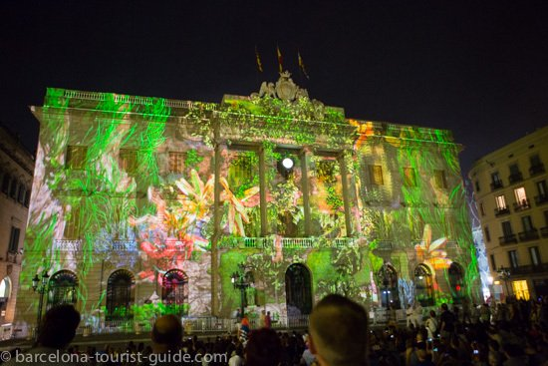
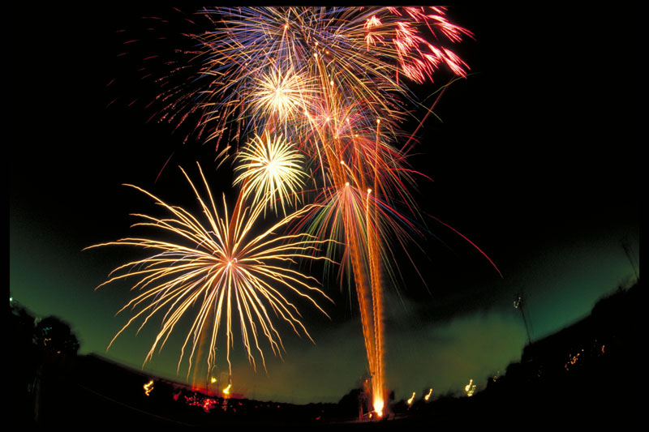
Other Information
Festival de la Mercè
La Mercè festival in September is the largest festival in
Barcelona and honours Mare de Déu de la Mercè, one of the
patron saints of Barcelona. It lasts for around 5 days.
The festival includes some famous events such as the
Correfoc - the fire run with fire breathing dragons ; los
Gigantes – the Giants parade ; the Castellers – human tower
builders; projection shows on buildings in Barcelona and the
huge firework display which closes the festival.
Sant Joan
Sant Joan
Sant Jo takes place on 23rd and 24th June every year to
celebrate the Summer Solstice – the longest day of the year
and the start of summer. The festival is often known as ‘Nit
del Foc’ which means Night of Fire because of the huge
number of fireworks which are set off all over the city.

Slide 7
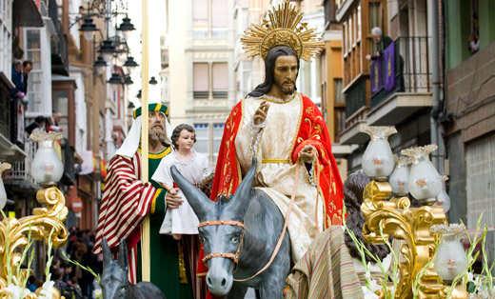
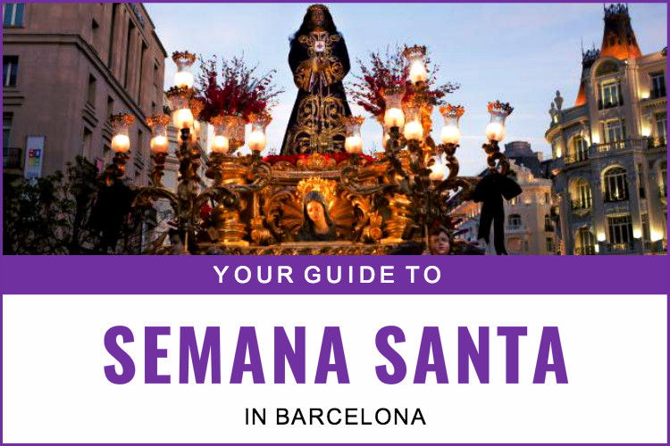
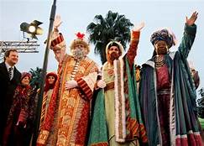
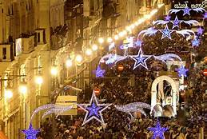
Other Information
La Semana Santa
La Semana Santa (Holy week) is important in Spain. The week
before Easter is celebrated with a variety of religious
ceremonies and processions.
El Día de los Reyes Magos
El Día de los Reyes Magos is the most celebrated festival in
Barcelona, just as in the rest of Spain. In Spain, the three
Kings bring children presents on 6th January. The King’s day
parade 'la Cabalgata de Reyes Magos’ is the biggest parade in
Barcelona and takes place on 5th January every year on the
evening before Twelfth Night on the 6th January

