Slide 1
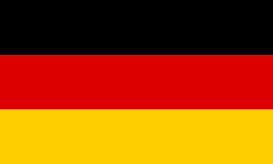
Country: Germany City: Munich Language: German Currency: Euro
Add in flag here

Slide 2
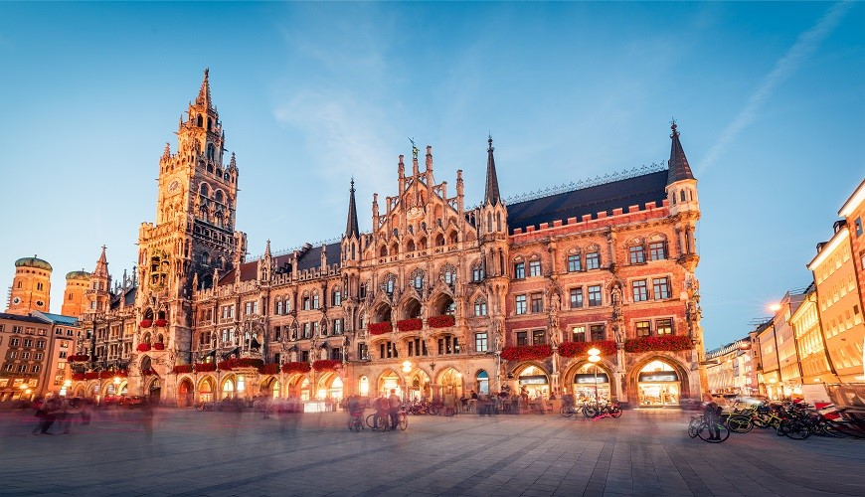
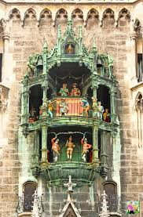
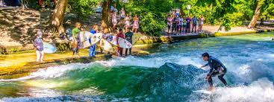
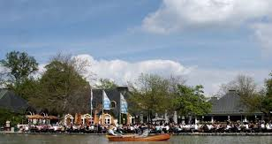
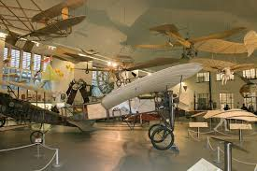
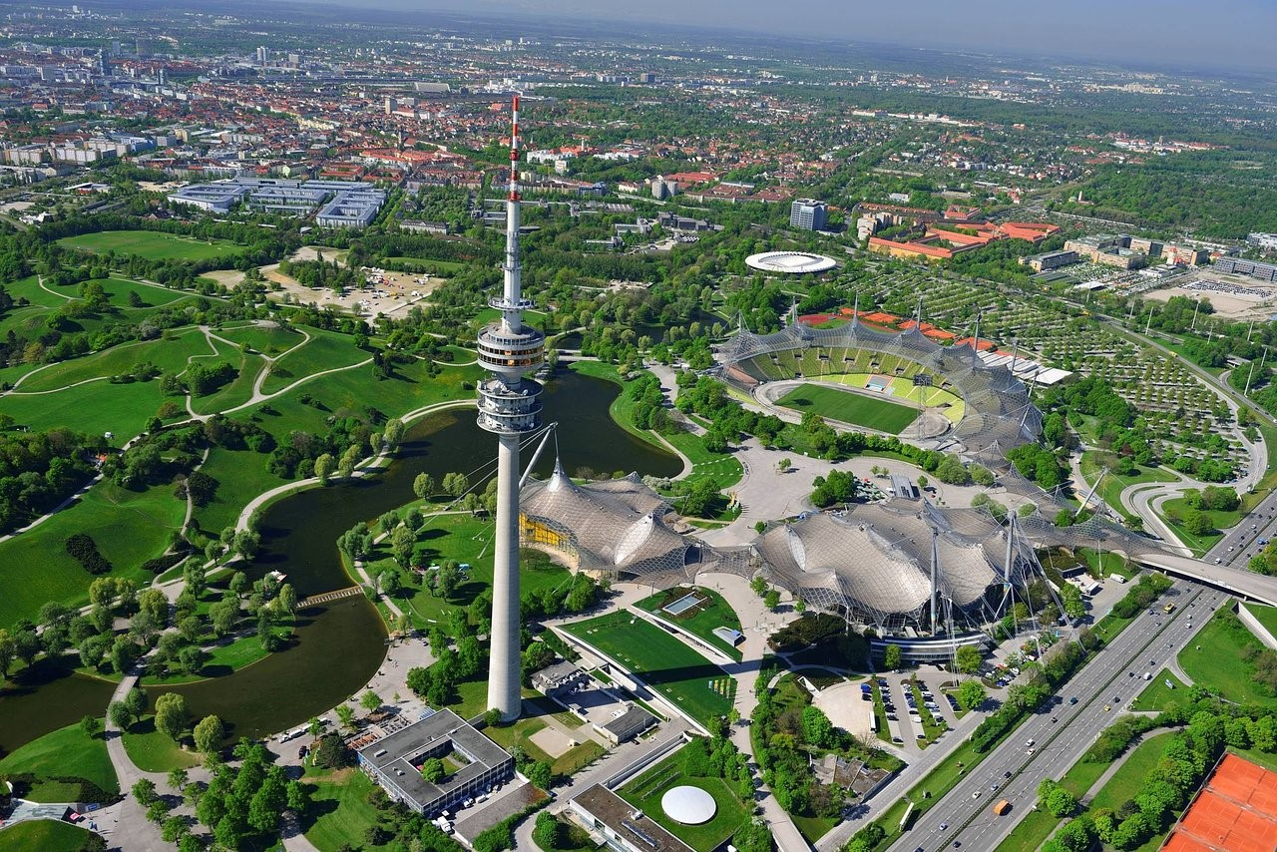
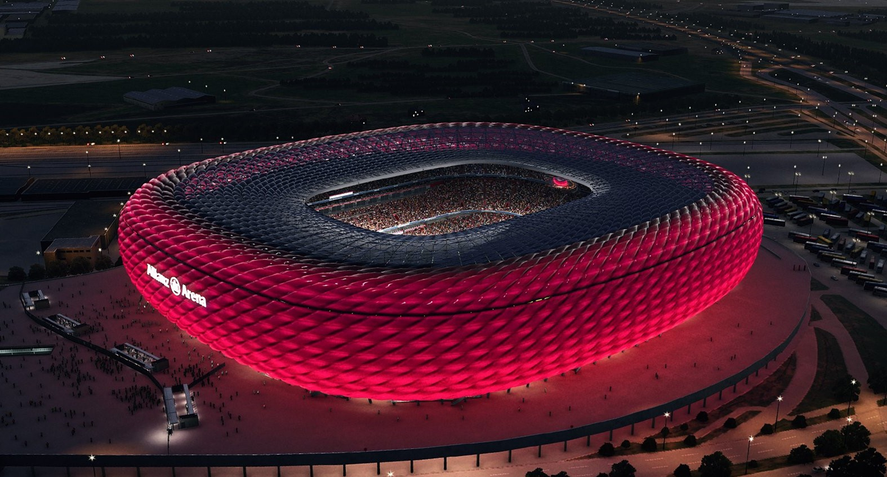
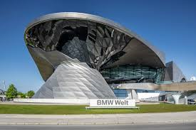
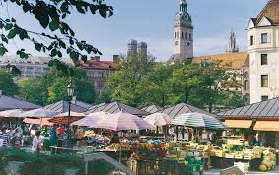
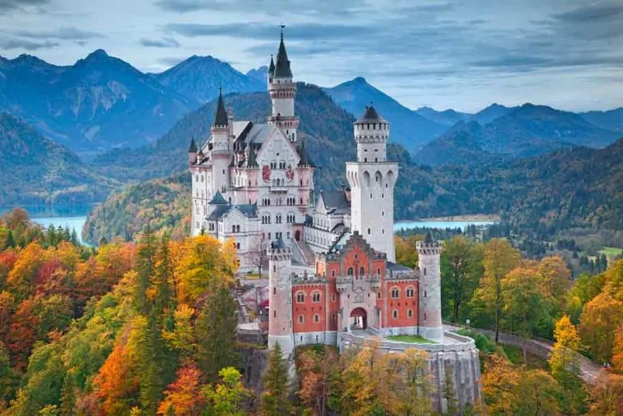
Places to visit
 | Rathaus-Glockenspiel im Marienplatz
 | Eisbachwelle im Englischen Garten
 | Deutsches Museum
 | Olympiapark
 | Allianz Arena
 | BMW Welt
 | Viktualienmarkt
 | Schloss Neuschwanstein (day trip)

Slide 3
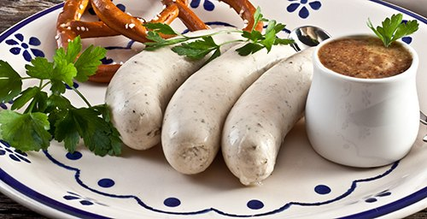
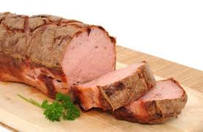
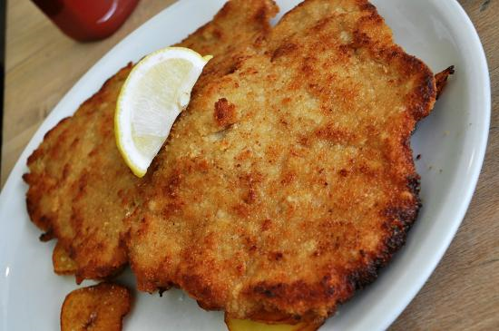
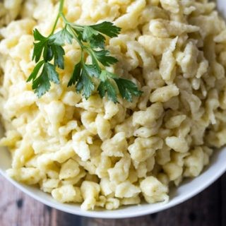
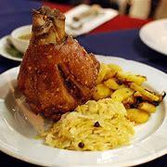
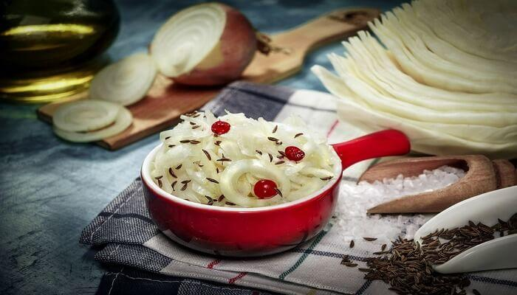
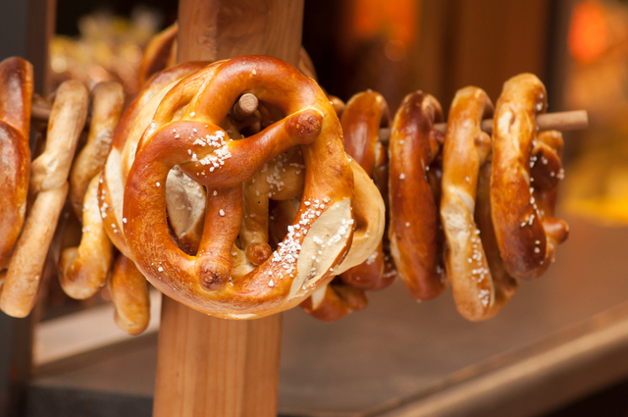
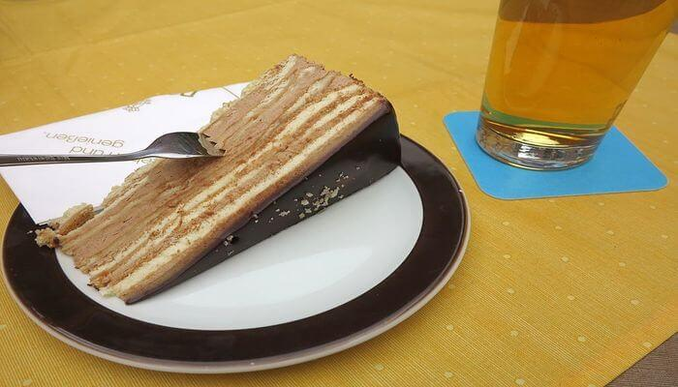
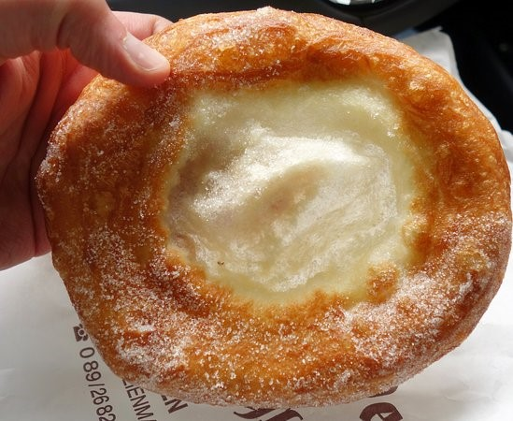
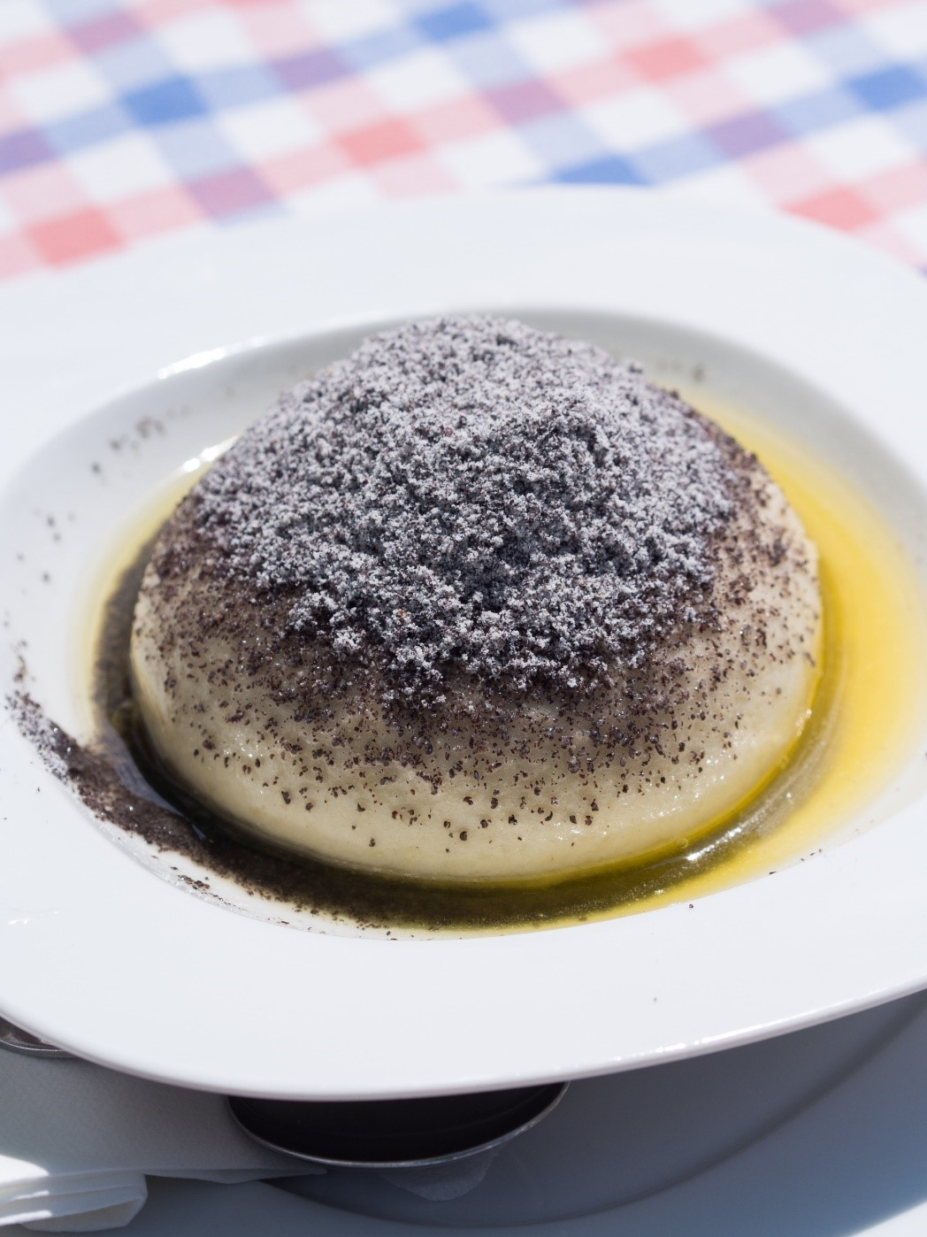
Specialities
 | Weiβwürste
 | Leberkäse
 | Schnitzel
 | Spätzel
 | Schweinshaxe
 | Sauerkraut
 | Bretzeln
 | Prinzregententorte
 | Schmalznudel
 | Germknödel

Slide 4
German
English | German | Audio
Hello | Hallo /Guten Tag
How are you? | Wie geht’s?
Goodbye | Auf Wiedersehen
please | bitte
thank you | danke schön
Yes | Ja
No | Nein
I would like an ice-cream | Ich möchte ein Eis
I would like an orange juice | Ich möchte einen Orangensaft
I would like a mineral water | Ich möchte ein Mineralwasser
I would like a tea | Ich möchte einen Tee
I would like a coffee | Ich möchte einen Kaffee
I would like a hot chocolate | Ich möchte eine heiβe Schokolade
I would like a sandwich | Ich möchte ein belegtes Brot

Slide 5
I would chips | Ich möchte Pommes
I would like a cake | Ich möchte ein Kuchen
How much is it? | Wieviel kostet das?
The bill please | Die Rechnung ,bitte
Where are the toilets? | Wo sind die Toiletten?
I am looking for … | Ich suche
a chemist | eine Apotheke
a doctor | einen Arzt
Go straight ahead | Gehen Sie geradeaus
Turn right | Gehen Sie nach links
Turn left | Gehen sie nach rechts
Excuse me | Entschuldigung
Sorry | Es tut mir leid

Slide 6
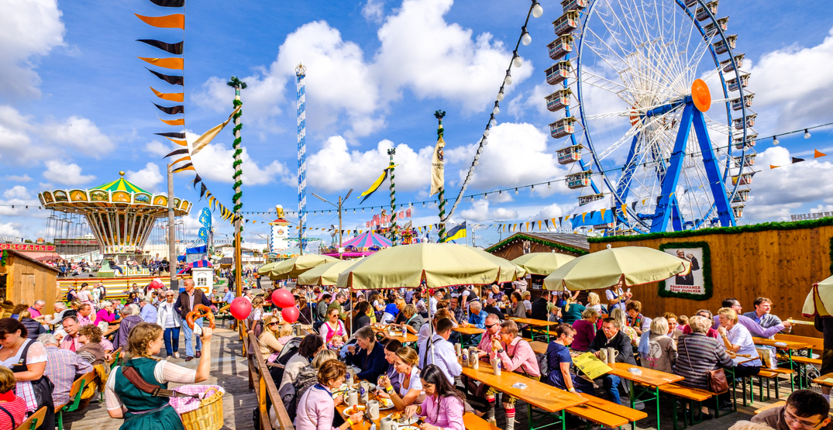
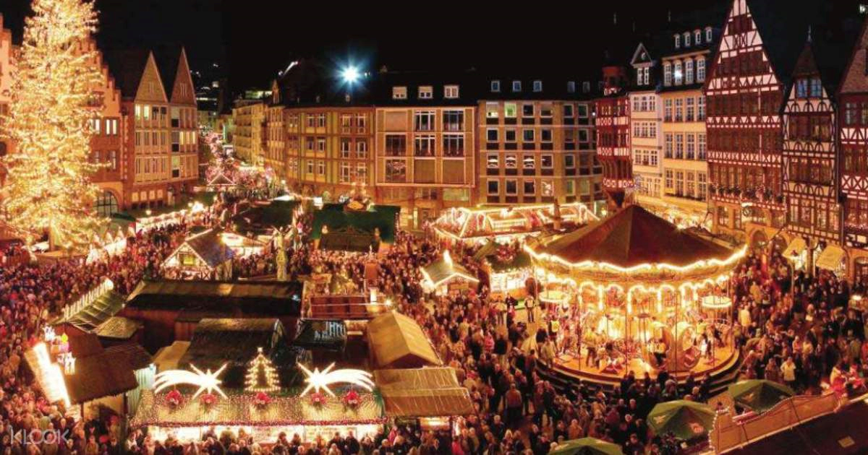
Other Information
Oktoberfest
Munich is famous for Oktoberfest.
It is the biggest fair in the world and lasts 16 days .
It finishes on the first Sunday in October.
Oktoberfest began in 1810 as the celebration of the wedding
of the Bavarian Crown Prince Ludwig and is an important part
of Bavarian culture.
More than six million people from around the world attend
every year for the traditional German food, beer, carnival
stalls,games and parades.
Christmas Markets
Germany's Christmas markets are famous throughout the
world. In Munich there are 10 main markets spread throughout
the city .The biggest Christmas market is in the Marienplatz,
with hundreds of stands and a huge Christmas tree.
There are daily musical performances on the balcony of the
Neues Rathaus (New Town Hall) at 5.30pm. The markets are
open from November 26 to December 24.

Slide 7
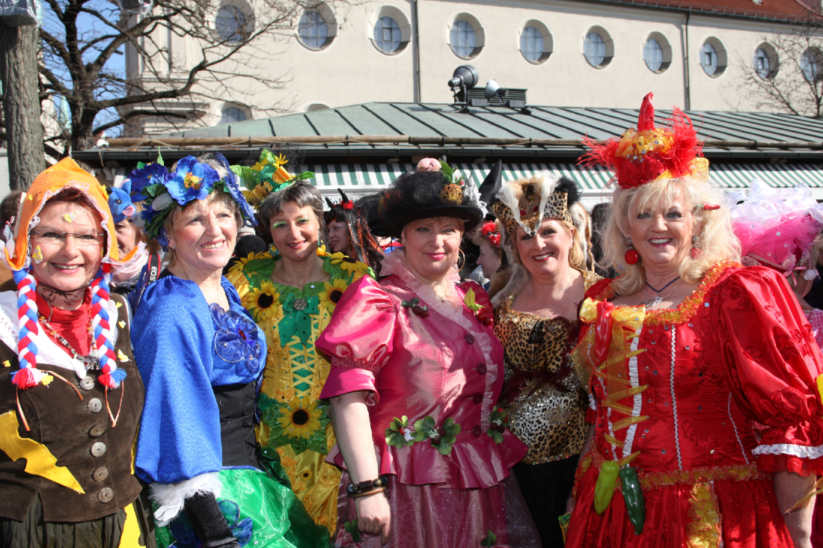
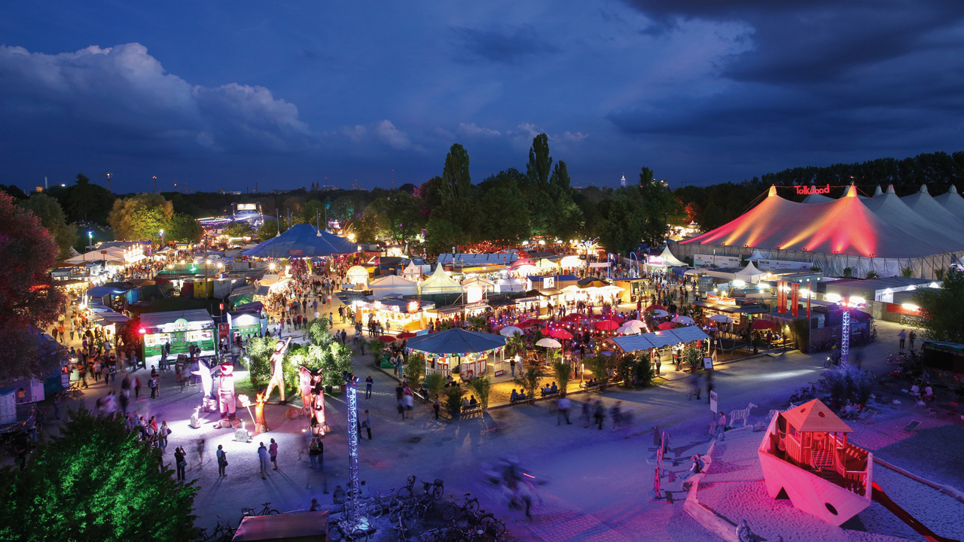
Other Information
Fasching
The carnival season in Munich is called "Fasching".
It begins on November 11 with the coronation of a carnival prince
and princess and lasts until Ash Wednesday, seven weeks before
Easter.
On February 16 at 1 p.m. there is the carnival parade.
During the last three days of the carnival (Fasching Sunday, Rose
Monday and Shrove Tuesday) the pedestrian area in the city
centre around Marienplatz is turned into a gigantic open-air
party zone with live music, fancy dresses and dancing.
One of the highlights of the Munich Fasching is the dance of the
market women of the Viktualienmarkt (food market) on Shrove
Tuesday. The market women rehearse for months beforehand
.
Tollwood summer festival
During June and July the Olympia Park becomes a festival village
Full of colourful tents and stages. This Munich festival is known for the variety of circus performances
and musical acts that come from all
over the world.
There is also a festival for children

