Slide 1

Argyll and Bute Literacy
National Literacy Network
June 2019

Slide 2
Population: 90 000
55% in settlements with fewer than 3000 people or outwith settlements
23 inhabited islands – 17% of the population
89 schools:
78 primary
10 secondary – ranging from 27 pupils to 1300
1 special school

Slide 3


Slide 5

Storyline Scotland
1965 – Primary School in Scotland published by HMSO. Integration of subjects, group work, differentiation, active child centred learning.
1967 – Jordanhill College Staff Tutor Team established to support implementation.
1968 – 80 – Development work in schools and workshop courses for teachers – Staff Tutor Topics.
1988 – Staff Tutor topic work renamed STORYLINE.

Slide 6
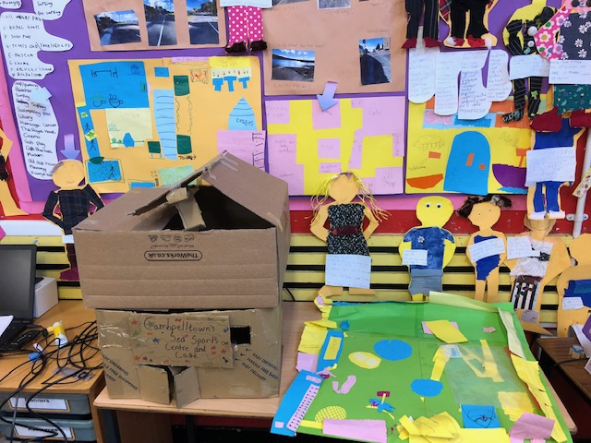
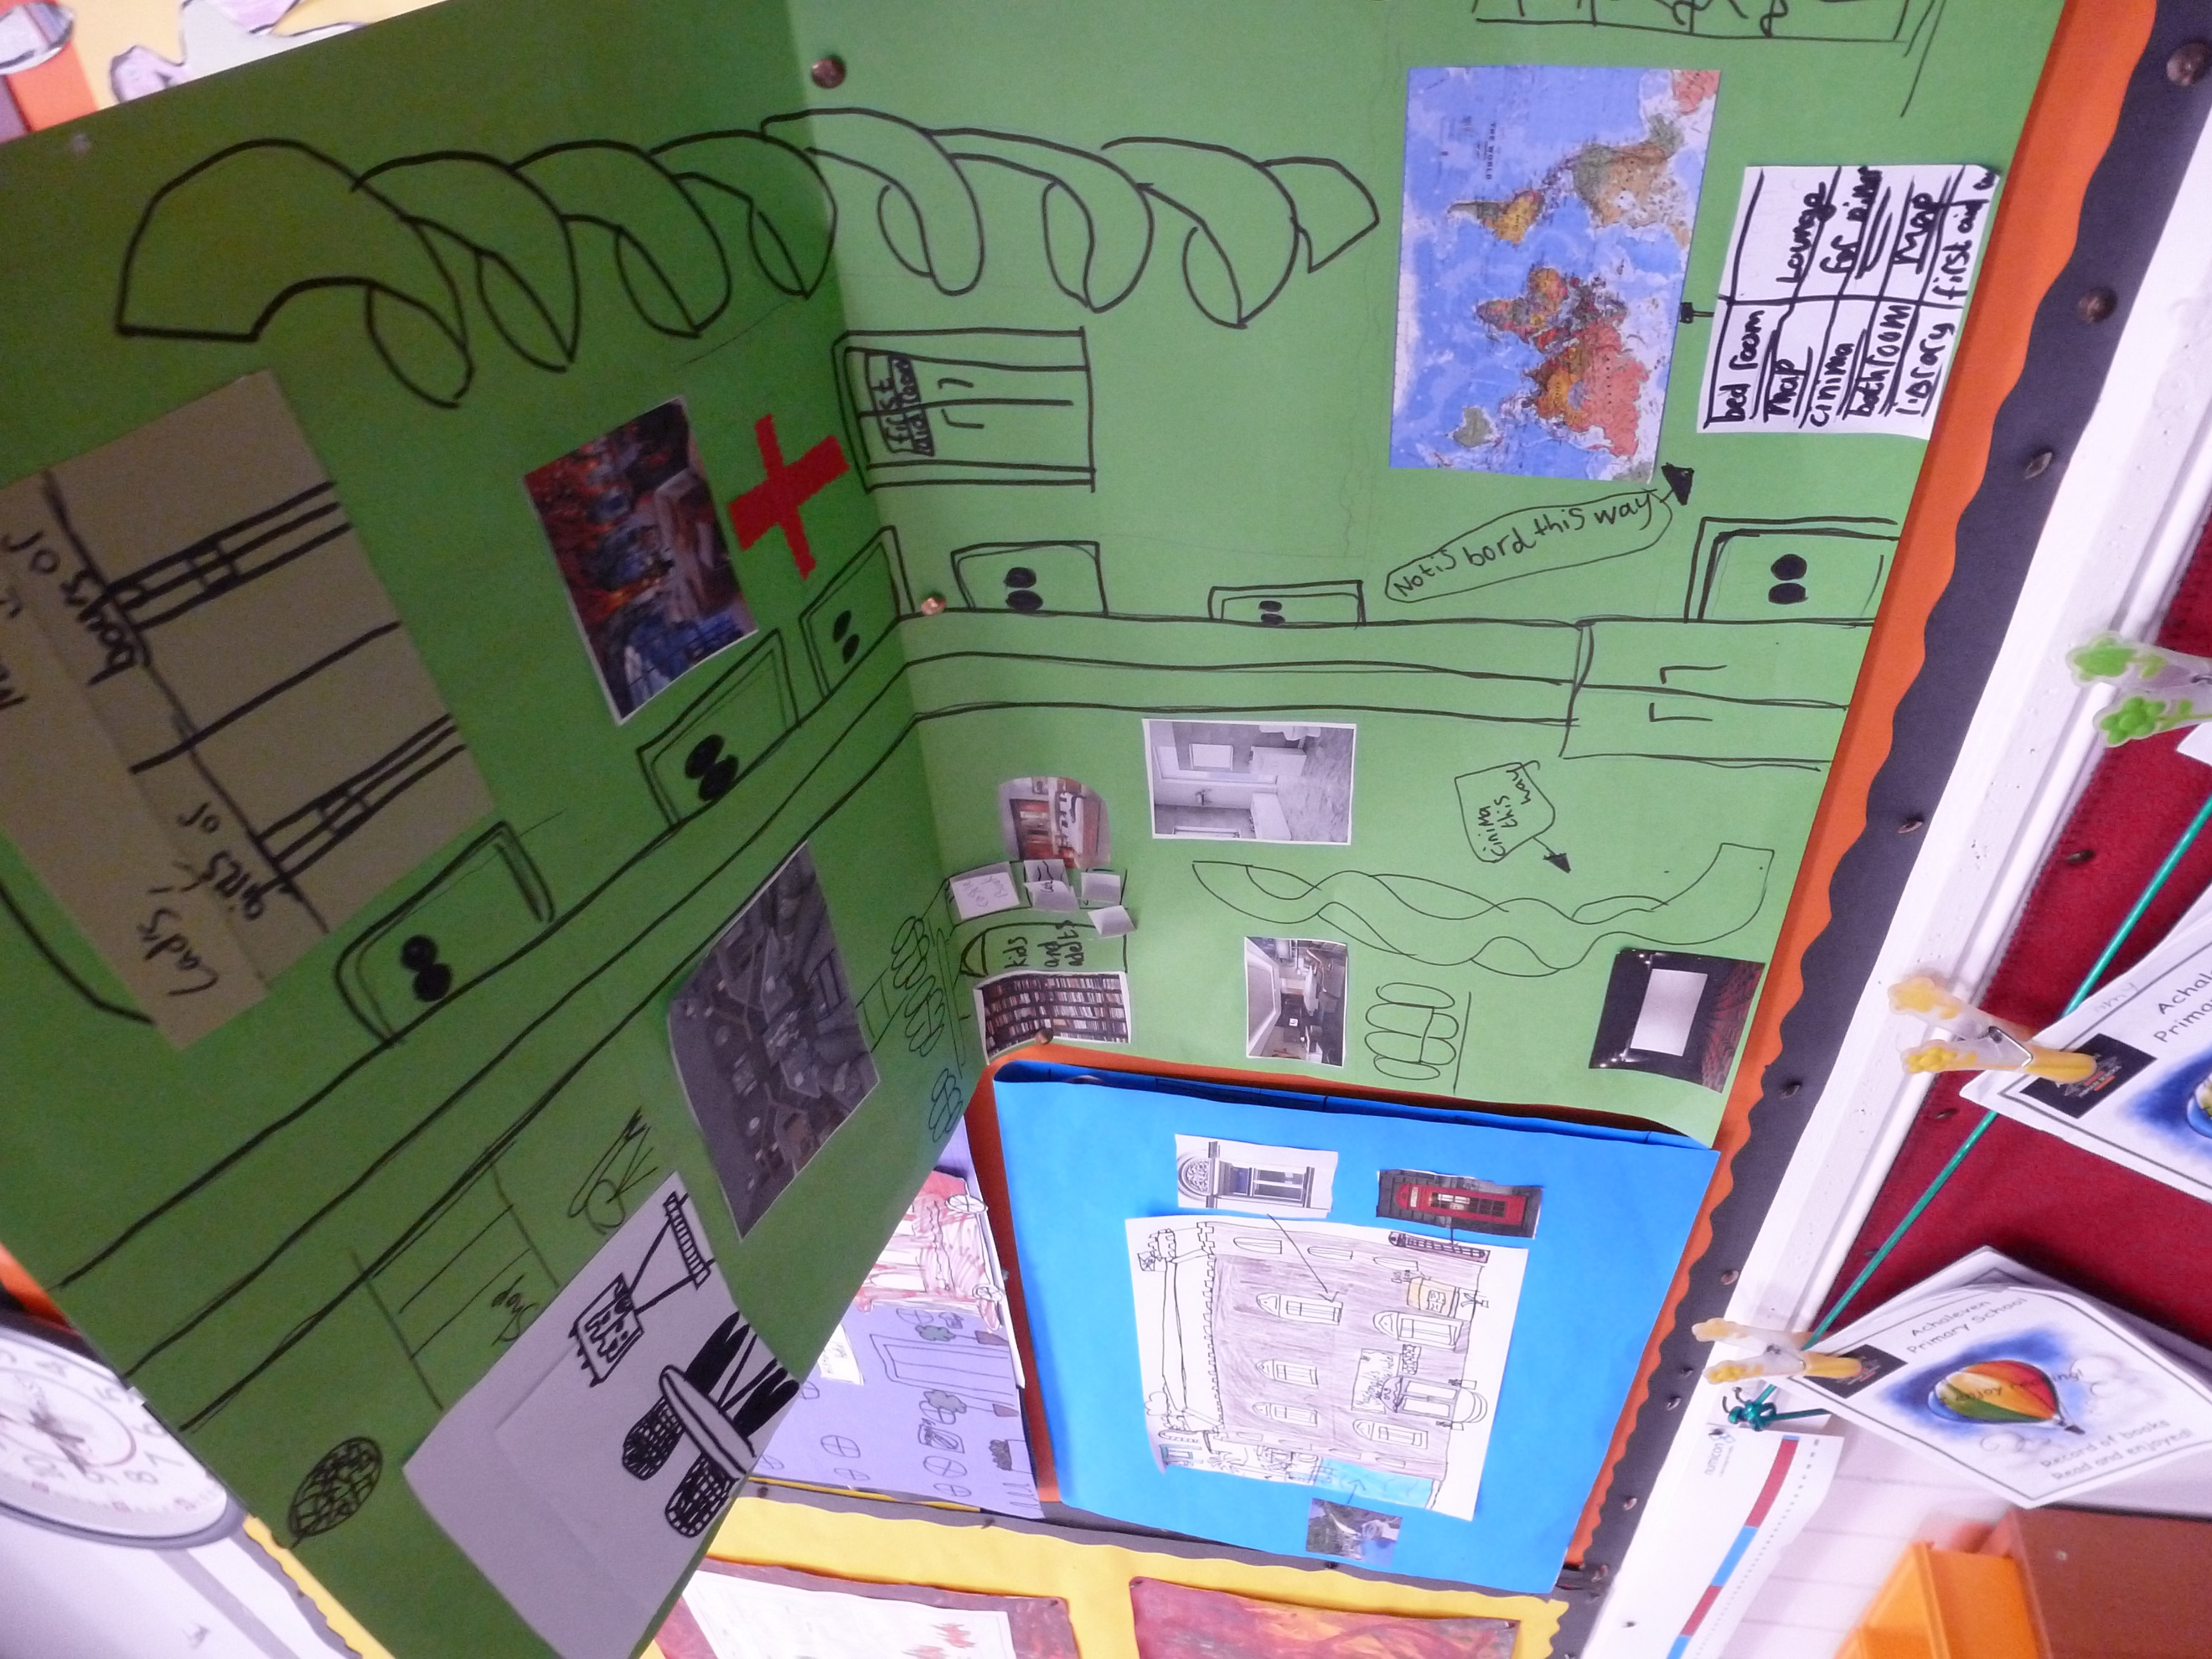
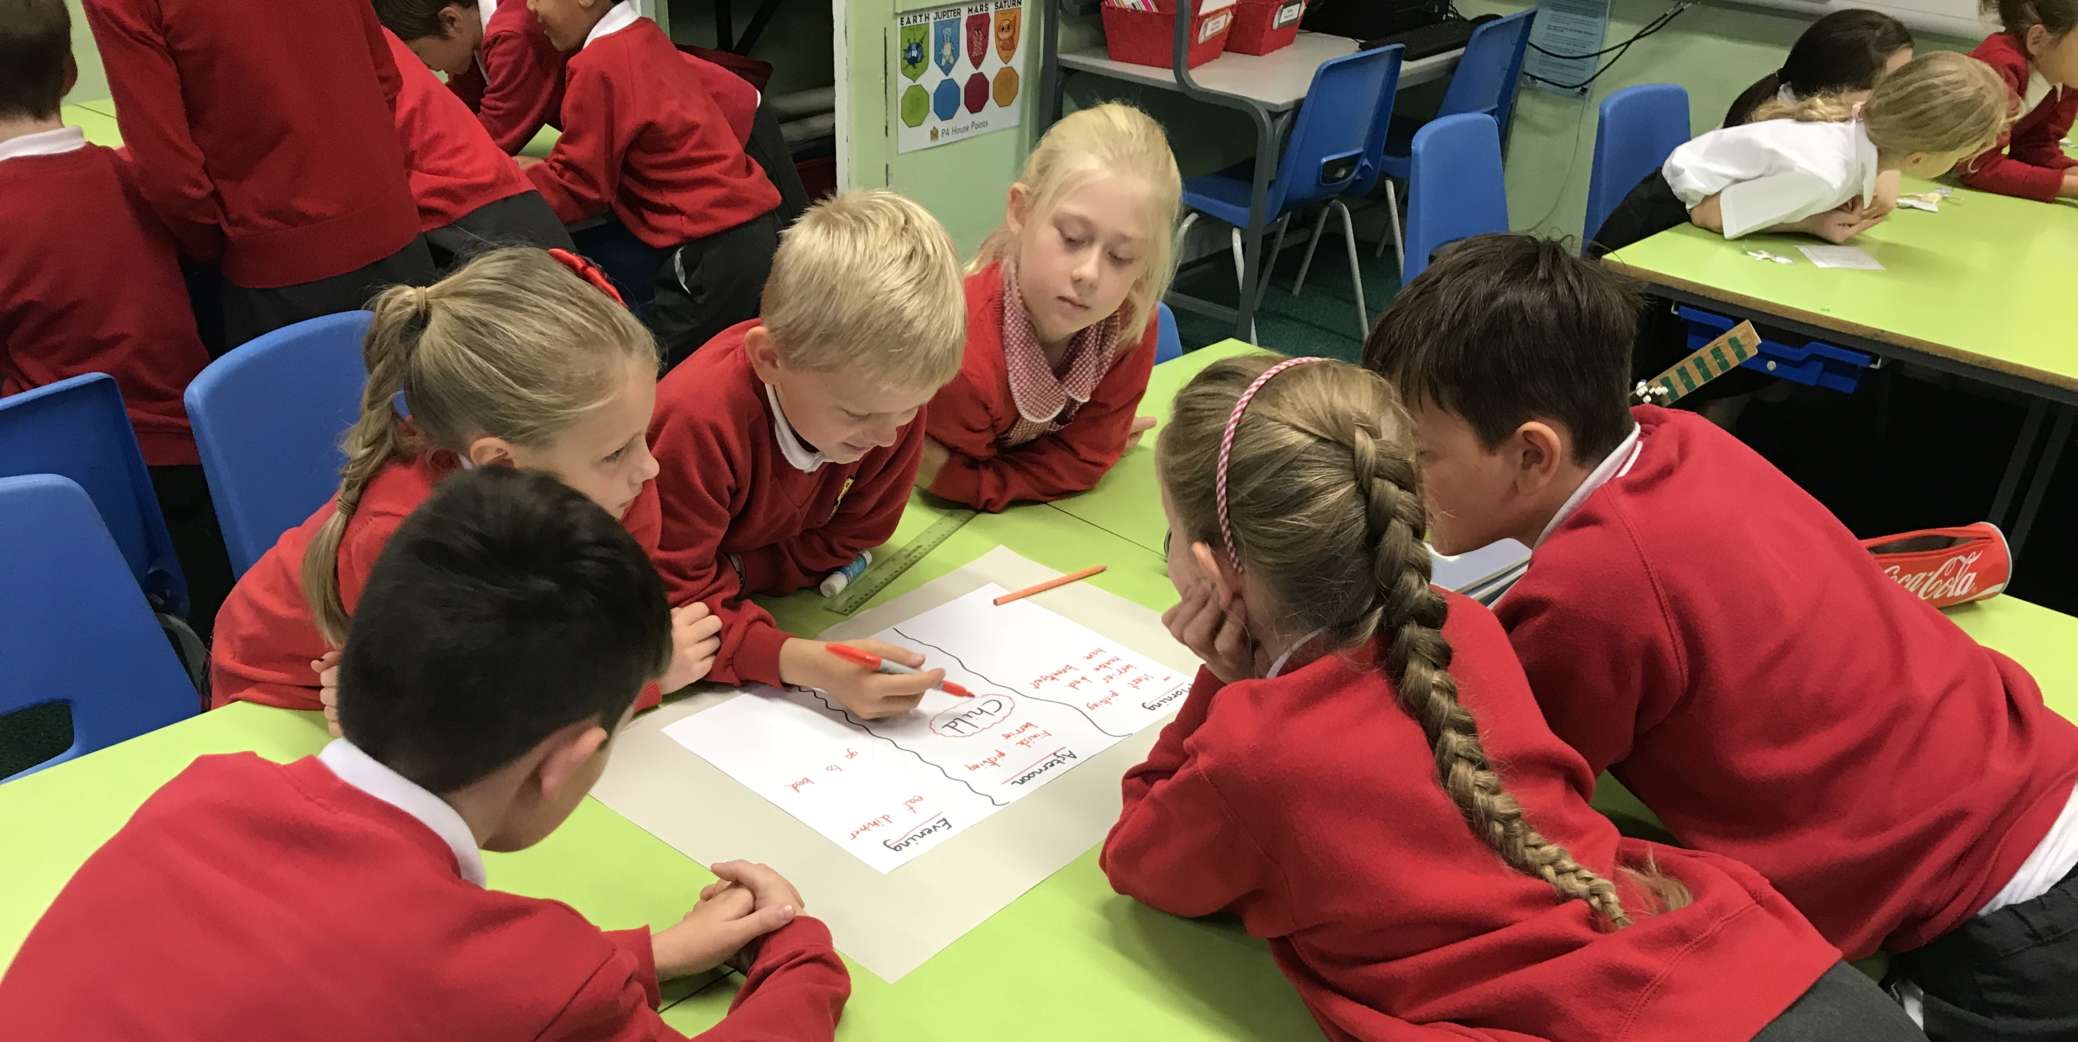
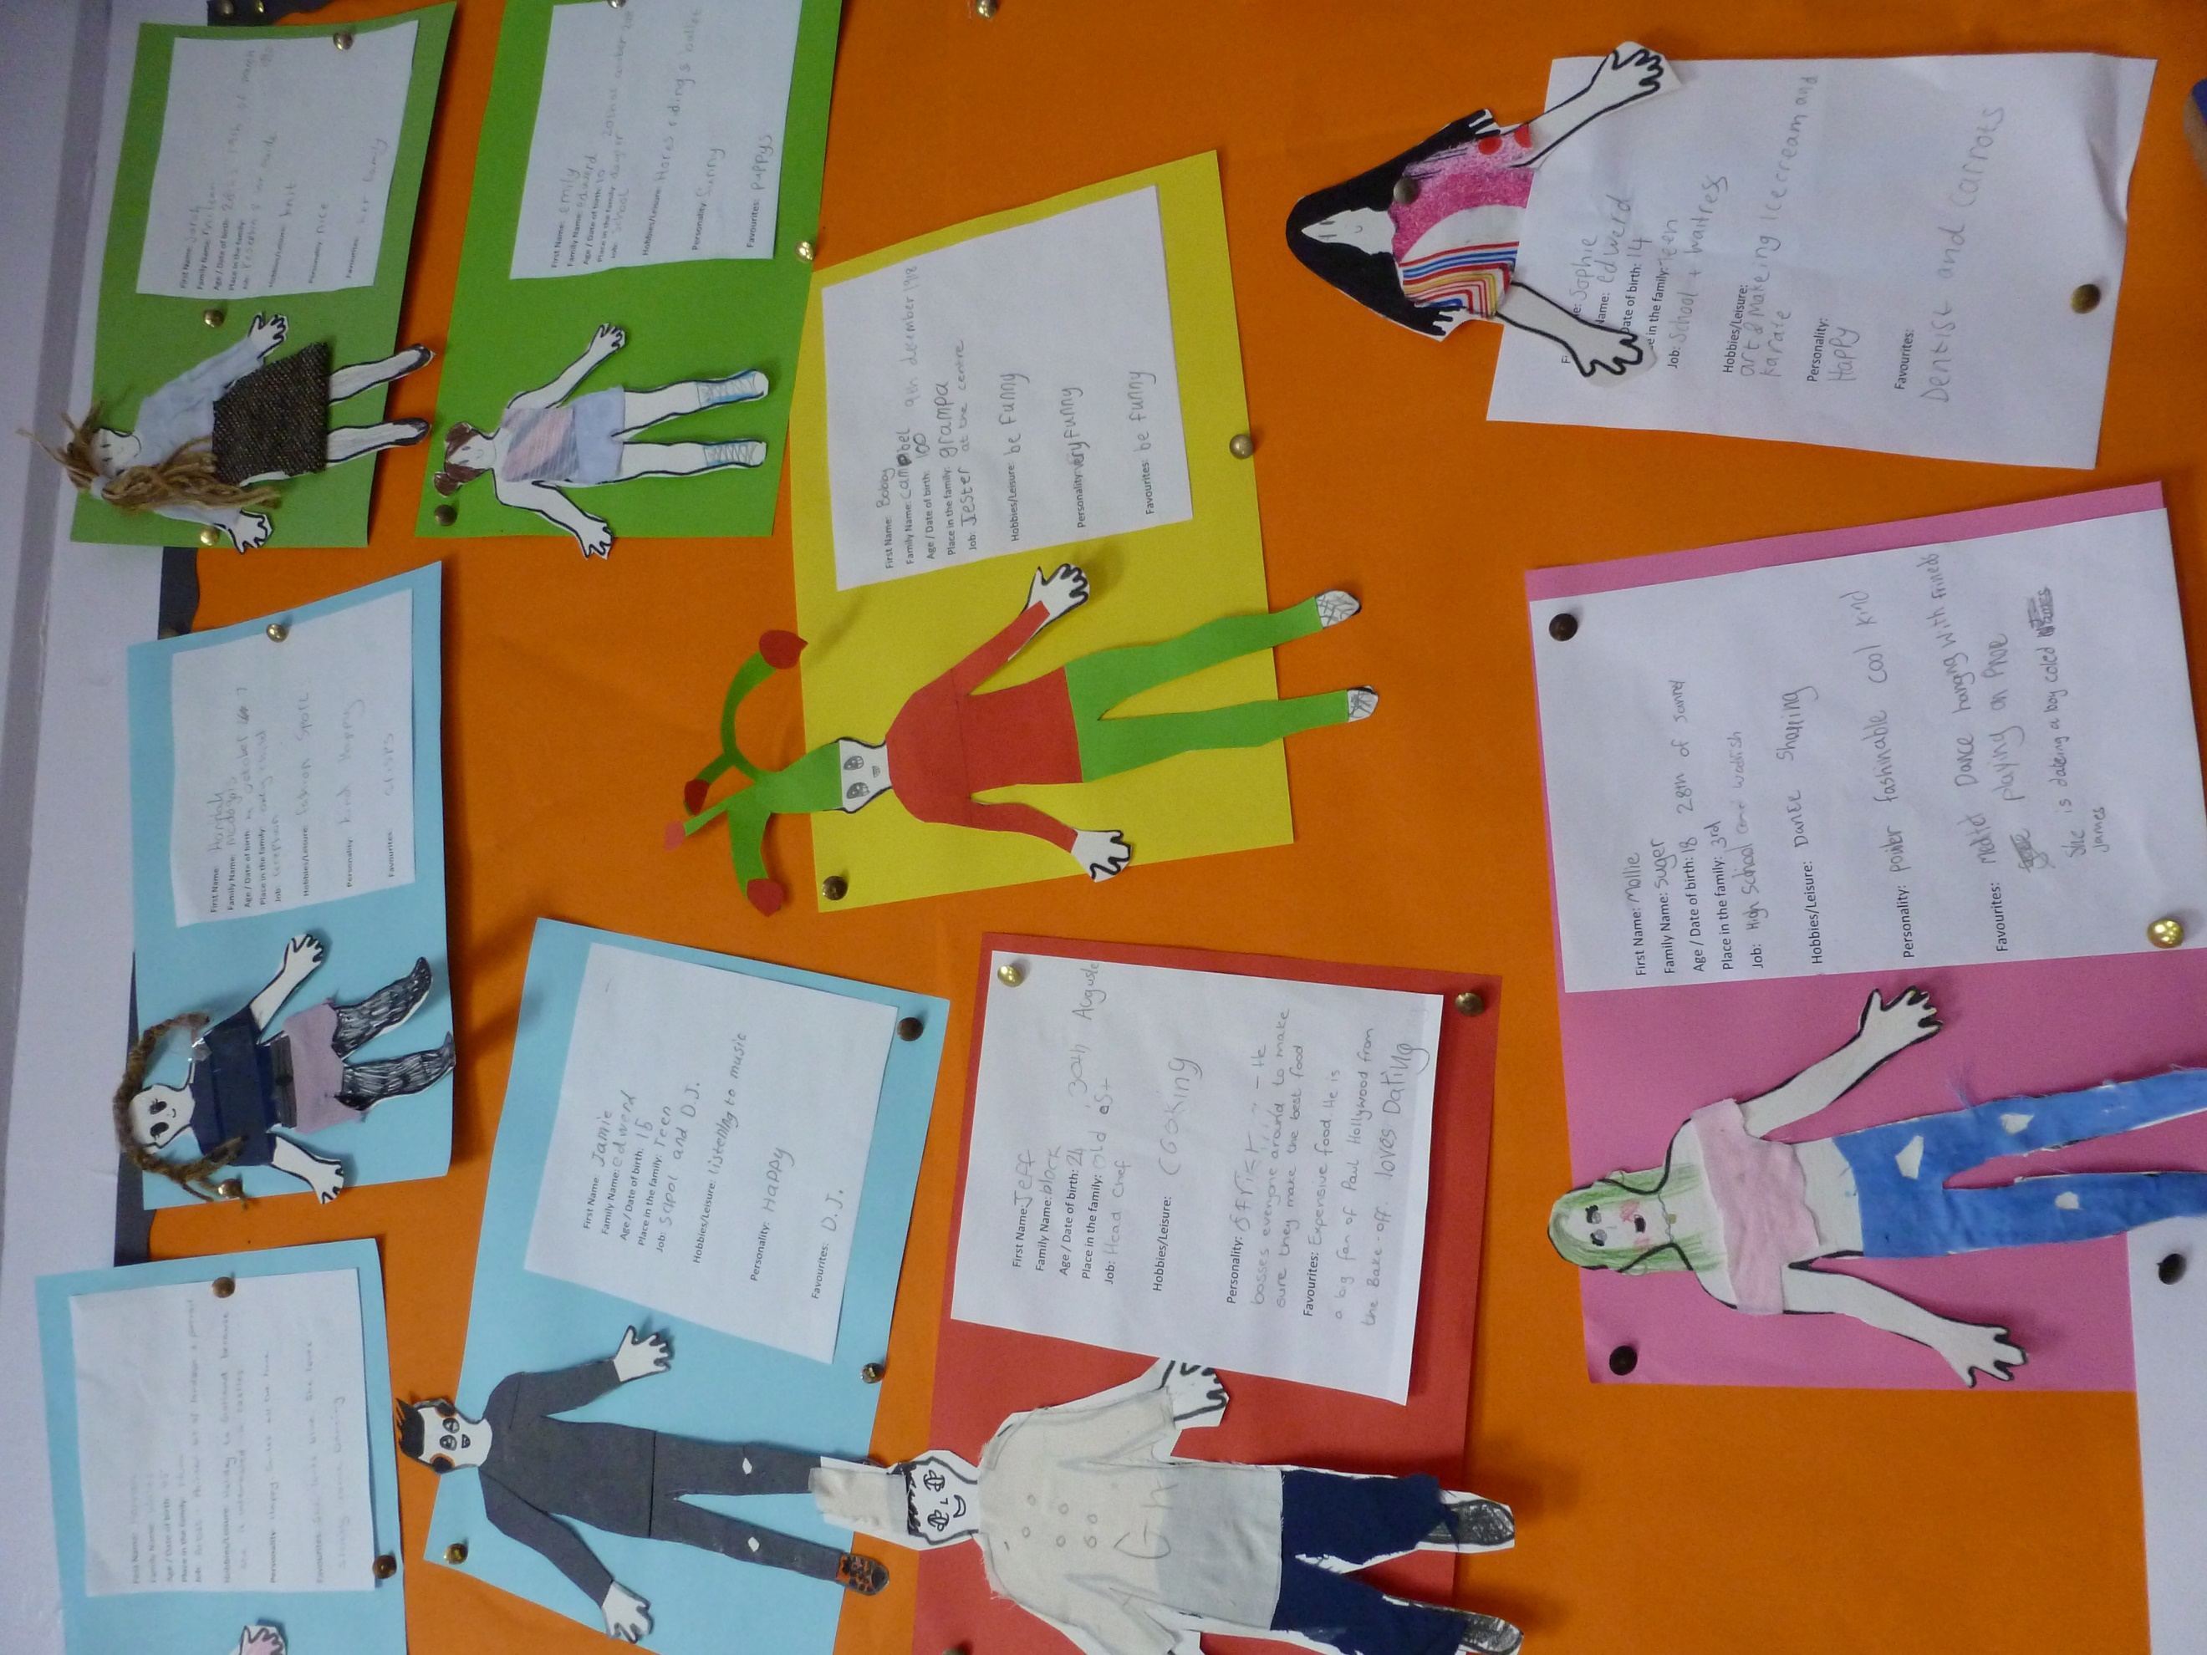
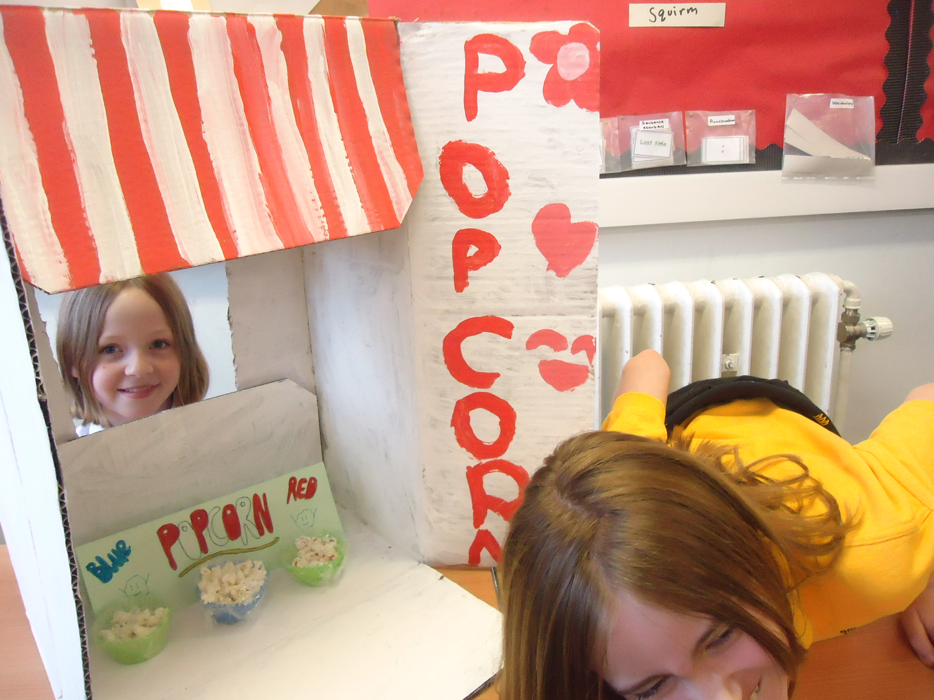
The Visitor Centre
Hook
Setting
Characters
Incidents
Culminating Event
Review

Slide 8
“I feel more motivated to try out different styles and genres of writing with an engaging context.”
“I used the job application as a piece of formal assessed writing for this term and I can honestly say it was the best standard of writing I've had at this stage in P6, across the board.”
“I will definitely be using this approach every year in my teaching career!”
“This approach has been particularly effective in motivating some disengaged boys.”
“Pupil motivation, enthusiasm and success rates have increased dramatically.”

Slide 10
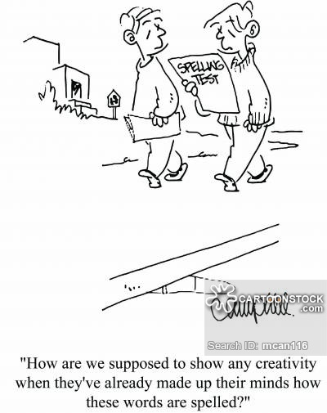
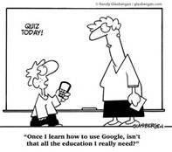
Learning across the curriculum (literacy)
“All staff have a responsibility to develop, reinforce and extend learning in literacy.”
3-18 Literacy Review

Slide 11
What we did
Staff understand the importance of literacy to learning across the curriculum
Staff understand the level of challenge required when designing literacy tasks
Literacy is embedded within planning across the school
Literacy learning is made visible to learners
Pupils have an overview of their own literacy across the school
Staff provide feedback on literacy
All staff involved in the assessment of literacy

Slide 12
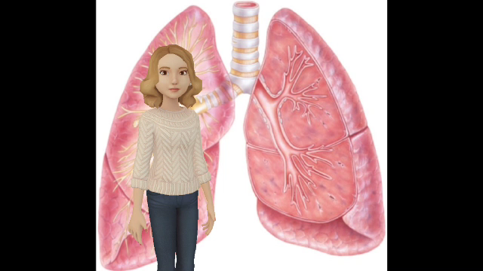

Slide 13
What type of activity might produce this? | Level 2 | Level 3 | Level 4
 | Tasks which ask pupils to work together | Tasks which ask pupils to bring some previous research to the discussion Tasks which ask pupils to take different sides Cooperative learning tasks where pupils take on a specific role | Tasks which ask pupils to reach agreement after coming to the task with different viewpoints or approaches Tasks which have specific contexts requiring an awareness of audience and purpose Tasks which require pupils to talk at length

Slide 14
 | Level 2 | Level 3 | Level 4
Science Planet earth, Biodiversity & Interdependence SCN 2-02a, 3-02a, 4-02a, 4-02b | How have plants benefitted society? | Photosynthesis: what do you as a group understand by this word? What questions do you still have about it? | Out of all the topics we have covered in this unit, which do you think are most fundamental to an understanding of plant life? Now meet with your group and share ideas. You should come to an agreement which you will present to the class.

Slide 15
Literacy boxes and training

Slide 19
Training
Understanding of the standard in writing and talking
How to support reading skills
How to set up an effective group discussion and take notes on it
Support in creating holistic assessments

Slide 20


Holistic assessment tasks
Demonstrate breadth of learning – they come from a range of Es and Os across different organisers
Demonstrate challenge – they ask pupils to use a range of higher order thinking skills such as analysis, creation, evaluation, problem solving, tackling multi step tasks, interpreting tasks
Demonstrate application of learning in new and unfamiliar situations
Come from one of the four contexts of learning:
Life and ethos of the school as a community
Curriculum areas and subjects
Interdisciplinary learning
Opportunities for personal achievement

Slide 21
Cultures of literacy increasing
Members of English department going in to other subject areas to demonstrate how to approach aspects such as group discussion
Senior pupils used as literacy ambassadors
Literacy walls in every department containing the language you need to succeed in each subject area
Literacy lunches: a literacy champion from each department is given lunch, during which they are taught something literacy related to take back to their department
‘What I am reading’ on doors

Slide 22
Impact

Slide 23
Ongoing Concerns
2017 | 2018 | 2019
Staff reluctance | Staff reluctance | Staff reluctance
Time | Staff following through on promises | Lack of SLT support
Lack of understanding of importance | Uncertainty over responsibility | Other initiatives
Lack of consistent resources

Slide 24
Updated priorities
Every department will feed into ACEL data, starting with S3, then moving into all of BGE. Within this therefore is the expectation that departments will be planning for holistic assessments that include literacy.
There will be a shared understanding of standards – what does it mean when a pupil is working within level 3?

Slide 25
There will be a consistency of understanding and approaches to sharing literacy skills with pupils.
Moderation will take place relating to literacy-related elements such as planning and feedback.
Schools will have support structures in place for their staff confidence in literacy.

Slide 26
“It doesn’t mean that every practitioner will teach everything a secondary English teacher does . . .the greatest impact for learners will come from all practitioners, in all learning environments, including rich literacy experiences as part of their day to day learning and teaching programmes.”
Literacy and English principles & Practice paper

Slide 27
Clare.Bryden3@argyll-bute.gov.uk
Pauline.Inglis@argyll-bute.gov.uk

