Slide 1

Writing – Professional Learning Workshop

Slide 2
Purpose of the workshop
This workshop has been designed to support improvement in teaching and assessing writing in all subject areas in levels first to third.
The workshop can be delivered by Faculty heads, principal teachers, literacy leaders, CLPL leaders.

Slide 3
Aims
To reflect on current practice in the learning and teaching and assessment of writing in your establishment
To develop practitioners’ understanding and skills in this area in order to improve learners’ attainment.

Slide 4
Outline of workshop
 | Focus | Slides | Time (approx)
Part 1 | Modelling writing skills | 7-11 | 45 mins to an hour
Part 2 | Case Study – A writing strategy | 12-14 | 30 – 45 mins
Part 3 | Writing Across Learning | 15-17 | 45 mins – 2 hours+
Part 4 | Reflection and planning | 23 | 15 mins
Notes:
The workshop is broken down into sections and an approximate time for completion is provided. You may decide to complete all of the sections in one session, or you may wish to separate the sections and use them over a longer period of time, for example over the course of a few weeks. It is recommended that the activities are completed as part of a group but they can be completed by one person. You should read through the content of the entire presentation in order to decide which sections are most relevant to the needs of your establishment. The reflection and planning activity at the end of the presentation may be completed at the end of each section or when you have completed all of the sections.

Slide 5
Modelling writing skills

Slide 6
Resources
To complete this workshop each participant will need:
Handout: Modelling stages of the writing process
Handout: Case study: Writing at Livingston Village Primary School
Notes:
It may also be useful to have flipchart paper, marker pens and post-its to hand.

Slide 7
I think there are two types of writers, the architects and the gardeners. The architects plan everything ahead of time, like an architect building a house. They know how many rooms are going to be in the house, what kind of roof they're going to have, where the wires are going to run, what kind of plumbing there's going to be. They have the whole thing designed and blueprinted out before they even nail the first board up. The gardeners dig a hole, drop in a seed and water it. They kind of know what seed it is, they know if planted a fantasy seed or mystery seed or whatever. But as the plant comes up and they water it, they don't know how many branches it's going to have, they find out as it grows. And I'm much more a gardener than an architect.
George R. R. Martin
What type of writer are you? What stages do you go through when you have to produce a piece of extended writing?
Notes:
In this quotation George R. R. Martin describes his own approach to writing as a process that is messy and organic as opposed to linear and completely predictable. Though learners may begin to write with a plan in mind, this may adapt and grow once the process is underway. Every stage of the process is important from planning through to publishing the final draft. Practitioners should discuss their own experiences of writing and reflect upon the different stages of their own writing process.

Slide 8



What is modelling?
Eggen and Kauchak’s Educational Psychology defines modelling as “changes in people that result from observing the actions of others.” This text also claims that modelling is a key element of social cognitive theory, which “examines the processes involved as people learn observing others and gradually acquire control over their own behaviour.”
Learners need to know what good writing looks and feels like.
Discuss with a partner: in what ways do you model the writing process?
Notes:
This reference to Eggen and Kauchak’s Educational Psychology offers a definition of modelling skills in the classroom. It is included here to get participants thinking about what it actually means to model the skills of writing in their own classroom practice.
Modelling writing involves making the thought processes of a writer visible and explicit.
(Eggen, Paul and Don Kauchak. Educational Psychology: Classroom Connections. 5th ed. New York: Macmillan, 2001)

Slide 9

Modelling the writing process
thinking
planning
reviewing
editing
publishing
How do you currently model the different stages of the writing process?
How do you make visible the dynamic nature of this process?
Notes:
It is effective practice to model the different stages of the writing process: thinking, planning, reviewing, editing and publishing. At the same time, it will help learners to see that this process is not linear and that writers are constantly assessing and re-evaluating the choices they make and their likely impact on the reader. For example, stopping regularly to review written work will lead to adjustments being made to the overall planning of a written piece. Decisions made about purpose and audience at the thinking stage will inform the editing and the publishing stages, and so on.
Participants should reflect on how they currently model the different stages of the writing process. There might be some gaps at this stage but they should list as many ideas as possible. When initial ideas have been recorded, the group can use the handout “Modelling skills for Writing” which can be found in the accompanying resource pack. This list is by no means exhaustive and once discussion is underway, participants will probably want to add to it.

Slide 10
Case study – a writing strategy
Notes:
This section focusses on a case study taken from the 3-18 Literacy and English impact review. Participants should read through and consider the details of the case study, on slide 11.
You may then go on to work with the reflective discussion questions on slide 12.
The case study and questions are also included in a printable handout which can be downloaded from the accompanying pack.

Slide 11
Case Study: A Writing Strategy
In order to raise attainment in writing, staff in Livingston Village Primary School developed a whole school, structured approach to the organisation of writing lessons. After a whole class learning and teaching focus, the children are organised into 3 groups to begin their individual pieces of writing. One group works independently without any further teacher input, one group is provided with additional support from a pupil support worker and the final group is fully supported by the teacher during the lesson. In this third group, the teacher provides focussed support for individual children based on their prior learning and on-going formative feedback. The groups then rotate on a weekly basis so that every 3 weeks, the children are producing a piece of unsupported writing. Teachers focus their written formative feedback on these unsupported pieces of work and this group then becomes the teacher focus group the following week. This approach enables staff to continue to improve the quality of pupils’ writing through robust formative assessment, regular opportunities to track progression of individuals, on-going opportunities to engage in purposeful dialogue with learners to support target setting and next steps.
Notes:
This case study, taken from the 3-18 Literacy and English Impact Review illustrates how writing lessons can be planned to ensure that learners working with their own personalised writing targets are able to benefit from peer and teacher support during the writing process, as well as having regular opportunities to apply their learning by writing independently.
The reflective questions on the following slide are designed to help participants to think about what kind of strategy could be adopted in their own classrooms to ensure that learners experience different kinds of support, receive regular feedback, work with personalised targets and have regular opportunities to apply their skills by writing independently.

Slide 12
Writing strategy: reflective discussion
To what extent do you ensure that learners work with meaningful writing targets that they take forward from piece to piece?
What do you do to ensure that learners receive enough peer and teacher support when writing?
How do you plan lessons to ensure that all learners are given time to work unsupported in order for them to follow up their next steps in learning?
How do you plan lessons to ensure that all learners have regular opportunities to engage in dialogue with you on their next steps?

Slide 13
Writing across learning

Slide 14
Purposes for writing
Writing to convey experiences or information
Writing to describe events (real or imagined)
Writing to explain processes
Writing to persuade
Writing to explore issues
Writing to express an opinion
Notes:
Outlined on the slide are some broadly defined purposes for writing. * Think about the writing experiences you provide in your establishment. Think about the writing experiences that you currently offer learners. Which of these purposes are covered in these experiences? Some purposes may be covered more often than others. The activity on the next slide is designed to get practitioners thinking about how to broaden learners’ experience of writing by considering different opportunities for writing across all four contexts of the curriculum.
*These definitions of purposes for writing were used in the Scottish Survey for Literacy and Numeracy (SSLN) 2011-2016

Slide 15
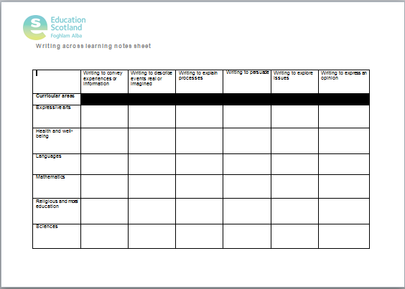
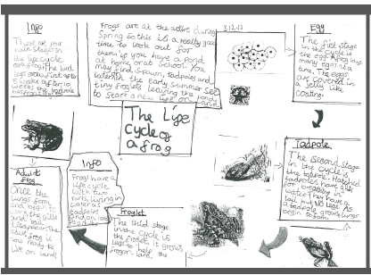
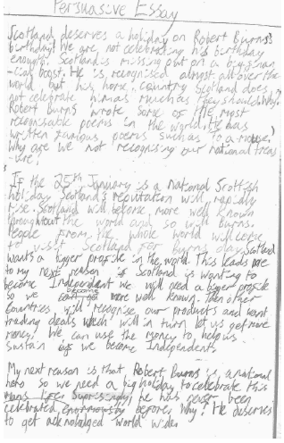
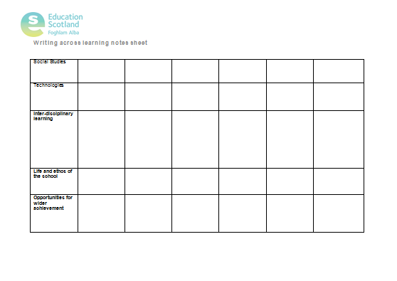
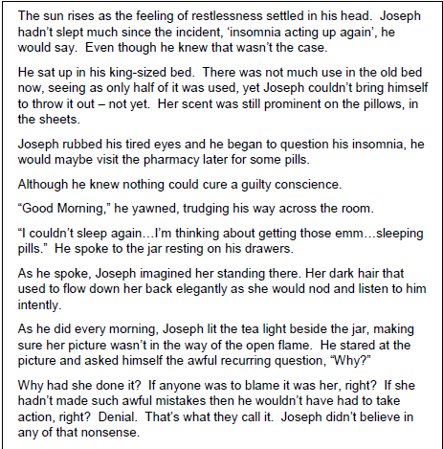
Notes:
Use the downloadable packs of writing samples to explore a range of different examples of writing across learning. Use the A3 note taking sheet to record any that you might be interested in using / adapting for your own context. Fill in the gaps with any further ideas that emerge from your discussion.

Slide 16
Reflection and planning
 | As a result of this workshop, what changes will you make to your practice? | Resources/further reading/support needed to complete your target.
Next week
Next term
Next session
Notes:
The purpose of this task is to help practitioners to reflect on what impact the workshop session is going to have on their own practice in the short, medium and long term. Depending on the needs of your context and the content of the workshop, it may be that practitioners can plan in all three boxes, or just one or two. The purpose of the final column is to help practitioners to think about the additional support that they will need to help them to make changes. This could involve any combination of the following:
Use of resources provided within the workshop materials for classroom displays, to support lesson planning etc
Further reading and engagement with resources from the National Improvement Hub, or beyond
Planning support mechanisms such as self evaluation, peer observation, teacher learning communities…

Slide 17
Education Scotland
Denholm House
Almondvale Business Park
Almondvale Way
Livingston EH54 6GA
T +44 (0)141 282 5000
E enquiries@educationscotland.gov.uk
www.educationscotland.gov.uk

