Slide 1
Update on:
Quality Assurance and Moderation Support Officer (QAMSO) programme
Scottish National Standardised Assessments
For Scotland's learners, with Scotland's educators

Slide 2

National QAMSO Programme
The aim of the Quality Assurance and Moderation Support Officer programme is to:
Support local authorities and schools to develop a better understanding of standards in literacy and numeracy
Support effective assessment and moderation, including the development of holistic assessments
Share good practice
Enable local authorities and schools to have greater confidence in the validity and reliability of teacher professional judgement.
For Scotland's learners, with Scotland's educators

Slide 3
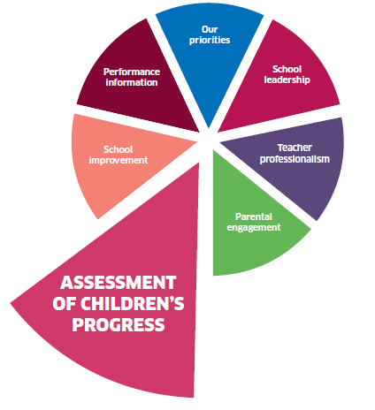
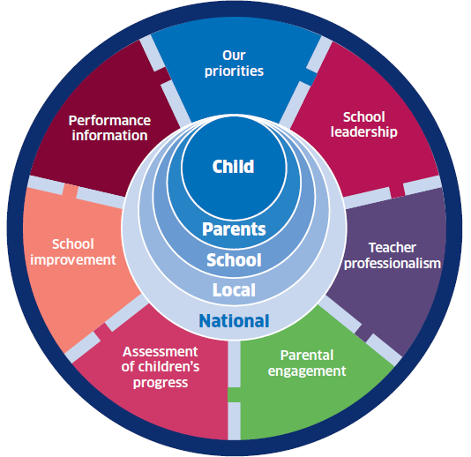
National Improvement Framework
For Scotland's learners, with Scotland's educators

Slide 4

‘In developing systematic approaches to the quality assurance and moderation of assessment across Scotland, support structures have to be put in place so that
local and national practices are fully aligned and
everyone is clear about roles and responsibilities.’
Building the Curriculum 5: A Framework for Assessment
For Scotland's learners, with Scotland's educators

Slide 5
Quality Assurance & Moderation Support Officers
QAMSO programme began in session 2016/2017
Offered training in the moderation process
Focused on developing a better understanding of standards in BGE literacy & numeracy
A review of the programme in June 2018 involved feedback from QAMSOs and Assessment Coordinators from each local authority which has informed planning for 2018-19.
For Scotland's learners, with Scotland's educators

Slide 6
QAMSO Events: Session 2018/19
Launch events for new QAMSOs - literacy and numeracy (all levels):
07 November 2018: Numeracy - The Hallmark Hotel, Glasgow
14 November 2018: Reading - The Hallmark Hotel, Glasgow
21 November 2018: Writing - The Hallmark Hotel, Glasgow
27 November 2018: Listening and Talking - The Double Tree by Hilton Hotel, Glasgow.
For Scotland's learners, with Scotland's educators

Slide 7
QAMSO Events: Session 2018/19
January to March 2019 – per area
Early/1st levels
2nd/3rd levels
4th/NQ
April to June 2019 – per area
Early/1st level
2nd/3rd level
4th/NQ
For Scotland's learners, with Scotland's educators

Slide 8
QAMSO events:
October/November | Moderation process & high quality assessment items
January/February/March | Standards and moderation of learner evidence *
April/May/June | Achievement of a level *
* May alter slightly to reflect information from moderation process
For Scotland's learners, with Scotland's educators

Slide 9
Quality Assurance and Moderation Support Officers’ Role
Attend every quality assurance and moderation event for their level
Collect a range of evidence from schools (ideally evidence that has already gone through school and local moderation)
Share key learning and messages in their own context
Take part in national moderation.
For Scotland's learners, with Scotland's educators

Slide 10
GTCS Professional Recognition
All QAMSOs will:
Have the option to complete an application for professional recognition
Participants will either:
Develop and lead a regional/local moderation event, or
Submit a moderated portfolio of evidence, together with a standards presentation for the national ‘Understanding Standards’ support bank.
For Scotland's learners, with Scotland's educators

Slide 11
Additional QAMSO Events: Session 2018/19
Events for existing QAMSOs i.e. those who have undergone national training over the previous two years:
Four national events (Reading/Writing/Listening & Talking/Numeracy).
These events will:
Reinforce key moderation messages and processes
Provide opportunities to moderate across levels and sectors
Encourage continued leadership of moderation events at local and regional level.
For Scotland's learners, with Scotland's educators

Slide 12
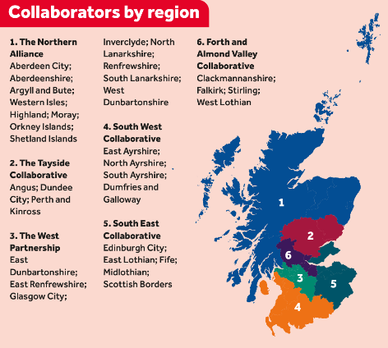
Senior leaders/those facilitating moderation in schools
Events in Regional Improvement Collaboratives articulating national messages and sharing expectations:
By end of 2018, either as a whole RIC or as LAs (to suit geography)
Making better links between national and local programmes.
Local authority assessment coordinator meetings:
Three meetings (September/January/June).
For Scotland's learners, with Scotland's educators

Slide 13
Assessment Coordinators’ Role
Each local authority has an Assessment Coordinator.
The Assessment Coordinator is there to:
  Organise local moderation to support the National Quality Assurance and Moderation events
  Nominate Quality Assurance and Moderation Support Officers (QAMSO) for each level and group
  Support the identification/collection of evidence.
For Scotland's learners, with Scotland's educators
Notes:
(Read from slide)

Slide 14
Best practice identified by QAMSOs in 2017-18
Assessment & moderation is now a priority across the local authority
Regular meetings with QAMSOs and the QAMSO experience being used to plan events
Clear focus through LA steering groups
Tiers of drivers – QIOs/HTs/Moderation Coordinators/Teachers – shared expectation
Effective use of in-service for moderation – effectively planned for
Sectors working together
Calendar of planned events in school/cluster/across local authority
Local banks of evidence as reference points
Each school contributing to evidence gathering for QAMSO events or local events.
For Scotland's learners, with Scotland's educators

Slide 15



National resources for assessment and moderation
For Scotland's learners, with Scotland's educators

Slide 16
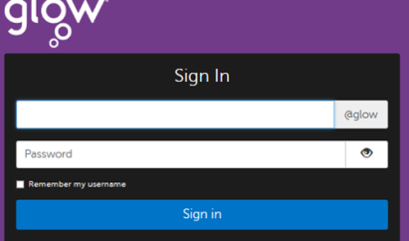

The Glow Moderation Hub
Glow (login required)
Universal resource
Links to relevant ES resources (e.g. BtC5), National Improvement Hub, Moderation Cycle
Sections on each stage of Moderation Cycle include:
      Explanation
      Presentation
      Workshop
      Self evaluation
      Moderation documents
For Scotland's learners, with Scotland's educators

Slide 17
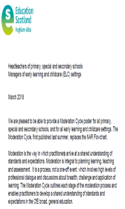
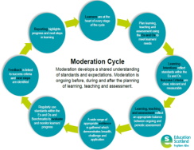

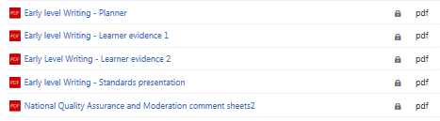

National resources for assessment and moderation
A1 poster of moderation cycle
Assessment animation on Moderation Hub
                https://youtu.be/JVHyGPYiuos
Materials on Yammer QAMSO
Community (soon to be Teams!)
Scottish National Standardised Assessments
For Scotland's learners, with Scotland's educators

Slide 18
How is Education Scotland supporting BGE moderation?
Commitment to the QAMSO programme for new practitioners
Senior staff events to share expectations
Introduction of Listening & Talking to the suite of training
Extension of the programme to continue supporting trained QAMSOs
Emphasis on leadership through development of Professional Recognition model
Commitment to National Improvement Hub support and sharing of materials
Moderation across level
Commitment to better support the transition from 4th level to NQs
For Scotland's learners, with Scotland's educators

Slide 19
Evidence of Learning
Data from SNSA
Teacher Professional Judgement
Education Scotland support
BGE Benchmarking
LA /RIC support
Evidence of Learning
For Scotland's learners, with Scotland's educators

Slide 20

Updates to the SNSA
Changes to the SNSA for session 2018/19
SNSA long scale to be used in all reports
National norms to be used in all reports
New feedback process to be built into SNSA platform
  Children
  Teachers
Updated training programme – 5 courses
National Report published in December 2018

Slide 21
Individual Learner: Overview report with long scale

Slide 22
Understanding the Long Scale: Band Descriptions
Band 12
and above
730 and above
Band 11
682-789
Band 10
634-681
Band 9
586-633
Band 8
538-585
Band 7
490-537
Band 6
442-489
Band 5
394-441
Band 4
346-393
Band 3
298-345
Band 2
250-297
Band 1
Up to 249
SNSA 2018
Include band descriptions
Align with benchmarks
Describe what a child or young person in this band is typically able to demonstrate
Band 2 Primary 1 Literacy Description
Learners in this band are typically able to distinguish letters from numbers and symbols. They are able to match up a range of letters with their sounds and identify the first or last sounds in words.

Slide 23
Individual Learner:
Comparative report with national norms - time referenced
Numeracy

Slide 24
Updates to Training Programme
5 SNSA training course for session 2018/19
An Introduction to SNSA
An Introduction to Analysing SNSA Data
An Update on SNSA Data Analysis – Using the Long Scale
Using SNSA Data to Support Improvement
A Closer Look at Using SNSA in an ASN & EAL Context

Slide 25
User Review of the SNSA
Changes to be made in response to user concerns
Replenishment of questions (30%) – replacing those questions that have been a barrier (Hummingbird!)
Re-ordering of questions to ensure children have a more positive start
Re-designing questions to reduce the amount of scrolling and click and drop
Refresh the P1 practice assessments to include all types of questions ( un-supported reading)
Provide tips, hints and training on classroom management including case studies of successful practice – published October 2018
Establish a P1 practitioner improvement forum

Slide 26
Parliamentary vote on P1 SNSA
DFM made a statement to Parliament – 25/10/18
Established an independent review of the P1 assessments to report in May 2019
Still believes in the value of assessments
Advised schools to continue with existing plans to deliver SNSA, including P1

Slide 27
SNSA - Key messages
SNSA is a diagnostic assessment, not a high stakes assessment
SNSA assesses aspects of Literacy and Numeracy
SNSA is aligned to Curriculum for Excellence
SNSA provides indicative information against national curriculum standards
SNSA provides information at a moment in time (of the schools choosing), but can be compared against time referenced national norms
SNSA will show progress of children over time – long scale
SNSA should be part of the moderation process
SNSA contributes to the teacher professional judgment of children’s progress

