Slide 1

National Literacy Network
Monday 19th March, 2018
Helen Fairlie: Education Officer, Literacy and English

Slide 2
Welcome!
Notes:
Theme – taking stock
Outline programme

Slide 3

National Overview of Literacy – Early findings
Notes:
Overall objective: To pull together key information about attainment, along with Inspection findings in order to build a picture of strengths and next steps at a national level.
Health and wellbeing and numeracy teams also working on this. Work is not finished.

Slide 4
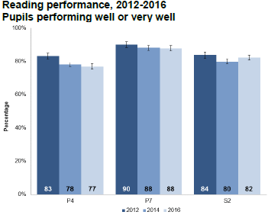
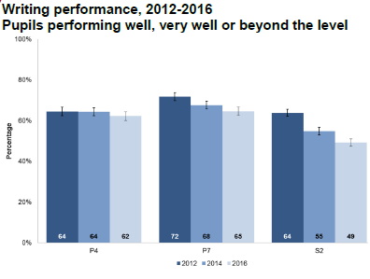
Attainment – SSLN 2016
http://www.gov.scot/Resource/0051/00517651.pdf

Slide 5
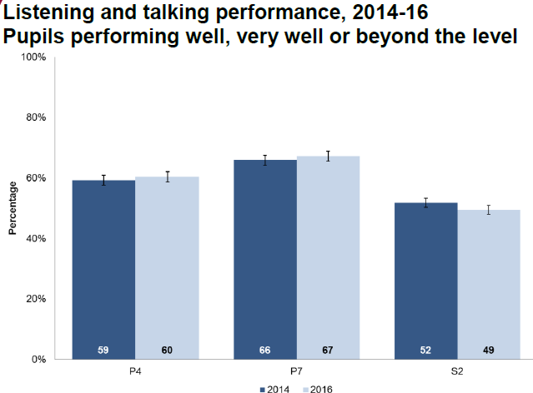
Attainment – SSLN 2016

Slide 6
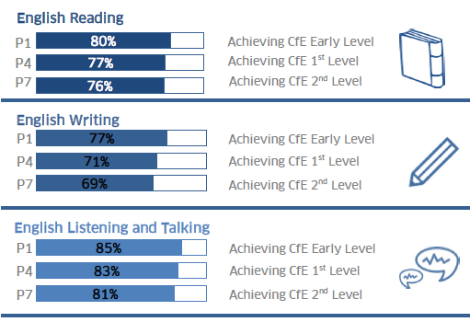
Achievement of CfE Levels, 2016 – 17 Primary
http://www.gov.scot/Resource/0052/00528886.pdf
Notes:
Not comparable to SSLN
SSLN sampled across primaries and secondaries, comprised of a reading assessment, 2 pieces of writing assessed externally and group discussion assessed by trained visiting assessors.
Achievement of a level data reported by all schools on all pupils based on teacher professional judgement (supported by teacher professional judgement)

Slide 7
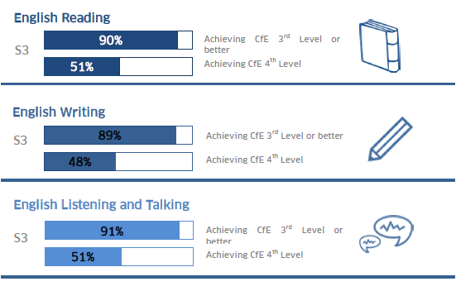
Achievement of CfE Levels, 2016 – 17 Secondary
Notes:
ACEL experimental stats so no comparison over time

Slide 8
National Qualifications N5-AH : 2014-2017
English: S4: National 5
S4 | Entries | A | A-B | A-C
2014 | 27283 | 39.0 | 68.1 | 87.9
2015 | 30250 | 46.5 | 74.4 | 91.0
2016 | 32038 | 42.2 | 71.1 | 90.6
2017 | 34004 | 41.5 | 72.7 | 90.1

Slide 9
S5 - Higher
S5 | Entries | A | A-B | A-C
2014 | 18350 | 26.3 | 53.5 | 81.7
2015 | 21802 | 31.0 | 59.3 | 83.8
2016 | 23714 | 30.3 | 57.6 | 83.0
2017 | 24580 | 27.4 | 55.5 | 80.2

Slide 10
Advanced Higher
English: S6: Advanced Higher
S6 | Entries | A | A-B | A-C
2014 | 1478 | 18.7 | 48.5 | 84.1
2015 | 1456 | 17.9 | 48.0 | 80.8
2016 | 1996 | 22.3 | 49.5 | 80.1
2017 | 2303 | 17.4 | 40.4 | 72.7

Slide 11
Inspection - Primary
3.2 Raising attainment and achievement
Excellent | Very Good | Good | Satisfactory | Weak | Unsatisfactory
0 | 12 | 45 | 47 | 11 | 1
0 | 10% | 39% | 41% | 9% | 1%
August 2016 – December 2017
Notes:
116 schools total

Slide 12
Inspection - Secondary
3.2 Raising attainment and achievement
Excellent | Very Good | Good | Satisfactory | Weak | Unsatisfactory
0 | 2 | 12 | 9 | 2 | 0
0 | 8% | 48% | 36% | 8% | 0%
August 2016 – December 2017
Notes:
27 schools

Slide 13
Moderation and assessment - Primary
Common comments:
Moderation approaches are in the early stages of development
Schools should develop practice in moderation using the National Benchmarks
Existing systems of monitoring and tracking need to be developed / improved
  Need to be underpinned by more robust processes of moderation to improve confidence in understanding standards
  Need to better enable leaders and staff to identify gaps and plan effective interventions
Moderation and assessment need to draw upon a wider range of evidence
Structures in place to allow for moderation with other schools
Effective moderation is in place leading to confidence in shared understanding of standards
Notes:
Use with caution – work on reviewing SIFs is unfinished

Slide 14
Moderation and assessment – Primary
Also of interest…
Occasionally moderation approaches are weak / not in place
Occasionally monitoring and tracking systems are ineffective
Structures in place to allow for moderation with other schools
Effective moderation is in place leading to confidence in shared understanding of standards
Notes:
Use with caution – work on reviewing SIFs is unfinished

Slide 15
Listening and talking - primary
Common comments
Children respond well to instructions
Children demonstrate ability to take turns
Children demonstrate that they are able to share ideas and opinions
Opportunities are given for children to deliver individual spoken presentations
Notes:
Use with caution – work on reviewing SIFs is unfinished

Slide 16
Listening and talking – primary
Comments on next steps:
Clearer success criteria needed for listening and talking activities to support children to progress
Work on the listening aspect of group discussion – children should learn different ways of building on the contributions of others
Notes:
Use with caution – work on reviewing SIFs is unfinished

Slide 17
Reading – primary
Common comments
Children benefit from a positive experience of early reading instruction, including phonics
Children are able to read with expression and fluency
Children demonstrate a good understanding of ideas, character, setting and plot in their study of fiction texts
Also of interest…
Schools are promoting reading for pleasure
Notes:
Use with caution – work on reviewing SIFs is unfinished

Slide 18
Reading - primary
Comments on next steps
Improve approaches to early reading instruction, including phonics
Develop children’s use of higher order thinking skills
Increase the range of texts that children engage with
Introduce more appropriately challenging texts
Develop children’s independent reading for pleasure
Notes:
Use with caution – work on reviewing SIFs is unfinished

Slide 19
Writing – Primary
Children have opportunities to create a range of texts across different genres and purposes
Also of interest
Where schools are being advised to build upon existing moderation approaches, moderation of writing is often in place
Notes:
Use with caution – work on reviewing SIFs is unfinished

Slide 20
Writing – primary
Comments on next steps
Plan more opportunities to apply writing skills across curricular areas and contexts
Feedback provided on writing needs to be more specific in order to aid progress
More attention to grammar, punctuation and spelling is needed
Also of interest
Provide more opportunities for extended writing
Provide more opportunities for independent writing (early primary)
Notes:
Use with caution – work on reviewing SIFs is unfinished

Slide 21
Secondary Schools - Moderation and assessment
Moderation to support schools’ understanding of standards in the Broad General Education is in its early stages
Schools are developing monitoring and tracking systems that will allow them to see more clearly value added between S1 and S3
Improvement in the impact of developing monitoring and tracking systems is dependent upon improved understanding of standards in the BGE (moderation)
Small numbers of schools had no monitoring and tracking in place and no structured formal moderation in place.
Small numbers of schools noted to be working with cluster primaries to share understanding of standards and to develop assessment materials
Notes:
Set in the context of the publication of the draft benchmarks 2016 / final benchmarks summer 2017
Use with caution – work on reviewing SIFs is unfinished

Slide 22
Secondary schools – Literacy across learning
Most common type of comment: Literacy across learning is in the early stages of development
Comments on Literacy coordinators, working groups and teams
Comments on policies, handbooks, common assessment codes
Also of interest
Comments on the visibility of literacy skills being planned and taught across subject areas
Notes:
Use with caution – work on reviewing SIFs is unfinished

Slide 23
Strategy for raising attainment in literacy
Comments feature when there is a coherent and effective strategy in place for raising attainment in literacy
  Can be tied up with a school’s involvement in the Scottish Attainment Challenge
More comments on schools’ strategy for raising attainment in literacy suggest that it is in it’s early stages of development
Notes:
Use with caution – work on reviewing SIFs is unfinished

Slide 24
Plenary

Slide 25
Education Scotland
Denholm House
Almondvale Business Park
Almondvale Way
Livingston EH54 6GA
T +44 (0)141 282 5000
E enquiries@educationscotland.gov.uk
www.educationscotland.gov.uk
Notes:
This is a back cover page in blue. You may edit the address if needed only. It can only be once and at the end of the PowerPoint presentation. Use the corresponding blue internal and back pages if you are using this page.

