Slide 1
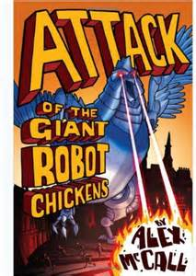
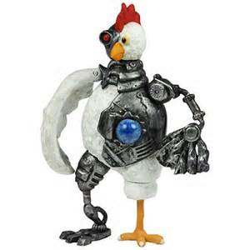
Attack
of the
Giant
Robot
Chickens

Slide 2
What is the story going to be about?

Slide 3
Can you put the word “robot” into a sentence?

Slide 4
Can you put the word “robot” into a sentence?
Suddenly, from the very back of the unsettled crowd
appeared a gigantic metallic robot yelling “ATTACK!”

Slide 5
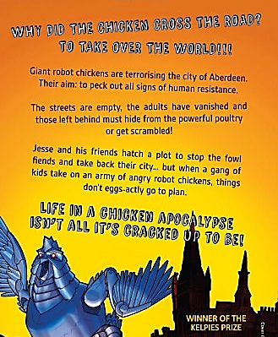
Can you highlight some interesting words in the extract?

Slide 6
Can you highlight some interesting words in the extract?
terrorising

Slide 7
Can you highlight some interesting words in the extract?
terrorising
resistance

Slide 8
Can you highlight some interesting words in the extract?
terrorising
resistance
vanished

Slide 9
Can you highlight some interesting words in the extract?
terrorising
resistance
vanished
powerful

Slide 10
Can you highlight some interesting words in the extract?
terrorising
hatch a plot
resistance
vanished
powerful

Slide 11
Can you highlight some interesting words in the extract?
terrorising
hatch a plot
resistance
vanished
apocalypse
powerful

Slide 12
*Read this extract from Chapter 1

Slide 13
What was Jesse’s brother obsessed about?

Slide 14
What was Jesse’s brother obsessed about?
Jesse’s brother was obsessed by the
end of the world.

Slide 15
What ways did he imagine that the end of the world would happen?
He had planned to escape from tsunamis,
meteors, floods, aliens and his favourite
which was zombies.

Slide 16
What ways did he imagine that the end of the world would happen?

Slide 17
Apart from this fascination, describe Jesse’s brother.

Slide 18
Apart from this fascination, describe Jesse’s brother.
Jesse’s brother was a normal 16 year old
who hung about with his friends. At school,
he got good marks and he even had a
girlfriend.

Slide 19
What happens next…

Slide 20
