Slide 1
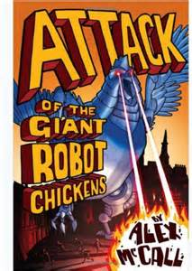
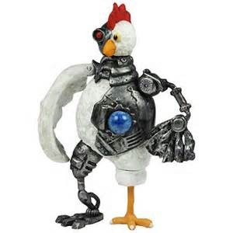
Attack
of the
Giant
Robot
Chickens

Slide 2
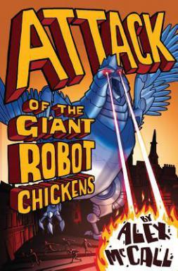
Metalinguistics
Read through Chapter 1 and copy down any
words that are new, interesting or unfamiliar.

Slide 3
Metalinguistics
Read through Chapter 1 and copy down any
words that are new, interesting or unfamiliar.
fascinated

Slide 4
Metalinguistics
Read through Chapter 1 and copy down any
words that are new, interesting or unfamiliar.
fascinated
civilisation

Slide 5
Metalinguistics
Read through Chapter 1 and copy down any
words that are new, interesting or unfamiliar.
fascinated
crumbling
civilisation

Slide 6
Metalinguistics
Read through Chapter 1 and copy down any
words that are new, interesting or unfamiliar.
geeky
fascinated
crumbling
civilisation

Slide 7
Metalinguistics
Read through Chapter 1 and copy down any
words that are new, interesting or unfamiliar.
crumbling
fascinated
geeky
obsession
civilisation

Slide 8
Metalinguistics
Read through Chapter 1 and copy down any
words that are new, interesting or unfamiliar.
crumbling
geeky
fascinated
obsession
civilisation
shrugged
(examples from page 7)

Slide 9
Metalinguistics
For each of the words that you have identified,
use the dictionary to find the meaning.
Fascinated :

Slide 10
Metalinguistics
For each of the words that you have identified,
use the dictionary to find the meaning.
Fascinated : to be interested strongly in something
or someone.

Slide 11
Metalinguistics
For each of the words that you have identified,
use the dictionary to find the meaning.
Fascinated : to be interested strongly in something
or someone.
Now, place the word into an appropriate sentence.

Slide 12
Metalinguistics
For each of the words that you have identified,
use the dictionary to find the meaning.
Fascinated : to be interested strongly in something or someone.
It was no surprise that the children were fascinated by the snow as
this was the first time they had ever seen the white fluffy flakes
fall from the sky!.

