Slide 1
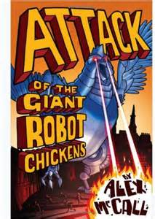
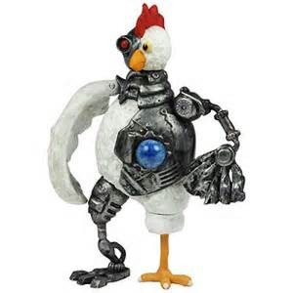
Attack
of the
Giant
Robot
Chickens

Slide 2
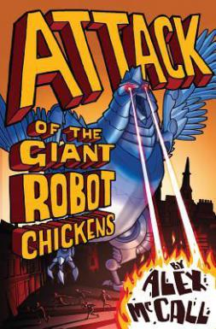
Comprehension
Read through Chapter 1 and answer the following
questions that are literal, inferential and
evaluative.

Slide 3
Comprehension
Read through Chapter 1 and answer the following questions that are literal, inferential and evaluative.
Q1. What was Jesse’s brother fascinated by and why?
Q2. Describe Jesse’s brother?
Q3. How did Jesse’s brother make him feel?
Q4. What did Jesse notice about the way Sam and Mike
were behaving?
Q5. Who was the leader, why?

Slide 4
Comprehension
Read through Chapter 1 and answer the following questions that are literal, inferential and evaluative.
Q6. What reaction did Jesse get when he had finished his
joke and why?
Q7. How did Jesse alert everyone about it being time to
move?
Q8. Describe the Aberdeen they saw outside?
Q9. What did Jesse do when he became scared?
Q10. What was hunting them and for how long?

Slide 5
Comprehension
Can you make up some questions about
Chapter 1 for your partner?
Why?
Who?
What?
Describe?
When?
Where?
Explain?

