Slide 1
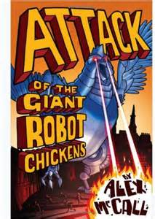
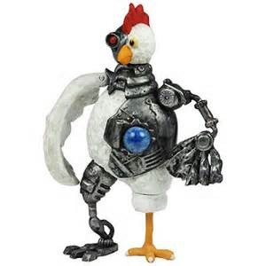
Attack
of the
Giant
Robot
Chickens

Slide 2
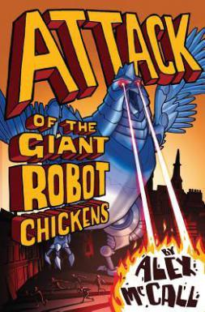
Grammar - Apostrophes
Read through Chapter 1 and list all the words
that have an apostrophe into your Active
Literacy Jotter(there should be 23).
for example: don’t
he’d

Slide 3
Grammar - Apostrophes
Now, can you write next to each word either
a (c) or a (p) to indicate whether or not the
apostrophe is to indicate a contraction – joining
two words or possession – belonging to.
for example: don’t (c)
he’d (c)
people’s (p)

Slide 4
Grammar - Apostrophes
Then, can you write next to each contraction
the two words that have been joined.
for example: don’t (c) - do not
he’d (c) - he would/he did
people’s (p)

