Slide 1
Offshore Renewable Energy Catapult
12/03/2018

Slide 2
Health and safety
Listen carefully!
Fire alarms
Toilets

Slide 3
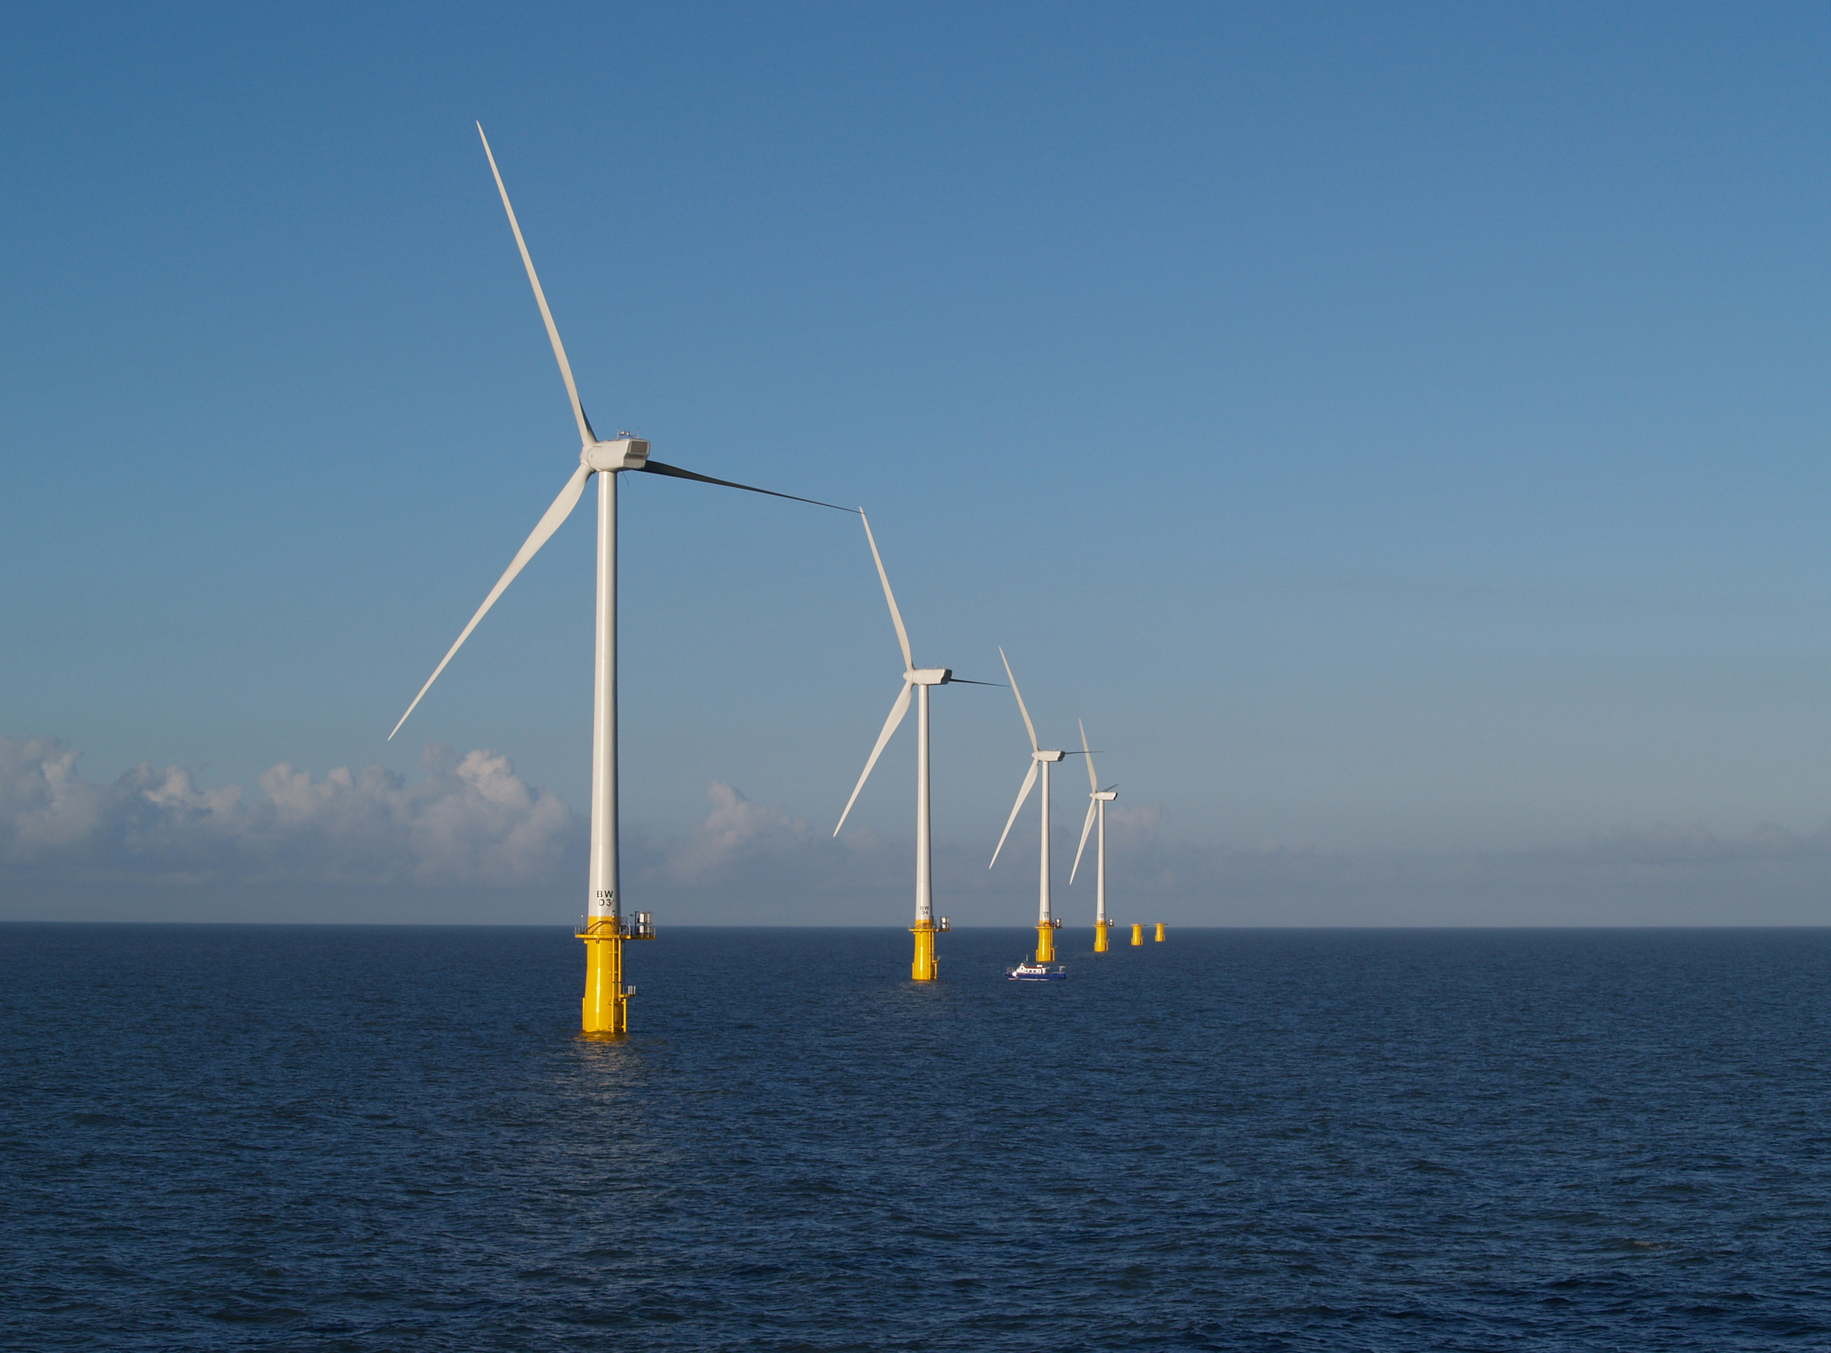
The Parts of a Wind Turbine
Nacelle
Blades
Tower
Transition Piece (TP)

Slide 4
Different Parts of the Blade

Slide 5
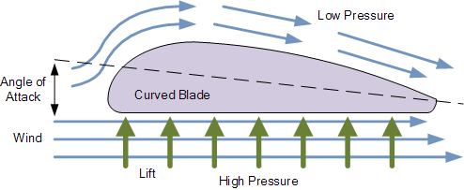
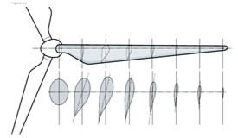
How a Blade works
Similar to a aircraft wing
The high pressure is turned into rotation
Cross section or profile of the blade changes along its length

Slide 6
How a blade is made
Made using two moulds
Build using fibreglass matting, resin and balsa wood
Some made in a one, some made in two halves.

Slide 7
Blade testing

Slide 8
Video

Slide 9
Video

Slide 10
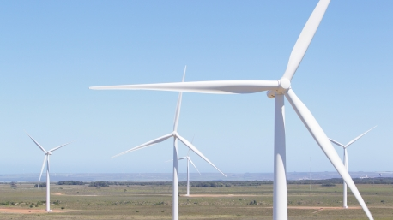
Transporting large blades
Question: how do you transport a wind turbine blade?
Watch this video >>

Slide 11
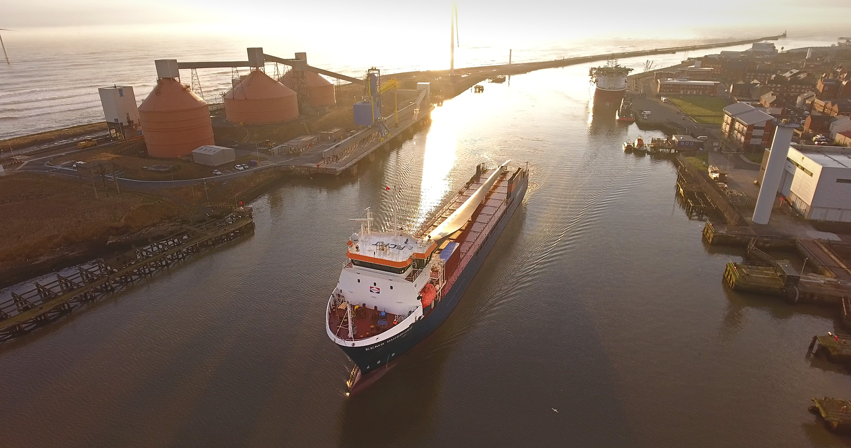
Transporting large blades

Slide 12
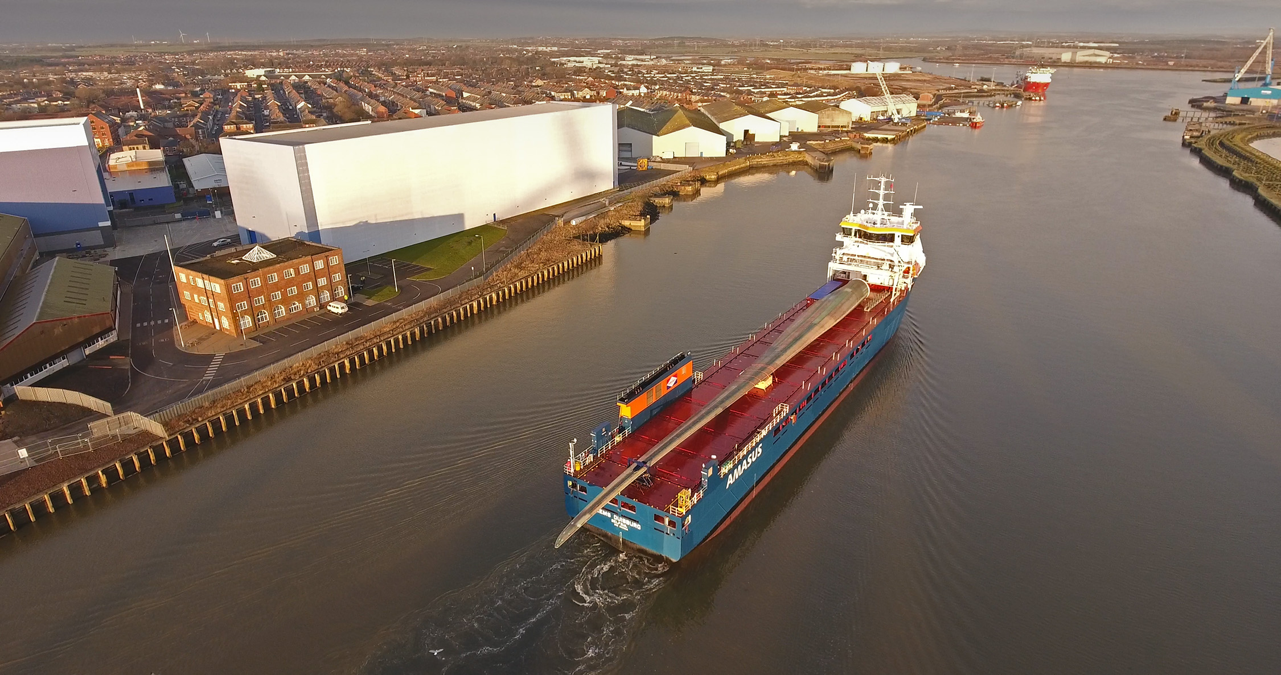
Blade arrival

Slide 13
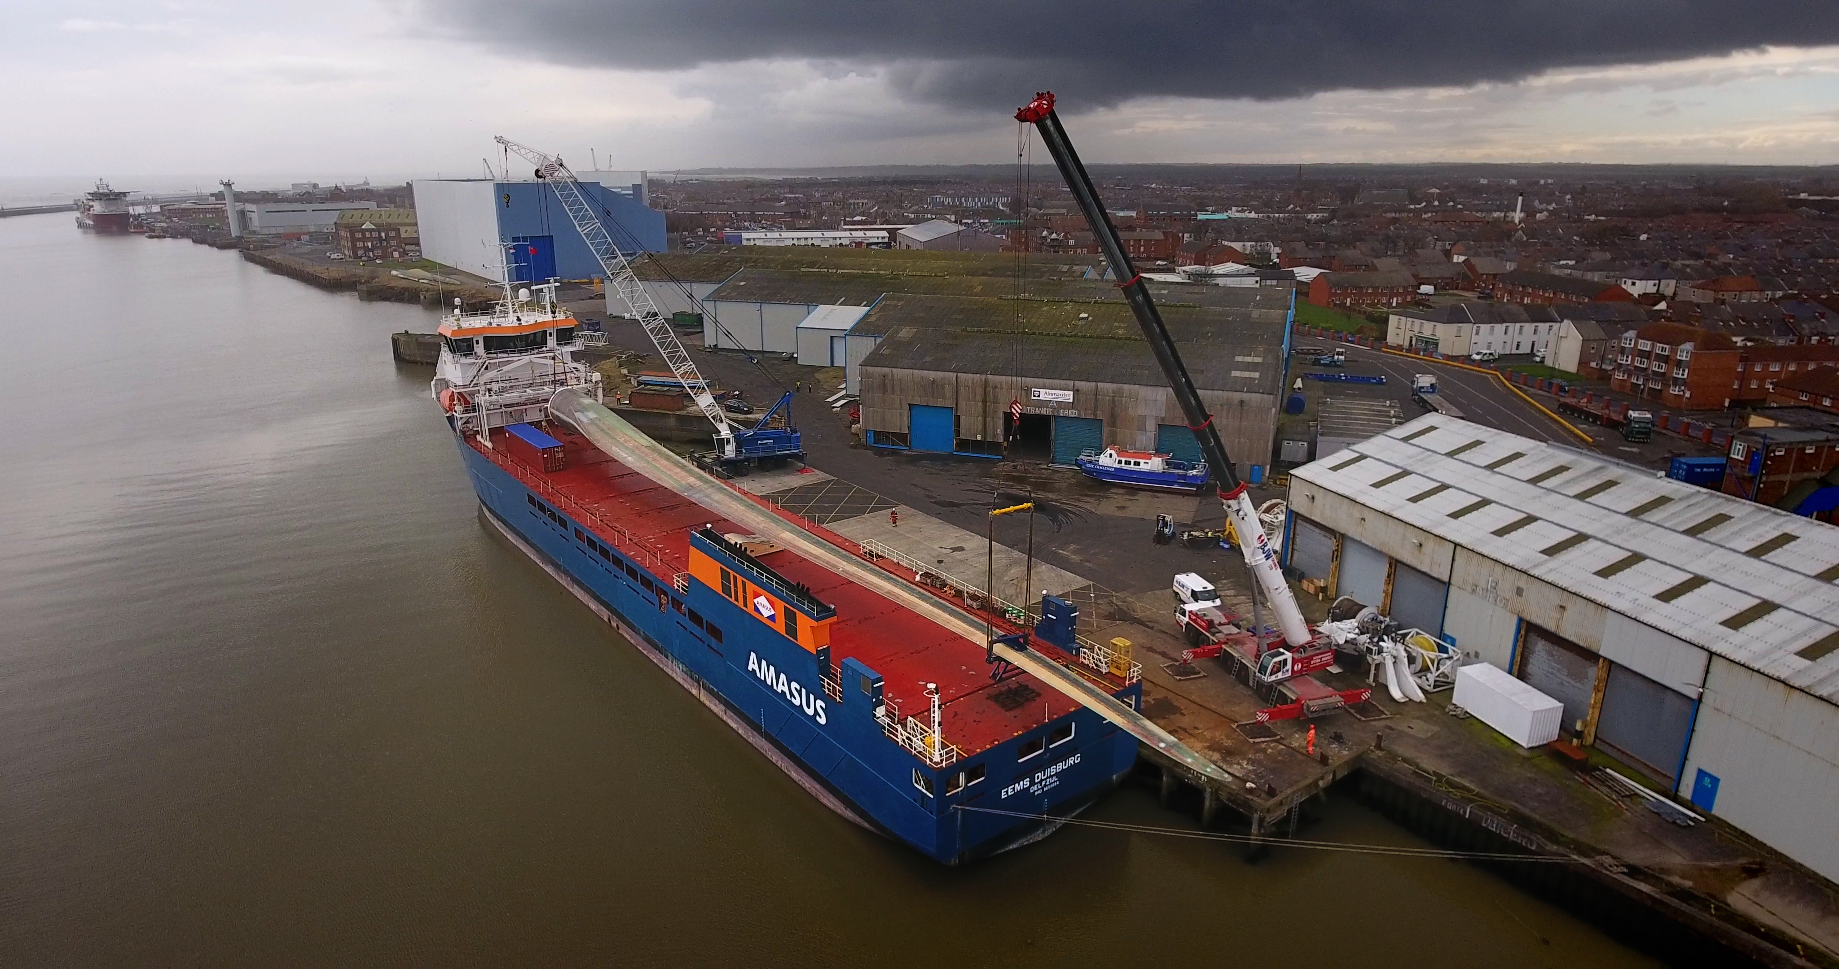
Blade arrival

Slide 14
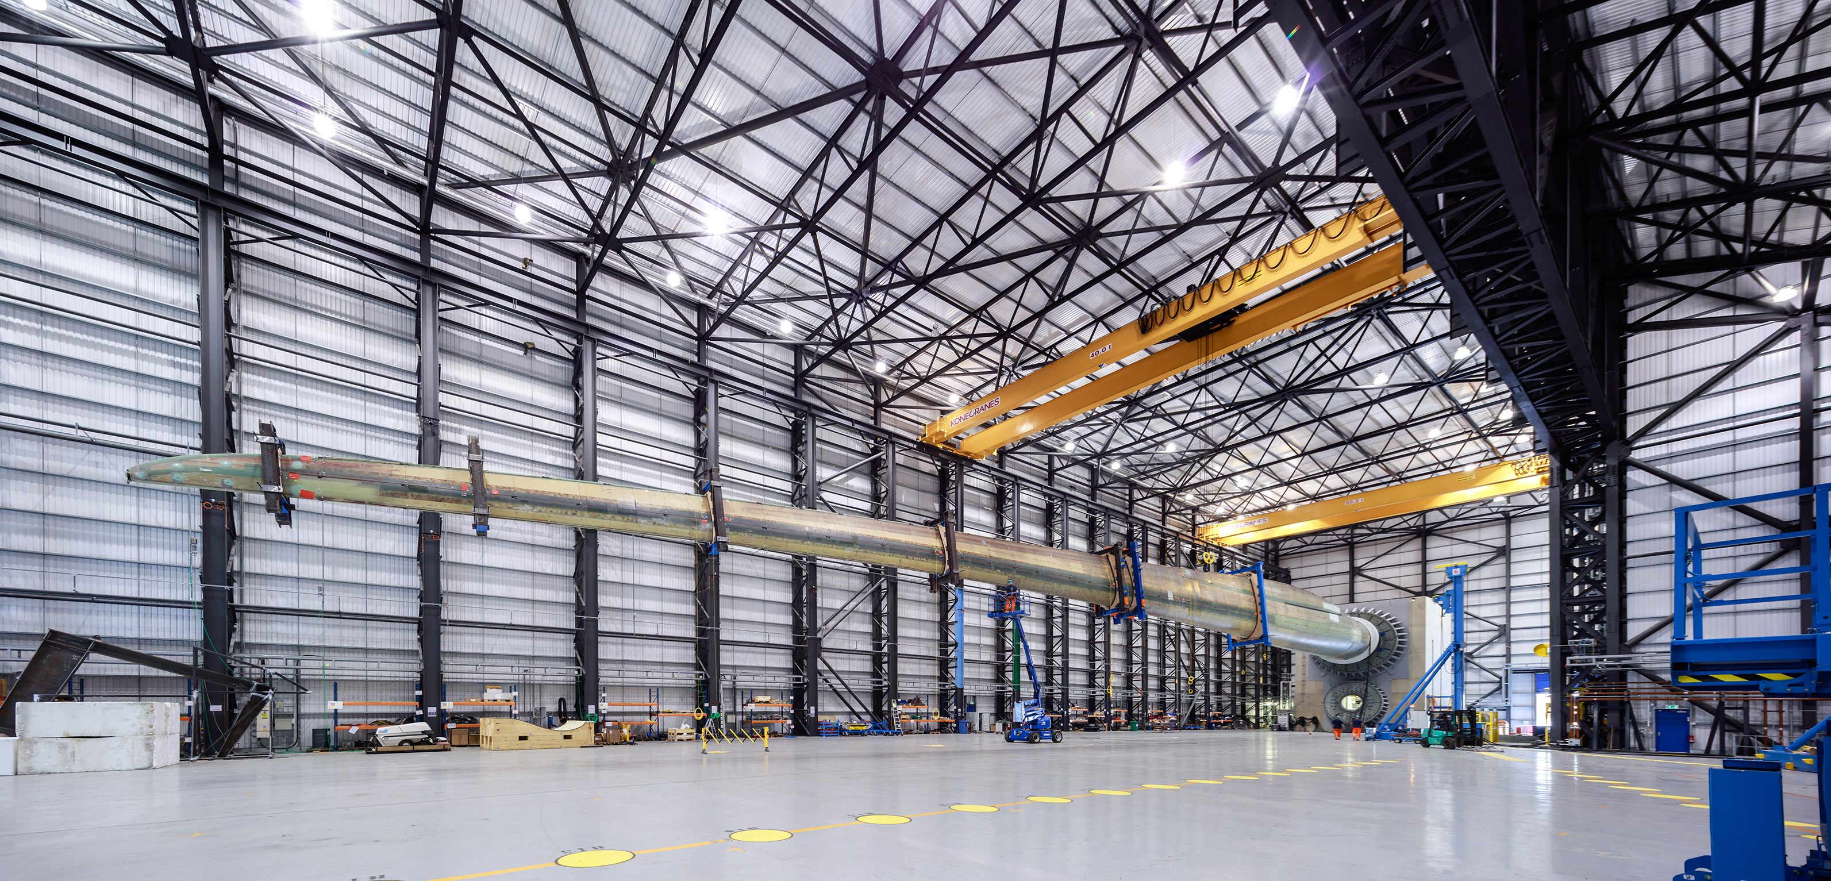
Blade in our facility

Slide 15
Blade challenge
Design, build and test your own blades
Paper, sellotape and dowels
Test your blades over two distances
Record your results using the voltmeter
Once results have been recorded, redesign your blades and try them again - see if you can beat your reading!

