Slide 1
Wind Power

Slide 2
Wind power has been used for
4000 years,
Initially to pump water and grind grains.

Slide 3
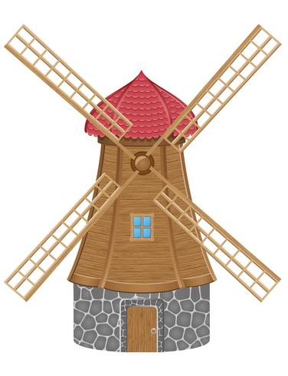
Wind Mills

Slide 4
Today we generate electricity with wind turbines.

Slide 5
Wind Turbines

Slide 6
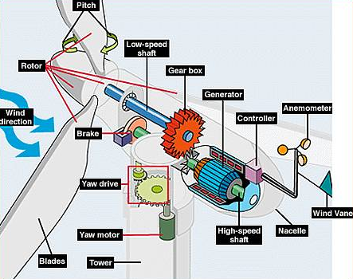
How Wind Turbines Generate Electricity

Slide 7
97%
of Scotland’s
electricity came from
renewable energy in 2020.
https://www.scottishrenewables.com/forums/renewables-in-numbers/

Slide 8
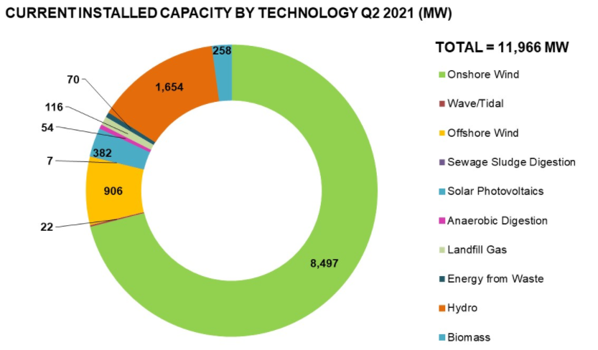
Scotland’s Energy Mix
https://www.scottishrenewables.com/our-industry/statistics

Slide 9
In 2020 wind power provided over 24%
of the UK’s total energy.
Renewable UK - Wind Energy Statistics : https://www.renewableuk.com/page/UKWEDhome

Slide 10
In 2021, UK wind turbines are generating enough electricity to power
18,481,652 homes.
(There are 2.6 million homes in Scotland)
Renewable UK - Wind Energy Statistics : https://www.renewableuk.com/page/UKWEDhome

Slide 11
The electricity generated by wind turbines saved over
29,492,799,000 kg
of carbon emissions.

Slide 12
A single rotation of an 8.8MW wind turbine can power an average home for
32 Hours.

Slide 13
Most wind turbines have
3 blades which can reach speeds at the tip of over 200 mph!

