Slide 1
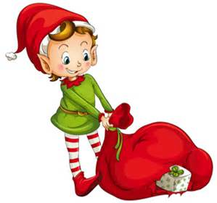
CHRISTMAS BAKE SALE

Slide 2
BAKE SALE

Slide 3
TODAYS LESSON
Learning Intention:
To deepen our understanding about the role of the marketing department.
Context: Advertising a bake sale
Success Criteria:
I can use Word Processing to create an eye catching poster advertising our bake sale using appropriate text size, diagrams and language.
I can include the relevant information about the bake sale for example, where it is, when it is, who is organising it, what the purpose is and the price of various items.

Slide 4
TASK
You are going to create a class business that will run a Christmas Bake Sale. It is your responsibility to produce the marketing materials for your posters, and then produce the products to sell at your Bake Sale.
Remember the bake sale will be next Thursday, and you will all be expected to sell the cakes during lunch

Slide 5
Things to include
Where is the bake sale?
When is it?
Who is organising it?
The Joint
Thursday 15th December
S1/4

Slide 6
PRICES
Cookies – 40p
Cupcakes – 50p
Biscuits – 40p

Slide 7
WHO IS IT FOR?
Glasgow Children’s Hospital Charity (formerly Yorkhill).

Slide 8
WERE WE SUCCESSFUL?
Success Criteria:
I can use Word Processing to create an eye catching poster advertising our bake sale using appropriate text size, diagrams and language.
I can include the relevant information about the bake sale for example, where it is, when it is, who is organising it, what the purpose is and the price of various items.

