Slide 1
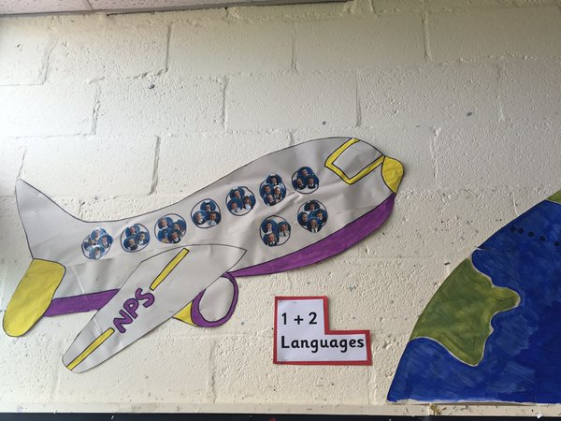
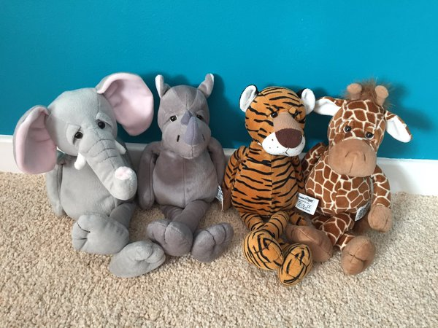
1 + 2 Adventure

Slide 2
Destination 1: France

Slide 3
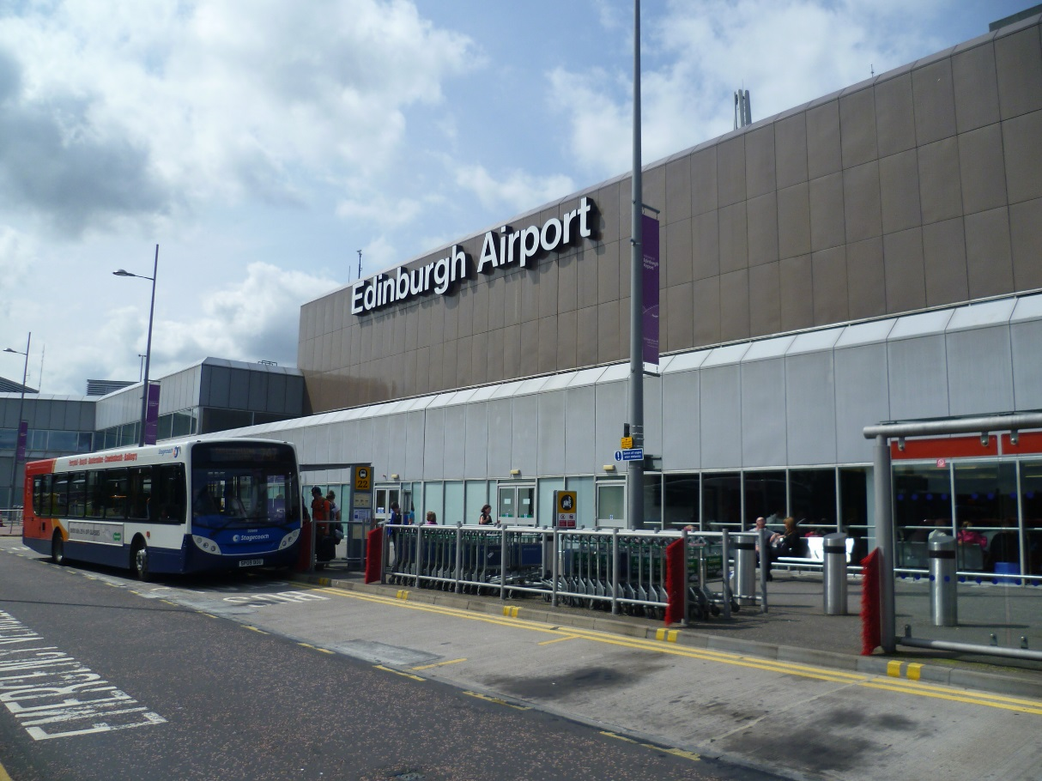
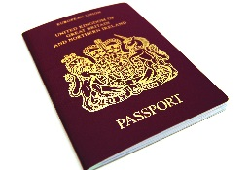
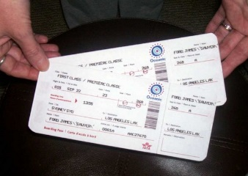
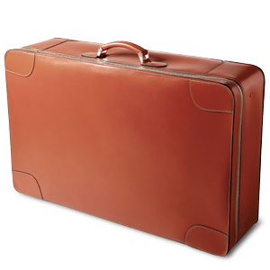
Time to go to the airport! We are flying from Edinburgh Airport.
Checklist:
* Passport
* Tickets
* Suitcase

Slide 4
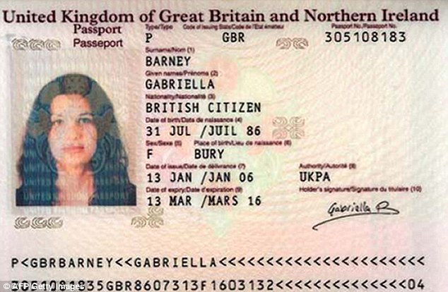
Passport
We need a passport to prove we are who we are.
It must have our name, date of birth and passport number on it.
We cannot travel abroad without one!

Slide 5
Task 1: Create your own passport.

Slide 6
What’s next on the checklist?
Checklist:
* Passport √
* Tickets
* Suitcase

Slide 7
Task 2: Online Check In/ Tickets

Slide 8
What’s next on the checklist?
Checklist:
* Passport √
* Tickets √
* Suitcase

Slide 9
Task 3: Packing your Suitcase What will you pack?

Slide 10
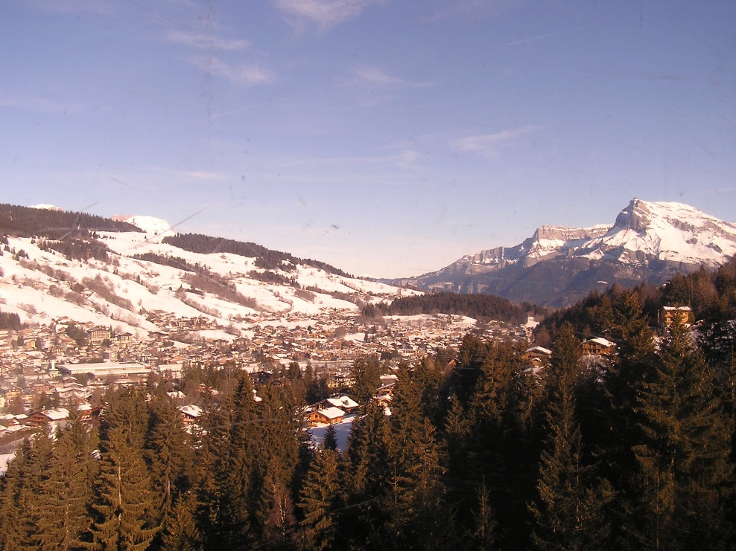
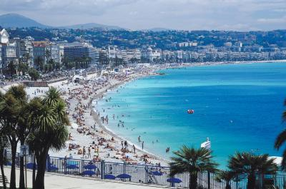
Weather in France: May
http://www.holiday-weather.com/country/france/
http://www.bbc.co.uk/weather/3017382

Slide 11
What’s next on the checklist?
Checklist:
* Passport √
* Tickets √
* Suitcase √

Slide 12
We’re nearly ready!! Lets go to the airport!

Slide 13
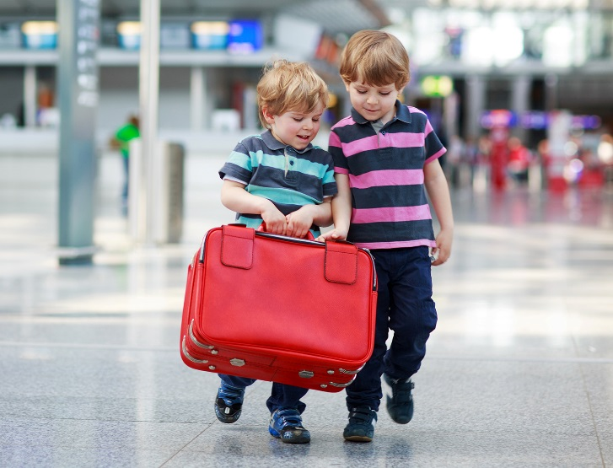
It’s time to check in our bags!

Slide 14
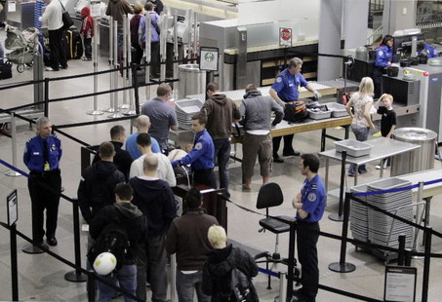
We have to go through airport security and show our passports.

Slide 15
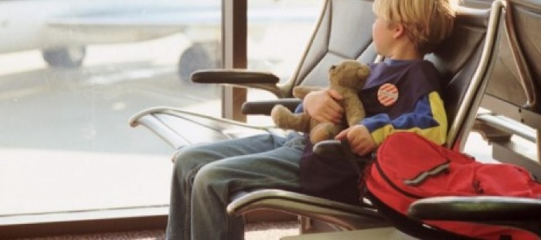
We’re through! Time for relaxing before our flight!
Welcome to Duty Free.

Slide 16
Can you see our plane from here?

Slide 17
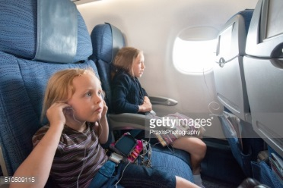
Time to board our plane!
Please watch the follow safety video .
https://www.youtube.com/watch?v=CjHCc6TZhaMb

Slide 18
Ready for take off!
https://www.youtube.com/watch?v=q-HLzLdzGYE

Slide 19
We’re nearly there!
https://www.youtube.com/watch?v=Cibs_EltD6g

Slide 20
Bienvenue a France!
Home of Etienne and Celeste.

