Slide 1
Falkirk High School Tartan Competition
Notes:
Please switch off the lights when using this presentation. The tartans don’t look the right colours otherwise. Thanks!

Slide 2
Last term S1 pupils took part in a competition to design a new school tartan.
The top 10 tartans were chosen and now it’s your turn to choose the winning tartan which will then be turned into school scarves for you to wear!

Slide 3
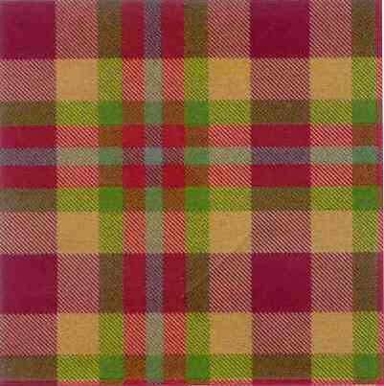
Tartan 1

Slide 4
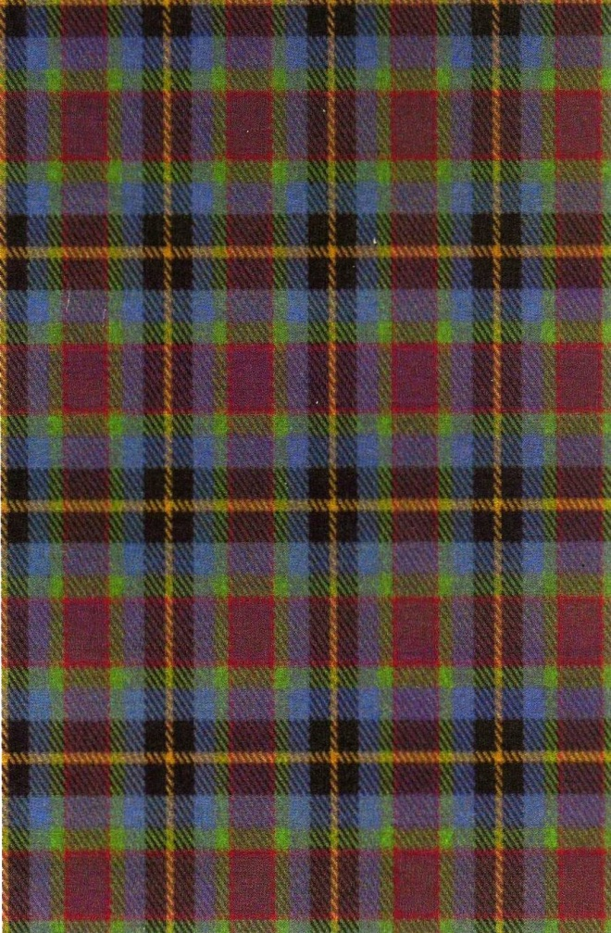
Tartan 2

Slide 5
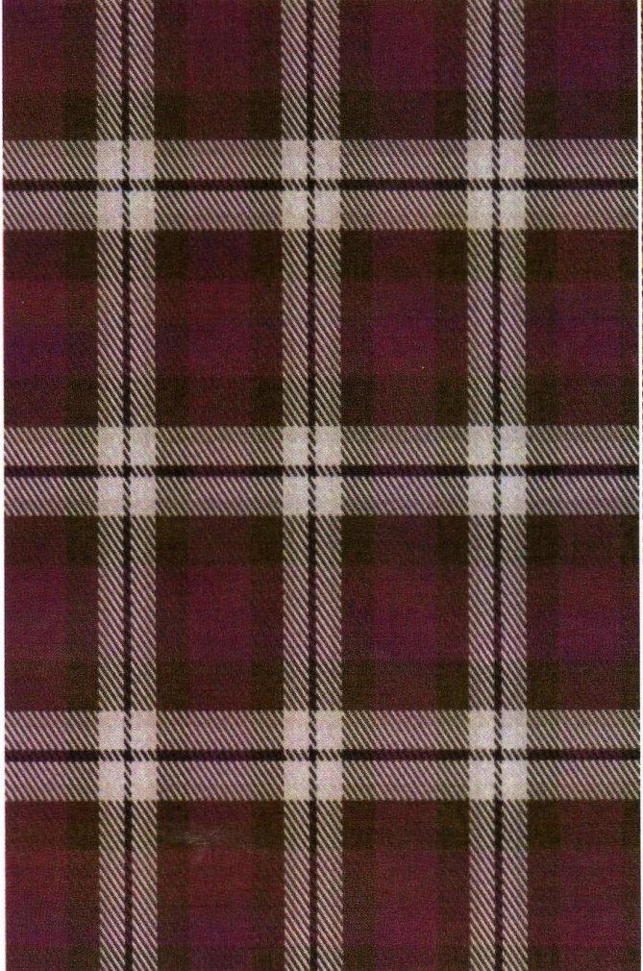
Tartan 3

Slide 6
Tartan 4

Slide 7
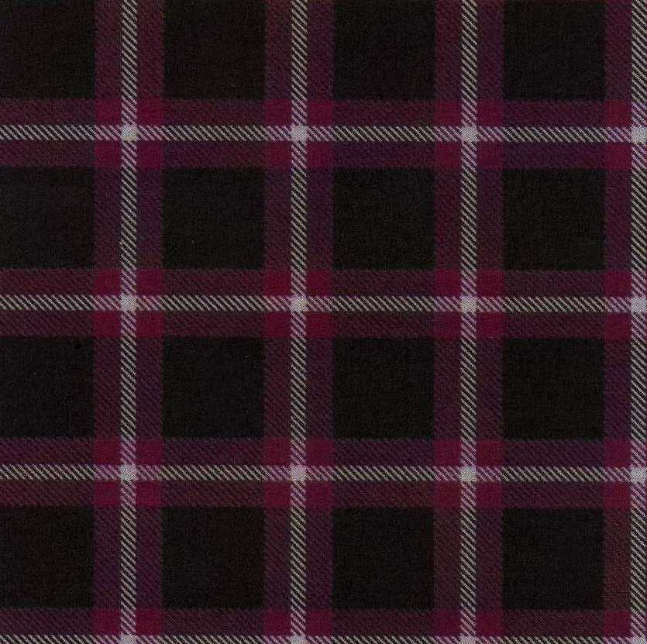
Tartan 5

Slide 8
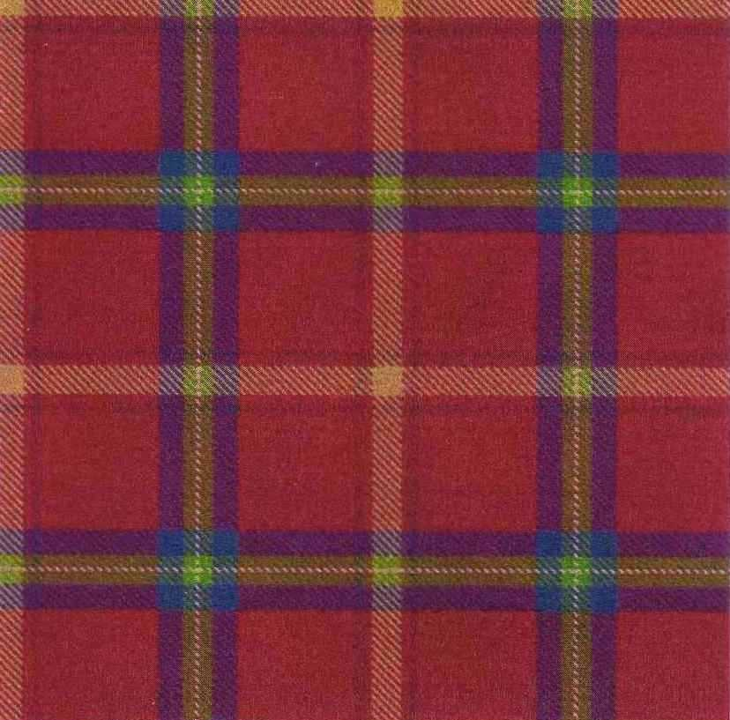
Tartan 6

Slide 9
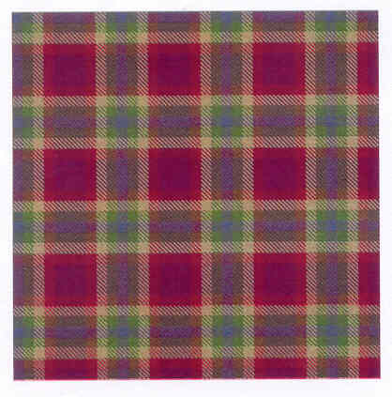
Tartan 7

Slide 10
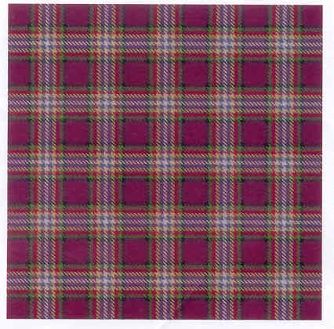
Tartan 8

Slide 11
Tartan 9

Slide 12
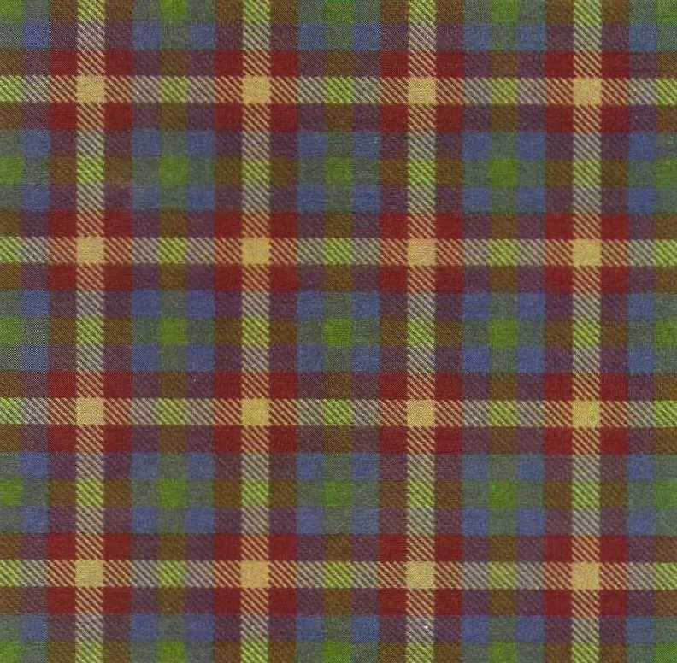
Tartan 10

Slide 13
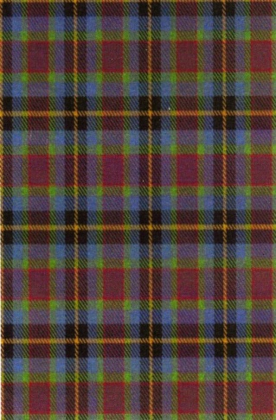
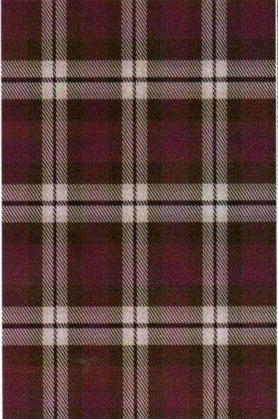
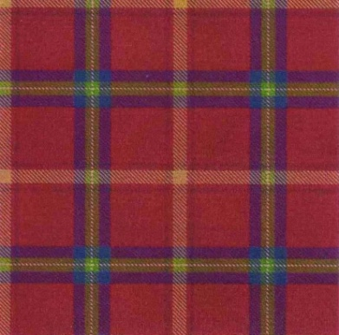
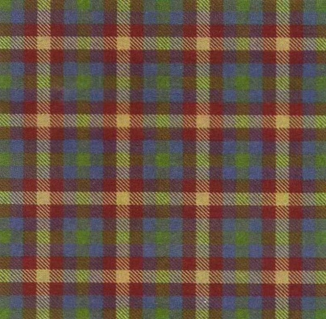
Here are all 10 designs for you to vote:
1
2
3
4
5
6
7
8
9
10

